Slide 1





Smart Parking
IoT Reservation System
Real-time Parking Management with IoT Automation
Presented By
7521955 Davronbek Orifjonov

Slide 2











Motivation - Urban Parking Challenges
02
Traffic Congestion: Aimless circling for parking significantly contributes to urban traffic jams and delays.
30%
of traffic congestion caused by searching for parking
Environmental Impact: Increased fuel consumption and carbon emissions from vehicles searching for spots.
17 min
User Frustration: High stress levels and wasted time create poor user experiences in city centers.
average wasted per driver finding available spots
Lack of Real-time Data: Traditional systems offer no visibility into current availability before arrival.
$$$
Lost revenue from inefficient space utilization
Inefficient Enforcement: Manual checking of reserved slots is labor-intensive and prone to errors.

Slide 3










Objectives and Scope
03
Multi-sensor IoT Lock Devices
Automated Reservation Lifecycle
Integrate magnetic sensor for vehicle detection, battery monitoring, signal tracking, mechanical arm actuator, and tamper alarm into unified units.
Develop complete workflow from slot reservation through vehicle arrival detection to automatic status updates and expiration handling.
Reliable MQTT Communication
Real-time Web Dashboard
Implement MQTT protocol with 4 topic types (up_link, down_link, down_link_ack, heartbeat) for robust bidirectional IoT messaging.
Build responsive interface with interactive maps, live status updates via WebSocket, and comprehensive monitoring capabilities.
Gateway Coordination Layer
Data Persistence & Visualization
Create gateway devices managing multiple locks with centralized command processing, status aggregation, and health monitoring.
Implement in-memory storage with system logs, sensor data tracking, and reservation management for operational visibility.

Slide 4
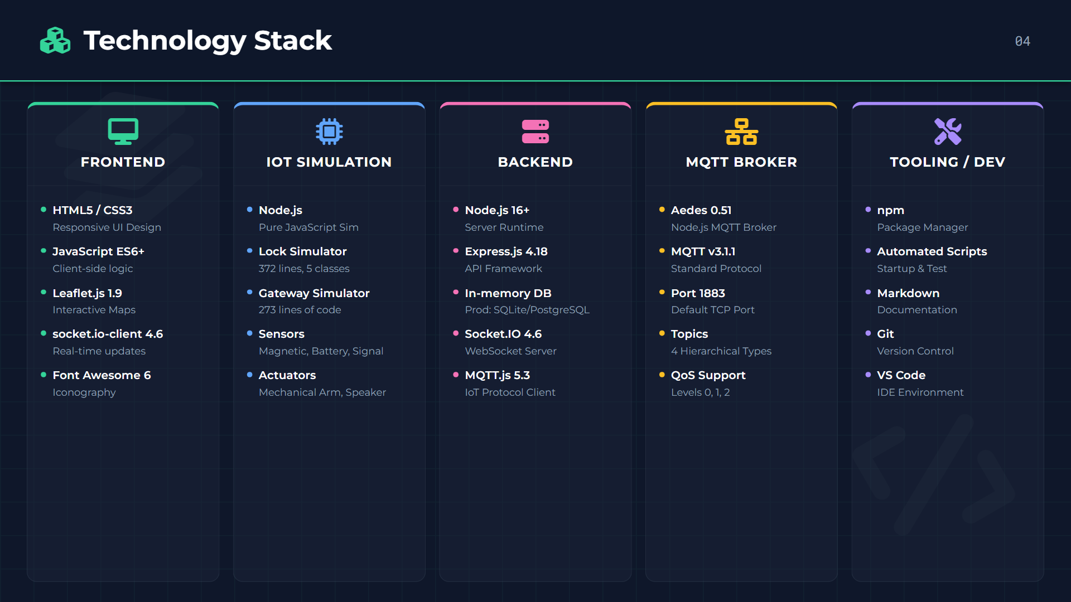

Slide 5
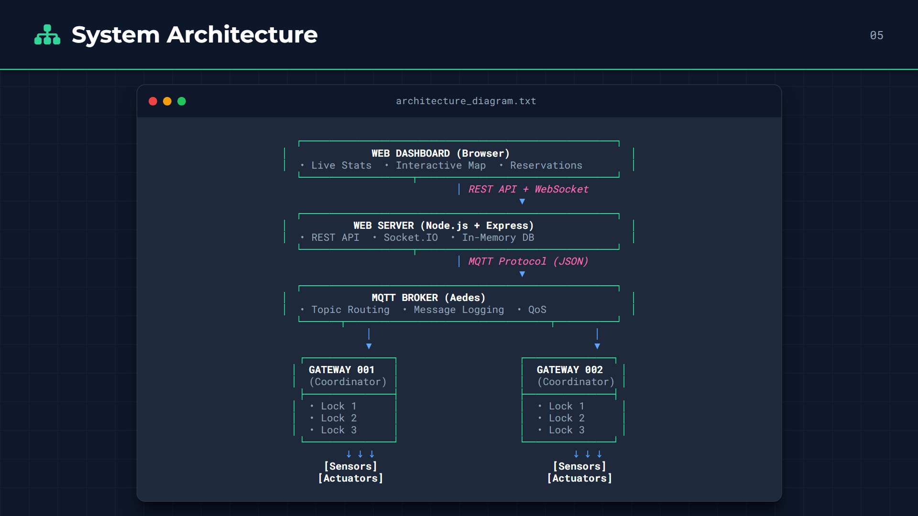

Slide 6









Data Model
06
Core Entities
Relationships
Parking Lots
Parking Slots
Lot
One-to-Many
Slots
idUUID (PK)
idUUID (PK)
nameString
lot_idUUID (FK)
addressString
gateway_idString
Gateway
One-to-Many
Locks
coordinates{lat, lng}
statusEnum(free/occ...)
total_slotsInteger
batteryInteger (%)
availableInteger
signalInteger (dBm)
Slot
One-to-One
Active Res
Reservations
System Logs
Status changes trigger automatic cascades (e.g., Expiration → Slot Release)
idUUID (PK)
idUUID (PK)
slot_idUUID (FK)
typeString
plate_numString
levelEnum(info/err)
user_infoJSON
messageText
timespan{start, end}
timestampDateTime
statusEnum
metaJSON

Slide 7











Data Flow
07
Real-time Pipeline
MQTT (TCP)
Sub / Pub
WebSocket
Gateway
Broker
Web Server
Dashboard
Publishes State
Routes Msg
Process Logic
Live UI
MQTT Topics
Reservation Lifecycle
System Logic
Structure: /{gateway_id}/{type}
Reserve: User books slot via App/Web
Server-side Check (30s)
.../up_link
Status Upd
Command: Server publishes 'reserve'
Scans active reservations. If now > endTime, mark expired & release slot.
.../down_link
Commands
.../down_link_ack
Confirm
Actuate: Gateway raises Lock Arm ⬆️
.../heartbeat
Health
Arrival: User arrives, Arm lowers ⬇️
Device Self-Check (10s)
Detect: Magnetic sensor sees vehicle
Lock verifies reservation validity locally. Auto-release if connection lost/timeout.
JSON Payload
{ deviceId, timestamp, sensors... }
Update: Status: Occupied
Bidirectional Flow
Commands (Server → Gateway)
Status (Gateway → Server)

Slide 8
























Device Simulation (Node.js)
08
Edge Device 1: Parking Lock
Edge Device 2: Gateway
Simulated Hardware Unit
Coordinator Node
Sensors
Responsibilities
Coordinators for 3 locks per gateway
MQTT Connectivity (TCP/IP)
Magnetic
Battery
Signal (RF)
> 500 units
70-100%
0-100%
Command Processing & Routing
Status Aggregation
Actuators
Topology
Mech. Arm
Speaker
Raise/Lower (2s)
Tamper Alarm
State Flow
Free
Reserved
Occupied
Free
Heartbeat: 30s
ACK System

Slide 9
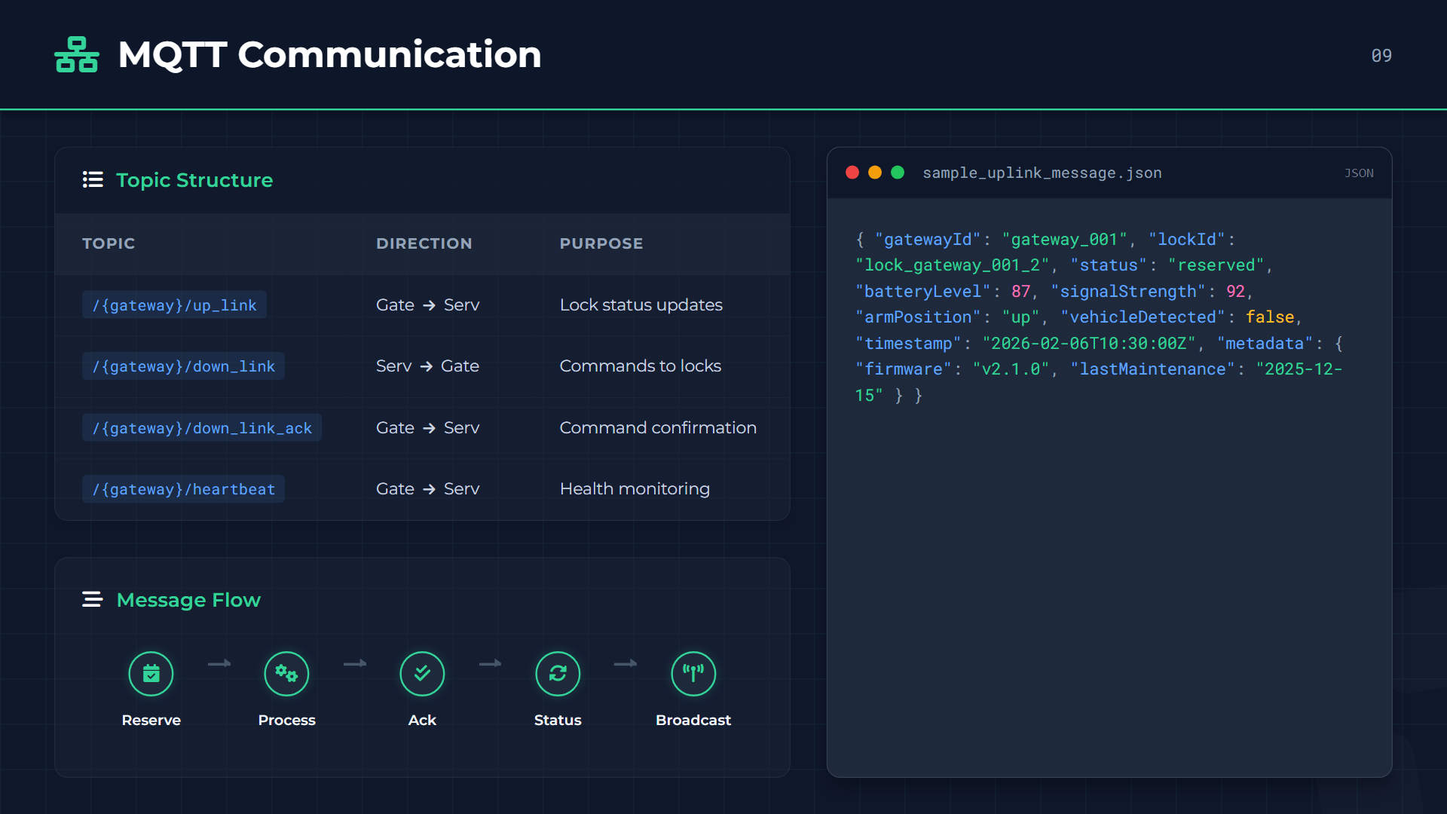

Slide 10


Backend API (Express.js)
10
Core Endpoints
Method | Endpoint Route | Purpose
GET | /api/parking-lots | List all lots with availability summary
GET | /api/parking-slots?lot_id={id} | Get specific slots & status for a lot
POST | /api/reservations | Create new slot reservation
GET | /api/reservations?filter=active | List current user's active bookings
POST | /api/reservations/:id/arrive | Mark arrival trigger (Opens Lock)
DEL | /api/reservations/:id | Cancel existing reservation
GET | /api/dashboard-stats | Real-time system statistics
GET | /api/system-logs?limit=50 | Recent audit and system event logs

Slide 11

















Dashboard Features
11
5-Tab Interface Structure
Real-time Updates
WebSocket Connection
Dashboard
Instant state reflection via Socket.IO
DEFAULT
Live statistics (Total, Available, Occupied, Reserved)
Toast Notifications
Alerts for "Vehicle Detected" or "Confirmed"
Map View
Auto-Refresh
Interactive Leaflet map with color-coded markers
Dynamic slot availability without page reload
Parking
Browse lots and select specific available slots
Responsive & Interactive
Reservations
Mobile-First Design
Manage active bookings & "I'm Here" arrival trigger
Touch-optimized controls for smartphones
Visual Indicators
Green/Red/Yellow status color coding
Monitoring
Real-time System logs and MQTT message tracking
Geolocation
"Find Nearby" using browser GPS API

Slide 12
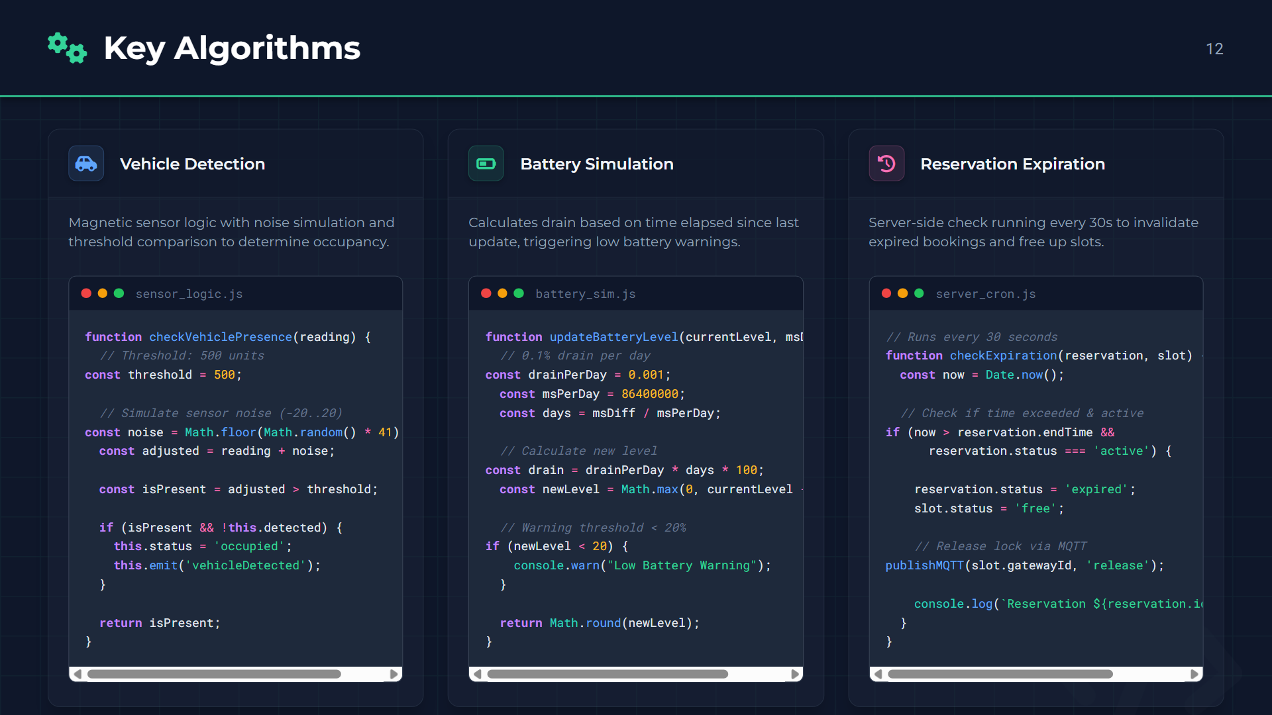

Slide 13















Live Demo — Flow
13
Demonstration Timeline
Startup
Reserve
Arrival
Monitor
30 Sec
1 Min
1 Min
30 Sec
System Init
1
Booking Flow
2
Park Vehicle
3
Real-time Data
4
Start MQTT Broker 1883
Select Downtown Lot A
Click "I'm Here" button
Stream MQTT Messages
Launch Web Server 3000
Click Green Slot
Lock Arm Lowers ⬇️
Battery & Signal stats
Connect 2 Gateways (6 Locks)
Enter: ABC-123 / 2h
Magnetic Sensor Detects
Heartbeat (30s interval)
Dashboard auto-launch
Lock Arm Raises ⬆️
Status: Occupied
Departure → Free

Slide 14











Achievements & Takeaways
14
DONE
DONE
DONE
Integrated IoT Pipeline
Real-time Monitoring
Automated Enforcement
Successfully connected 2 distinct device types (Locks + Gateways) establishing a robust edge-to-cloud data path.
Implemented low-latency communication using MQTT for devices and WebSocket dual-channel for the dashboard.
Developed autonomous logic for slot enforcement with physical lock simulation covering 4 distinct mechanical states.
DONE
DONE
DONE
Complete Lifecycle
100% Compliance
Modular Architecture
Engineered end-to-end workflow handling booking, arrival detection, parking duration, and auto-release upon departure.
Met all functional requirements including multi-sensor integration, interactive dashboard, and system visualization.
Built a scalable, component-based system design that decouples device simulation from backend logic, ready for production.

Slide 15






















Future Directions
15
Q2 2026
Q3 2026
INFRASTRUCTURE
Phase 2: Expansion
Phase 3: Intelligence
Hardware Integration
License Plate Recognition
ML Predictions
LoRaWAN Devices
OpenALPR + Camera Integration
Occupancy Forecasting Models
Replace simulated locks with real IoT hardware
Native Mobile App
GPS Auto-Arrival
React Native (iOS/Android)
Geofencing Detection Logic
Physical Sensors
Deploy vehicle detection loops & magnetometers
Payment Gateway
Multi-Tenant Support
Secure Stripe Integration
White-label SaaS Solution
RF Communication
Database Migration
Cloud Deployment
Implement 433 MHz protocol (Gateway ↔ Locks)
PostgreSQL Persistent Storage
AWS IoT Core + Lambda

Slide 16




Questions?
Thank You!
Smart Parking IoT Reservation System
7521955 Davronbek Orifjonov
IoT Automation Project 2026

