Slide 1
4-dars
Davronbek Malikov

Slide 2
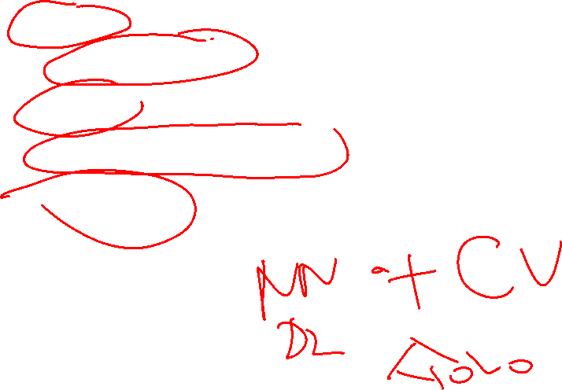
Bugun
Takrorlash
Image Classification
Scikit-image(skimage)
Image classification Project
YOLO algorithm

Slide 3
Takrorlash

Slide 4
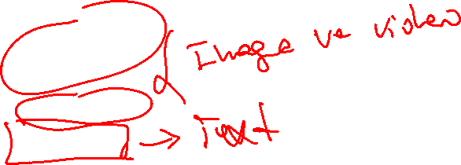
Takrorlash
Kutubxonalar
Opencv(cv2)
Pillow
Mediapipi
Pytessarct
Face Detection
Webcam face
Video blurring
Text detection(Pytessarct)

Slide 5
Image Classification

Slide 6

Image Classification
Image classification uchun eng mos kutubxonalardan biri=skimage
Sodda image manipulation-> Advanced(feaure extraction)
Rasmlarni turli xil formatda(read,write,display)
Transformation(scaling,roating,zooming)
Filtering(tushunchmovchiliklarni kamaytirish)
Segmentation(rasmlarni manoli qismlarga ajratish)
Feature Detection(corner,height,width)

Slide 7
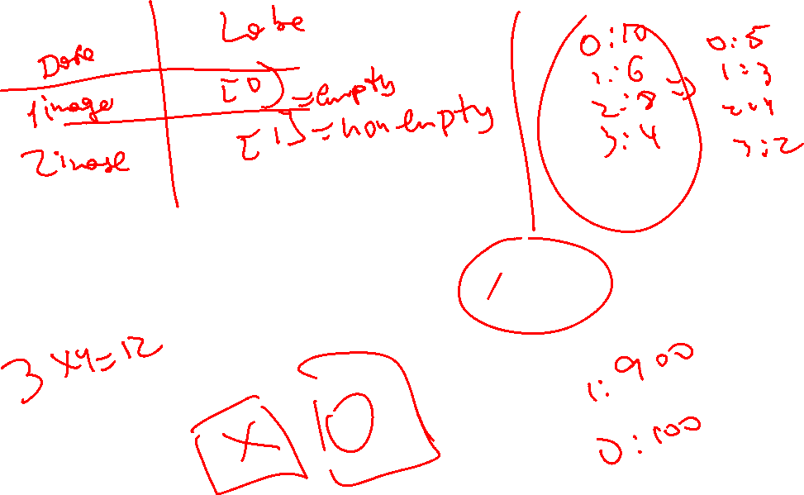
Image Classification Project

Slide 8
YOLO

Slide 9
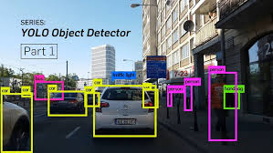
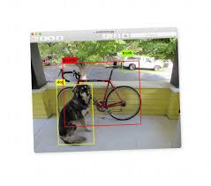
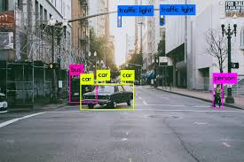
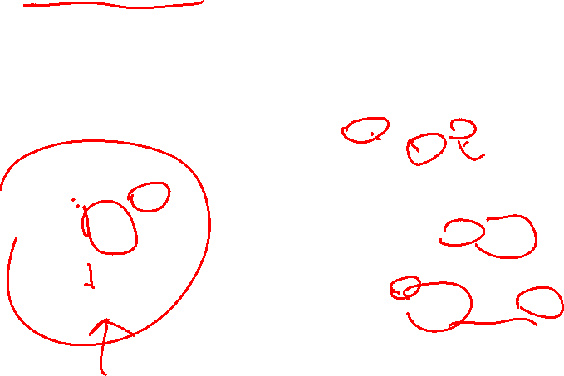
YOLO
YOLO-You only look once
YOLO –deep learning modeli

Slide 10

YOLO
YOLO versiyalari
YOLOv1 (2015): Yagona neyron tarmoq yordamida real vaqtli ob'ekt aniqlashni taqdim etdi.
YOLOv2 (2016) va YOLO9000: Aniqlikni oshirdi va 9000 dan ortiq ob'ekt kategoriyalarini aniqlash imkoniyatini berdi.
YOLOv3 (2018): Yaxshiroq xususiyatlarni ajratib olish bilan ishlashni yaxshiladi.
YOLOv4 (2020): Sanoat ilovalari uchun tezlik va aniqlikni optimallashtirdi.
YOLOv5 (2020): Ultralytics tomonidan taqdim etilgan bo'lib, PyTorch implementatsiyasi va foydalanish qulayligini taklif etdi.
YOLOv8 (2023): Eng so'nggi versiya bo'lib, zamonaviy ishlash ko'rsatkichlariga ega.

Slide 11

YOLOv8
YOLO vs
Obejct detection
Image classification
Image Segmentation
Key Features
Model structurasi rivojlandi
User-friendly

Slide 12

YOLOv8
Applications with YOLO v8
Traffic sign detection
Crowd Analysis

Slide 13

Vazifa
Supervised ML project
Xar bir CV kutubxonasiga kodlar yozish
Bugungi kodlarni takrorlash

