Slide 1
ADR Scotland (ADR-S) at EPCC
Mike Jackson, EPCC, The University of Edinburgh
Trusted Research Environments, 5th September 2022

Slide 2
What is administrative data?
Information created when people interact with public services
Public bodies must keep records of these interactions for operational purposes
Includes basic information about Scottish individuals
Births, deaths, marriages; electoral register; censuses
Not collected for research purposes
Potential benefits for researchers and so for policy makers
Notes:
Organisations and public services include schools, courts, social services, and the NHS.
Records of these interactions enable them to carry out their day-to-day work, to monitor and improve their performance, and keep providing services in an effective way.
Significant amounts of time and money are often spent on primary data collection for research.
Access to administrative data can be a major time and money saver for analysts, researchers and academics, as it allows them to use rich data that has already been collected and to invest greater resources elsewhere in the research process.
Administrative data has the potential to provide very useful insights that can help policy makers take better decisions.

Slide 3
Administrative data and data linkage
Data linkage temporarily brings together two or more datasets for research or statistical purposes
Reveal novel research insights that were not previously possible
Study how different aspects of life interact
Target support to those who need it most
Government departments can take decisions with a more complete understanding of how what they do affects others
Using administrative data to complement commissioned research can increase the value of research investment
Notes:
Access to anonymised administrative data is extremely valuable to research.
However, the greatest benefits from the use of administrative data come when data created by one government department or public service is linked to that from others.
Linking together existing data provides opportunities to give a much broader picture and to research areas of interest that may not have been previously possible.
It enables researchers to study how different aspects of life interact with one another, to enhance our understanding of society and where change is needed to improve lives.
For example, linking housing or income data to exam results data can be used to investigate the impact of socioeconomic factors on educational outcome.
The findings of such studies can then be used to inform policy and service delivery, ensuring support is targeted towards those who need it most.
Revealing how these relationships between different parts of our lives work also means government departments can take decisions not in isolation, but with a more complete understanding of how what they do affects others.
When administrative data is linked to other sources of data, such as surveys and longitudinal studies, the possibilities expand even further.
Government departments and research bodes spend significant amounts of money commissioning research that has to collect its data from scratch.
The value of these investments can be significantly increased by utilising the wealth of administrative data that already exists to complement such studies.

Slide 4







What is ADR Scotland?
Create a reusable portfolio of de-identified, linkable, non-health data from across government departments and local authorities
Provide a secure route for accredited researchers to use both this data and de-identified health data from health authorities
Partners:
Scottish Government
Scottish Centre for Administrative Data Research (SCADR)
electronic Data Research and Innovation Service (eDRIS) of Public Health Scotland
National Records of Scotland (NRS)
The University of Edinburgh (EPCC)
Part of ADR UK, funded by ESRC
Notes:
Scottish Government: build infrastructure, acquire data, Information Government, progress reporting.
SCADR: support ADR Scotland researchers, deliver strategic impact, build knowledge exchange.
eDRIS, part of the Information Services Division (ISD) within Public Health Scotland (PHS): Liaise with researchers, specify data and linkages required for researchers, review linked datasets, review researcher outputs for quality assurance and data protection, manage National Safe Haven.
NRS: Indexing service, create linkages between datasets.
EPCC: Run National Safe Haven, maintain ADR-S infrastructure within National Safe Haven, ingest data, extract data, prepare linked datasets for researchers.

Slide 5
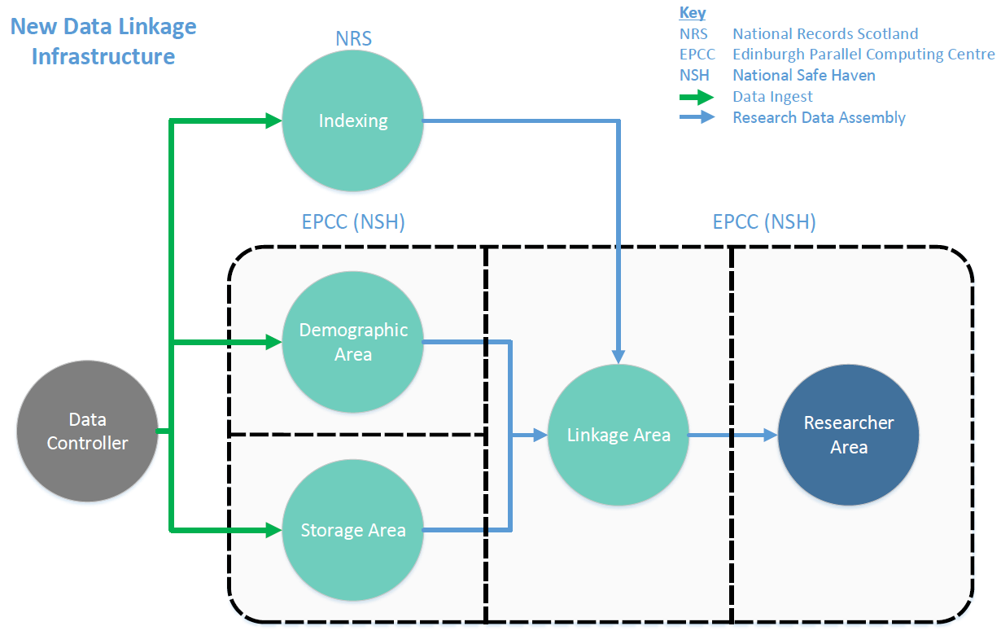
ADR Scotland data linkage infrastructure within the National Safe Haven
Notes:
Administrative data is usually personal data and thus must be handled and processed in a confidential and secure manner.
A virtual infrastructure (dashed lines) is hosted within Scotland’s National Safe Haven (NSH), owned and managed by eDRIS and maintained and operated by EPCC.
This is complemented by NRS’s own infrastructure.
Three classes of data:
Indexing data: personal identifiers, date of birth, sex, post code.
Demographic data: date of birth, sex, gender, geographical variables e.g. post code.
Storage data: all other variables.
Indexing data is held by NRS.
Demographic and storage data are held within the NSH.
No single organisation has all the information about a complete dataset or individual.
‘separation of functions’ helps protect privacy and to keep the risk of individuals being identified to an absolute minimum during both data storage and linkage.
This is also applied within the ADR-S infrastructure.
These are 3 separate areas, VMs, – Demographic, Storage, Linkage – with local PostgreSQL database management systems and mounted file systems.
These are virtually isolated from each other.
The ADR-S infrastructure is virtually isolated from the virtual infrastructure of other projects in the NSH.
EPCC ADR-S staff cannot have access to more than one area.

Slide 6
Data ingest
Data Controllers create de-identified keys for personal identifiers
Personal identifiers, de-identified keys, and additional data required for indexing are sent to NRS
NRS index personal identifiers against the population spine
Data Controllers replace personal identifiers with de-identified keys
Demographic and storage data is sent to EPCC
A data catalogue and metadata will make ADR-S-hosted data easier to find and use
Notes:
Personal identifiers can include, for example, student candidate numbers for education.
Additional data required for indexing can include date of birth, sex, post code.
NRS probabilistically match personal identifiers to a common dataset (NHS Central Register (NHSCR) population spine).
NRS create and keep a lookup/mapping between the keys and the spine.
NRS do not have access to any other variables.
Original personal identifiers are then deleted.
Demographic and storage data are held within the NSH in separate virtual areas of the ADR-S infrastructure.
Reduce time and effort required by Data Controllers – Data Controllers provide their data once (or yearly) to ADR-S rather than to individual research projects.

Slide 7
Research data assembly
EPCC sends cohort keys from requested datasets to NRS
NRS generate master indices for linkage
EPCC extracts data from requested datasets
EPCC uses master indices to link the datasets
eDRIS check linked datasets then transfer these to the researcher
Notes:
Linkage is for both demographic and storage parts of a single dataset and, also, for linkage (at the person-level) between different datasets.

Slide 8
Research data assembly with external datasets
External data deposit
External datasets can be used in a specific research project
NRS indexes the dataset then sends master indices back to External Data Controller
External Data Controller replaces personal identifiers with master indices
Dataset is transferred, via eDRIS, to Linkage Area
Dataset is deleted from Linkage Area once project has completed
Notes:
The ADR Scotland infrastructure also caters for researchers who want to link data held outside of the infrastructure (external data) with data within it (ADR-S-hosted data).
This may happen when data controllers store data for research elsewhere, or have only agreed to its use for a single project.
External datasets are only brought in after a project is approved, and are only used within the research data assembly phase.

Slide 9
Data access and usage by researchers
Researchers must complete required data protection and information security training before accessing any data
Data is only accessible within the National Safe Haven
Research data for export is reviewed by eDRIS for data protection and quality assurance
Notes:
Data Controllers can specify the training that a researcher is required to undertake.
Approved researchers access the NSH via one of a number of secure, controlled access points (safe havens) around the UK at an approved institution.
Approved researchers may also be able to access data remotely through a virtual private network, depending on the Data Controllers.
Statistical disclosure control must be undertaken on all outputs before release from the National Safe Haven
Researchers cannot publish outputs that risk identifying any individuals
Outputs are checked by eDRIS as well as researchers
Judgements are made according to the requirements of the Data Controllers

Slide 10
Challenges at EPCC – people and planning
Staffing 4 distinct roles
Demographic Agent, Storage Agent, Linkage Agent, Secure Managed File Transfer Operator
Planning and “bursty” activity
Ingests can be delayed by completion of legal agreements between partners
Research projects can be delayed by approvals
Context switching
Notes:
4 staff minimum, 8 preferable for resilience.

Slide 11
Challenges at EPCC – import and export
Access VMs via virtual desktop infrastructure within browser
Import ADR-S software
Upload to secure managed file transfer server
Files transferred hourly to ADR-S-specific server
Files transferred 15 minutes later to destination ADR-S VMs
Export metadata, reports, software and system logs
Copy and paste from browser
Upload to secure managed file transfer server from within ADR-S VM
EPCC ADR-S staff are not the same category of user as EPCC HPC Systems team or researchers
Notes:
ADR-S software are database and dataset preparation scripts implemented in Python.
Reports need to be written for ingest (CSV metadata, validation queries, to check the ingest etc.), and data extraction and linkage during research data assembly (CSV metadata, linkage details etc.).
Alternative approach to imports – enable network access – would be even more time consuming as it would involve shutting down PostgreSQL, removing the secure mounted file system, enabling network access, importing ADR-S software, disabling network access, adding the secure mounted file system, restarting PostgreSQL.

Slide 12
Conclusion
Data is handled in a safe, secure and appropriate manner
Infrastructure centred within the National Safe Haven, a highly secure computing environment
No single organisation has all the information about a complete dataset or an individual
Data is de-identified and direct personal identifiers removed
Research outputs are checked prior to release
Data Controllers maintain control and visibility over how their data is used but with less administrative burden
Notes:
In order for ADR Scotland to host data on behalf of Data Controllers, it is very important to provide confidence and assurance that their data will be handled in a safe, secure and appropriate manner.
Reduce time and effort required by Data Controllers.

Slide 13
Acknowledgements and references
These slides contains images and content from a number of ADR-S Scotland presentation specifically a Scottish Government ‘ADR Scotland An Introduction’ presentation and presentations by:
Cecilia MacIntyre, Scottish Government
Mark Sawyer, EPCC, The University of Edinburgh

Slide 14
Further information
ADR Scotland, https://www.adruk.org/about-us/our-partnership/adr-scotland/
ADR Scotland Data Catalogue, https://www.researchdata.scot/adr-scotland-data-catalogue
ADR UK, https://www.adruk.org/
Scottish Centre for Administrative Data Research (SCADR), https://www.scadr.ac.uk/
Research Data Scotland (RDS), https://www.researchdata.scot/
Joined-up data for better decisions: Guiding Principles for Data Linkage, Scottish Government, https://www.gov.scot/publications/joined-up-data-better-decisions-guiding-principles-data-linkage/
Keeping data safe, SCADR, https://www.scadr.ac.uk/administrative-data/keeping-data-safe

