Slide 1
Movie revenues Big data project
AHMAD NAWAR DROUBI
AYDIN DAVUTOğLU

Slide 2
OUTLINE:
Introduction
Introduce the subject of the study
Collecting Data
Dataset description
Statistical Analysis
Study of the overall dataset
ML Models
ML predictions
Testing Hypotheses
Accuracy of ML model
Summary
Final Findings

Slide 3
Introduction:
This study was based on movies data-set which includes 8,000 movies meta-data.
The original data-set had missing values, in order to do feature engineering we had to clean the data-set.
The second step was statistical analysis the data so we can test 9 hypothesis with the aim of finding what effects the revenue of a movie.
The last step was creating a machine model to predict the revenue based on multiple factors.

Slide 4
Collecting Dataset
To create the dataset we collected the movie data from 2 sources:
The Movie Database API
OMDb API
From The Movie Database API we used an endpoint that allowed us to receive a random list of 10,000 movies from the top 100,000 by revenue.
Then we used OMDb API to fill the meta-data of those movies.
The resulting dataset columns were as follows:
Title 2) Budget 3) Revenue 4)Run-time
5) Motion Picture Association of America rating 6) Genre
7) Top100 Actors in Movie 8) Language 9) Country
10) Meta-score 11) IMDb Rating 12) IMDb-Votes
13) Production-Company 14) Year of Release

Slide 5
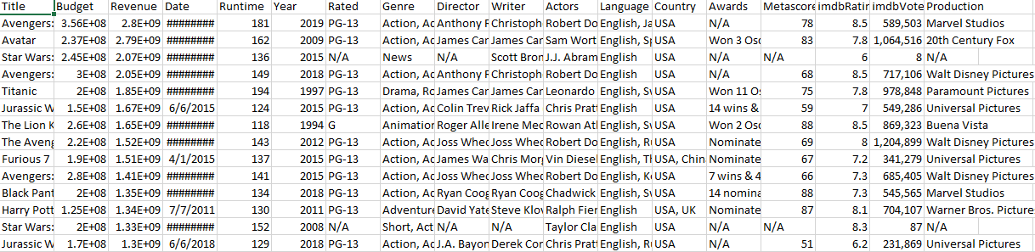
Dataset before any alterations:

Slide 6
Cleaning data-set:
The original data-set contained 10,000 movies, after filtering the data-set
It reduced to 8,000 movies, because of the problems in the following features:
1-) The Year column : the OMDB API provided a lot of missing values , whereas the data from “The Movie Database” API was almost complete, so we extracted only the year and then renamed it into “Year of Release”
2-) The Language column: we changed the missing values of this column to English.

Slide 7
Cleaning data-set: (cont’d)
3-) The Country column: the missing value in this columns were assigned the value USA
4-) The IMDB Rating and Votes columns: we assigned Zero to the missing values, so the missing values will not effect data-set
5-) The Actors column: The main goal of this column to check how many famous actors/actress in these movies, so we generated a list that contains 100 famous actor/actress, and compered each movie with this list.

Slide 8
Cleaning data-set: (cont’d)
6) The Production column: The missing values in this columns has been changed from null to others, and there were some production companies that only produced a few movies we also added them to others
7) The Run-time column: we assigned the mean to the missing value in this column.
8) The Genre column: we only took the first value in this column to be able to use label encoding on it.

Slide 9
Cleaning data-set: (cont’d)
9) The Awards column: Had a lot of null/missing values and also unusable values, so we found a better alternative in a data-set called “academy-awards” from “Kaggle” and cross referenced our movies data-set with it and counted how many awards each movie have and added it to a column called “Number of Awards” in our data-set.
10) The Released Outside USA column: we add this column to indicate if the movies were released inside USA only or not.

Slide 10
Collecting Dataset:
Some Notes on the dataset:
Top 100 Actors in Movie column holds the number of top 100 actors (according to IMDb) that acted in the movie.
Motion Picture Association of America rating column is the age rating of the movie. We used this matric because it’s the most used metric in the world.

Slide 11
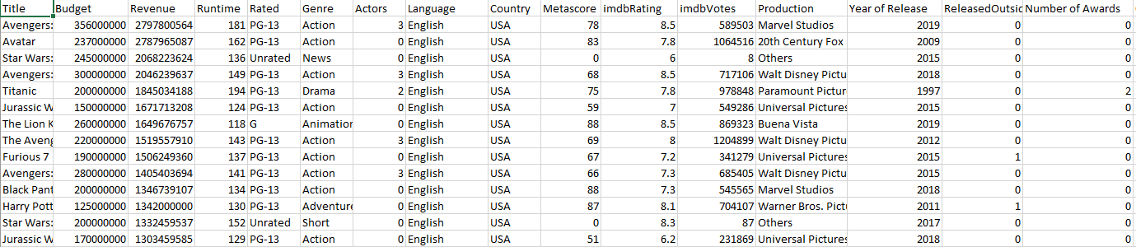
Filtered movies data-set

Slide 12
Statistical Analysis:
Firstly we found the statistical data for the numerical features as follows:
For IMDb Votes the mean is: 79283.1397 vote
For Production Company the mode is ”Others” which indicates that no one production company had their movie be in top 100,000 movie by revenue.
For Revenue, the mean is: 7.099426e+07.
Then using the correlation heat diagram Figure 1 we noticed the features that had a likely significant relation to revenue. Those features were: the budget and IMDb votes.

Slide 13
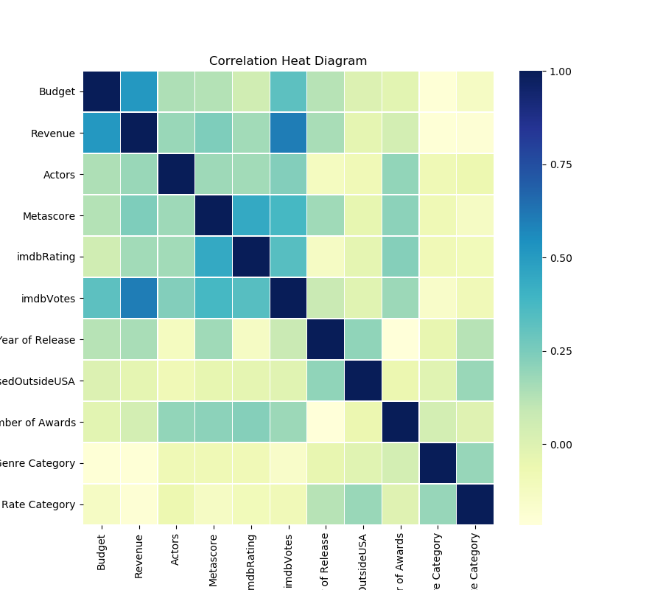
Statistical Analysis: Correlation Heatmap
Figure 1

Slide 14
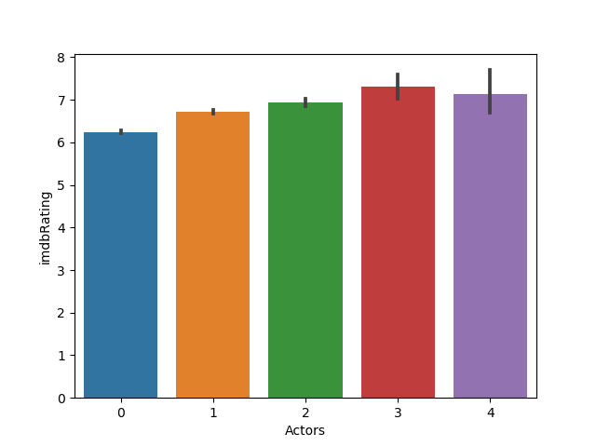
Statistical Analysis: Some Diagrams
Figure 2: Actors vs IMDB rating
This shows that generally the more famous actors in a movie the higher the rating

Slide 15
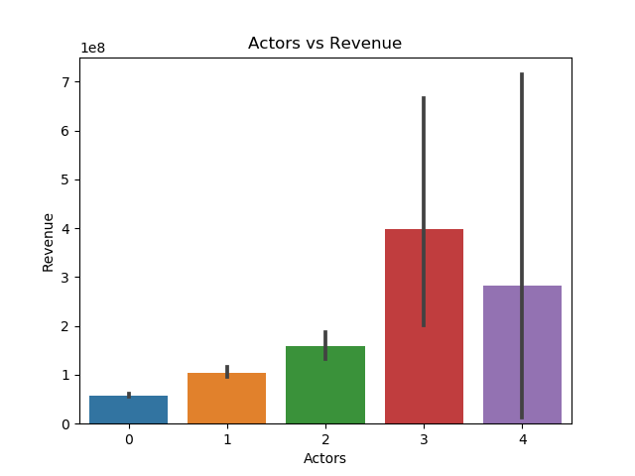
Statistical Analysis: Some Diagrams
Figure 3: Actors vs Revenue
This shows that generally the more famous actors in a movie the higher the revenue is (note however that it goes down at 4 which could be interesting if we higher values for actors to check for a trend)

Slide 16
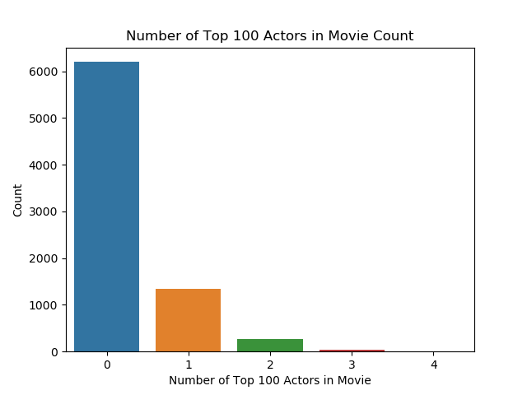
Statistical Analysis: Some Diagrams
Figure 4: Count of movies depending on number of famous actors in it
This shows that there are almost no movies with more than 1 famous actors in them

Slide 17
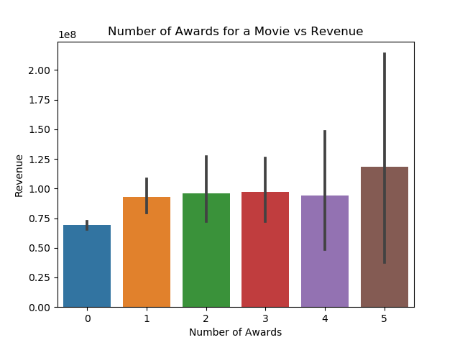
Statistical Analysis: Some Diagrams
Figure 5: Awards vs Revenue
This shows that generally number of awards doesn’t effect the revenue much

Slide 18
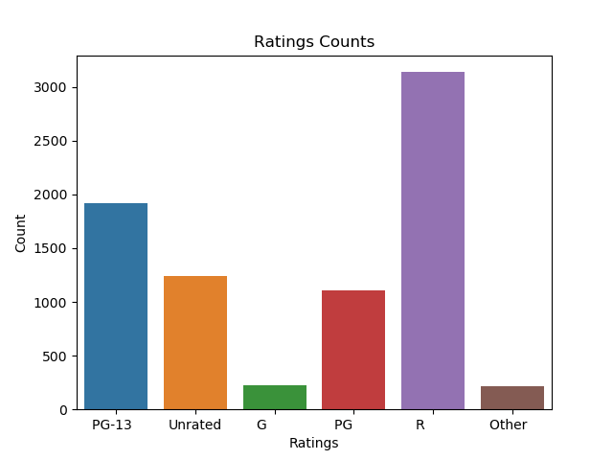
Statistical Analysis: Some Diagrams
Figure 6: Count of movies depending on rating

Slide 19
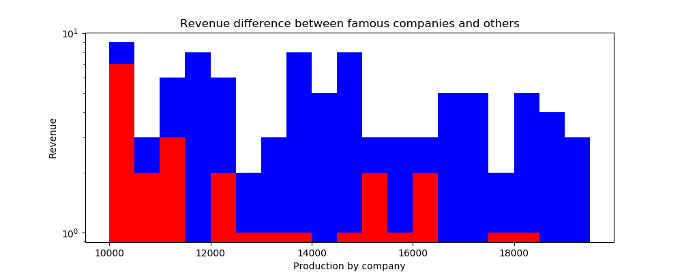
Statistical Analysis: Some Diagrams
Figure 7: Revenue difference between named companies and others.
Red is others
Blue is named companies

Slide 20
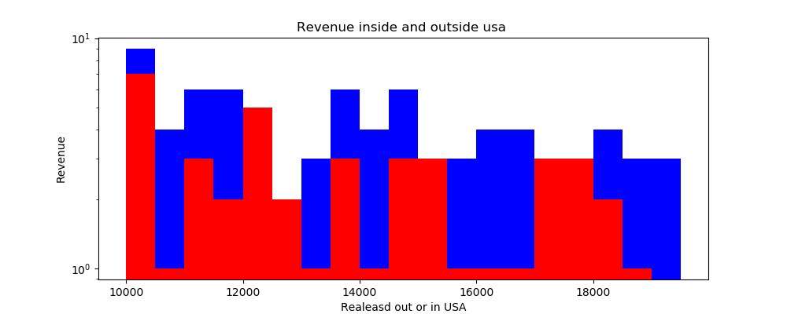
Statistical Analysis: Some Diagrams
Figure 8: Revenue difference between movies released inside USA only or world-wide
Red is inside of USA only
Blue is outside of USA too.

Slide 21
Statistical Analysis: Hypotheses Time
we tested 9 hypotheses which are (each with its NULL hypothesis, method of testing and result): Hypothesis 1:
H0
The lower the number of famous actors in a movie, the lower the revenue is
H1
The higher the number of famous actors in a movie, the higher the revenue is.
Method of Testing
using bar plot and checking the Peterson's Correlation Coefficient which was 0.187.
Result
We rejected the alternative hypothesis.

Slide 22
Statistical Analysis: Hypotheses Time
we tested 9 hypotheses which are (each with its NULL hypothesis, method of testing and result): Hypothesis 2:
H0
The budget of a movie doesn't effect the number of famous actors in it.
H1
The budget of a movie does effect the number of actors in it.
Method of Testing
the Peterson's Correlation Coefficient which was 0.141.
Result
We rejected the alternative hypothesis.

Slide 23
Statistical Analysis: Hypotheses Time
we tested 9 hypotheses which are (each with its NULL hypothesis, method of testing and result): Hypothesis 3:
H0
If a movie's genre is Action, it has a lower average revenue, than if it was of another genre.
H1
If a movie's genre is Action, it has a higher average revenue, than if it was of another genre.
Method of Testing
calculating the overall mean and comparing it with the mean of action genre movies.
Result
The alternative hypothesis passed, and we reject the null hypothesis

Slide 24
Statistical Analysis: Hypotheses Time
we tested 9 hypotheses which are (each with its NULL hypothesis, method of testing and result): Hypothesis 4:
H0
If a movie is released outside of USA, it's revenue will be lower than revenue if released in USA only.
H1
If a movie is released outside USA, it's revenue will be higher than revenue if released in USA only.
Method of Testing
the Mann-Whitney U test with p-value = 2.44e-10
Result
We reject the alternative hypothesis

Slide 25
Statistical Analysis: Hypotheses Time
we tested 9 hypotheses which are (each with its NULL hypothesis, method of testing and result): Hypothesis 5:
H0
The Higher the budget of a movie the Lower the revenue is.
H1
The Higher the budget of a movie the Higher the revenue is.
Method of Testing
Method of testing: the Peterson's Correlation Coefficient which was 0.51.
Result
The alternative hypothesis passed, and we reject the null hypothesis

Slide 26
Statistical Analysis: Hypotheses Time
we tested 9 hypotheses which are (each with its NULL hypothesis, method of testing and result): Hypothesis 6:
H0
The Higher number of famous actors in a movie, the Lower its rating is.
H1
The Higher the number of famous actors in a movie, the Higher its rating is.
Method of Testing
bar plot.
Result
The alternative hypothesis passed, and we reject the null hypothesis

Slide 27
Statistical Analysis: Hypotheses Time
we tested 9 hypotheses which are (each with its NULL hypothesis, method of testing and result): Hypothesis 7:
H0
The Higher the number of people who voted for a movie, the higher its rating is.
H1
The Higher the number of people who voted for a movie, the lower its rating is.
Method of Testing
the Peterson's Correlation Coefficient which was 0.34.
Result
We reject the alternative hypothesis.

Slide 28
Statistical Analysis: Hypotheses Time
we tested 9 hypotheses which are (each with its NULL hypothesis, method of testing and result): Hypothesis 7:
H0
If a movie is produced by “others”, then it will have higher than average revenue.
H1
If a movie is produced by “others”, then it will have lower than average revenue.
Method of Testing
the Mann-Whitney U test with p-value = 2.44e-10.
Result
We reject the alternative hypothesis.

Slide 29
Statistical Analysis: Hypotheses Time
we tested 9 hypotheses which are (each with its NULL hypothesis, method of testing and result): Hypothesis 7:
H0
If a movie has more than 1 award, it has a lower revenue.
H1
If a movie has more than 1 award, it will have a higher revenue.
Method of Testing
using bar plot and checking the Peterson's Correlation Coefficient which was 0.04.
Result
We reject the alternative hypothesis.

Slide 30
Machine Learning Model: Logistic Regression
For the machine learning we conclude that a movie is successful if the revenue is double the budget.
For the string type columns (Genre , Country,…) we changed them to category type and used label encoding
We used Logistic Regression to build the model. Firstly, we started with all the features to see how much accuracy they give us, and we kept iterating the model until we got an acceptable accuracy. The features we were using at that point were the budget and imdb-votes.
The final accuracy of the model was 0.77

Slide 31
Machine Learning Model: Checking for Overfitting
We used cross validation to try to avoid overfitting problem.
The resulting accuracy is 76.099, which indicates that it’s likely we didn’t fall in overfitting trap.

Slide 32
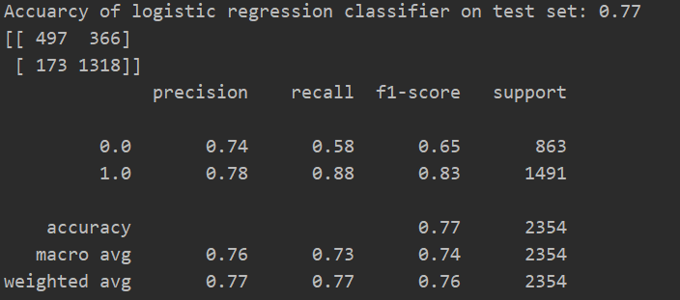
Logistic Regression Confusion Matrix

Slide 33
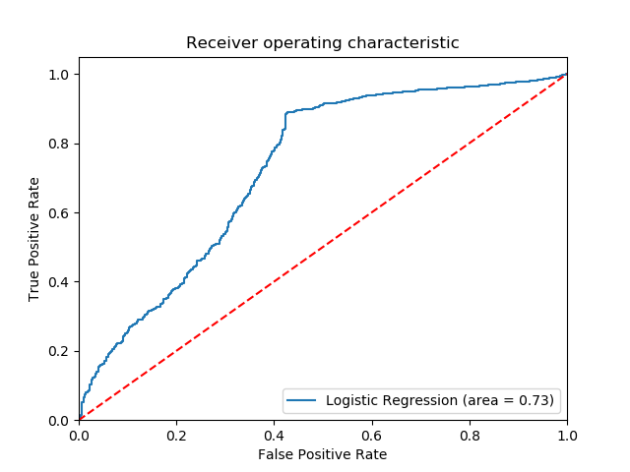
Logistic Regression ROC Curve

Slide 34
Conclusion
We set out in this study to answer the question of what affects the revenue of a movie and to build a ML model to classify/predict whether a movie is successful or not.
We found out that the budget and the number of IMDB-votes of a movie are the main effecting forces on its revenue. The budget in this case is predictable, however, the IMDB-votes could indicate that the more successful the movie is the more the audience are inclined
To vote for it on IMDB – needs further studying.
For the ML model we used Logistic Regression to create a model that can classify/predict whether a movie is successful with an accuracy of 0.73 using 2 features which are budget and IMDB-votes.

Slide 35

Thanks for listing

