Slide 1


How Tomcat Works
-based on tomcat 5.0.18 (2004)
Outline:
What Is Tomcat
Tomcat Architecture & Main Comp
Connector
Container
Tomcat Startup Process
Tomcat Request Handling Process
Tomcat Shutdown Process
TODO
Prerequisite:
Familiar with the Usage of Tomcat
Familiar with Servlet/JSP
Knowledge of ClassLoader

Slide 2
What Is Tomcat?
What is tomcat?
What do tomcat do?
What’s the difference between tomcat/jetty & apache/nginx?
3 Roles
App User
Tomcat Developer
Servlet/App Developer
What should we care when creating our own tomcat?
Parse Request/Response
URL -> Servlet Mapping
Parse JSP -> Servlet (Jasper JSP Engine)
JSP/Servlet Hot Deploy & ClassLoader Separation
Filter & Listener Invocation
Container Level Logger & Interceptor
Session Management
Notes:
What do tomcat do: Referenced implementation of Servlet/JSP API
Web Server & Application Server

Slide 3
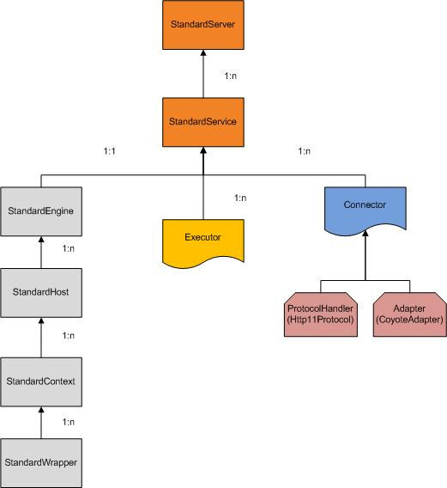
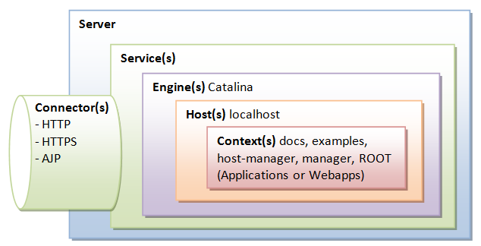
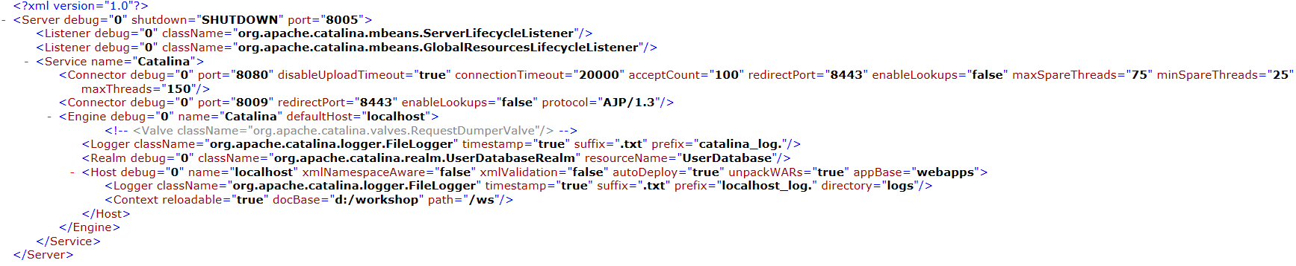
Tomcat Architecture
Main components:
1) Server->Service
2) Connector
Adapter
ProtocolHandler
Mapper
3) Container(Engine)
Engine
Host
Context
Wrapper
ServletContext

Slide 4
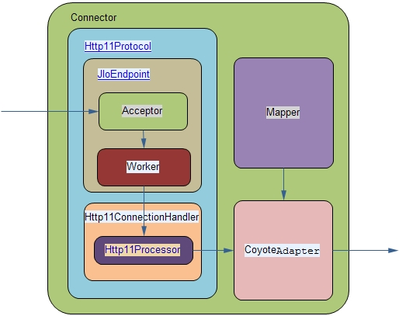
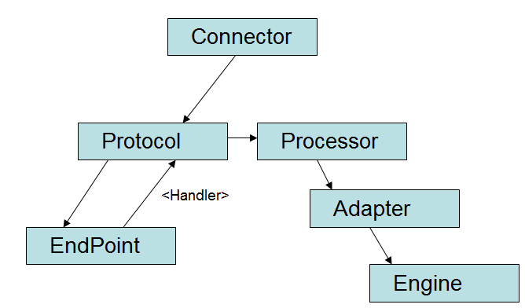
Connector
There are some pretty ugly interdependencies here. While re-factoring would resolve that, time has been spent improving performance. –Fhanik@apache.org
Connector Architecture
Connector Class Dependencies
Connector Types
HTTP Connector
o.a.coyote.http11.Http11Protocol
o.a.coyote.http11.Http11AprProtocol
o.a.coyote.http11.Http11NioProtocol
AJP Connector
org.apache.jk.server.JkCoyoteHandler
org.apache.coyote.ajp.AjpAprProtocol
AJP/1.3 aliased to the two above
此对象负责将http request解析成HttpServletRequest对象，
之后绑定相应的容器，然后从engine开始逐层调用valve直至该servlet

Slide 5
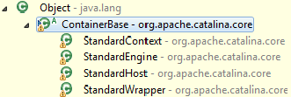
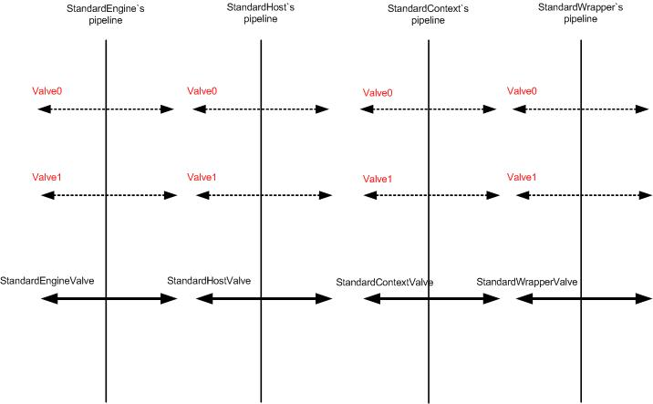
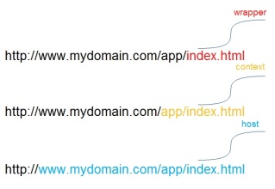
Container
Pipeline/Valve Mechanism
ContainerBase Interface Analysis:
Pipeline/Contained Interface Analysis:

Slide 6
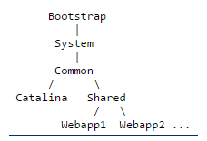
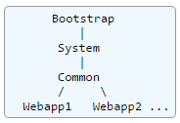
ClassLoader
Q:
Why do tomcat ever need to create its own ClassLoader?
What’s the usage of each class loader?
What’s the class loading sequence from the perspective of a web application?
Why do they retire Catalina ClassLoader?
ClassLoader Hierarchy in Tomcat 5
ClassLoader Hierarchy in Tomcat 7
Bootstrap classes of your JVM
System class loader classes (described above)
/WEB-INF/classes of your web application
/WEB-INF/lib/*.jar of your web application
$CATALINA_HOME/common/classes
$CATALINA_HOME/common/endorsed/*.jar
$CATALINA_HOME/common/i18n/*.jar
$CATALINA_HOME/common/lib/*.jar
$CATALINA_BASE/shared/classes
$CATALINA_BASE/shared/lib/*.jar
<Loader delegate=“false”>
Bootstrap classes of your JVM
/WEB-INF/classes of your web application
/WEB-INF/lib/*.jar of your web application
System class loader classes (described above)
Common class loader classes (described above)
<Loader delegate=“true”>
Bootstrap classes of your JVM
System class loader classes (described above)
Common class loader classes (described above)
/WEB-INF/classes of your web application
/WEB-INF/lib/*.jar of your web application

Slide 7
Tomcat Startup Process

Slide 8
Tomcat Request Handling Process
Tomcat receives a request on an HTTP port
d1) The request is received by a separate thread which is waiting in the PoolTcpEndPoint class.
It is waiting for a request in a regular ServerSocket.accept() method.
When a request is received, this thread wakes up.
d2) The PoolTcpEndPoint assigns the a TcpConnection to handle the request.
It also supplies a JMX object name to the catalina container (not used I believe)
d3) The processor to handle the request in this case is Coyote Http11Processor, and the process method is invoked.
This same processor is also continuing to check the input stream of the socket until the keep alive point is reached or the connection is disconnected.
d4) The HTTP request is parsed using an internal buffer class (Coyote Http11 Internal Buffer)
The buffer class parses the request line, the headers, etc and store the result in a Coyote request (not an HTTP request)
This request contains all the HTTP info, such as servername, port, scheme, etc.
d5) The processor contains a reference to an Adapter, in this case it is the Coyote Tomcat 5 Adapter.
Once the request has been parsed, the Http11 processor invokes service() on the adapter.
In the service method, the Request contains a CoyoteRequest and CoyoteRespons (null for the first time)
The CoyoteRequest(Response) implements HttpRequest(Response) and HttpServletRequest(Response)
The adapter parses and associates everything with the request, cookies, the context through a Mapper, etc
d6) When the parsing is finished, the CoyoteAdapter invokes its container (StandardEngine) and invokes the invoke(request,response) method.
This initiates the HTTP request into the Catalina container starting at the engine level d7)
The StandardEngine.invoke() simply invokes the container pipeline.invoke()
d8) By default the engine only has one valve the StandardEngineValve,
this valve simply invokes the invoke() method on the Host pipeline (StandardHost.getPipeLine())
d9) the StandardHost has two valves by default, the StandardHostValve and the ErrorReportValve
d10) The standard host valve associates the correct class loader with the current thread
It also retrives the Manager and the session associated with the request (if there is one)
If there is a session access() is called to keep the session alive
d11) After that the StandardHostValve invokes the pipeline on the context associated with the request.
d12) The first valve that gets invoked by the Context pipeline is the FormAuthenticator valve.
Then the StandardContextValve gets invoke.
The StandardContextValve invokes any context listeners associated with the context.
Next it invokes the pipeline on the Wrapper component (StandardWrapperValve)
d13) During the invokation of the StandardWrapperValve, the JSP wrapper (Jasper) gets invoked
This results in the actual compilation of the JSP. And then invokes the actual servlet.

Slide 9
Tomcat Request Handling Process
Servlet Invokation Chain
o.a.c.servlets.DefaultServlet.doGet
javax.servlet.http.HttpServlet.service
o.a.c.core.ApplicationFilterChain.doFilter
o.a.c.core.StandardWrapperValve.invoke
o.a.c.core.StandardContextValve.invoke
o.a.c.core.StandardHostValve.invoke
o.a.c.valves.ErrorReportValve.invoke
o.a.c.core.StandardEngineValve.invoke
o.a.c.connector.CoyoteAdapter.service
o.a.coyote.http11.Http11NioProcessor.process
o.a.coyote.http11.Http11NioProtocol$Http11ConnectionHandler.process
o.a.tomcat.util.net.NioEndpoint$SocketProcessor.run
java.util.concurrent.ThreadPoolExecutor$Worker.runTask
java.util.concurrent.ThreadPoolExecutor$Worker.run
java.lang.Thread.run
8. StandardHostValve
Sets context class loader
11. ApplicationFilterChain
Represents Servlet (spec)
FilterChain, invokes servlet
3. SocketProcessor –
Simple Runnable to invoke
Handler.process
6. StandardEngineValve
First valve in the engine
container
7. ErrorReportValve
Catches Throwable
Reports 400+ errors
9. StandardContextValve
Invokes (spec)
ServletRequestListeners
1. Everything starts with the thread
10. StandardWrapperValve
Invokes (spec)
FilterChain
12. The Servlet
Execution of the servlet
4. HttpProcessor –
parses HTTP request
2. NIO Connector defaults
to ThreadPoolExecutor
5. CoyoteAdapter
Creates Request
Response pair

Slide 10
Tomcat Shutdown Process

Slide 11
Good to Know
The word from Fhanik@apache.org
Not so difficult on first impression
Slightly confusing on second impression
Once you get a hang of it, go crazy
Modular design, and nasty deps
Not the typical text book java design
Tuning Tips
Mostly in the application itself, Tomcat default is pretty good
When it comes down to nuts and bolts, the tuning is in the connectors
What about tunning the servlet engine?
Sure, it can be done, but not through configuration
Most common bottlenecks turn out to be synchronized statements or locks
Compared to the webapp or the connector, spending time tuning the engine is not worth the time
Suggestions
Read 5.0.18 source code for architecture overview and startup/request handling flow.
Read 6.0+ source code for connector in depth.

Slide 12
Good to Explore
Code flow Related:
When did the FilterChain initiated and assembled?
How FilterChain->Servlet (CoR pattern) implemented in tomcat?
When did the Listener initiated and invoked?
With what format did url & servlet mapping exists?
What’s the mapping relationship between an url and Servlet? Could multiple urls mapping to the same Servlet?
Should there be initiation order between Container and Connector? If not, why?
Container Related:
What’s the advantage of Container Hierarchy? Compare Tomcat Container & E-Core GUI Container
When did Container Hierarchy Structure built?
Can you figure out what exactly did StandardWrapper wraps?
Why do we ever need a StandardWrapper instead of using the Servlet directly?
Please point out how did we prevent adding child container into Wrapper?
What’s the relationship between StandardWrapper and StandardWrapperValve?
What’s the relationship between StandardValveContext and Pipeline?
Could you find out the mechanism of tomcat removing timeout session?
ClassLoader Related:
Please find out how tomcat auto detect class changes and perform hot redeploy.
Others:
Tomcat 5.0.18 ThreadPool Implementation v.s JUC ExecutorService
ExtendedAccessLogValve L603
Notes:
FilterChain Mapping: StandardContext.addFilterMap
FilterChain: StandardWrapperValve.invoke->ApplicationFilterChain.internalDoFilter
StandardWrapper:
Session timeout removal: ContainerBase.threadStart

Slide 13
Good to Refer To
How Tomcat Works
http://tomcat.apache.org/tomcat-5.5-doc/architecture/
http://gearever.iteye.com/blog/1545250
http://www.ibm.com/developerworks/cn/opensource/os-lo-apache-tomcat/#icomments
https://tomcat.apache.org/tomcat-5.5-doc/class-loader-howto.html
https://tomcat.apache.org/tomcat-7.0-doc/class-loader-howto.html
You can download tomcat 5.0.18 source code from: https://code.csdn.net/Davyjones2010/catalina-sample/tree/master

Slide 14
// TO DO
Logger
Digester(XML->Bean)
Listener & Lifecycle Management
Session Management
Security Management
Tomcat & Design Pattern
Request/Response Façade Pattern
Container CoR Pattern
Connector Adapter Pattern
Lifecycle Observer Pattern

Slide 15
Q&A

Slide 16
Thanks

