Slide 1

Comprehensive Analysis to identify the Reader-Preferred Novels

Slide 2
Contents :
Introduction
Tools (Libraries) used
Website URL’s for Web-Scrapping
Raw Data
Data Cleaning and Data Manipulation
Cleaned Data
EDA (Uni, Bi and Multi - variate Data analysis using plots)
Challenges faced
Conclusion

Slide 3
Introduction :
Selection of the novels
Analysis of the distribution and correlation of different attributes in the dataset.
Finding the top novels depending on different properties.

Slide 4






Tools (Libraries) Used :
Requests
Beautiful Soup
Pandas
Numpy
Matplotlib
Seaborn
re

Slide 5
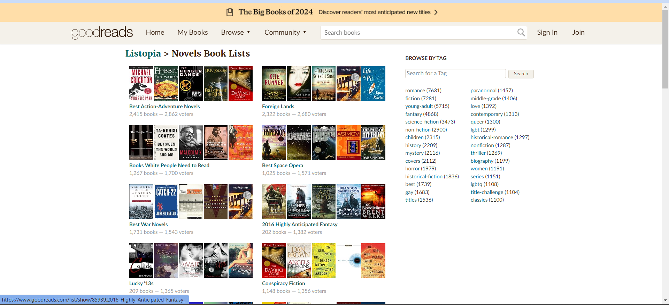
Website for Web-Scraping :
https://www.goodreads.com/list/tag/novels

Slide 6
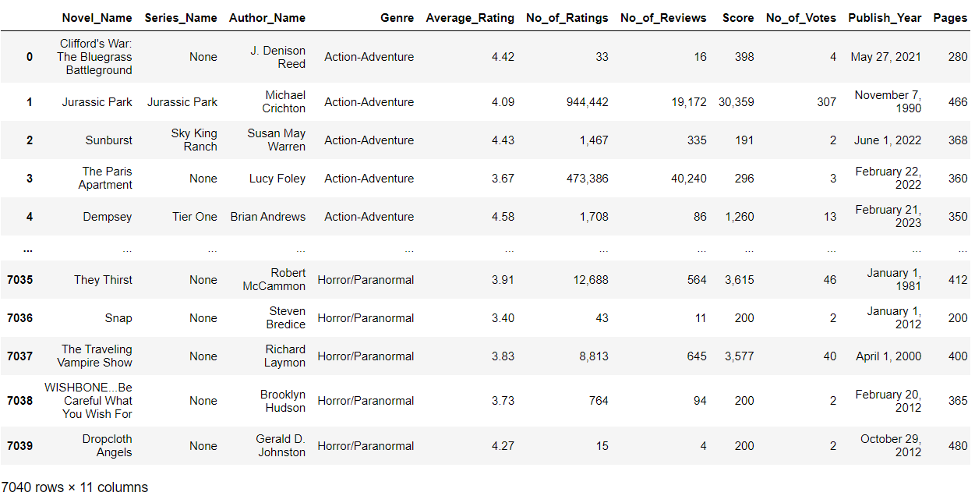
Raw data from website:
We got 7040 rows and 11 columns in the Raw data.

Slide 7
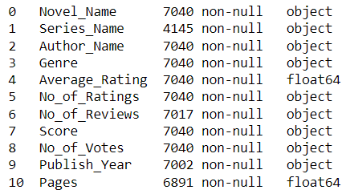
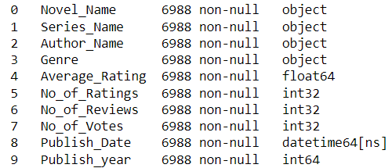
Data Cleaning Steps :
Removed ‘Score’ and ‘Pages’ columns.
Replaced Null values of ‘Series_Name’ column with ‘-’
Dropped remaining null value rows.
Updated datatypes of a columns into as required.
Created a new column ‘Publish_year’ which consists only the published year from the column ‘Publish_Year’ which was in this format (May 27, 2021)

Slide 8
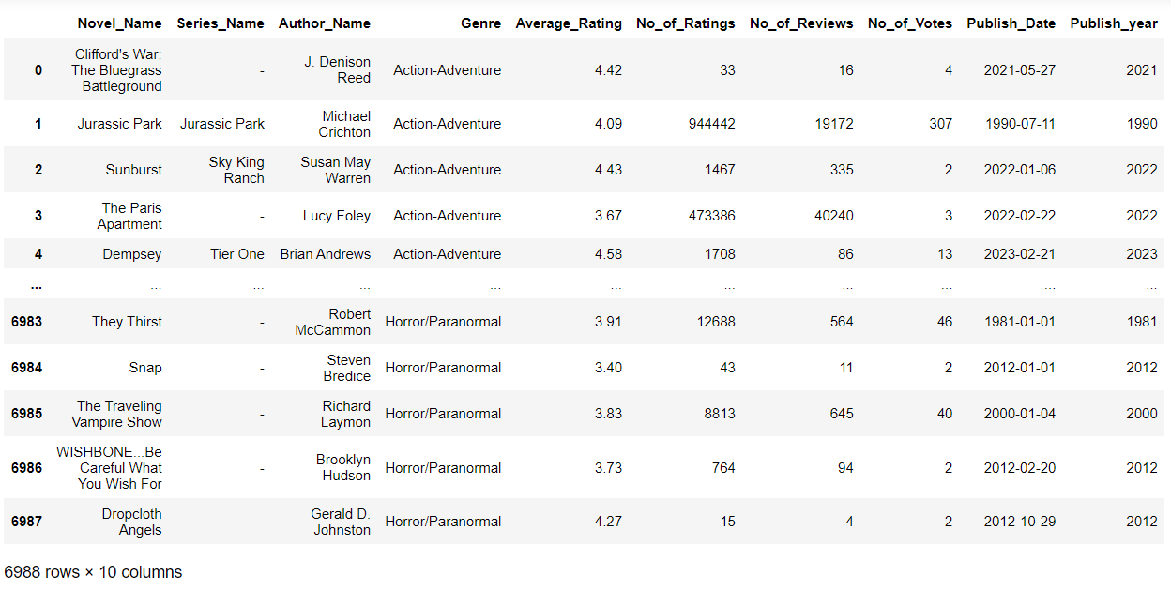
Cleaned Dataframe :
We got 6988 rows and 10 columns in the cleaned data.

Slide 9
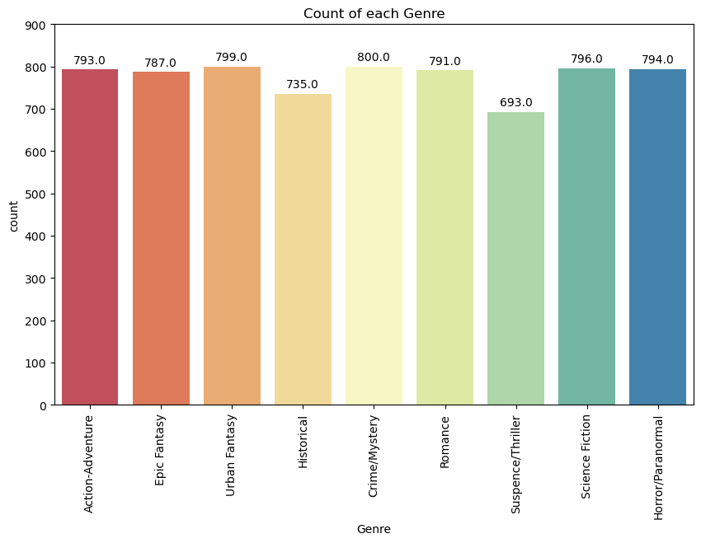
Distribution of Genre in the dataset
DATA VISUALIZATION

Slide 10
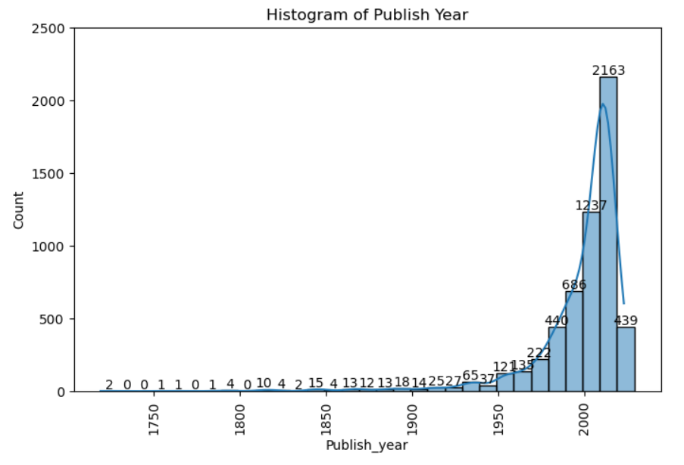
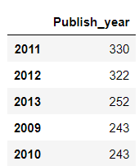
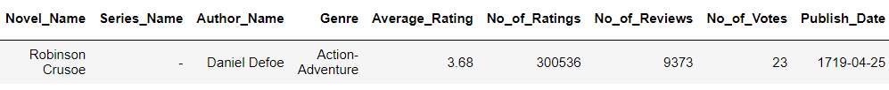
Distribution of Publish_Year

Slide 11
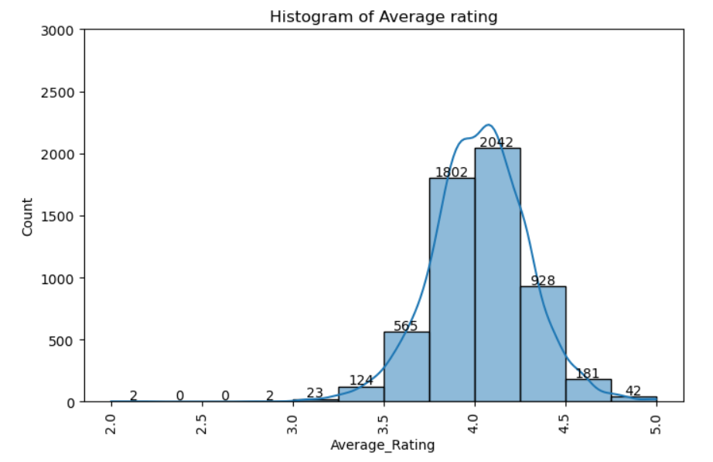
Distribution of Average_Rating:
Mean = 4.030987567851515

Slide 12
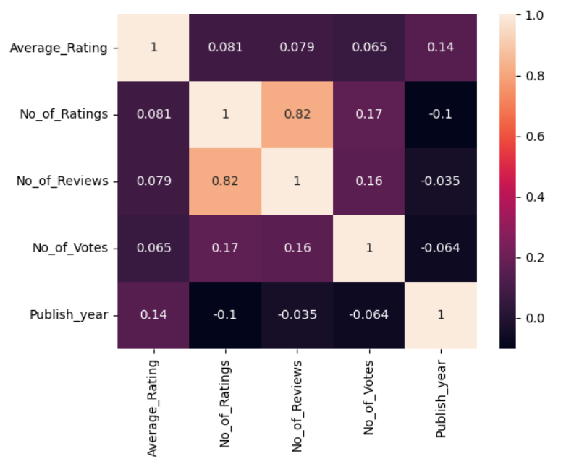
Heatmap

Slide 13
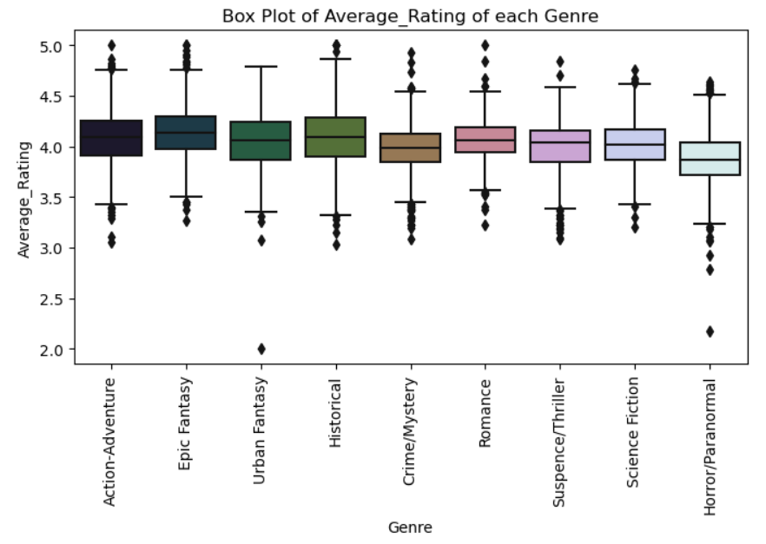
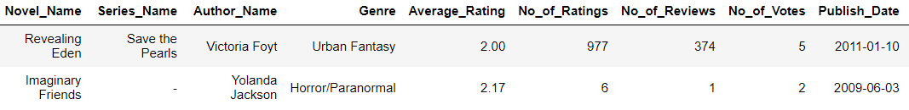
Boxplot

Slide 14
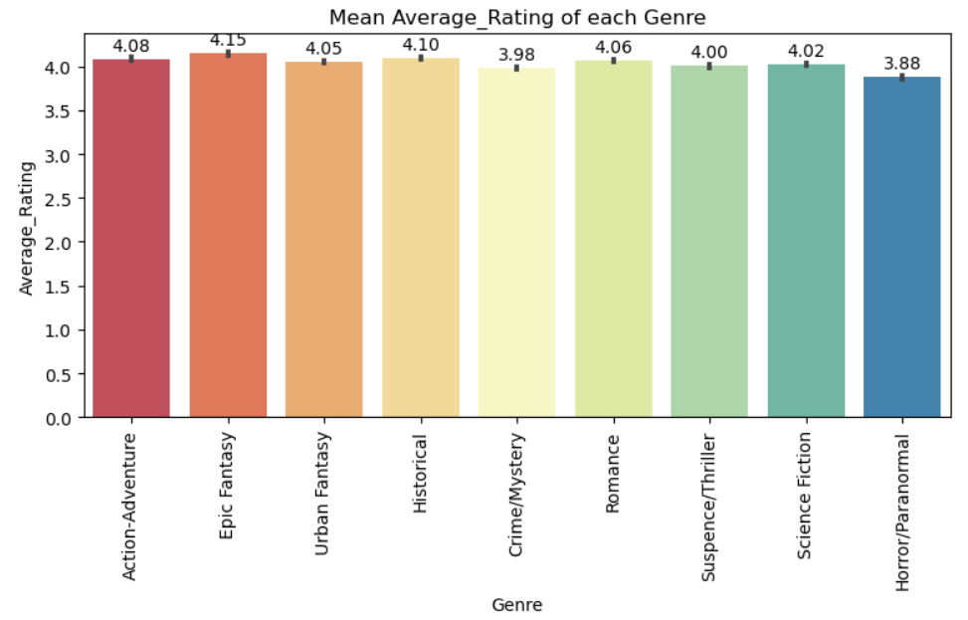
Average Rating of each Genre
According to the average rating, the best genre is Epic Fantasy and the least liked is Horror/Paranormal.

Slide 15
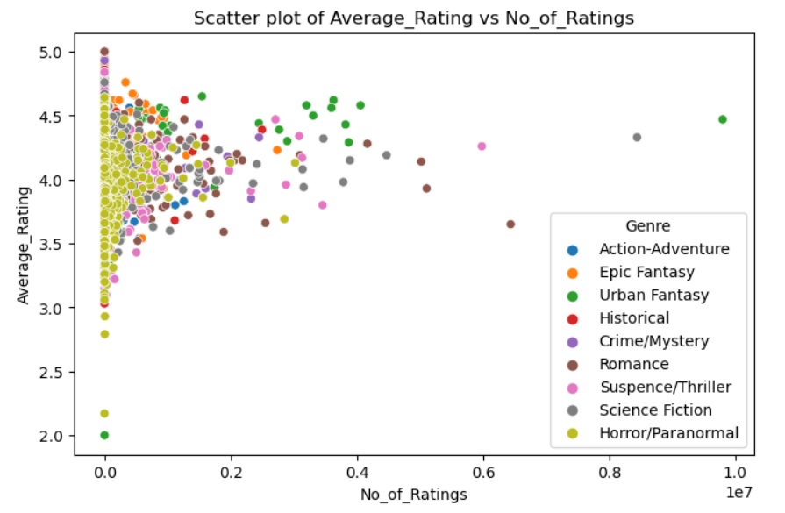
Average rating and no of ratings

Slide 16
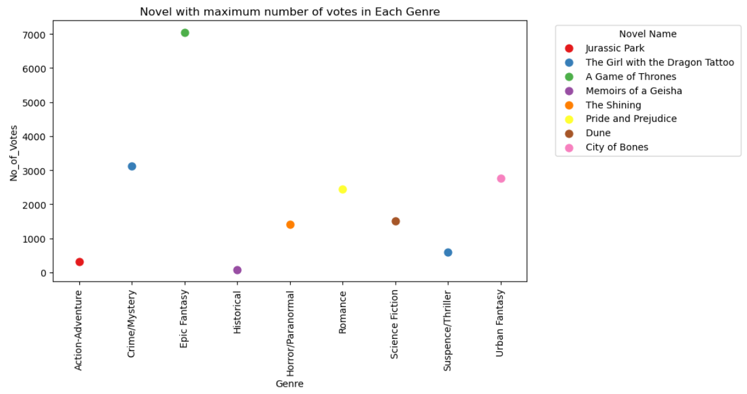
Novels with maximum votes

Slide 17
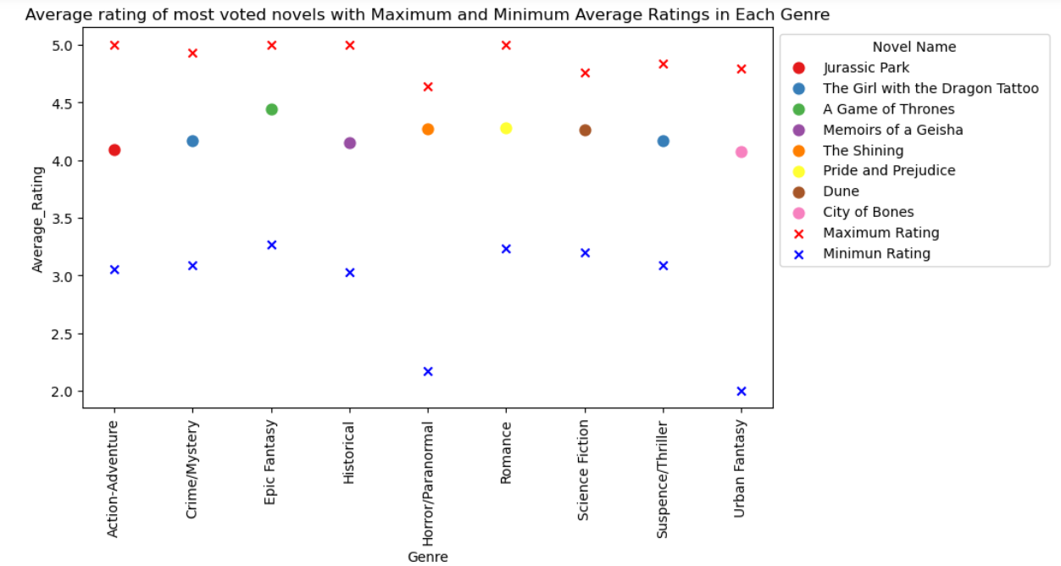

Slide 18
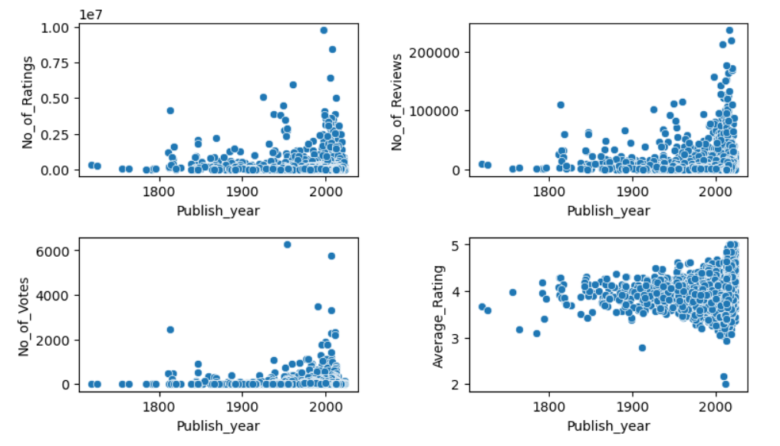
Publish Year vs other numerical column

Slide 19
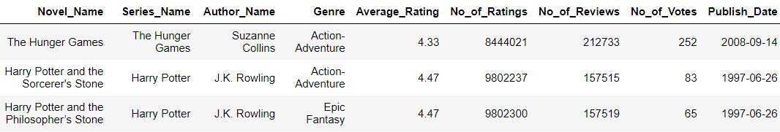
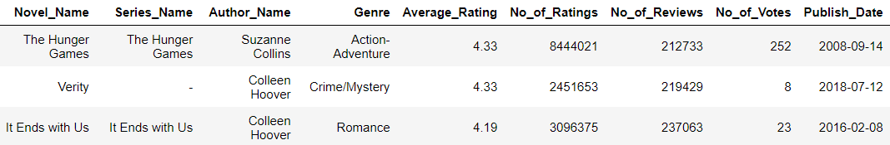
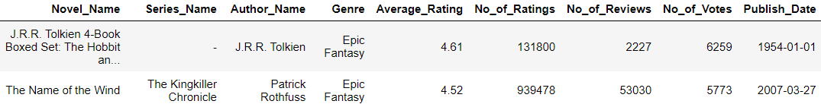
The most popular novel in classics
Novels with higher no of ratings
Novels with higher no of reviews
Novels with higher no of votes

Slide 20
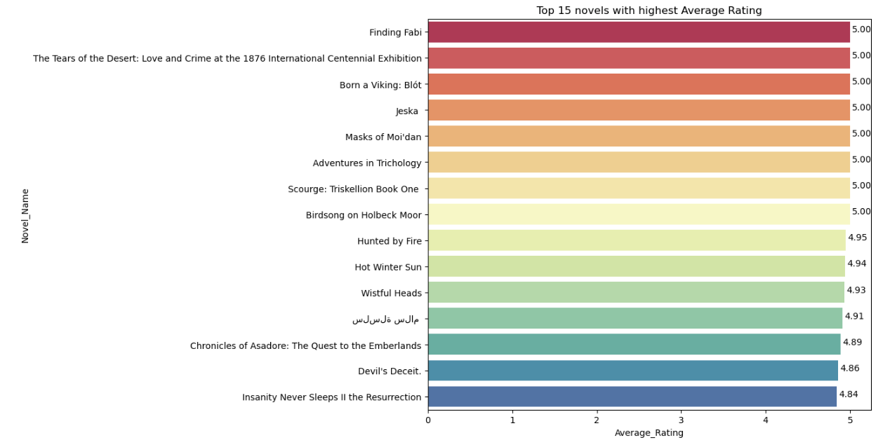
Analysis based on Average Rating
Top 15 novels

Slide 21
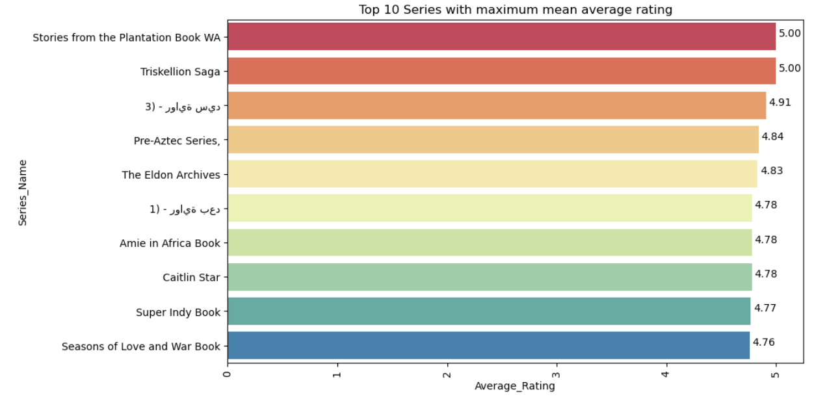
Top 10 series

Slide 22
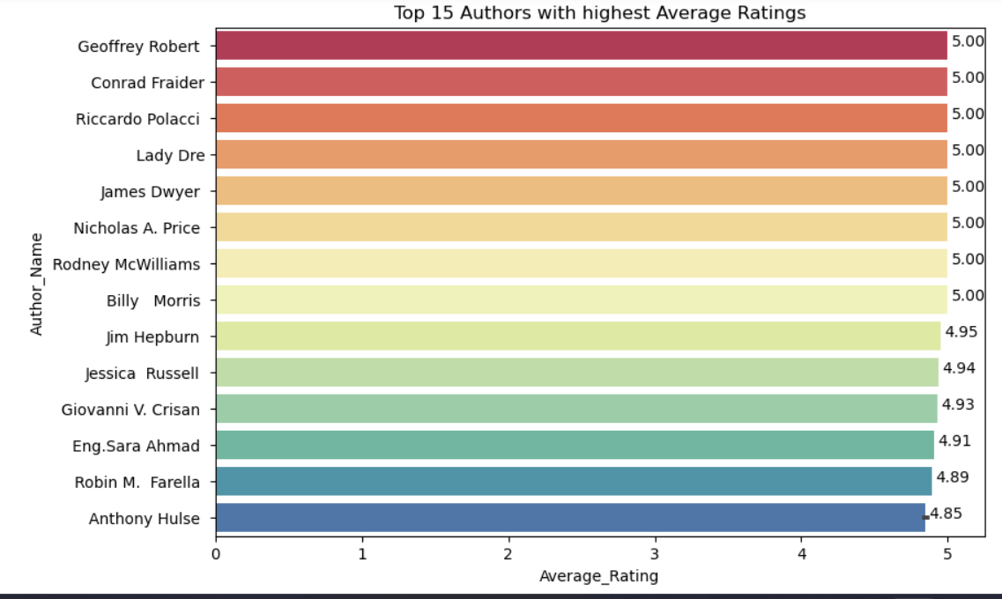
Top 15 authors

Slide 23
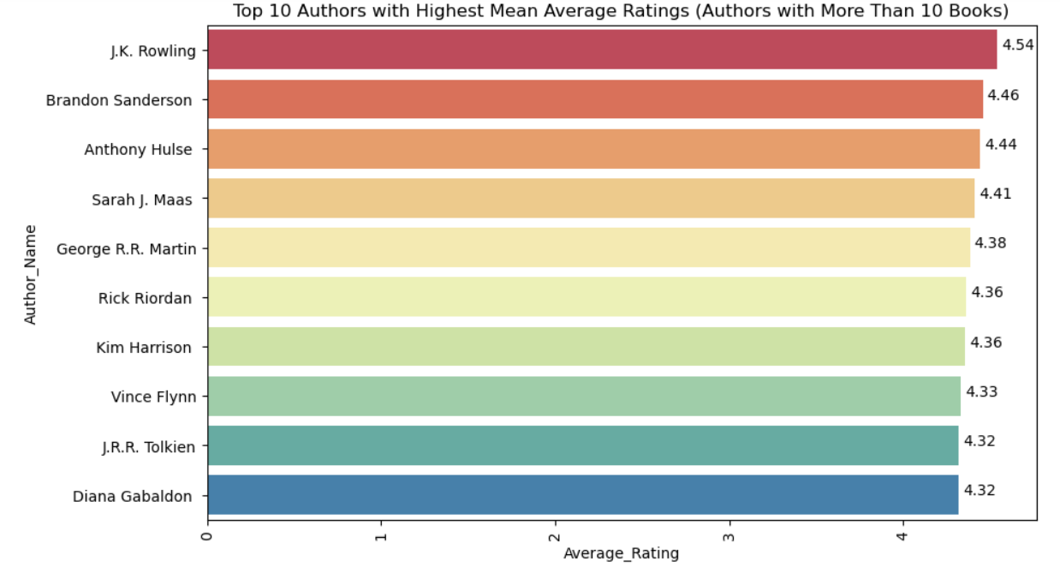
Top 10 authors (authors with more than 10 books)

Slide 24
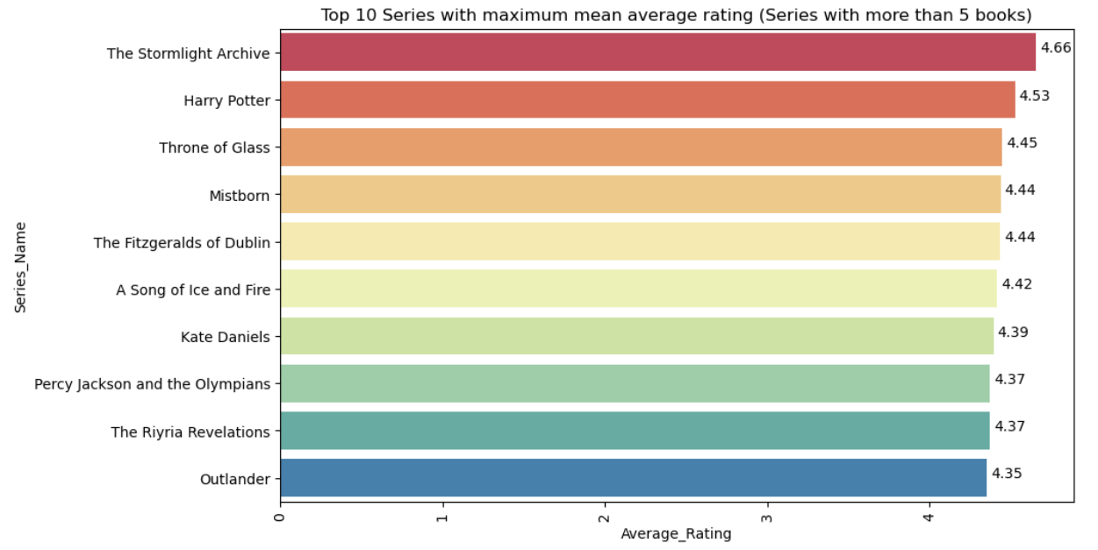
Top 10 series (series with more than 5 books)

Slide 25
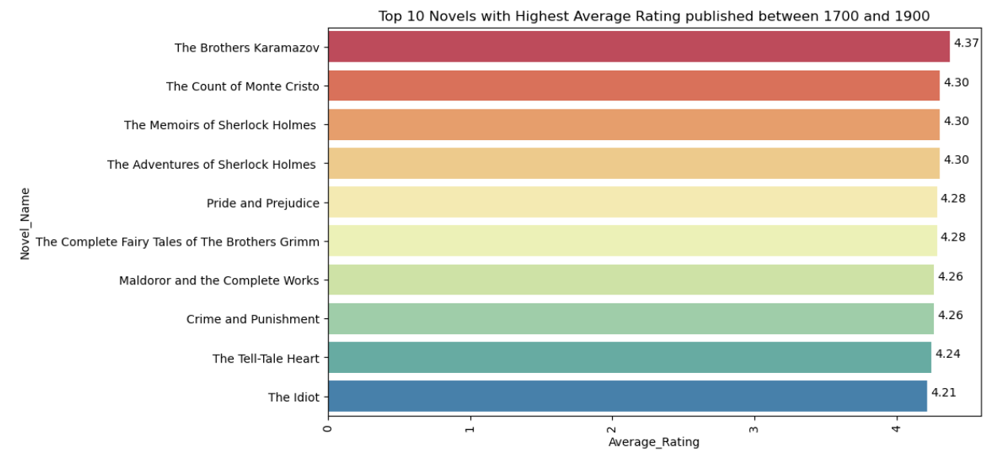
Top 10 novels (1700-1900)

Slide 26
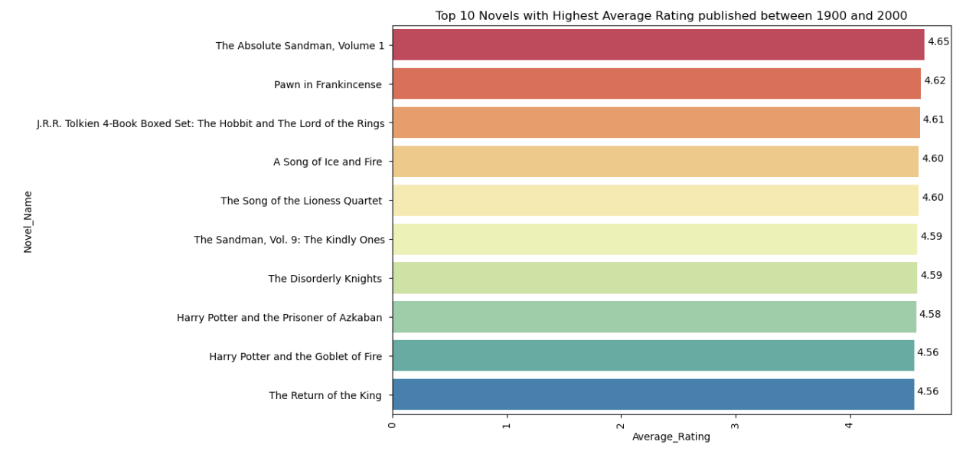
Top 10 novels (1900-2000)

Slide 27
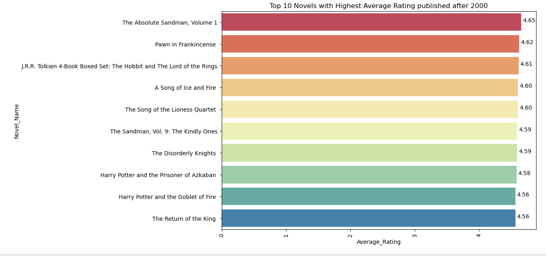
Top 10 novels (after 2000)

Slide 28
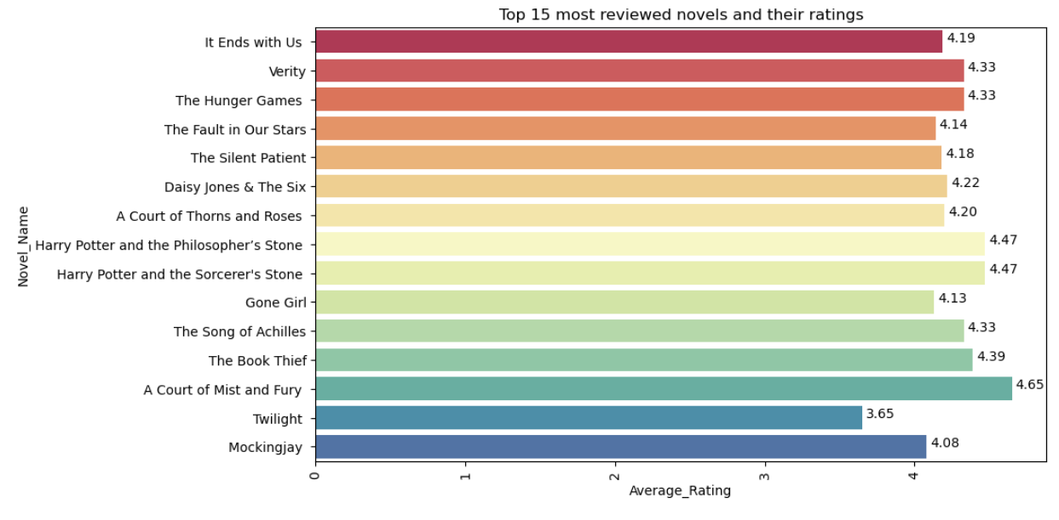
Analysis based on no of reviews
Top 15 novels

Slide 29
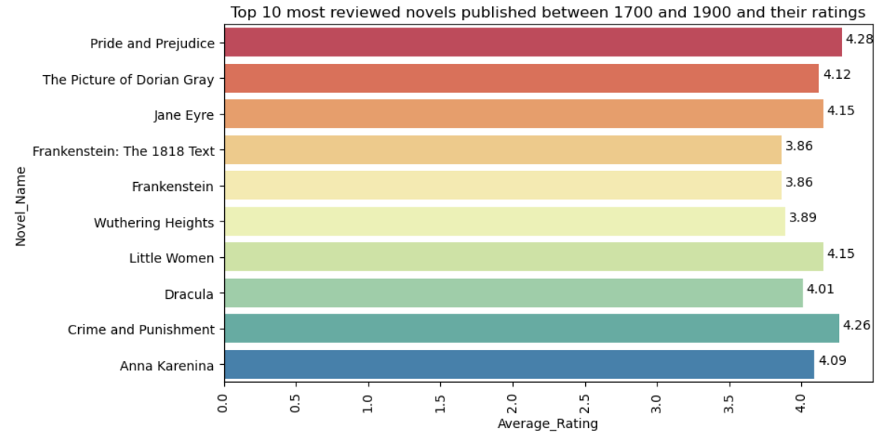
Top 10 novels (1700-1900)

Slide 30
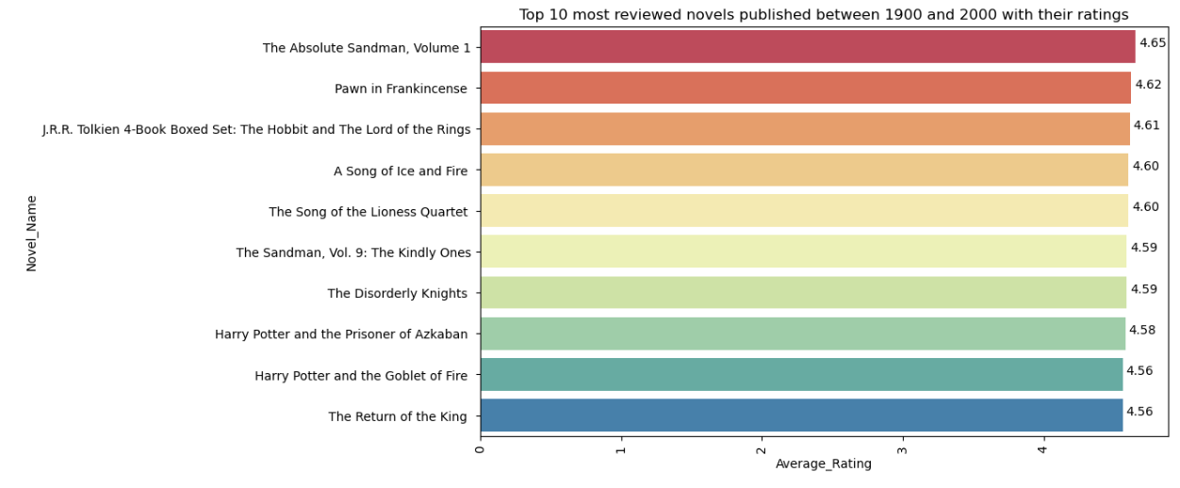
Top 10 novels (1900-2000)

Slide 31
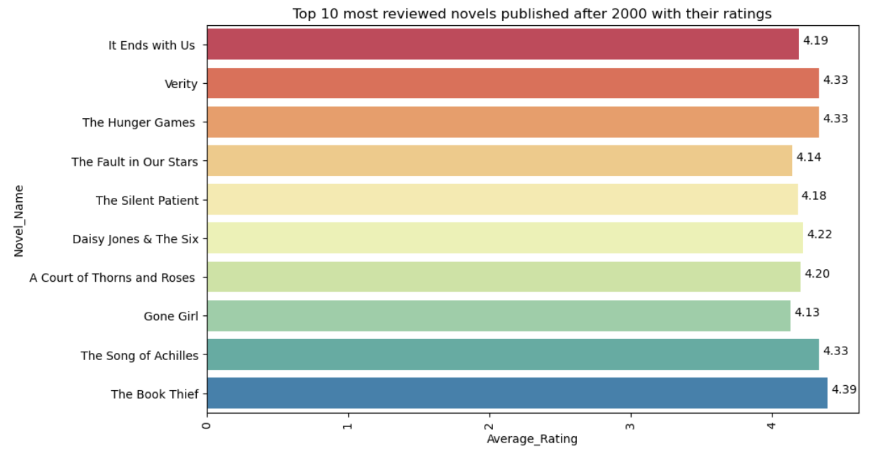
Top 10 reviews (after 2000)

Slide 32
Challenges faced :
Extracting data for publish year and no of reviews
Code's running time was excessively long, taking too many hours to complete.
Using dictionary instead of list

Slide 33
Conclusion:
Most liked genre is Epic Fantasy and least liked genre is Horror/Paranormal.
The most highly rated genre are not always the popular ones, but the ones which are most reviewed are popular.
There are extremely less audience for classic novels.

