Slide 1
Skill-Based Resume Ranking System
with Explainable AI for Recruitment Automation
CSE-414 · Machine Learning and Deep Learning Lab
TEAM MEMBERS Tanjina Akter Nisa — 22201086
Md. Daudul Islam — 22201088
Saswata Ghosal — 22201090
Course Teacher
Faria Zarin Subah
Assistant Professor University of Asia Pacific

Slide 2

Project Objective
🎯 Automate Resume Screening
⚖️ Reduce Hiring Bias
Eliminate manual, time-consuming CV review by using ML and DL models to automatically analyze, score, and rank candidates.
Provide an objective, skill-driven evaluation that removes subjective human bias from the shortlisting process.
🔍 Explainable AI (XAI)
⚡ Save Time & Cost
Every score is transparent — HR can see matched skills, missing skills, score breakdown, and AI-generated improvement suggestions.
Reduce CV screening from days to seconds. Support batch processing of multiple PDFs with ranked output and CSV export.
01

Slide 3

Societal Impact & Motivation
72%
of HR time
spent on screening
250+
CVs received
per job posting
10s
average time spent
per CV manually
🏢 HR Industry
Drastically reduces time-to-hire and operational costs for recruitment teams in any industry.
🤝 Fair Hiring
Candidates are ranked purely on skills, experience, and education — not on formatting or recruiter familiarity.
📈 Scalability
Handles bulk CV uploads simultaneously — ideal for large corporations and SMEs alike.
🌍 Broader Access
Levels the playing field for qualified candidates who may lack connections but have the right skill profile.
02

Slide 4

Dataset Description
📦 Dataset Information
🏷️ Preprocessing Steps
Dataset: UpdatedResumeDataSet.csv
Source: Kaggle/GitHub
Total Resumes: 962
Job Categories: 25
Data Format: Resume Text + Category
Text cleaning and null value removal
Label encoding for categories
TF-IDF vectorization
DistilBERT tokenization
Resume parsing using pdfplumber
03

Slide 5

Methodology & Model Architecture
ML
ML
DL
DL
Logistic
Regression
Random
Forest
DistilBERT
SBERT
MiniLM-L6
TF-IDF
TF-IDF
Fine-tuned
Semantic Sim.
Acc: 99.48%
Acc: 99.48%
Acc: 99.00%
Acc: Cosine
⚡ Hybrid Scoring Formula:
Final Score = 40% SBERT Similarity + 30% Skill Match + 15% Experience + 15% Education
NLP Pipeline
1. PDF Extract
→
2. Text Clean
→
3. Skill Extract
→
4. TF-IDF / BERT Tok.
→
5. Model Inference
→
6. Cosine Sim.
→
7. Ranked Output
04

Slide 6

Implementation
🛠 Tools & Frameworks
Python
Core Language
PyTorch
Deep Learning
HuggingFace
Transformers
sentence-transformers
SBERT
scikit-learn
ML Models
pdfplumber
PDF Parsing
Streamlit
Web UI
pandas / numpy
Data Handling
matplotlib
Visualization
⚙️ DistilBERT Training
🖥️ Streamlit Web App (3 pages)
• Epochs: 3 | Batch Size: 8
• Optimizer: AdamW | Warmup Steps: 5
• Loss Epoch 1: 2.005 → Epoch 3: 0.385
• Val Loss Epoch 1: 1.715 → Epoch 3: 0.342
• Login Page — HR authentication
• Scan Page — PDF upload, job input
• Output Page — scores, ranks, insights
• Design: Gradient bg + Glass-morphism cards
05

Slide 7

Results & Analysis
Model | Type | Accuracy | Precision | Recall | F1 Score
Logistic Regression | ML | 99.48% | 1.00 | 0.99 | 0.99
Random Forest | ML | 99.48% | 0.99 | 0.99 | 0.99
DistilBERT | DL | 99.00% | 0.99 | 0.99 | 0.99
SBERT (MiniLM-L6) | DL | Similarity Scoring | — | — | —
06

Slide 8
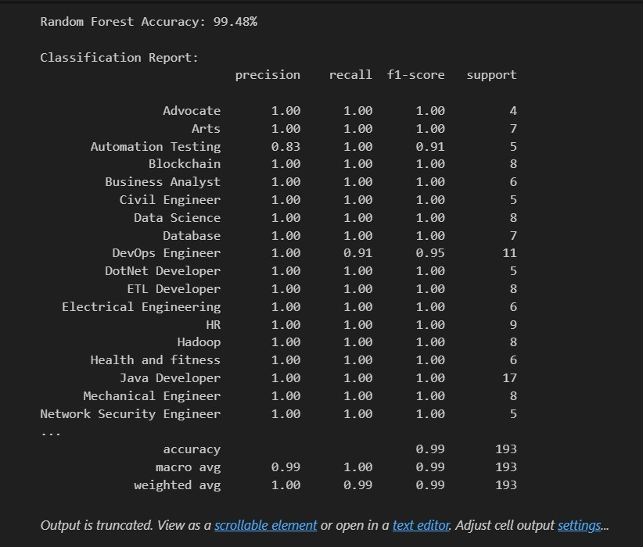
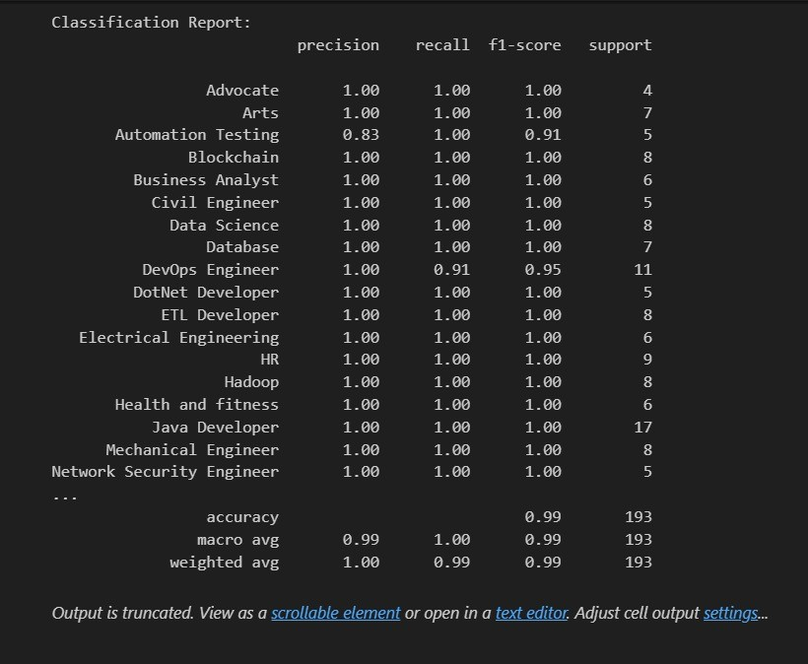
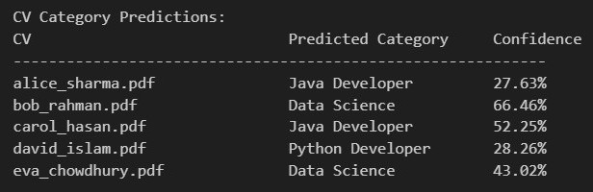
07

Slide 9

Team Member Contributions
22201086
Tanjina Akter Nisa
22201088
Md. Daudul Islam
22201090
Saswata Ghosal
Dataset collection, cleaning & preprocessing
TF-IDF vectorization & label encoding
Logistic Regression model training & evaluation
Result analysis, presentation
DistilBERT fine-tuning & hyperparameter tuning
SBERT semantic similarity integration
Hybrid scoring formula design & implementation
Report Writing
Random Forest model development & evaluation
Streamlit web app UI design & development
CEP mapping
Proofreading
08

Slide 10

CEP Outcome Mapping
Code | Attribute | Project Evidence | Report Section
WK1 | Mathematics & Science | Scoring formula, model evaluation metrics | Section V
WK2 | Data Analysis & Statistics | TF-IDF, label encoding, train/val split | Section IV
WK4 | Specialist ML/DL Knowledge | Transformer fine-tuning, SBERT embeddings | Section V
WK6 | Engineering Practice & Tools | Python, HuggingFace, Streamlit, pdfplumber | Section VI
WK8 | Current Research Literature | BERT, SBERT, transformer-based NLP | Section V
09

Slide 11
CEP Outcome Mapping Cont.
Code | Attribute | Project Evidence | Report Section
WP1 | Depth of Knowledge | Deep ML/DL model design required | Section V
WP2 | Conflicting Requirements | Technical + societal issues (bias, automation) | Sec. I, VIII
WP3 | Abstract Thinking | Novel hybrid ML+DL+rule-based scoring | Section V
WP4 | Infrequently Encountered | NLP applied to HR domain (novel) | Section I
10

Slide 12
CEP Outcome Mapping Cont.
Code | Attribute | Project Evidence | Report Section
EA1 | Range of Resources | Datasets, HuggingFace, cloud tools | Section VI
EA2 | Interaction Level | ML vs DL tradeoff analysis | Section VII
EA3 | Innovation | Transformers for resume ranking (novel use) | Section V
11

Slide 13

Conclusion
We built an end-to-end AI-powered resume ranking system that automates HR screening using Logistic Regression, Random Forest, DistilBERT, and SBERT — achieving up to 99.48% accuracy with full explainability.
✅ Key Outcomes
⚠️ Challenges & Limitations
• All 3 classification models achieved F1 = 0.99
• Hybrid scoring covers semantic + skill + exp. + edu.
• XAI gives matched/missing skills & suggestions
• Streamlit app supports batch CV upload + CSV export
• Dataset limited to 962 resumes / 25 categories
• DistilBERT requires GPU for fast training
• No multi-language CV support currently
• Real-world bias in training data possible
🚀 Future Work
Multi-language support · LLaMA/GPT-4 integration · Interview scheduling module · Cloud deployment · Real-world HR dataset expansion
12

Slide 14

References
[1] J. Devlin, M.-W. Chang, K. Lee, and K. Toutanova, "BERT: Pre-training of Deep Bidirectional Transformers for Language Understanding," Proc. NAACL-HLT, 2019.
[2] V. Sanh et al., "DistilBERT, a distilled version of BERT," arXiv:1910.01108, 2019.
[3] N. Reimers and I. Gurevych, "Sentence-BERT: Sentence Embeddings using Siamese BERT Networks," Proc. EMNLP, 2019.
[4] L. Breiman, "Random Forests," Machine Learning, vol. 45, no. 1, pp. 5–32, 2001.
[5] C. Cortes and V. Vapnik, "Support-Vector Networks," Machine Learning, vol. 20, pp. 273–297, 1995.
[6] S. Robertson and H. Zaragoza, "The Probabilistic Relevance Framework: BM25 and Beyond," Found. Trends Inf. Retr., 2009.
[7] UpdatedResumeDataSet.csv, Kaggle Dataset. [Online]. Available: https://www.kaggle.com
[8] Streamlit Inc., "Streamlit: A faster way to build and share data apps," 2020. [Online]. Available: https://streamlit.io
Thank You · University of Asia Pacific · CSE-414 Machine Learning and Deep Learning Lab
13

Slide 15
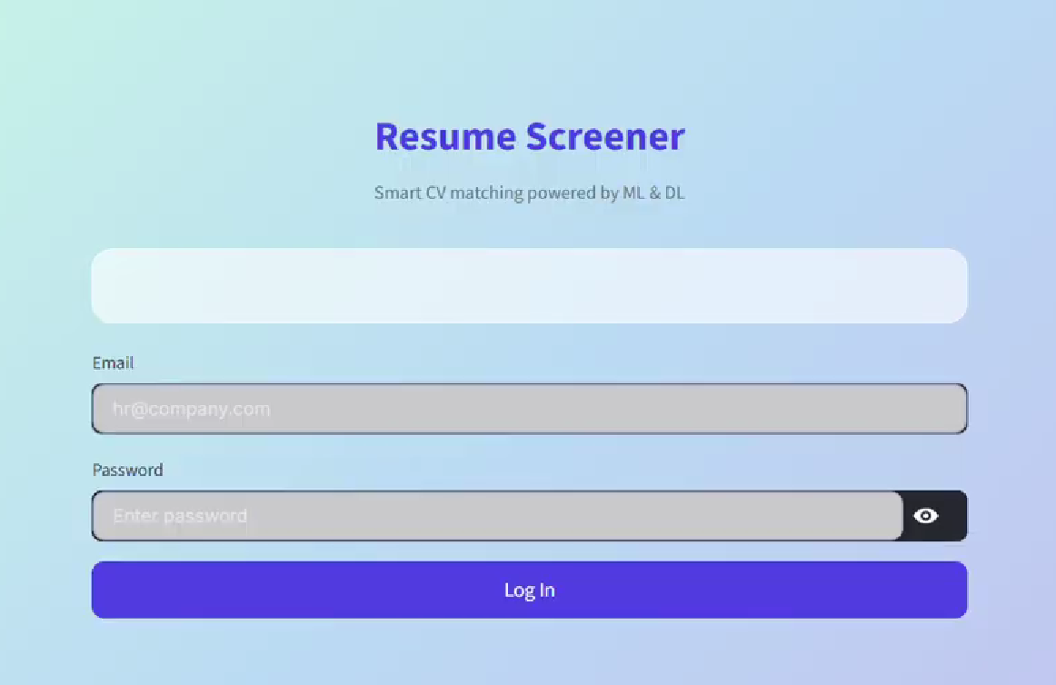
Demonstration Video
Click to Open the Video
14

Slide 16
Thank you for your attention

