Slide 1
Project-2
VGA Controller

Slide 2
Port List
About VGA
Inputs - VGA CLK, Wishbone Interface signals
Outputs - R,G,B (4 bit signals), Hsync, Vsync (Nexys Users) and TMDS Signals (Boolean Board)
rvfpganexys
Vsync, hsync
R,G,B [3:0]
Veerwolf core
Vsync, hsync
Wishbone Signals, VGA Clk
R,G,B [3:0]
Refer Background and Analog Displays and Controllers section in: https://www.realdigital.org/doc/594213b2335f9442054709263d61afe5
VGA
DTG

Slide 3
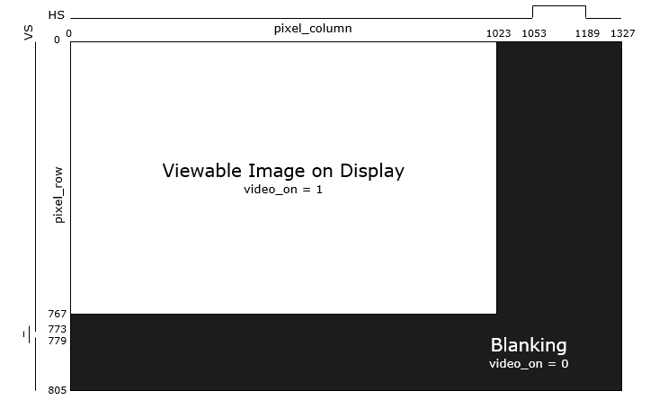
Display Timing Generator Module (DTG)
The image represents a 1024 x 768 VGA Display
VGA cable continuously sends each pixel
horizontally line by line and then restart at the
top of the screen again
Please note when the VSYNC and HSYNC are
Set to 1
Video_on signal denotes the active region of the
display(the screen on which you see the images)
HSYNC is generated for each row
After (row , col) = (767, 1023) both hsync and
Vsync are generated and later the index resets to
(0,0)
The video_on signal is cleared to 0 before the
Vsync and hsync pulse are generated

Slide 4
DTG
Generates timing signals for 640 x 480 (VGA) display
Implements 12-bit row and column counters that count from 0 to 479 (row) and 0 to 639 (column)
Inputs - 25.20 MHz Clock
Outputs - v_sync (Vertical Sync), horiz_sync (Horizontal Sync)
pixel_row, pixel_column (horizontal and vertical position of the pixel being written to the display)
video_on (enable video display)
Display Timing Generator Instantiation: (needs to be instantiated inside the VGA Module)
dtg dtg(
.clock(vga_clk),
.rst(reset),
.video_on(video_on),
.horiz_sync(vga_hs),
.vert_sync(vga_vs),
.pix_row(pix_row),
.pix_col(pix_col)
);
VGA Timing Information: http://tinyvga.com/vga-timing
What is the use of video_on signal?

Slide 5
VGA Peripheral Logic
Wishbone interface (reading and writing registers)
Add the wishbone interface logic to store:
Reg1: row [31: 16] and column[15: 0]
Reg2: data buffer
Example:
reg [31:0] wb_vga_reg, wb_vga_reg2;
always @(posedge clk, posedge wb_rst) begin
if (wb_rst) begin
wb_vga_reg = 32'h00 ;
wb_vga_reg2 = 32'h00;
wb_vga_ack_ff = 0 ;
end
else begin
case (wb_m2s_vga_adr[5:2])
0: wb_vga_reg = wb_vga_ack_ff && wb_m2s_vga_we ? wb_m2s_vga_dat : wb_vga_reg;
1: wb_vga_reg2 = wb_vga_ack_ff && wb_m2s_vga_we ? wb_m2s_vga_dat : wb_vga_reg2;
endcase
// Ensure 1 wait state even for back to back host requests
wb_vga_ack_ff = ! wb_vga_ack_ff & wb_m2s_vga_stb & wb_m2s_vga_cyc;
end
end
assign wb_s2m_vga_ack = wb_vga_ack_ff;
assign wb_s2m_vga_dat = (wb_m2s_vga_adr[5:2]==0) ? wb_vga_reg: wb_vga_reg2;
Character to Pixels
Displaying the pixels through VGA R, G, B pins

Slide 6
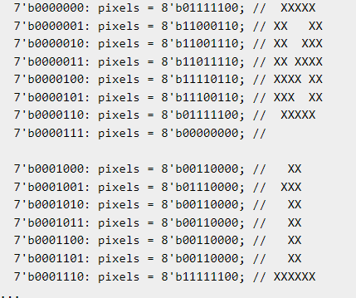
Character to Pixels
At each row, column we can generate the pixel information. Each pixel can have any particular colour using the R,G,B signals. Example: R + G = Y , by varying the intensities we can generate an orange signal too.
Each signal is a 4-bit value and can take up intensities from 0 to 15
Combining the information of each pixel we can display a character on to the screen.
It is upto you to decide on how many pixels you consider to display a character.
https://www.righto.com/2018/04/fizzbuzz-hard-way-generating-vga-video.html

Slide 7
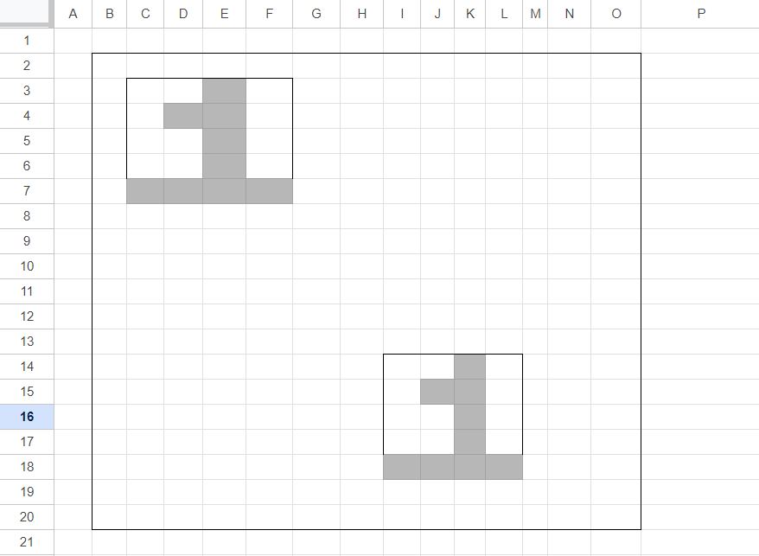
Writing Pixels to VGA Signals
Data = 1(ascii value)
Pixels = {{0010},{0110}, {0010}, {0010}, {1111}}
when pix_row = 4 and pix_col = D,
At each posedge of clk,
If (video_on)
Vga_r = 4{pixel[4][D]} // = 4’b1111
Vga_g = 4{pixel[4][D]} // = 4’b1111
Vga_b = 4{pixel[4][D]} // = 4’b1111
Else
Vga_r = 4{1’b0}
Vga_g = 4{1’b0}
Vga_b = 4{1’b0}

Slide 8
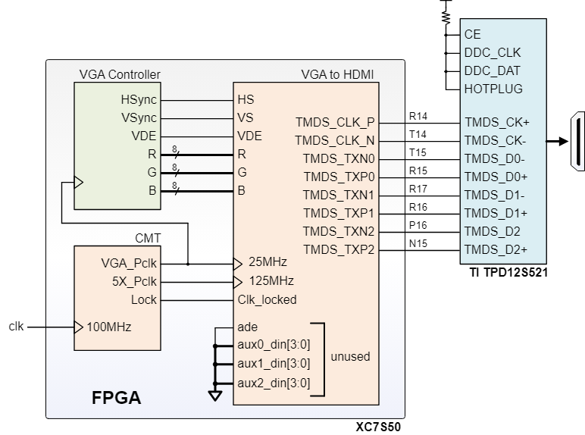
HDMI Converter for VGA (only for Boolean Board Users)
The Boolean Board does not have VGA Connector support. It has a HDMI connector support.
We need to come up with converting the VGA signals into HDMI signals.
Because HDMI display controllers are more complex than analog/VGA controllers, Real Digital provides a VGA-to-HDMI IP block
The VGA-to-HDMI core receives the VGA timing signals HSync, VSync, and VDE (Video Display Enable), and video data signals (R, G, and B) with up to 8 bits per color. These signals are mapped into HDMI timing and data signals, effectively allowing HDMI controller details to be ignored.In addition to the VGA timing and data signals, one additional clock signal running at 5X of the pixel clock is needed.
https://www.realdigital.org/doc/02013cd17602c8af749f00561f88ae21#hdmi-port

Slide 9
Additional References
ASCII Table: https://www.rapidtables.com/code/text/ascii-table.html

