Slide 1
RISC-V Processor Core
GitHub Repo: https://github.com/reecewayt/riscv-pipeline-core
Raghavendra Davarapalli - ragha@pdx.edu
Philip Nevins - pnevins@pdx.edu
Reece Wayt - reecwayt@pdx.edu
Maithreyi Venkatesan - maithven@pdx.edu
ECE 571 Introduction to SystemVerilog for design and Verification
Venkatesh Patil & Brian Cruikshank
Electrical and Computer Engineering Department
Maseeh College of Engineering and Computer Science

Slide 2
Project Overview
Implementation of RISC-V processor core focusing on fundamental pipeline stages
Modeled and simulated using SystemVerilog and QuestaSim
Uses both structural and behavioral-level modeling
Selected RISC-V for its open-source ISA and growing popularity
Current implementation is unpipelined (4-5 cycles per instruction)
Focused on thorough unit testing and verification
Makefile build system allows for top level builds and also running unit tests
Did not focus on synthesis
Notes:
Quick summary of what we’ve done.

Slide 3
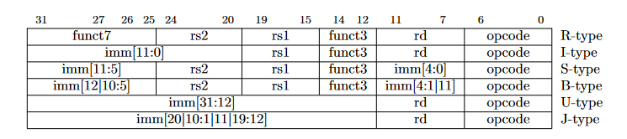
Introduction
RISC-V History
Originally invented at UC Berkeley by Patterson & Sequin in 1980s
Designed to simplify complex instruction sets [1]
Fixed-length 32-bit instructions supporting high-level languages
Single cycle execution for instructions
Load/store architecture
RV32I Base Integer Instruction Set [3]
40 Unique instructions
32x registers (x0-x32), 32 bits wide
x0 hardwired to zero
x1/x2 are return address/stack pointers
6 instruction formats: R, I, S, U, B, J Types
Notes:
RISC-V Instruction Format Fields
The image shows how each 32-bit instruction is split into different fields:
opcode (bits 6-0): Identifies the instruction type/category
rd (bits 11-7): Destination register
rs1 (bits 19-15): First source register
rs2 (bits 24-20): Second source register
funct3 (bits 14-12): Additional operation specifier
funct7 (bits 31-25): Extended operation specifier
1. R-type (Register): Used for register-to-register operations (ADD, SUB, etc.)
2. I-type (Immediate): Used for immediate and load operations
3. S-type (Store): Used for store instructions (i.e. SW for store word in memory)
4. B-type (Branch): Used for conditional branches (i.e. Branch if Equal)
5. U-type (Upper Immediate): Used for large immediate values
6. J-type (Jump): Used for unconditional jumps (i.e. Jump to a function call or something like that)

Slide 4
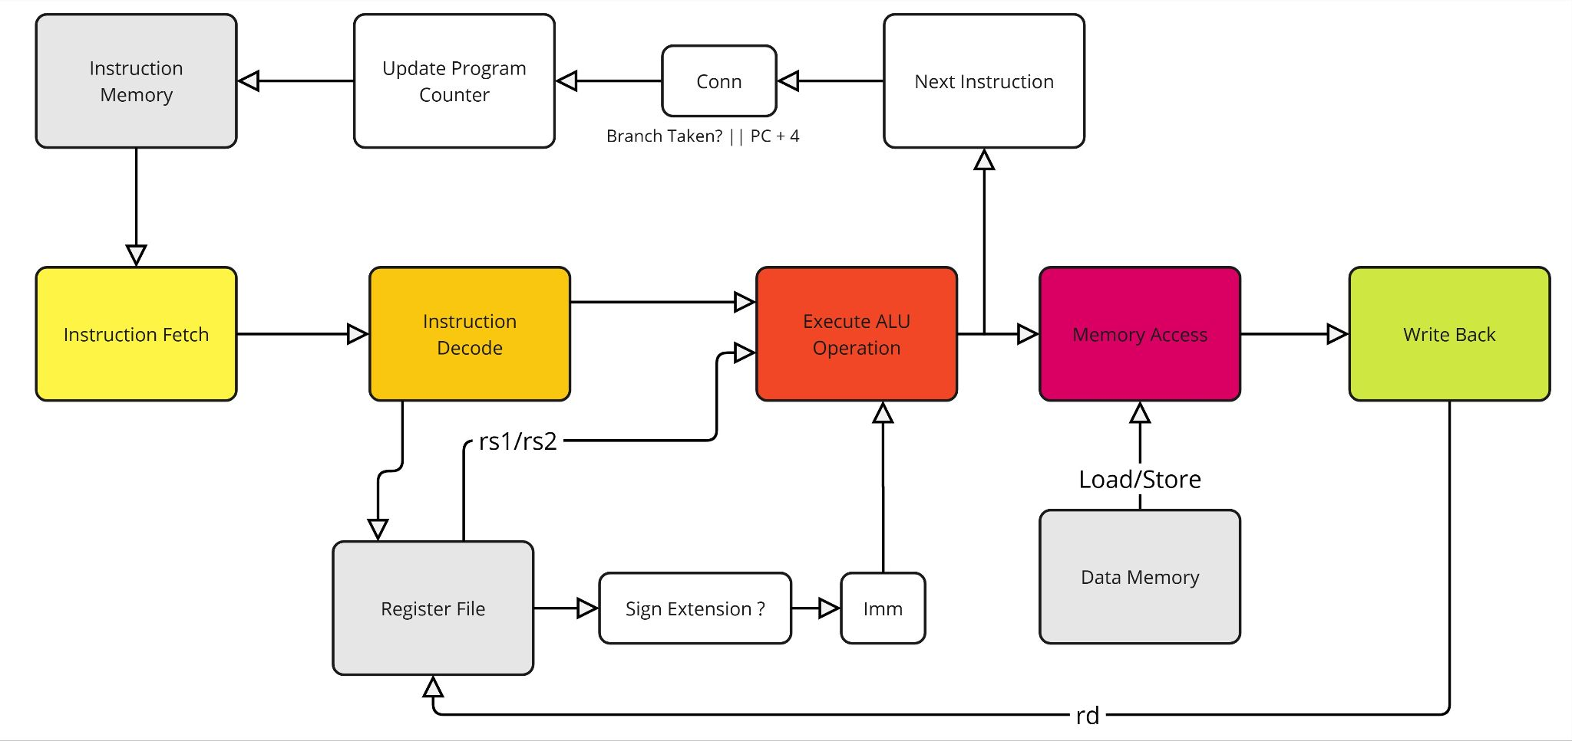
Architecture Overview [2]
Notes:
Top down design approach
Talk about pipeline control handshaking
For inter-stage communication, we implemented a simple handshaking protocol using valid and ready signals between adjacent pipeline stages, rather than using a more complex finite state machine (FSM) approach

Slide 5
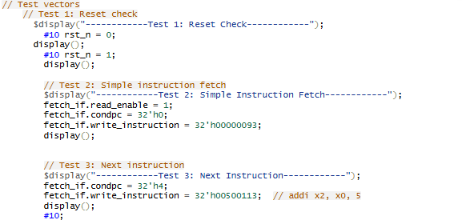
Fetch Stage - Maithreyi
What does fetch do?
This is the first stage of instruction pipelining where the processor retrieves the next instruction to be executed from memory.
The Program Counter(PC) provides the address to fetch the next instruction from memory which is then stored in the Instruction Register(IR) for decoding in the next stage.
The Program Counter(PC) is updated to point to the next instruction by incrementing it (PC+4) for sequential execution or redirecting it to a branch/jump address based on the MUX output from the Memory Stage. The Add Unit calculates the next PC (NPC) by adding 4 or a branch offset.

Slide 6
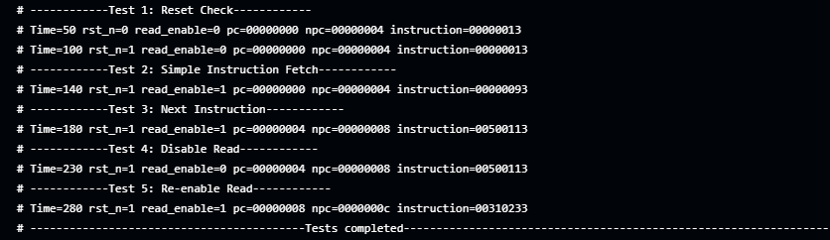
Fetch Stage - Maithreyi
The Fetch unit was tested with a set of five test cases each targeting a specific aspect of the Fetch stage.
Test 1: During reset (rst_n = 0), the PC, NPC, and instruction are initialized to default values. Test 2: When reset is disabled (rst_n = 1) and read_enable = 1, the unit fetches the first instruction and updates NPC to PC+4. Test 3: Fetching continues with read_enable = 1, advancing the PC and fetching the next instruction. Test 4: With read_enable = 0, fetching stops, and the PC, NPC, and instruction remain unchanged. Test 5: Re-enabling read_enable = 1 resumes fetching, updating the PC and loading the next instruction.

Slide 7
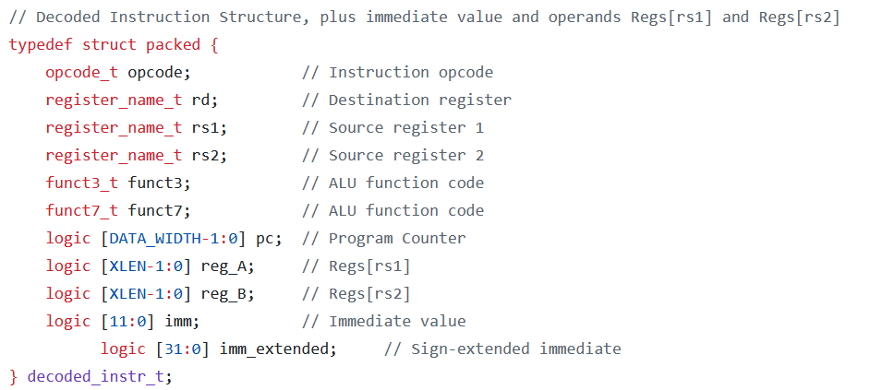
Decode Stage - Reece
What does the decode stage do?
Breaks the fetched instruction down into its constituent parts
Opcode
rs1/rs2 - accessed directly from register file
rd
immediate value if present
These constituent parts are fed directly into the ALU unit
We used a packed structure for passing these parts between each pipeline stage

Slide 8
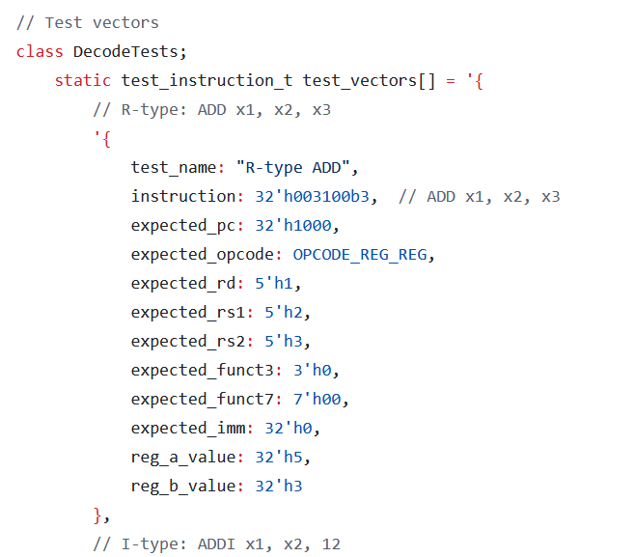
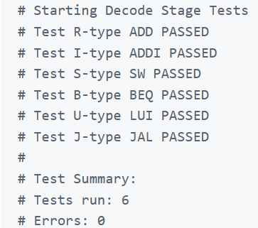
Decode Stage - Reece
Unit Testing and Results
Class based testbench with vectored attributes
These vectors acted as drivers to my test bench
Running make decode
Source: [5] Claude.AI
Notes:
Be sure to talk about how Claude.AI was used in this

Slide 9
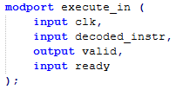
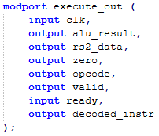
Execute Stage - Phil
What does the execute stage do?
It accepts decoded instructions and performs the appropriate alu operation
We systematically built the ALU unit, starting with the “easier” instructions and worked our way through, with a majority of the instructions complete and verified. The indented instructions are the ones we could not implement due to time constraints and/or complexity.
RV32i Instruction Set
1. R-type Arithmetic and Logical Operations
ADD: Addition
SUB: Subtraction
SLL: Shift Left Logical
SLT: Set Less Than (signed comparison)
SLTU: Set Less Than Unsigned
XOR: Bitwise XOR
SRL: Shift Right Logical
SRA: Shift Right Arithmetic
OR: Bitwise OR
AND: Bitwise AND
2. I-type Arithmetic and Logical Operations
ADDI: Addition with immediate
SLTI: Set Less Than Immediate (signed comparison)
SLTIU: Set Less Than Immediate Unsigned
XORI: Bitwise XOR with immediate
ORI: Bitwise OR with immediate
ANDI: Bitwise AND with immediate
SLLI: Shift Left Logical Immediate
SRLI: Shift Right Logical Immediate
3. Load Instructions (I-type)
LB: Load Byte (sign-extended)
LH: Load Halfword (sign-extended)
LW: Load Word
LBU: Load Byte Unsigned (zero)
LHU: Load Halfword Unsigned (zero)
4. Store Instructions (S-type)
SB: Store Byte
SH: Store Halfword
SW: Store Word
5. Branch Instructions (B-type)
BEQ: Branch if Equal
BNE: Branch if Not Equal
BLT: Branch if Less Than (signed comparison)
BGE: Branch if Greater or Equal (signed)
BLTU: Branch if Less Than Unsigned
BGEU: Branch if Greater or Equal Unsigned
6. Jump Instructions
JAL (J-type): Jump and Link
JALR (I-type): Jump and Link Register
7. Upper Immediate Instructions (U-type)
LUI: Load Upper Immediate
AUIPC: Add Upper Immediate to PC
8. Environment and System Instructions
ECALL: Environment Call
EBREAK: Environment Break

Slide 10
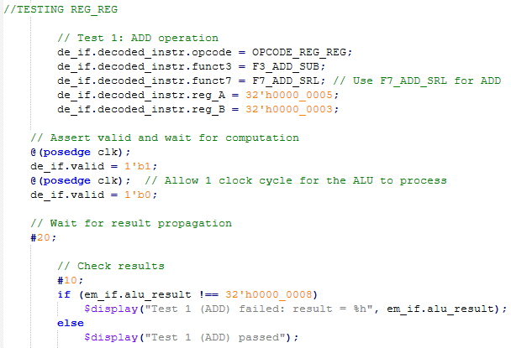
Execute Stage - Phil
Unit Testing and Results
Testbench with vectored attributes
We made specific vectors with expected outputs
so we can verify the instructions do what they
are intended to do
# Test 1 (ADD) passed
# Test 2 (SUB) passed
# Test 3 (OR) passed
# Test 4 (AND) passed
# Test 5 (XOR) passed
# Test 6 (SLT signed) passed
# Test 7 (SLT signed) passed
# Test 8 (SLTU unsigned) passed
# Test 9 (SLTU unsigned) passed
# Test 10 (ADDI) passed
# Test 11 (ORI) passed
# Test 12 (ANDI) passed
# Test 13 (XORI) passed
# Test 14 (SLLI) passed
# Test 15 (SRLI) passed
# Test 16 (SRAI) passed
# Test 17 (ADD with Overflow) passed
# Test 18 (SUB with Underflow) passed
# Test 19 (AND with Zero) passed
# Test 20 (Load Effective Address) passed
# Test 21 (Store Effective Address) passed
# Test 22 (SUBI) passed
# Test 23 Unsupported Opcode passed
# Test 24 Zero Operand passed
# Test 25 JAL Small Jump passed
# Test 26 JALR Non-Aligned passed
# Test 27 Maximum Shift passed
# Test 28 (SLTI signed, A >= Immediate) passed
# Test 29 (SLTI signed, A < Immediate) passed
# Test 30 (SLTIU unsigned) passed
# Test 31 (BEQ) passed
# Test 32 (BNE) passed
# Test 33 (BLT) passed
# Test 34 (BLTU) passed

Slide 11
Execute Stage - Phil
Register-to-Register Operations:
ADD Operation (Test 1): Verifies the addition functionality by adding two positive numbers (5 + 3). The expected result (8) confirms that the ALU performs addition correctly.
SUB Operation (Test 2): Examines subtraction by subtracting 3 from 8. The ALU's ability to handle subtraction is validated by the correct result (5).
OR Operation (Test 3): Confirms logical OR functionality using inputs 0xA and 0x5, with the expected result 0xF. The test ensures correct bitwise OR operations.
AND Operation (Test 4): Validates logical AND using inputs 0xA and 0x5, expecting the result 0x0. Confirms proper implementation of bitwise AND.
XOR Operation (Test 5): Tests XOR functionality with inputs 0xA and 0x5, expecting the result 0xF. Ensures accurate execution of bitwise XOR.
SLT Operation (Signed, Test 6): Checks signed comparison by evaluating whether -11 (0xFFFF_FFF5) is less than 5, expecting the result 1. Validates proper signed comparison handling.
SLT Operation (Signed, Reverse Case, Test 7): Examines the case where the first operand (5) is greater than the second (-11). The expected output is 0, confirming correctness in reverse scenarios.
SLTU Operation (Unsigned, Test 8): Tests unsigned comparison, comparing 3 and 5, with the expected result 1. Validates accuracy of unsigned comparisons.
SLTU Operation (Unsigned, Reverse Case, Test 9): Evaluates the case where the first operand (0xFFFF_FFFF) is greater than the second (1). The expected result is 0, confirming correct behavior for unsigned comparisons.
Register-to-Immediate Operations:
ADDI Operation (Test 10): Verifies addition with an immediate value. Adds 5 to 0, with the expected result 5.
ORI Operation (Test 11): Tests logical OR with an immediate value using inputs 0xA and 0x5, with the expected result 0xF.
ANDI Operation (Test 12): Validates logical AND with an immediate value using inputs 0xA and 0x8, expecting the result 0x8.
XORI Operation (Test 13): Confirms XOR immediate functionality with inputs 0xA and 0x6, producing the result 0xC.
SLLI Operation (Test 14): Shifts 0xF left by 2 bits, expecting the result 0x3C. Validates left-shift immediate functionality.
SRLI Operation (Test 15): Tests logical right-shift with immediate value. Shifts 0xF right by 2 bits, expecting 0x3.
SRAI Operation (Test 16): Performs an arithmetic right-shift on -16 (0xFFFF_FFF0) by 2 bits, expecting 0xFFFF_FFFC. Validates signed right-shift functionality.

Slide 12
Execute Stage - Phil
Special and Overflow Cases:
ADD with Overflow (Test 17): Verifies ALU handling of addition overflow by adding the maximum positive value (0x7FFF_FFFF) and 1. The expected result is 0x8000_0000.
SUB with Underflow (Test 18): Tests underflow by subtracting 1 from the minimum negative value (0x8000_0000), expecting the result 0x7FFF_FFFF.
AND with Zero (Test 19): Evaluates logical AND with all bits set (0xFFFF_FFFF) and cleared (0x0), expecting the result 0x0.
Load Effective Address (Test 20): Computes an effective address by adding a base address (0x1000) and offset (0x10), expecting 0x1010.
Store Effective Address (Test 21): Computes an effective address using a base (0x2000) and a negative offset (-16), expecting 0x1FF0.
SUBI Operation (Test 22): Performs subtraction with an immediate value, subtracting 2 from 5. The expected result is 3.
Additional Edge and Unsupported Cases:
Unsupported Opcode (Test 23): Tests ALU behavior for unsupported opcode (0xFF). Ensures the result defaults to 0.
Zero Operand (Test 24): Tests addition where one operand is zero (0 + 5). Expected result is 5.
JAL (Test 25): Verifies the Jump and Link (JAL) instruction by adding a program counter (0x1000) and an offset (0x004), expecting 0x1004.
Non-Aligned JALR (Test 26): Tests Jump and Link Register (JALR) with a misaligned base (0x1001) and an offset (0x004). Ensures alignment adjustment, with the result 0x1004.
Boundary Conditions for Shifts (Test 27): Tests maximum logical right-shift on 0x8000_0000 by 31 bits, expecting 0x0000_0001.

Slide 13
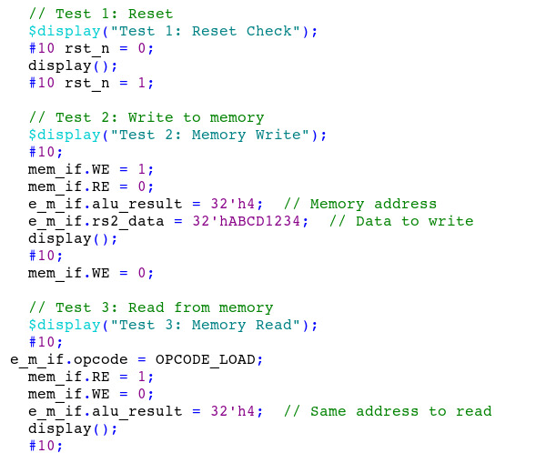
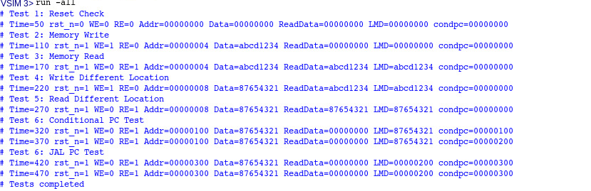
Memory Access - Raghavendra
What happens at the Memory Access stage ?
Handles operations tied with Memory Access.
Load/Store operations
Register B is forwarded in case of Store operation.
ALU result acts as the address for the Data Memory unit.
Sets the Program Counter(PC) value based on the condition flag received from Execute Stage.
The Memory Access unit was tested with a set of seven test cases each targeting a specific aspect of the Memory Access stage.

Slide 14
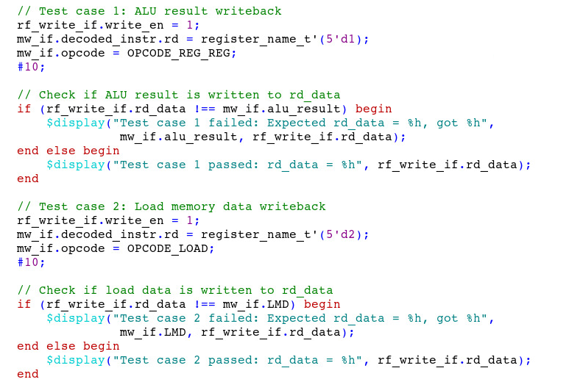

Memory Writeback - Raghavendra
Functionality of Writeback stage
Interacts with the Register file and writes back to the Destination Register (RD)
Writes back results of the ALU to the Register file.
Load/Store operations - Values from Data Memory
Arithmetic/Logical operations - Value from ALU result
the testbench is comprised of four comprehensive test cases that validate it’s functionality

Slide 15
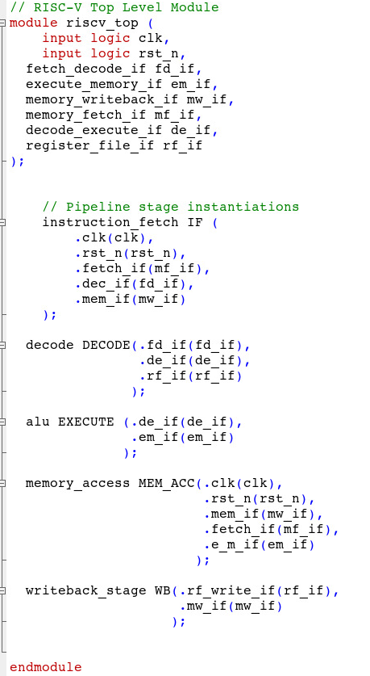
Demonstration - Top Level
Top Level Module
Instantiated all the individual stages.
Interface instances in port declaration.
Port connections using explicit .name(net)
style.
Verification
A set of test cases (test_vectors) is created
to test specific instructions and scenarios.
Each test case is executed sequentially in a
loop, control signals are updated based on
the type of instruction.
The outputs of the pipeline are compared
with the expected results from the testbench
Mismatches trigger an error message.

Slide 16
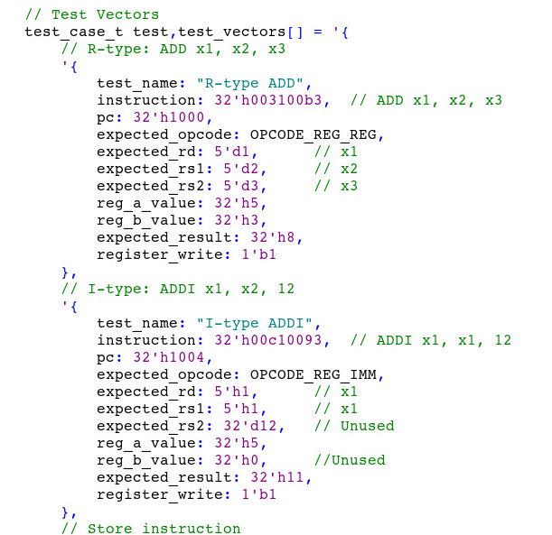
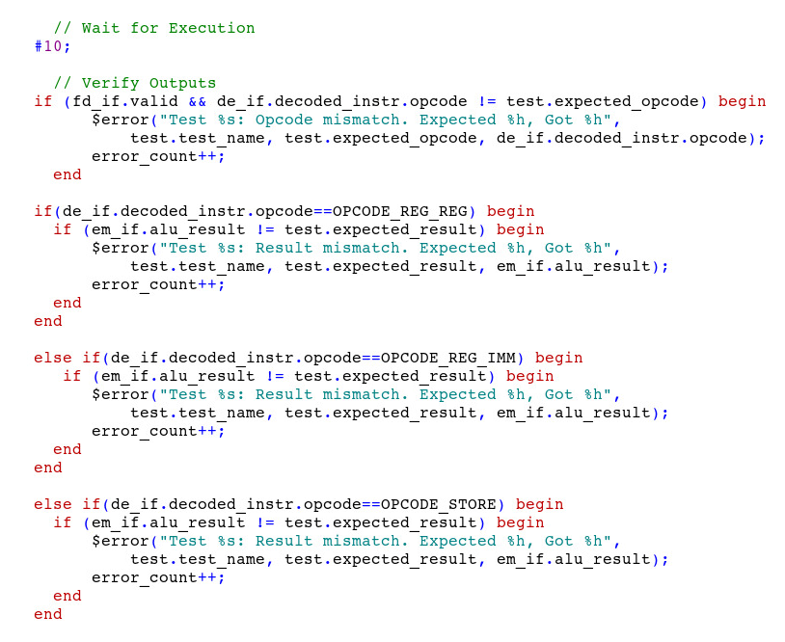
Demonstration - Top Level
Results/Summary:
At the end of execution, a summary is displayed, showing the number of tests run and errors encountered.

Slide 17
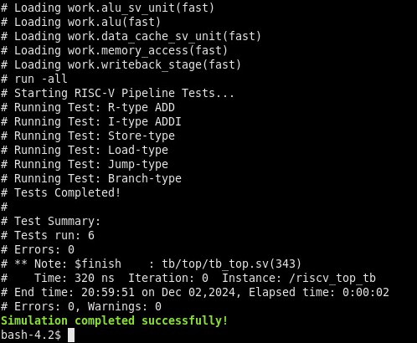
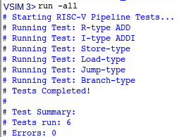
Demonstration - Top Level
Results/Summary:
At the end of execution, a summary is displayed, showing the number of tests run and errors encountered.
Simulation can be done from riscv-pipeline-core/ folder using make commands. Start with make compile and make simulate to see output.

Slide 18
Challenges
Managing complexity
This was mitigated by doing isolated unit testing and designs
Module integration
Matching port lists and handshaking signals
We achieved integration through frequent meetings and the use of code reviews on github
When combining different modules together for the top module, we had to debug each combined stage individually with specific testbenches every time we joined different stages to validate its functionality.
Validating the functionality of each stage using testbenches to ensure accurate behaviour and integration.

Slide 19
Future Work and Learnings
Future Work
Pipelining Implementation
Add pipeline registers
Implement branch prediction
Implement the more complex instructions
Hazard detection and data forwarding
Comprehensive Verification
Expand test coverage and verify all data paths using randomization
Identify corner cases
Learnings
Importance of modular design and isolated testing
Practical computer architecture experience
Questions?
Questions?

Slide 20
Sources
[1] - Patterson, David & Sequin, Carlo. (1998). RISC I: a reduced instruction set VLSI computer. Proceedings of the 8th Annual Symposium on Computer Architecture. 216-230. 10.1145/285930.285981.
[2] - J. L. Hennessy and D. A. Patterson, Computer Architecture: A Quantitative Approach. Cambridge, MA: Morgan Kaufmann Publishers, 2019.
[3] - "The RISC-V Instruction Set Manual Volume I: Unprivileged ISA Version 20240411," RISC-V International, May 2024. [Online]. Available: https://riscv.org/specifications/
[4] - https://github.com/VUnit/vunit
[5] - Anthropic. (2024). Claude [Large language model]. Retrieved from anthropic.com

