Slide 1
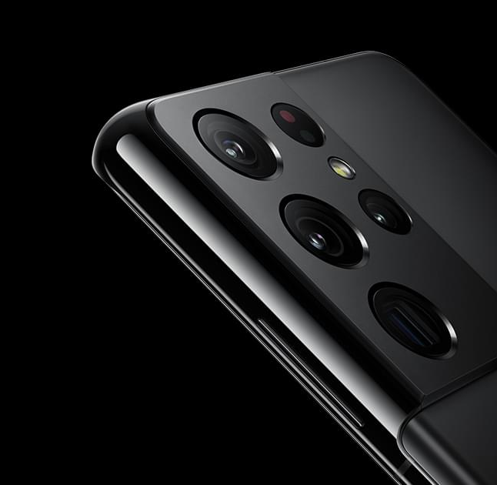
Tech-Week-Tastic
A Technology Website

Slide 2
Index
Design Rationale
Research & Design Output
Development Process
RWD Techniques Used
Problems and Solutions
Lesson Learned

Slide 3
Design Rationale
My design Idea came from looking at the Samsung website, there is websites that focus on all brands but I wanted to focus on only one brand.
I have decide to make a modern yet minimal looking website. A website that would be suitable for all ages. I wanted it to have dark colours that would work well together.
My goal was to have a smooth website on which users wouldn’t experience and frustrations, I wanted it to be easy to navigate and use. A website where they could read articles about products.

Slide 4
Research & Design
While doing my research initially my website was going to look different. It wasn’t until the second phase that I decided to make the most changes.
As time went on, I started not liking the first design I came up with, I tried to come up with something better. It didn’t take me long to change the design and I knew that I made the correct decision.

Slide 5
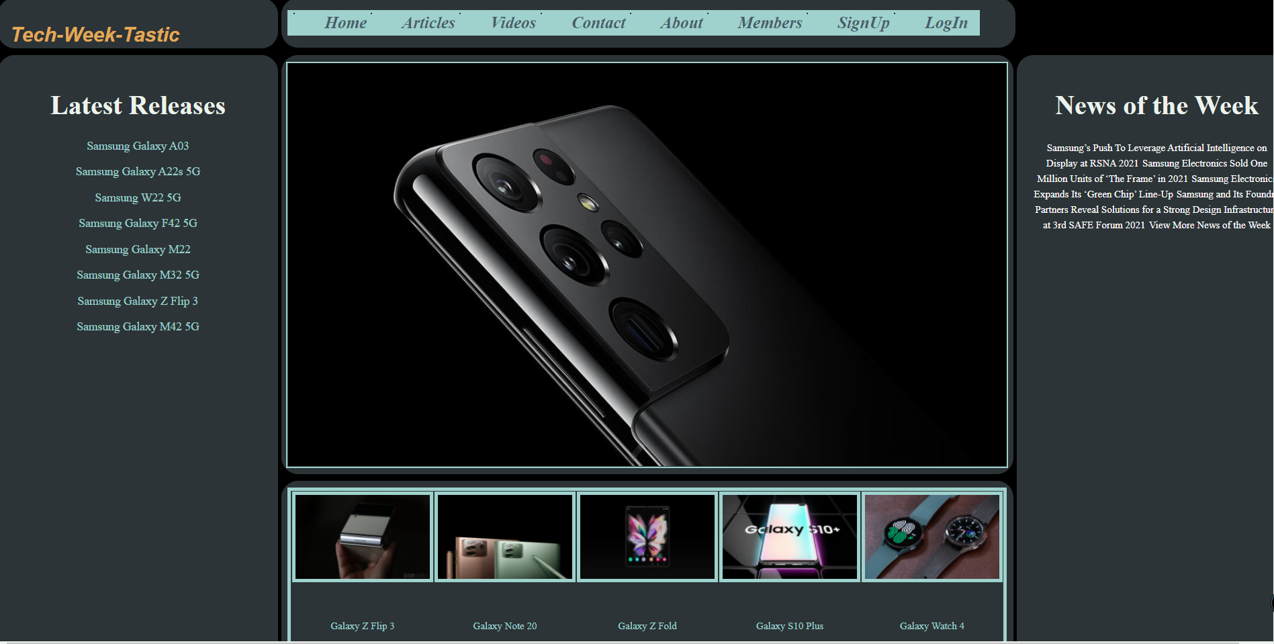
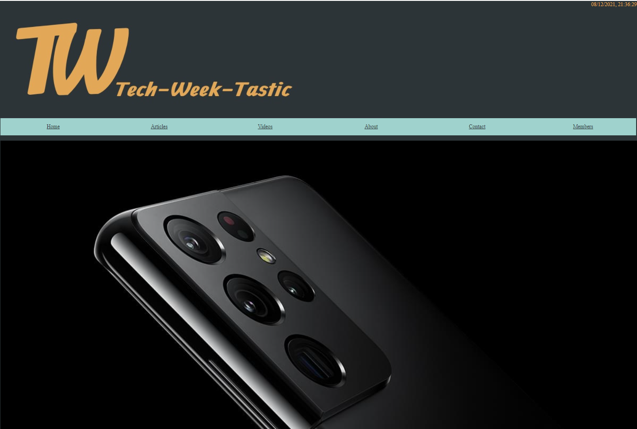
Phases & Changes
First Phase
Second Phase

Slide 6

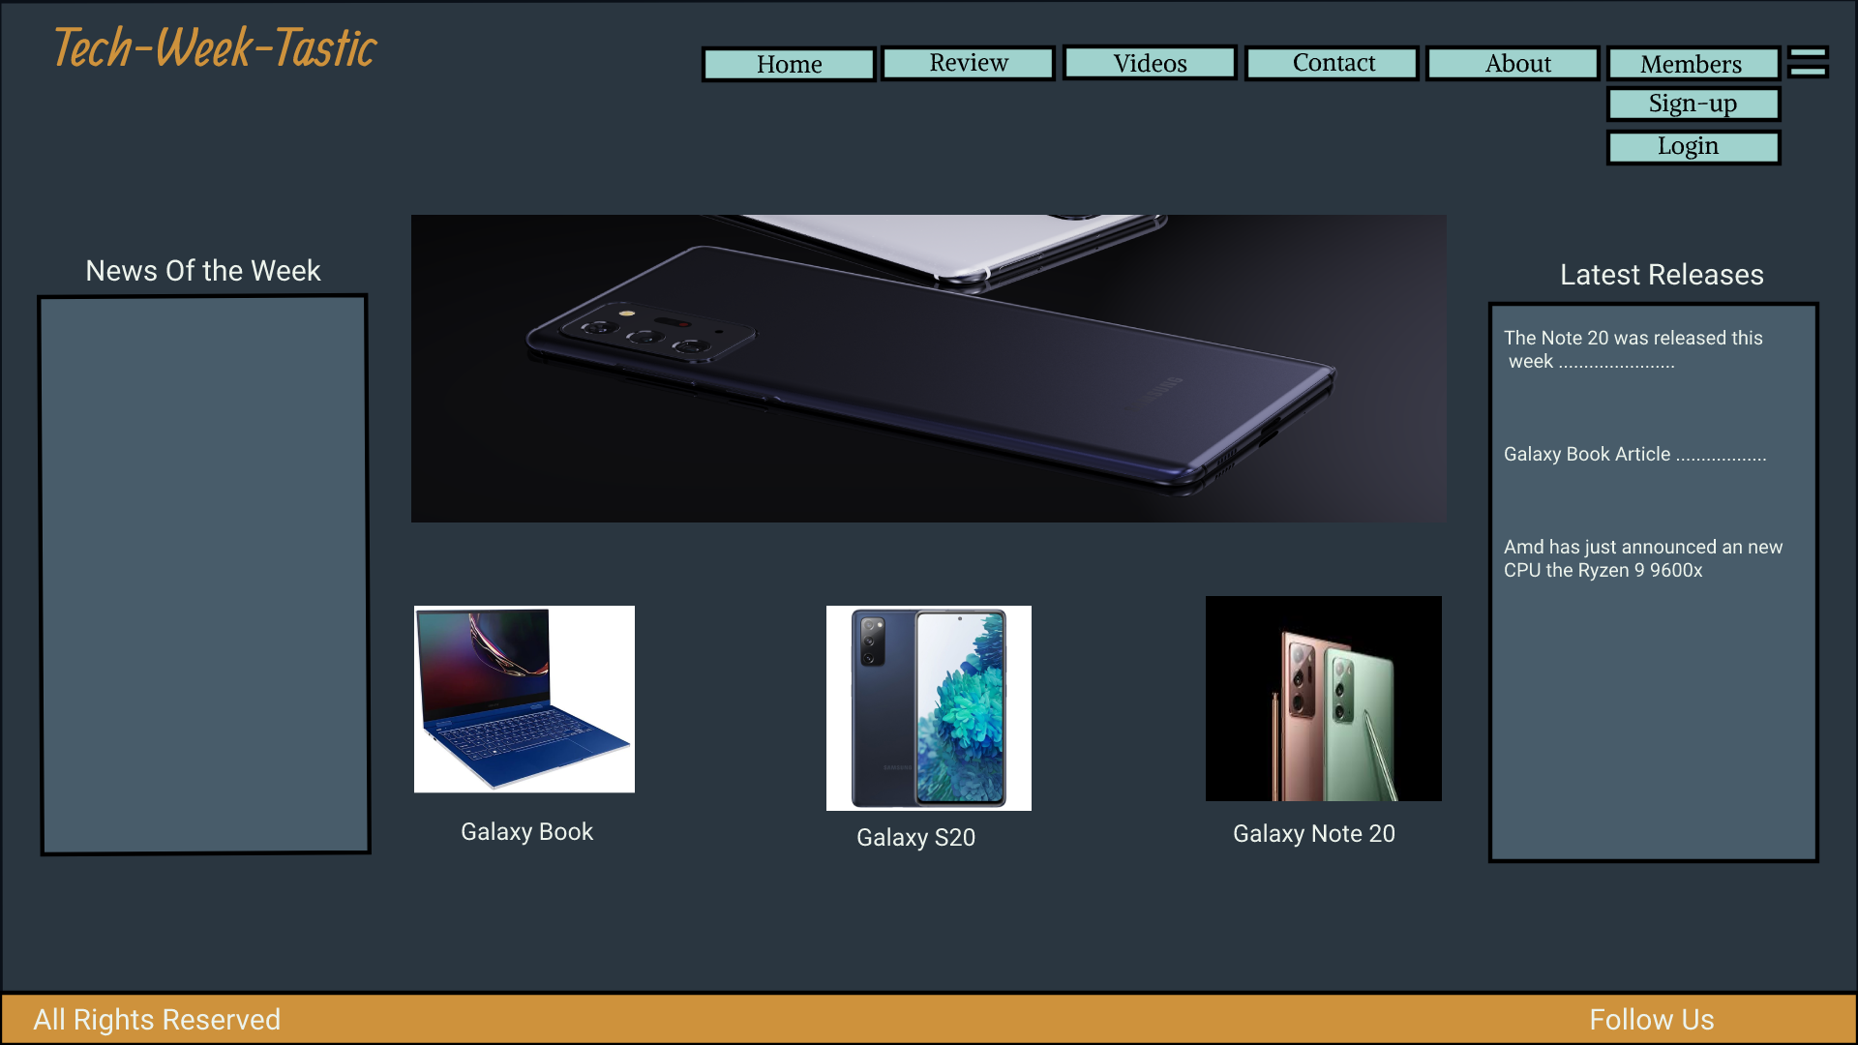
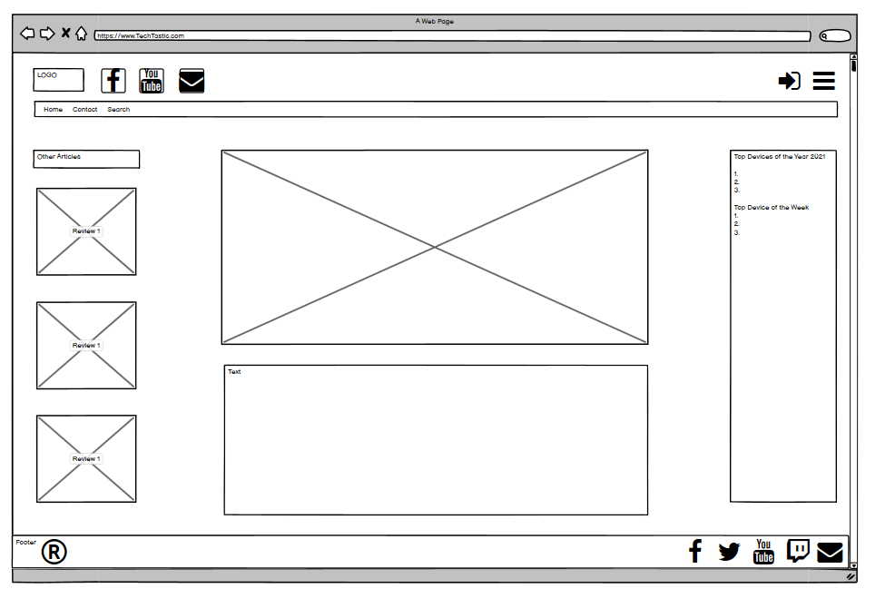
Development
I started the Development process by doing a photoshop design and wireframes
I moved onto the build and not until starting the second phase I decided to make changes

Slide 7
RWD Techniques Used
I have used Java script for the slideshow, navigation bar and the time/date displayed on the home page.
I used tables for articles, news and latest.
In addition, I used slicknav for the navigation on a small screen

Slide 8
Problems & Solutions
My main problem was getting the website to be responsive, that was fixed by using a different layout.
Another problem I encountered was moving and styling images hence I used tables.
The slideshow was causing me a bit of a problem but I kept on trying and I did finally get it to work ,the solution was to always make sure java scripts are in the correct place.

Slide 9
Lessons Learned
I have learned two key things from this project.
I have learned one extremely important thing that I thought I would never learn and that is that the layout is extremely important once you have more then 50 lines in CSS.
I definitely learned that once you try hard enough you will succeed, that nothing is impossible once you know where to start.

