Slide 1

SheeshApp
By Dawid maruszczyk & Manuel Wendling

Slide 2

Agenda
Project setup
Quality
Technical ability

Slide 3
Project Setup – Vision
Idea
Functionality
Create your own profile
Track your activity
Connect friends
Find surprising tobacco
Collect achievements
Notes:
Idea: Dawid
Functionallity: Manuel
- Therefore we think about which funcitonality is usefull
- And decided that we want to implement the possibility, to creat your on profile
- Track your activitys like → When, where and with who?
- Find new tabacco in friends profile
- Collect achievements so that the user can show his shisha skills

Slide 4
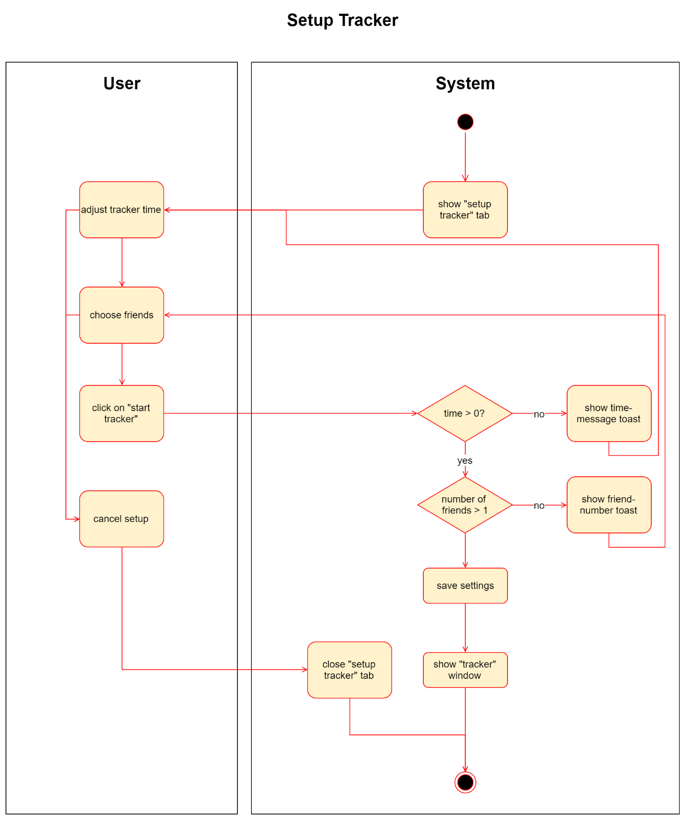
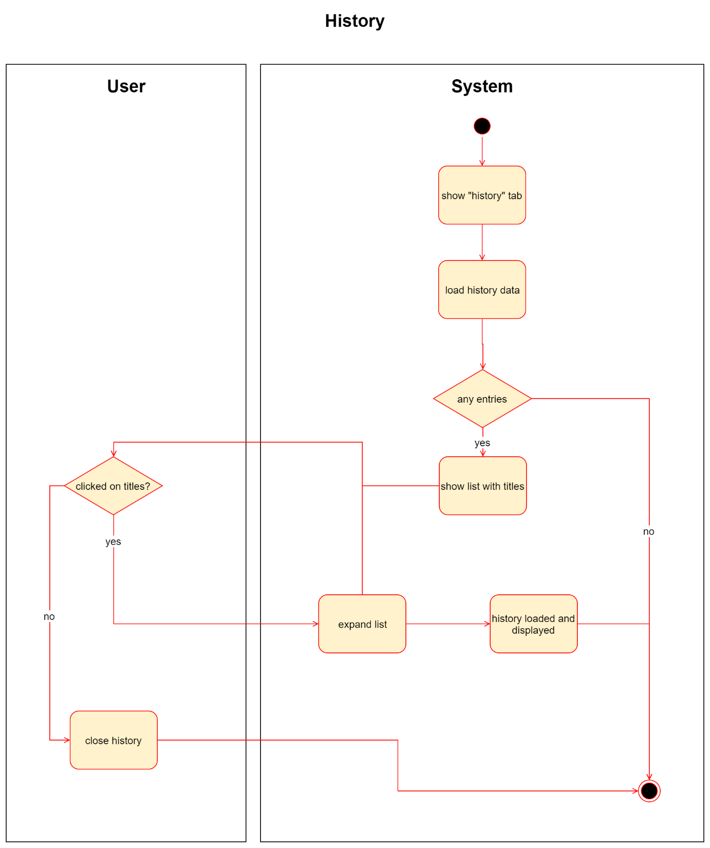
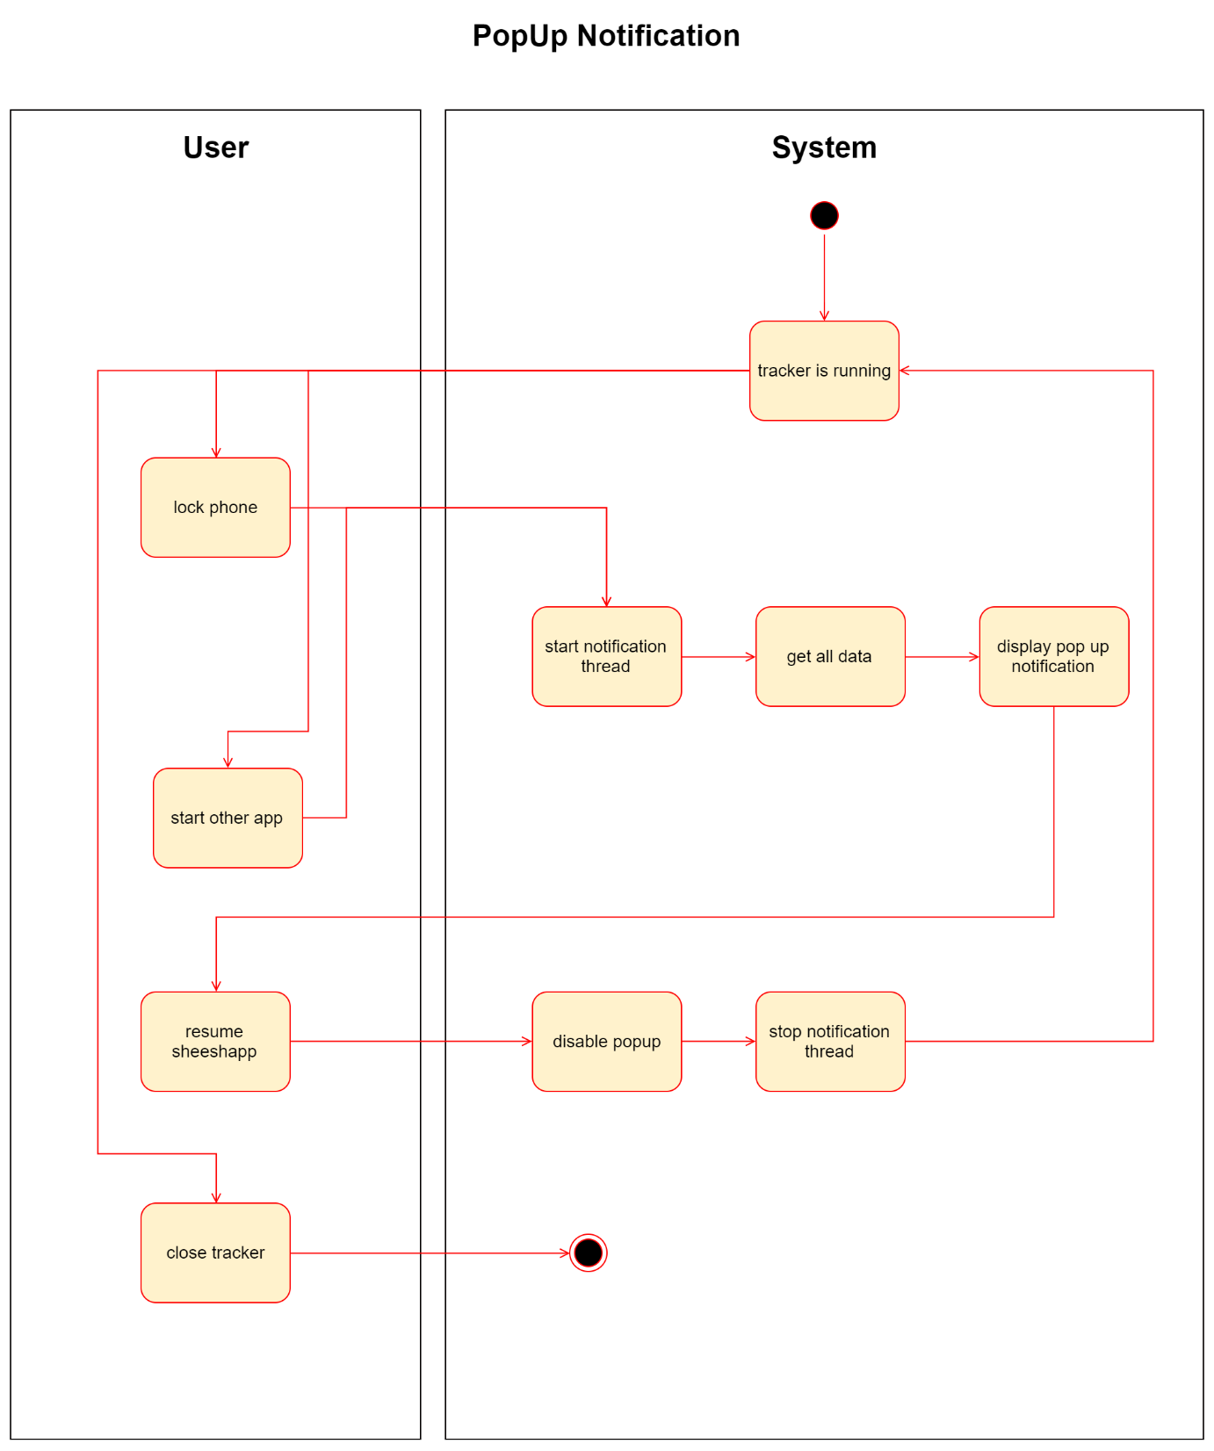
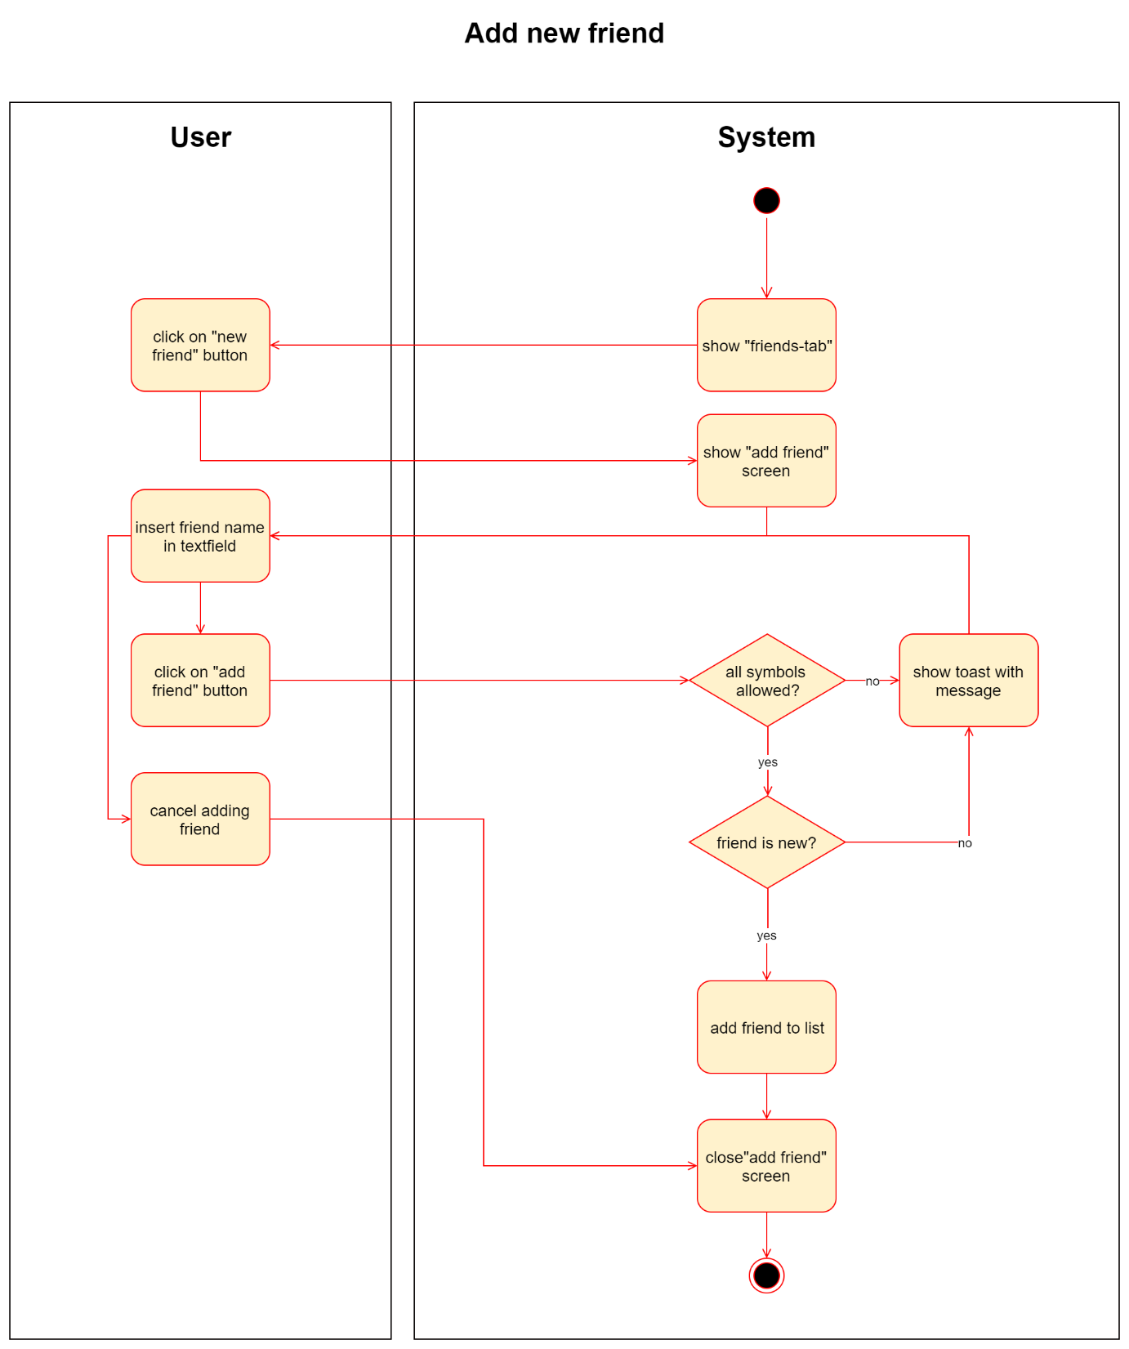
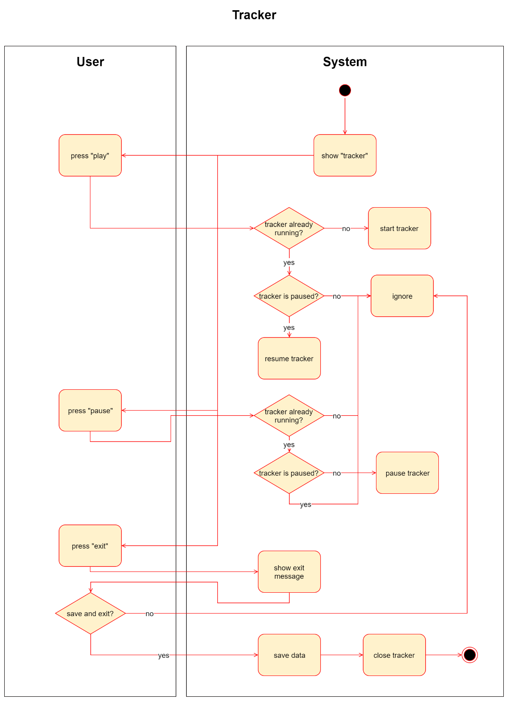
Project Setup – Use cases
Popup notification
Tracker setup
History
Tracker
Add friend
Notes:
In the history you can see your past activity Like:
With who?
Which tabacco
How much shishen you smoke?
And later also in which location

Slide 5
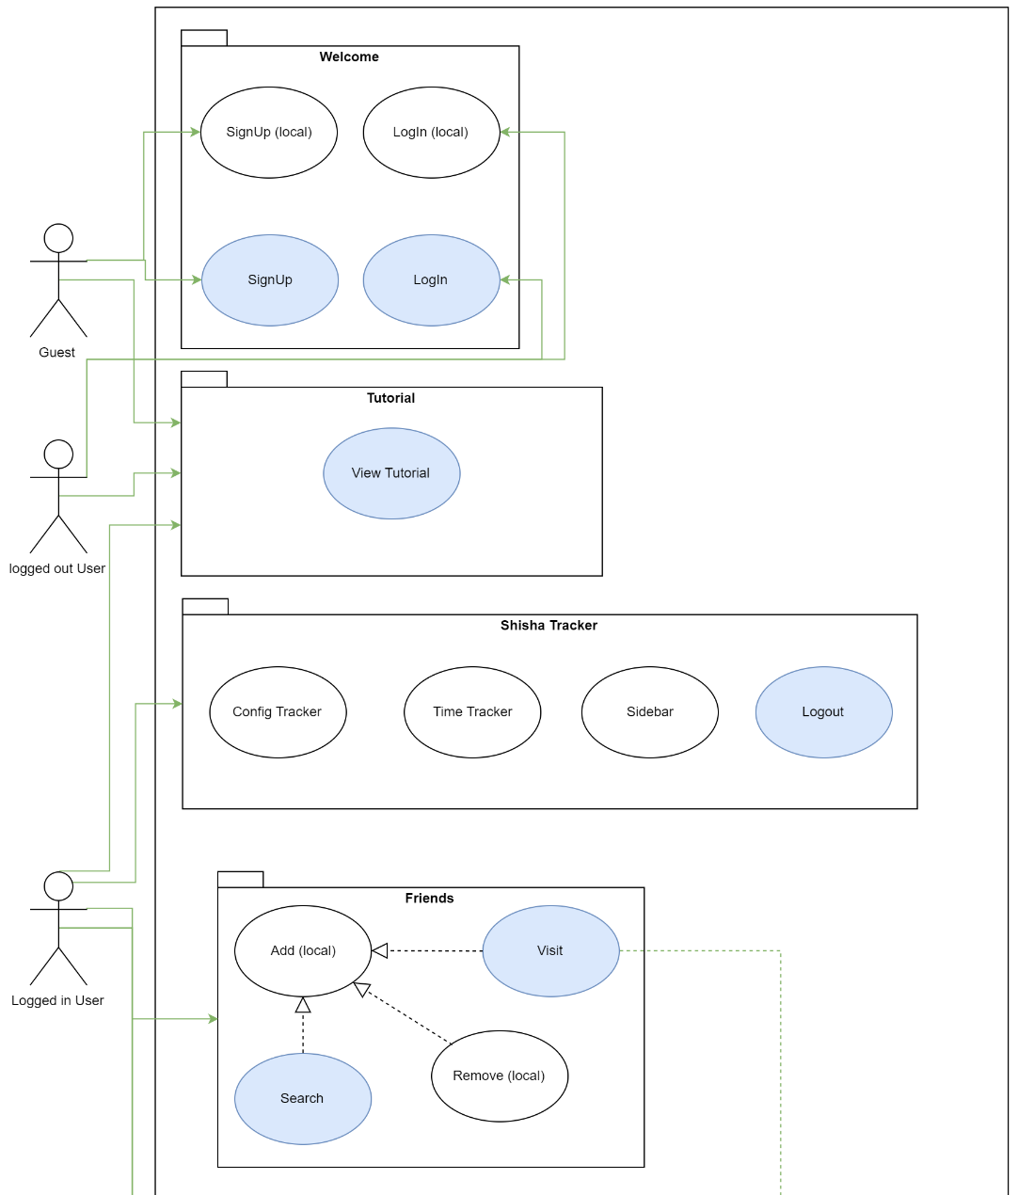
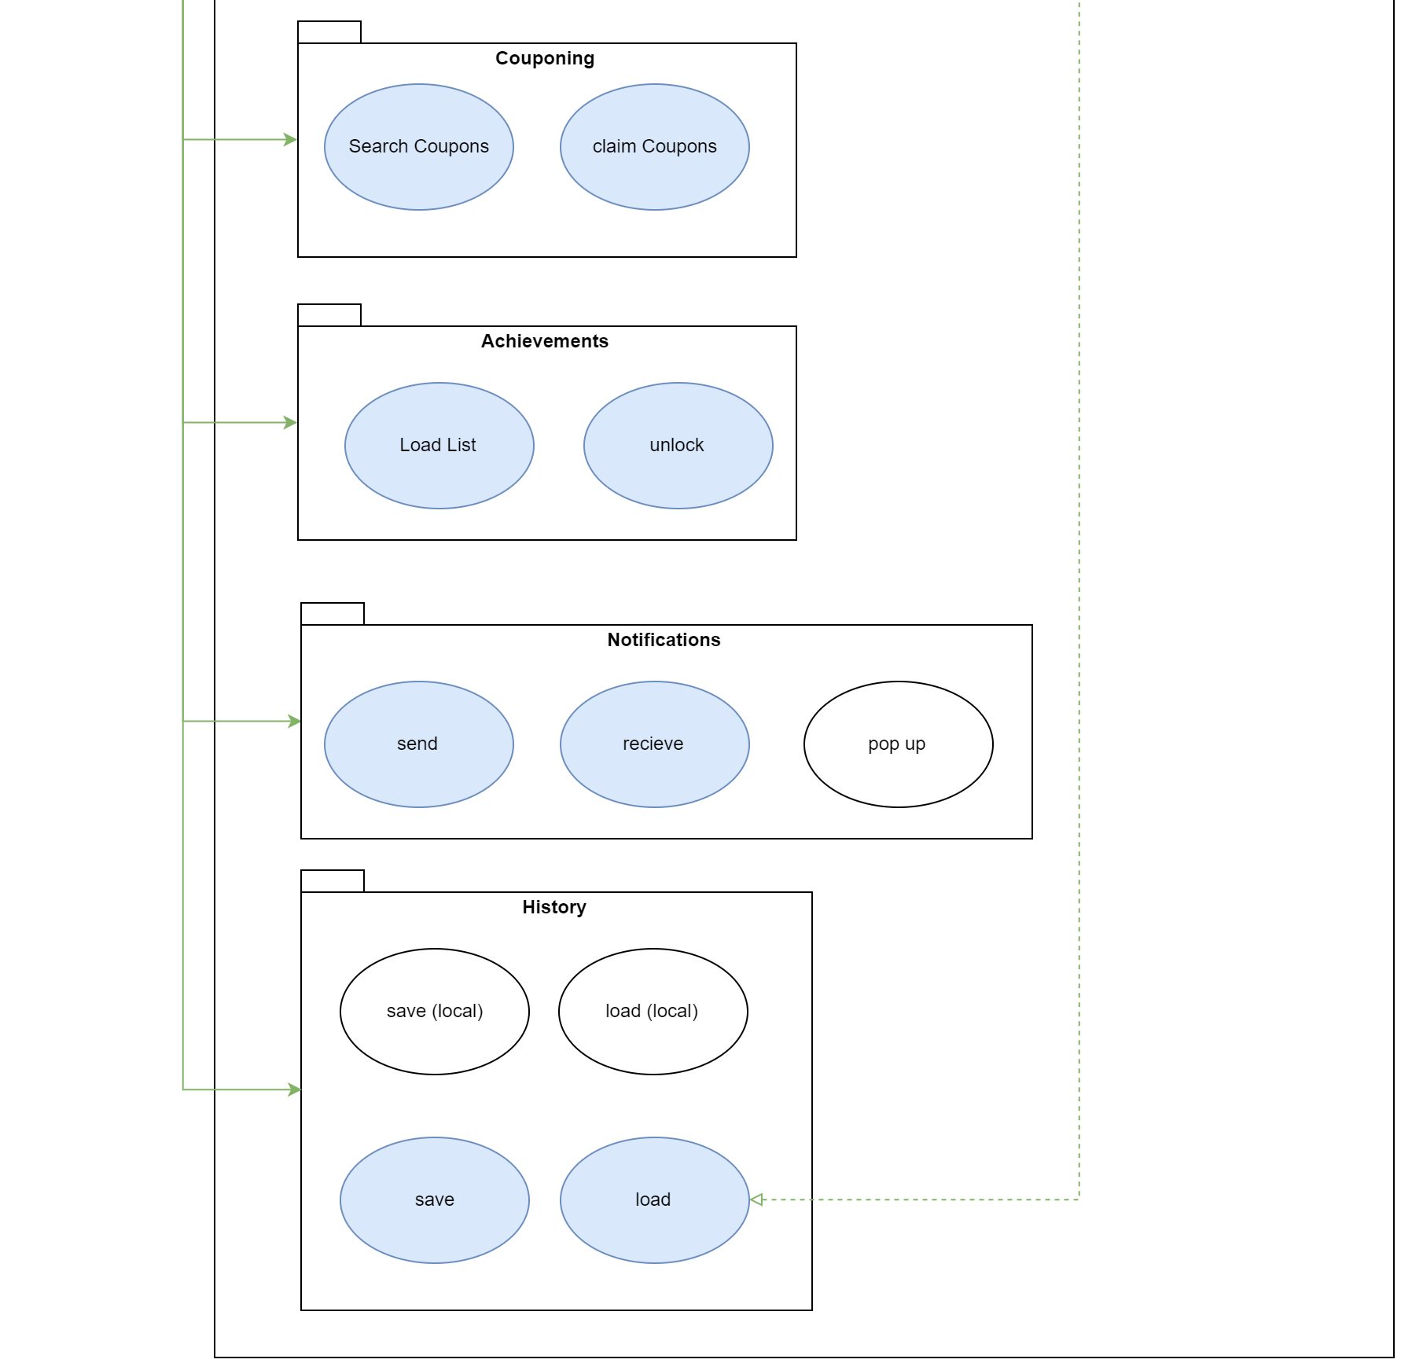
Project Setup – SRS
Scope (OUSD)
Requirements
Usability
Reliability
Notes:
Scope: Dawid
Requirements: Are the uscases wich we war already explained
Usability:
3.2.1 Smartphone user
3.3.2 Using a browser
3.3.3 Honest person
Reliability:
3.4.1 MTTR
Due to this being a student's project the time from failure to fix might strongly vary. Downtimes of more than a day will be possible.
3.4.2 Server availability

Slide 6
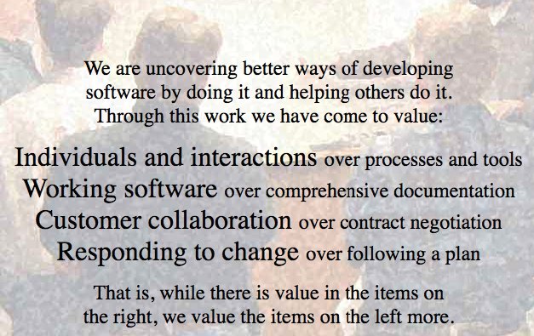
Project Setup – Management Scrum
Scrum master
Scrum
Product owner
Team
Responsible for execution
Explain Practices/principles
“Inspect & Adapt”
Values of Scrum
Commitment, simplicity, feedback focus, Communication, respect, courage, openness
Reflects condition
Value maximization
Should be reachable
Experts
Groups 5-10
Equality
Self-organized
Complementary special skills
Agile framework
Focusing at short iterative task
Complexity is not predictable
Gradual refinement
Notes:
Project Owner:
Usability, performance, functionality, quality

Slide 7
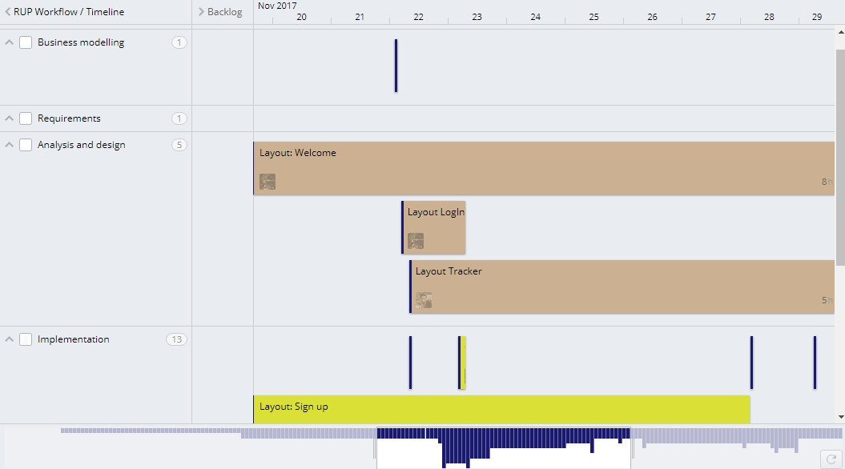
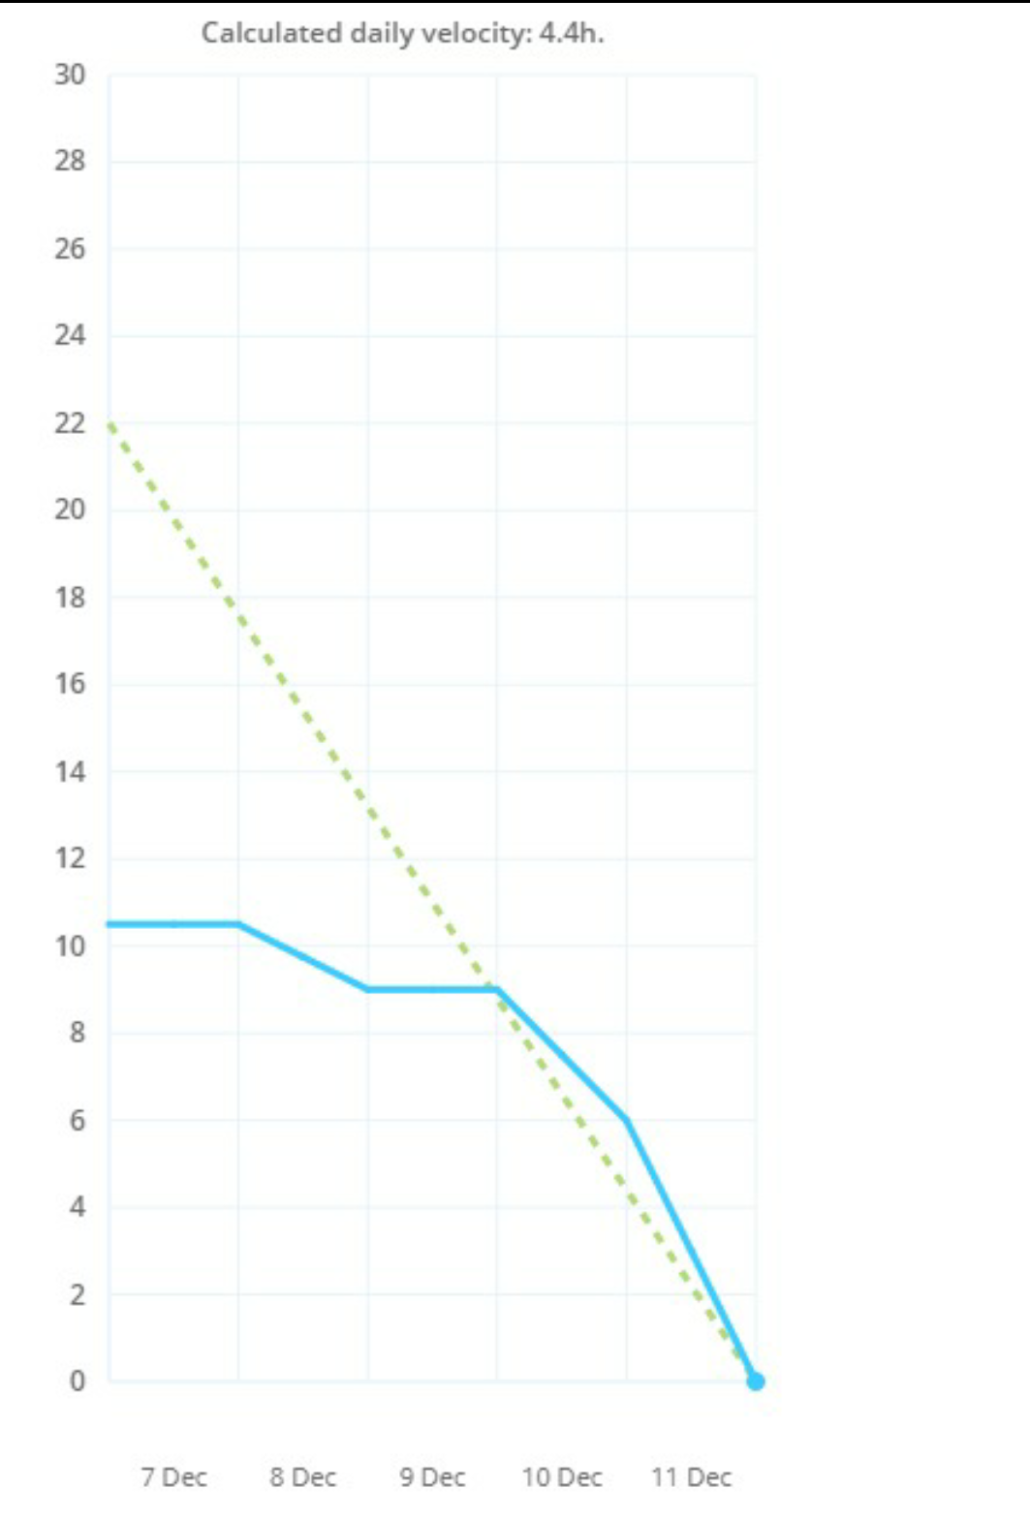
Project Setup – Management
Targetprocess
Roles
Sprint
Burndown charts
RUP
Gantt-Chart
Time management
Notes:
Stands for "Rational Unified Process.“
- It divides the development process into four distinct phases that each involve:
business modeling,
analysis and design,
implementation,
testing, and deployment
The RUP development methodology provides a structured way for companies to envision create software programs.

Slide 8
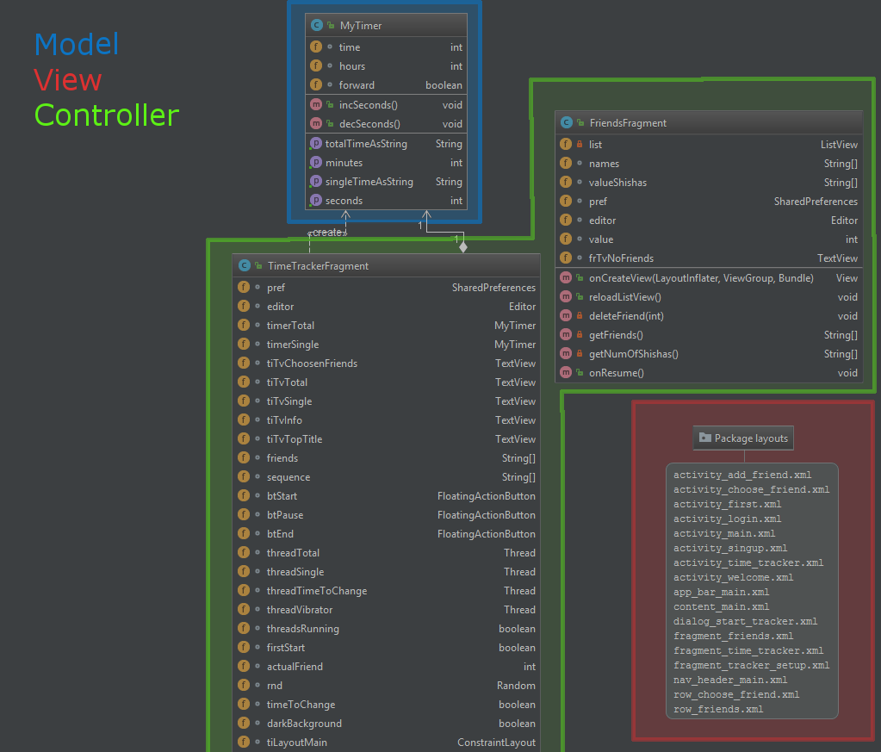
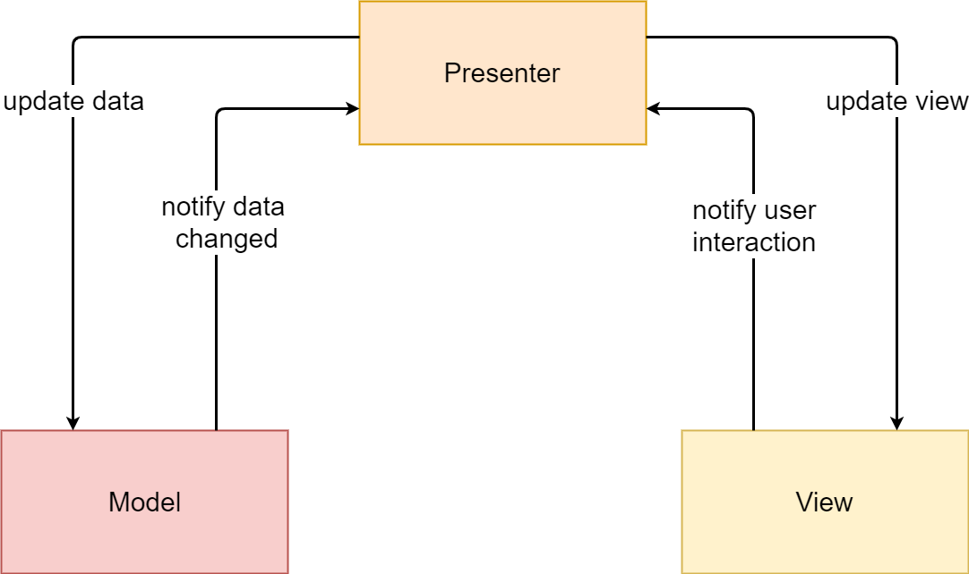
Quality – Architecture
MVC in android
Notes:
Charts

Slide 9
Quality – Configuration
Android Studio
Github & desktop client
www.github.com/familylocke/sheeshapp
Targetprocess
https://tauboard.com/v/b9d7f4e1d714d2a7aef4aafd34e878e9
Wordpress
www.sheeshapp.wordpress.com
Cucumber
Notes:
Charts

Slide 10
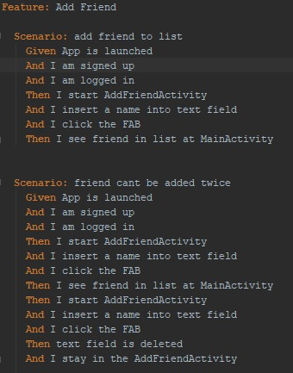
Quality – Testing (Automation)
Automated testing
Benefits
UI Test
Espresso record
.feature files
Notes:
Charts

Slide 11
Technical ability – Demo
Sign Up
Login
Use Cases
Add friends
Tracker setup
Shisha tracker
Pop up notification
History

Slide 12
Thank you for your attention !

