Slide 1

SheeshApp
By Dawid maruszczyk & Alexander Grundmann

Slide 2

Agenda
Project setup
Quality
Technical ability
Demo

Slide 3

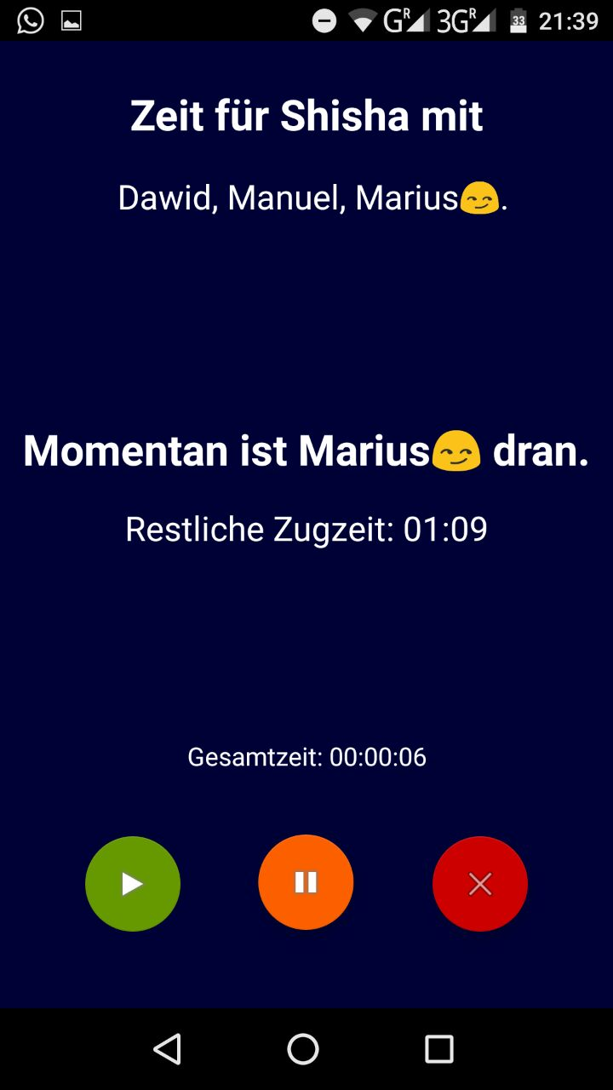
Project Setup – Vision
Idea
Functionality
Smoke with your friends
Create your own profile
Track your activity
See your history
Notes:
Idea: Dawid
Functionallity:
- Therefore we think about which funcitonality is usefull
- And decided that we want to implement the possibility, to create your on profile
- Track your activitys like → When, where and with who?

Slide 4
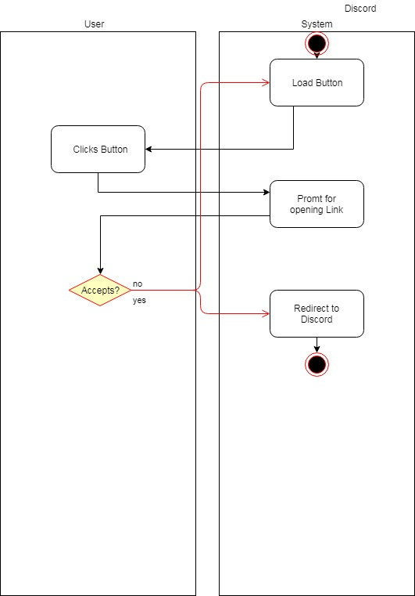
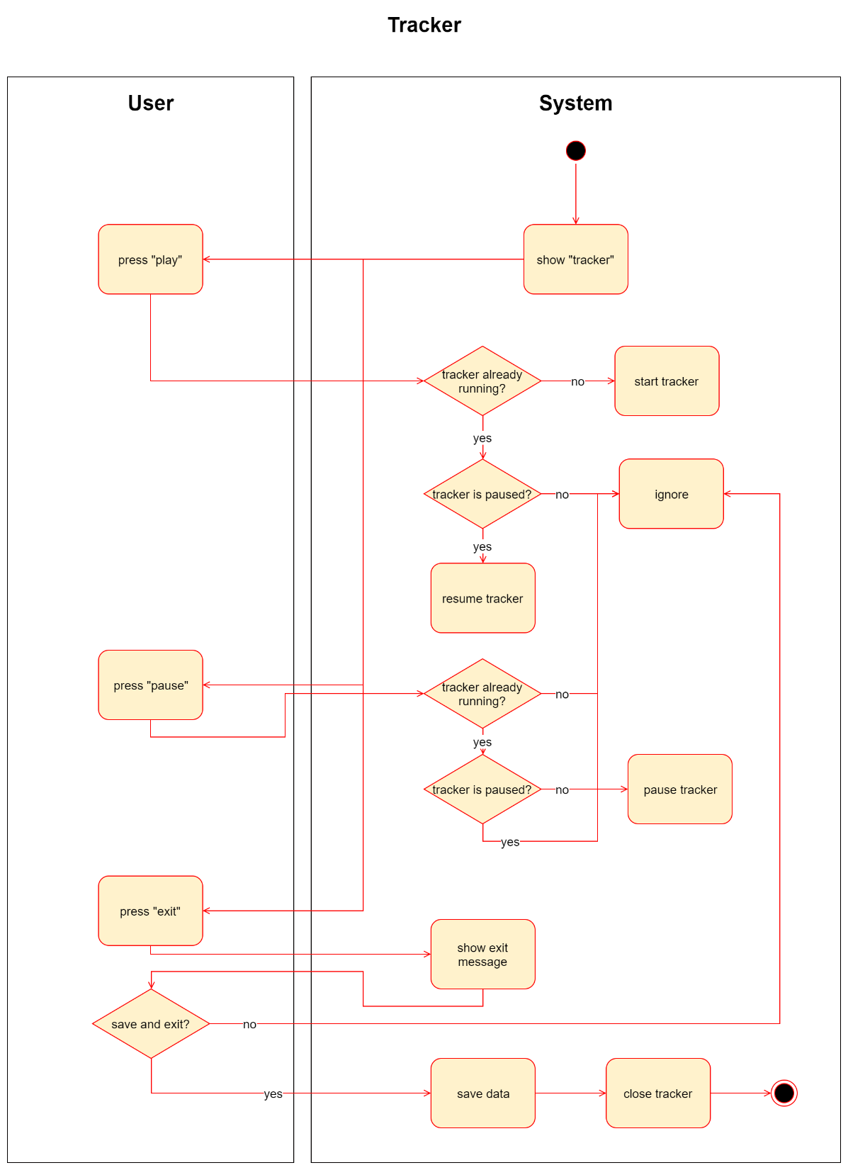
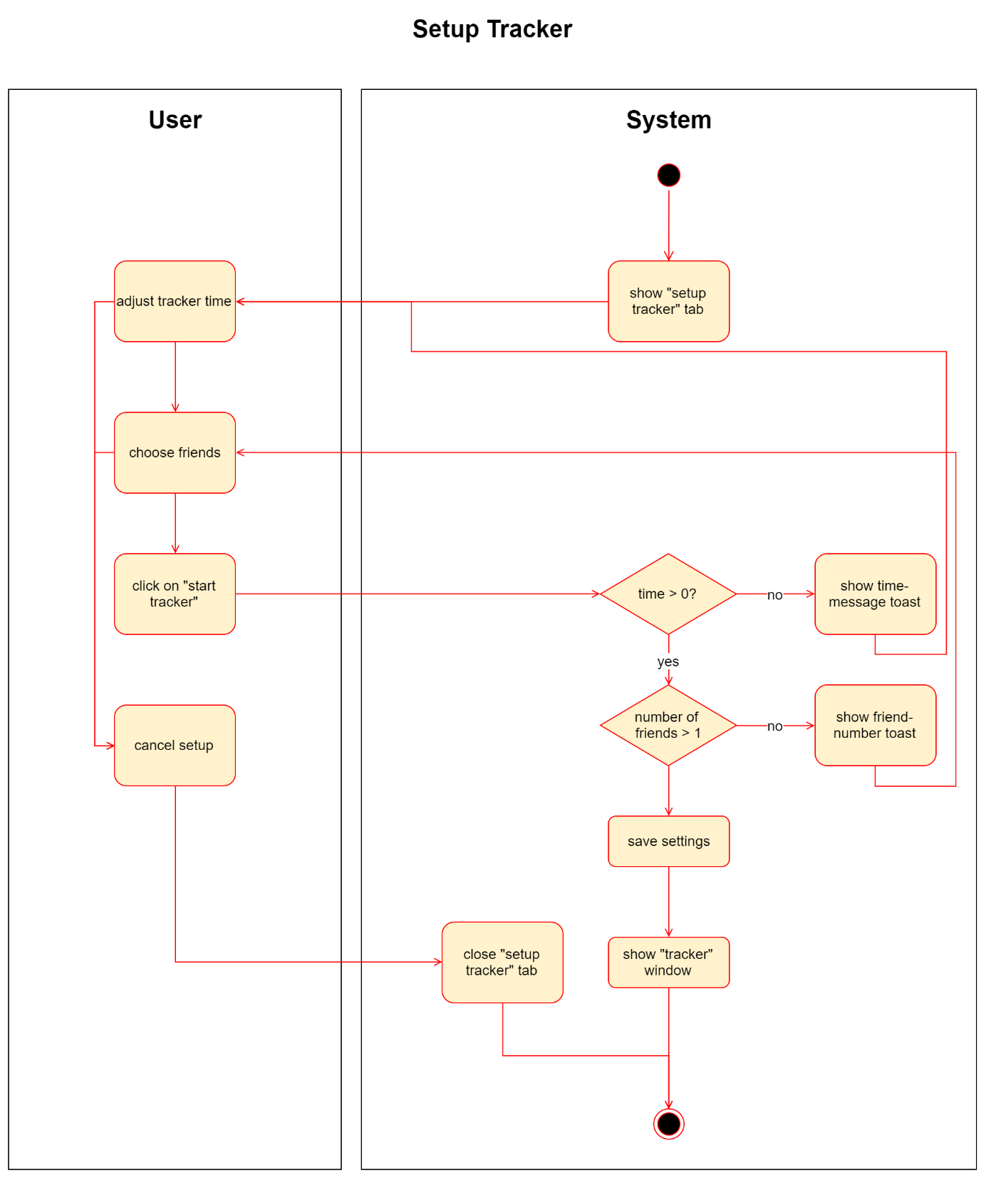
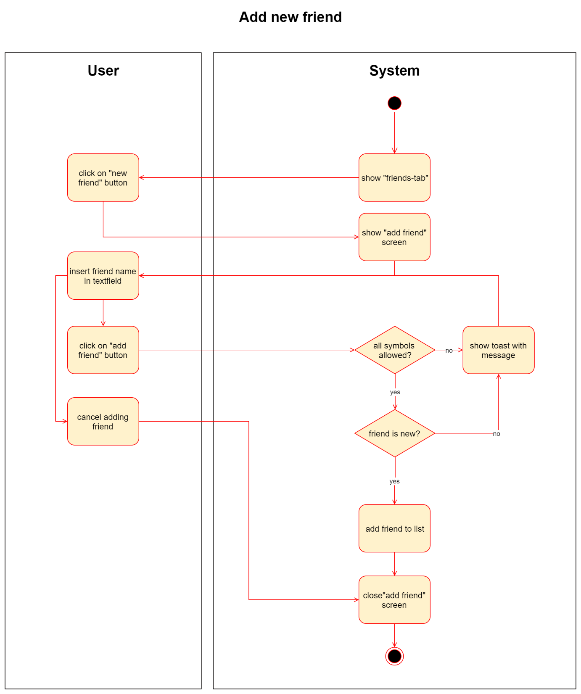
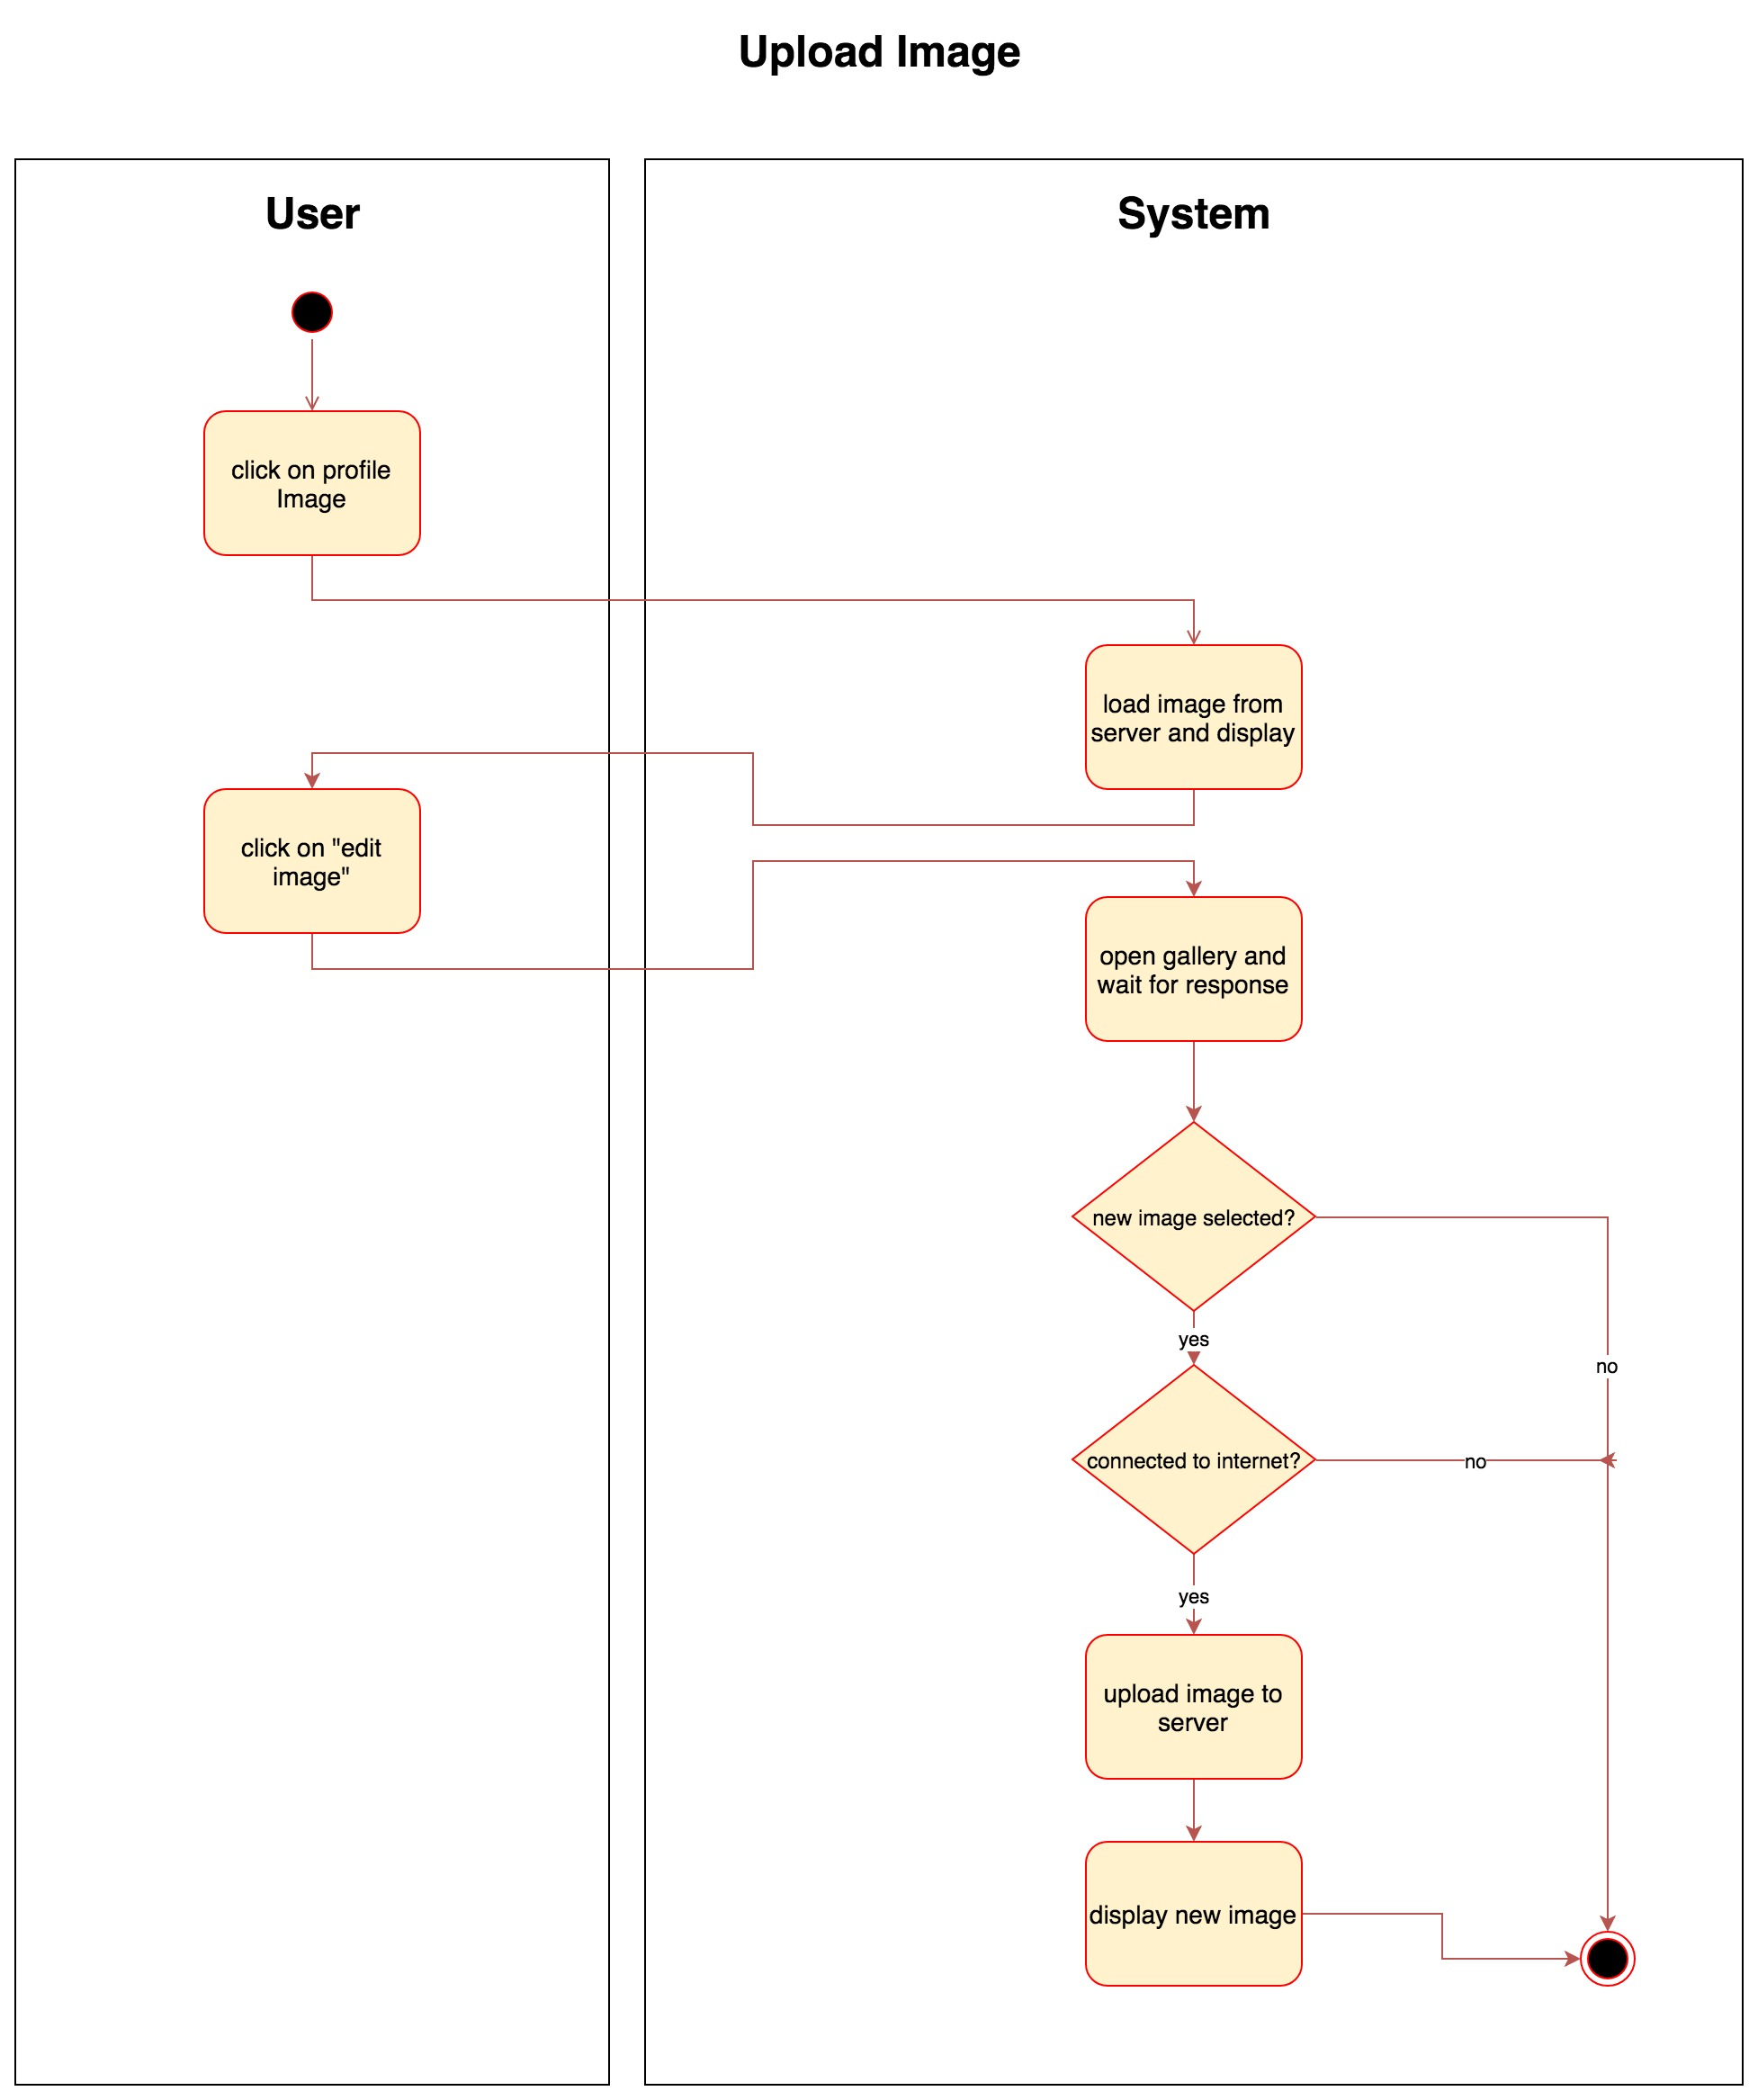
Use Cases
Discord
Tracker setup
Upload Image
Tracker
Add friend
Notes:
In the history you can see your past activity Like:
With who?
Which tabacco
How much shishen you smoke?
And later also in which location

Slide 5
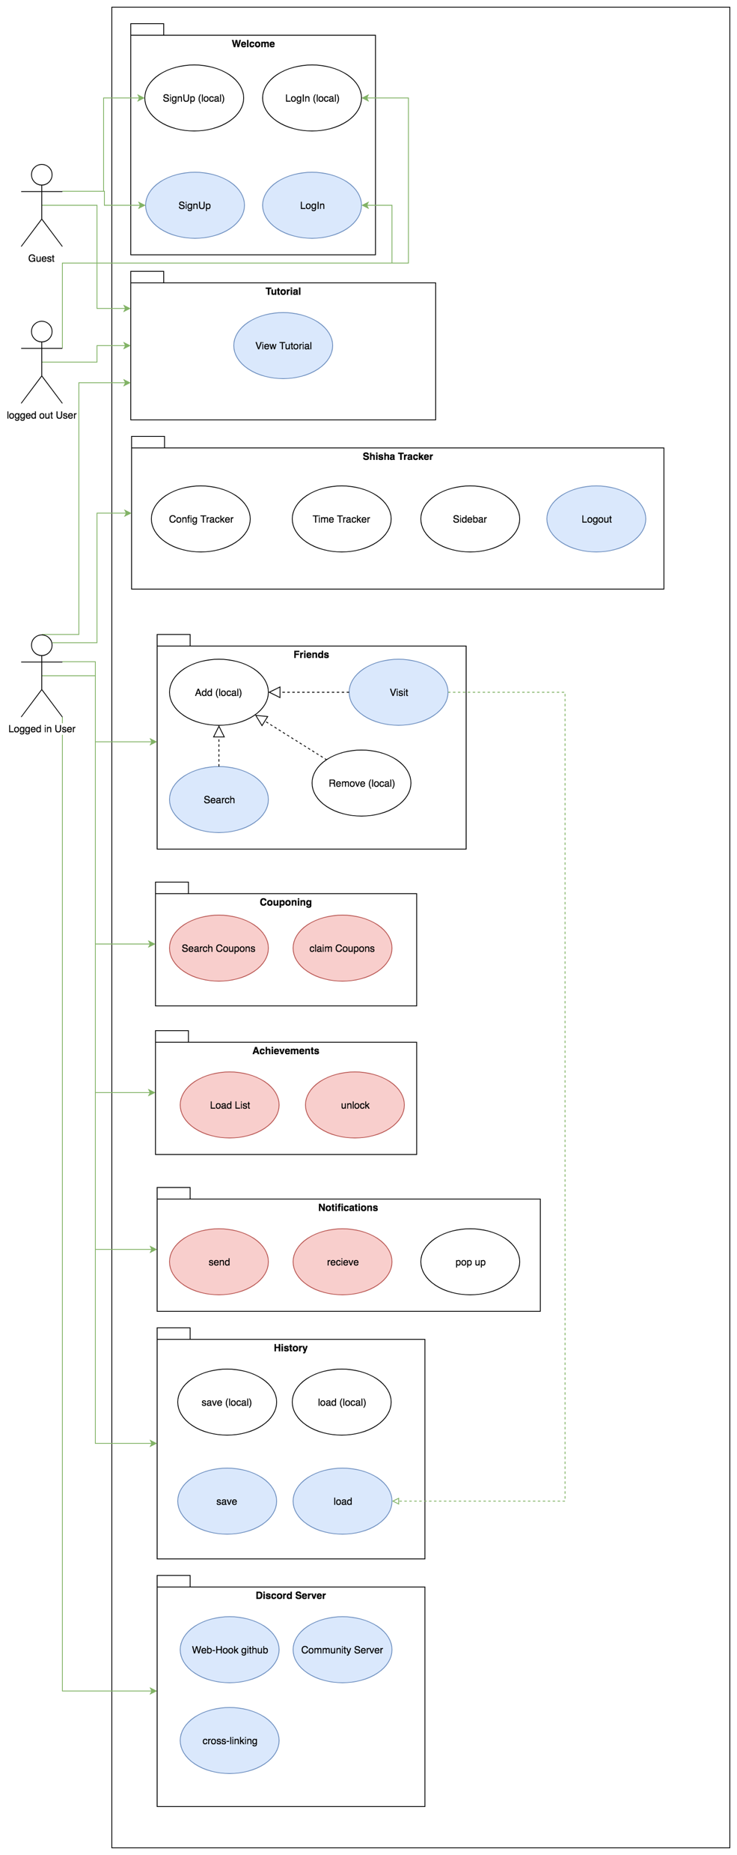
Project Setup – SRS
Scope
Requirements
Usability
Reliability
Notes:
Software Requirements Specifications
Requirements: Are the uscases wich we already explained
Usability:
3.2.1 Smartphone user
Who uses it?
3.3.2 Not Using a browser
3.3.3 Honest person
3.3 Reliability
Student Project
3.4.2 Server availability

Slide 6
Project Setup – Scrumming
Scrum
Teams
Agile framework
Focusing at short iterative task
Sprint
Experts
Groups 5-10
Equality
Self-organized
Notes:
Project Owner:
Usability, performance, functionality, quality

Slide 7
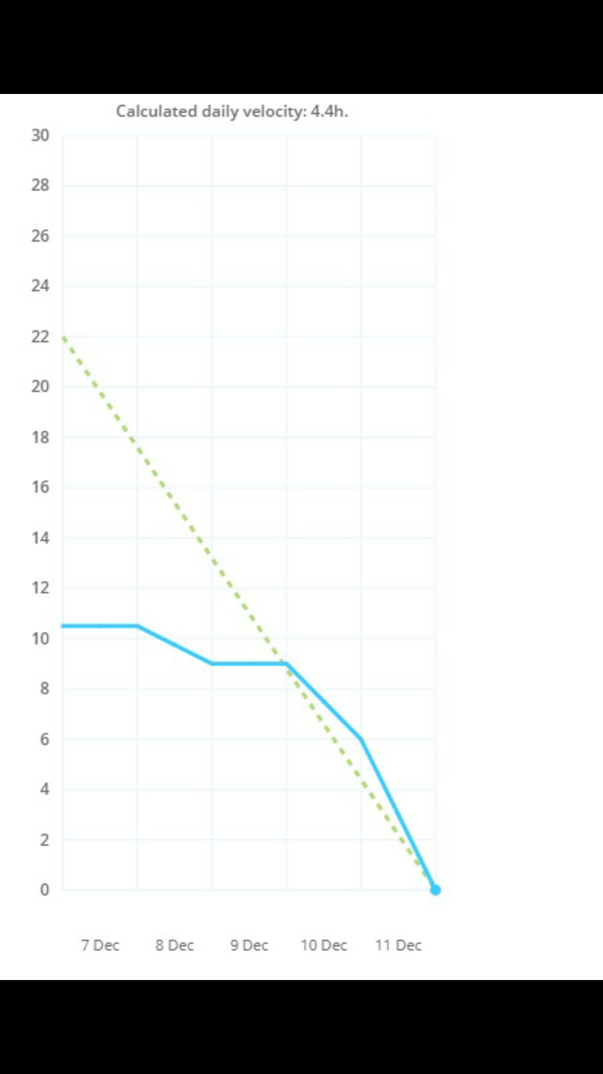
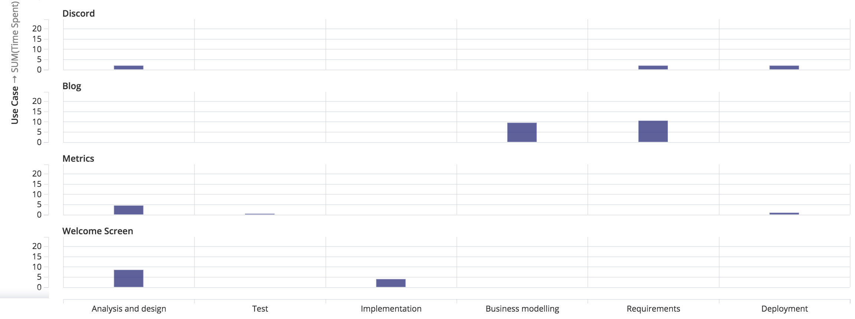
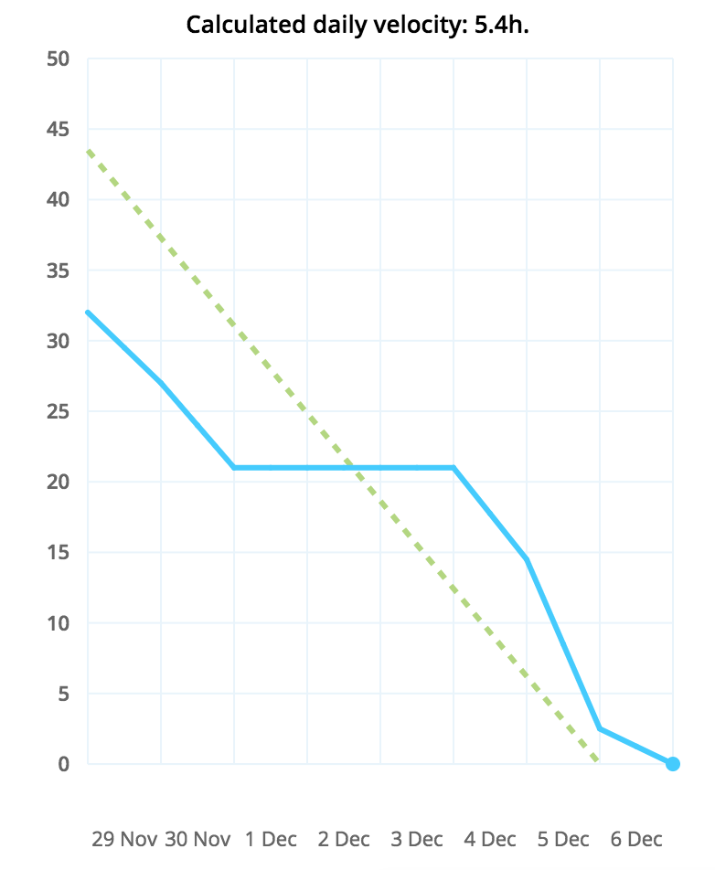
Management
Targetprocess
Roles
Sprint
Burndown charts
RUP
Gantt-Chart
Time management
Notes:
Targetprocess, project management tool, webapp, at beginning 1 week, then 2 weeks,
Roles: Dawid – Front end designer, backend designer, server backend developer,
Stands for "Rational Unified Process.“
It divides the development process into four distinct phases that each involve:
business modeling,
analysis and design,
implementation,
testing, and deployment
The RUP development methodology provides a structured way for companies to envision create software programs.
Time management: in targetprocess, tasks for every use case, times for every task, semi automatic

Slide 8
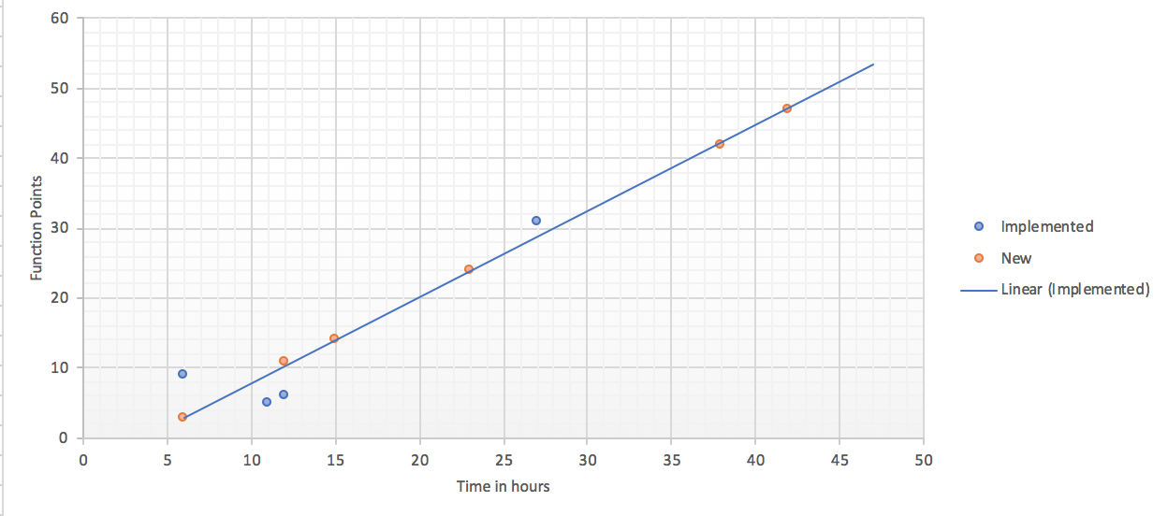
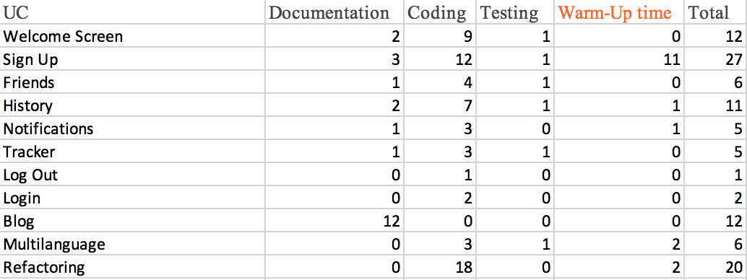
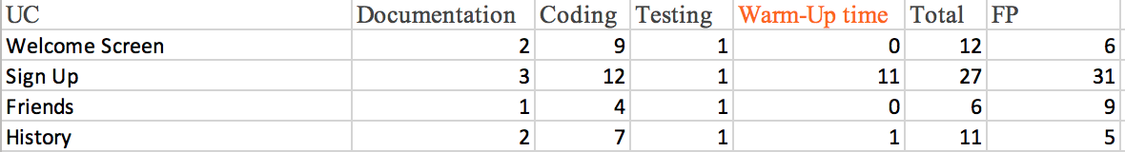
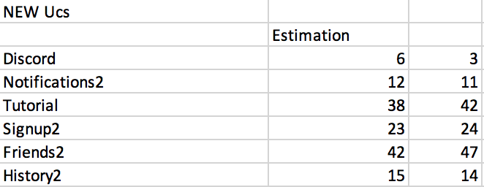
Quality – Function Points
Notes:
Charts

Slide 9
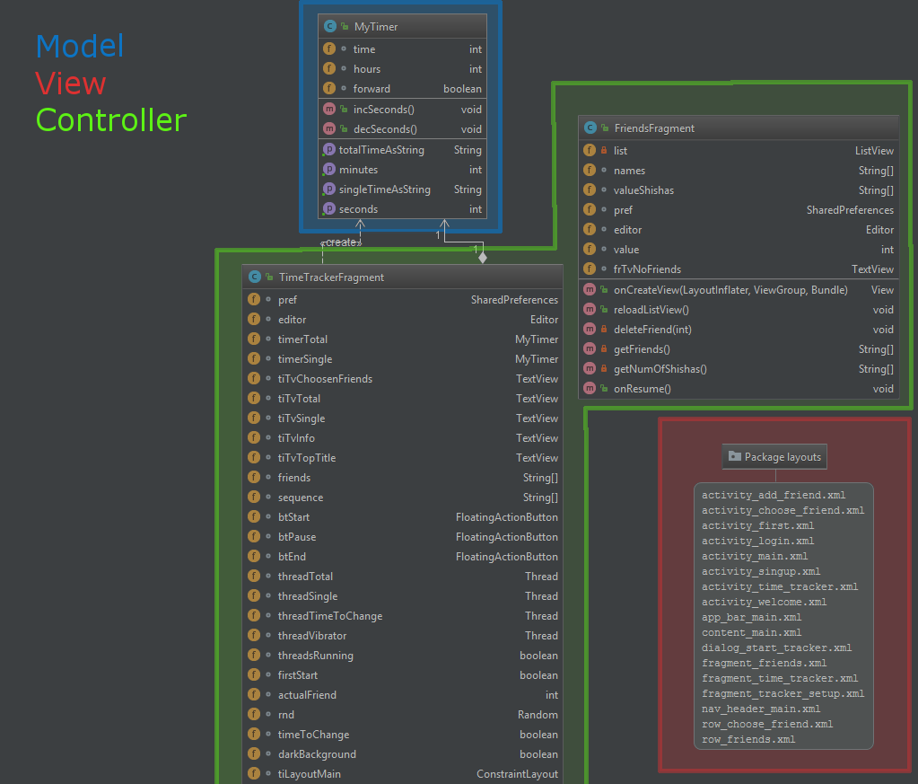
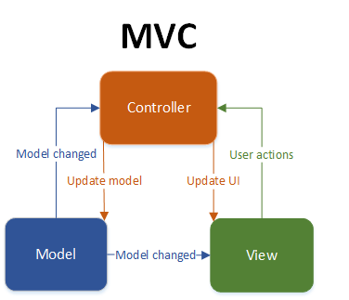
Quality – Architecture
MVC in android
Notes:
Charts

Slide 10
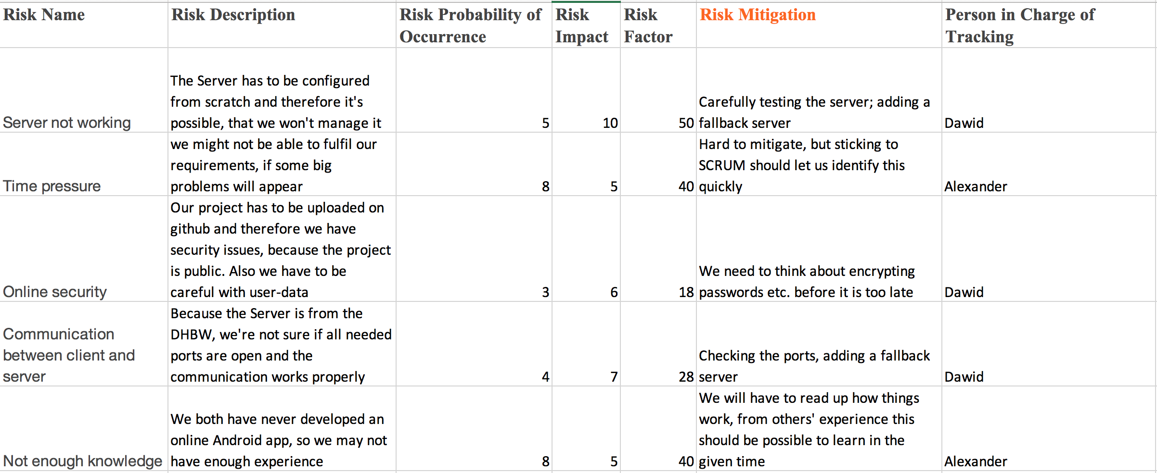
Quality – Risks
Notes:
Charts

Slide 11
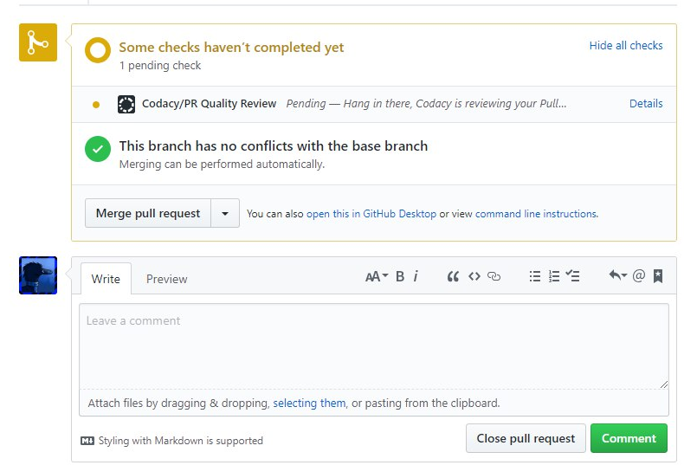
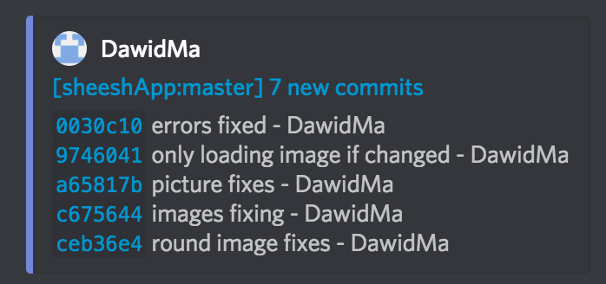
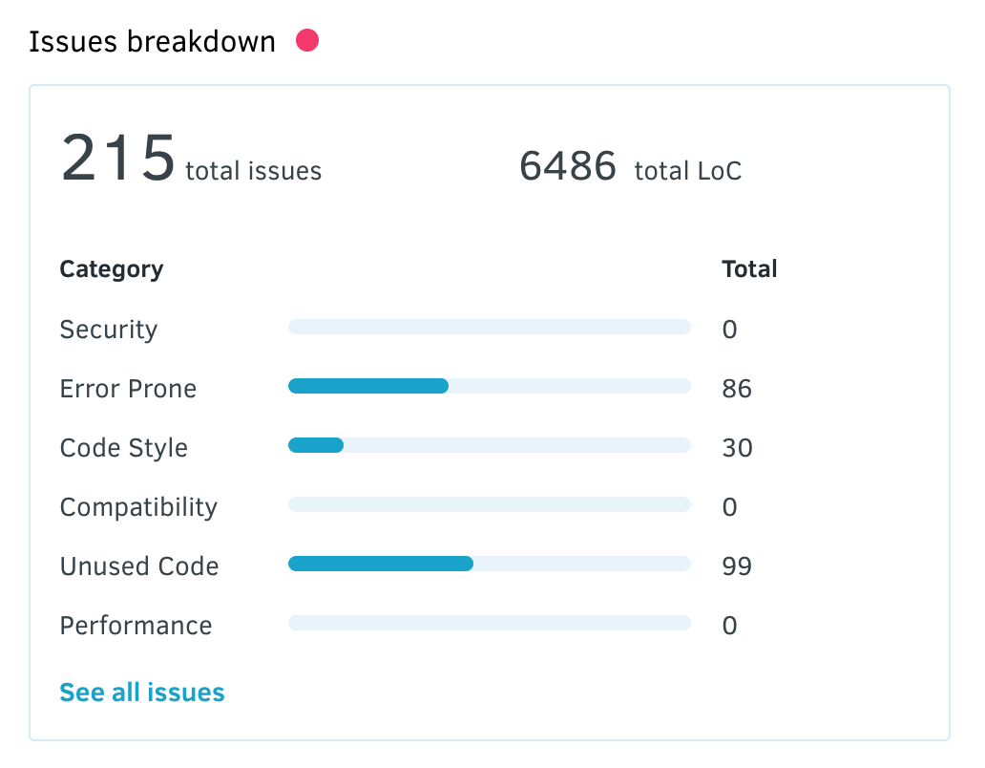
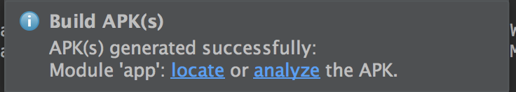
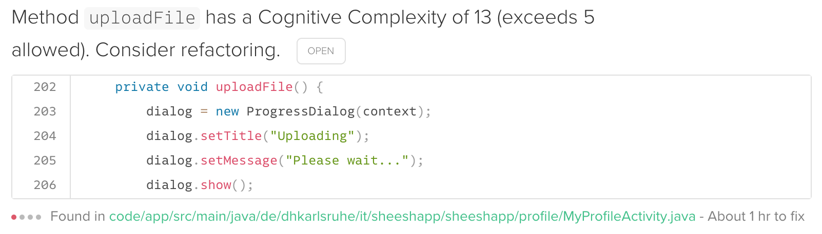
Continuous Integration & Metrics
Codacy
Code Climate
Discord Web Hook
Automatic Build
Automatic Testing
Notes:
Charts

Slide 12
Quality – Configuration
Android Studio
Github & desktop client
www.github.com/familylocke/sheeshapp
Targetprocess
https://tauboard.com/v/b9d7f4e1d714d2a7aef4aafd34e878e9
Wordpress
www.sheeshapp.wordpress.com
Discord
Spring Boot Server
Notes:
Charts

Slide 13
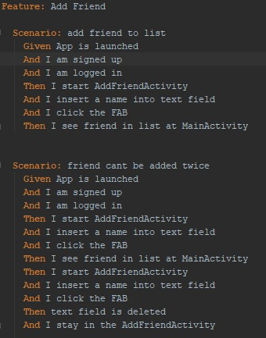
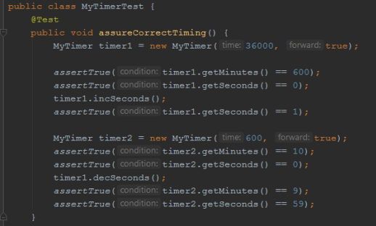
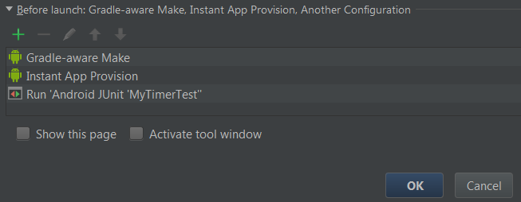
Quality – Testing
UI Tests
Automated
Espresso record
Cucumber .feature files
Unit Tests
Notes:
Charts

Slide 14
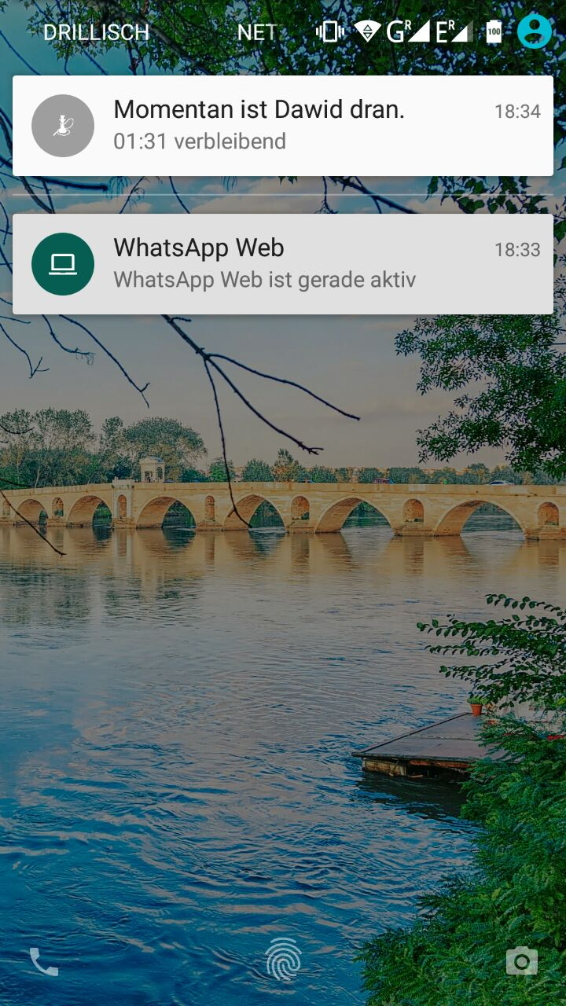
Demo

Slide 15
Thank you for your attention !

