Slide 1
The hangOut Project
Dawid Sitnik
Grzegorz Rypeść

Slide 2
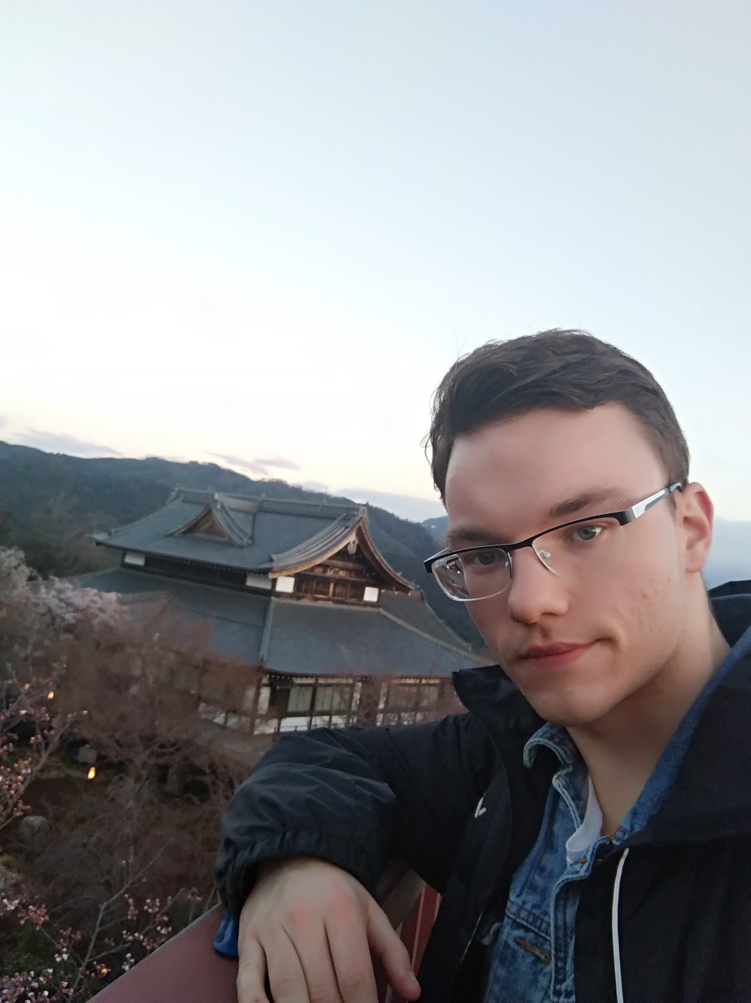
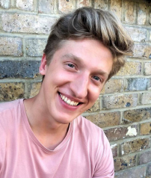
Who are we?
Greg
Dawid

Slide 3
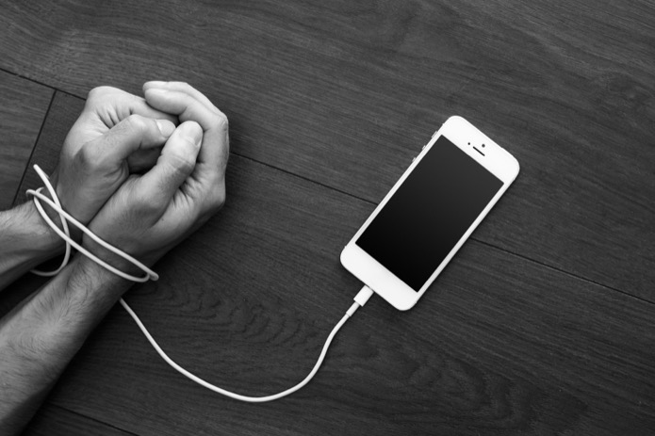
Motivation for the Project

Slide 4


Motivation for the Project

Slide 5
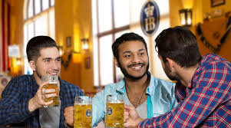
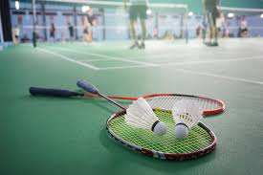

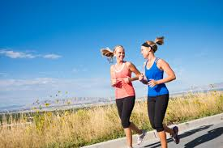

Our Application
Purpose

Slide 6
How does it work?
1. Create a hang out
2. Wait for response
3. Chat
4. Meet and enjoy
5. Add to friends and keep in touch

Slide 7
Project requirements
1. Backend and frontend implementation
2. Open source
3. Clean code
4. Easy to use interface
5. Originality and usability
6. Helping humanity

Slide 8



Backend

Slide 9



Frontend

Slide 10






Tools
Atom
Postman

Slide 11
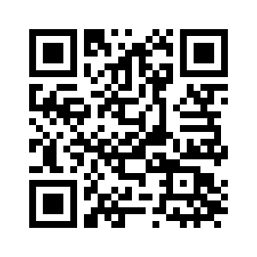
Thank you!
Find out more about the project on:
github.com/grypesc/hangOut

