Slide 1
The HangOut Project
Dawid Sitnik
Grzegorz Rypeść

Slide 2
Index
1. Challenges We Faced
2. How Does The App Work?
3. Github Repository
4. Meetings
5. Future Plans

Slide 3

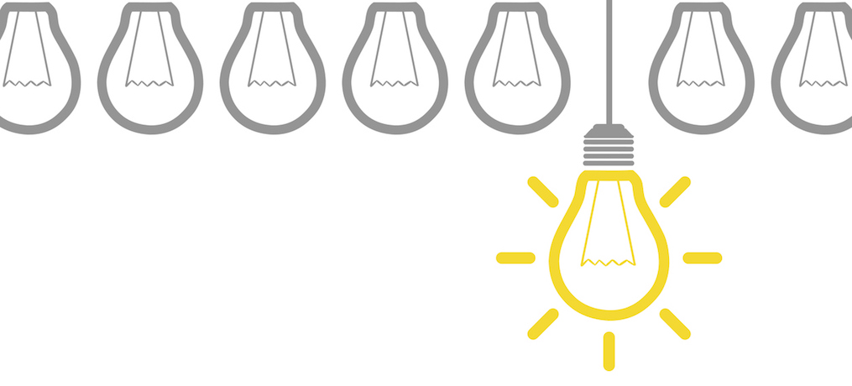
Challenges We Faced
- Lacks in documentation of React Native
- Two people against thousands lines of code

Slide 4



How Does it Work?

Slide 5
Video

Slide 6
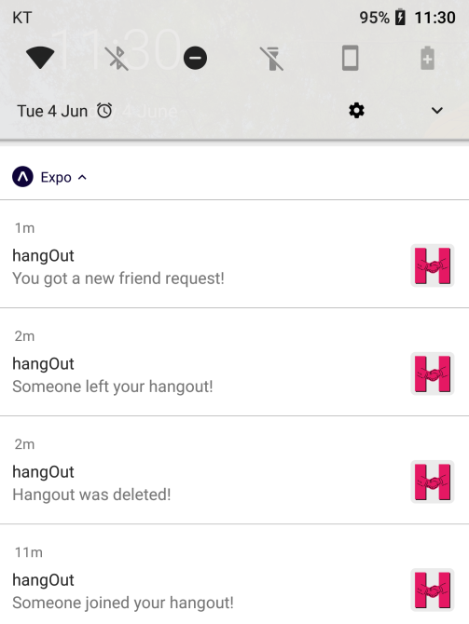


Notifications

Slide 7
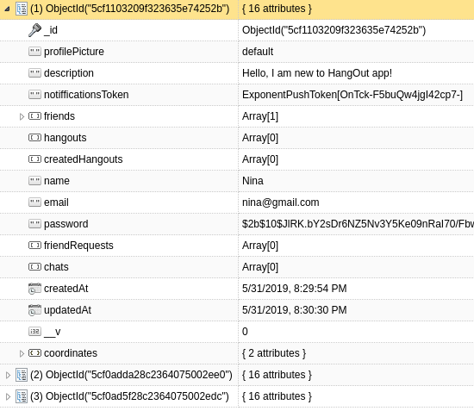
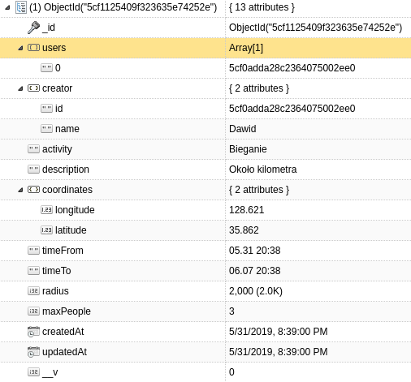
Database

Slide 8
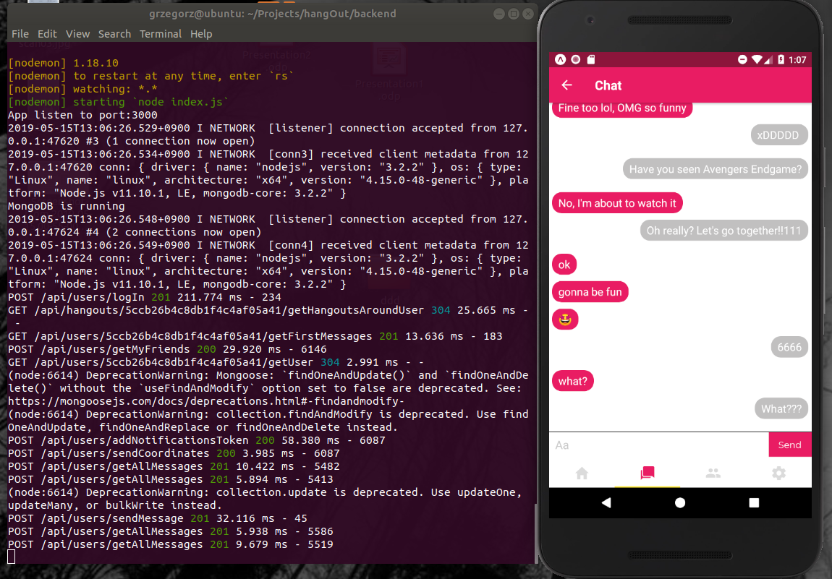
Back-End, AWS

Slide 9
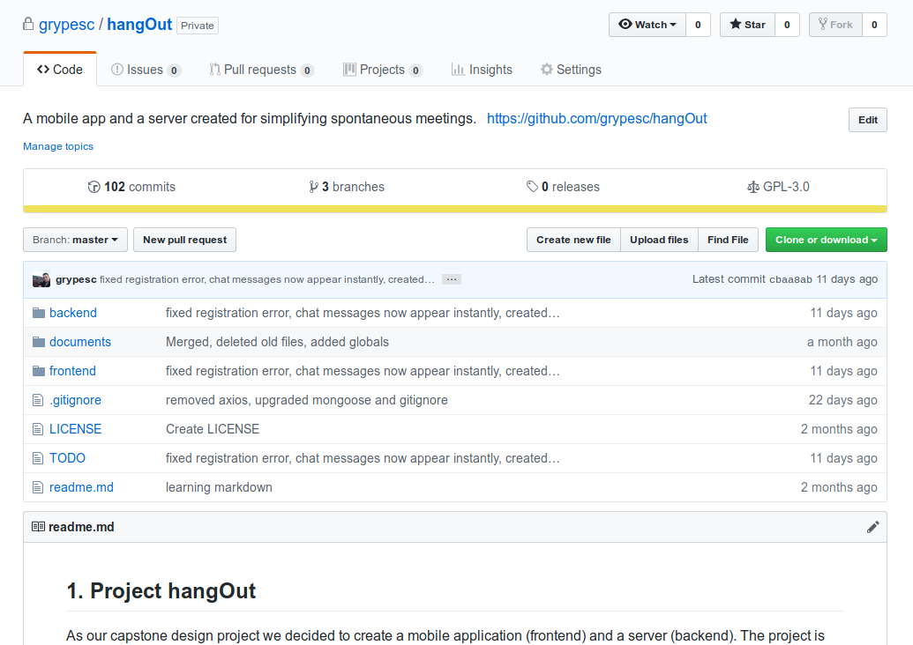
Github Repository

Slide 10
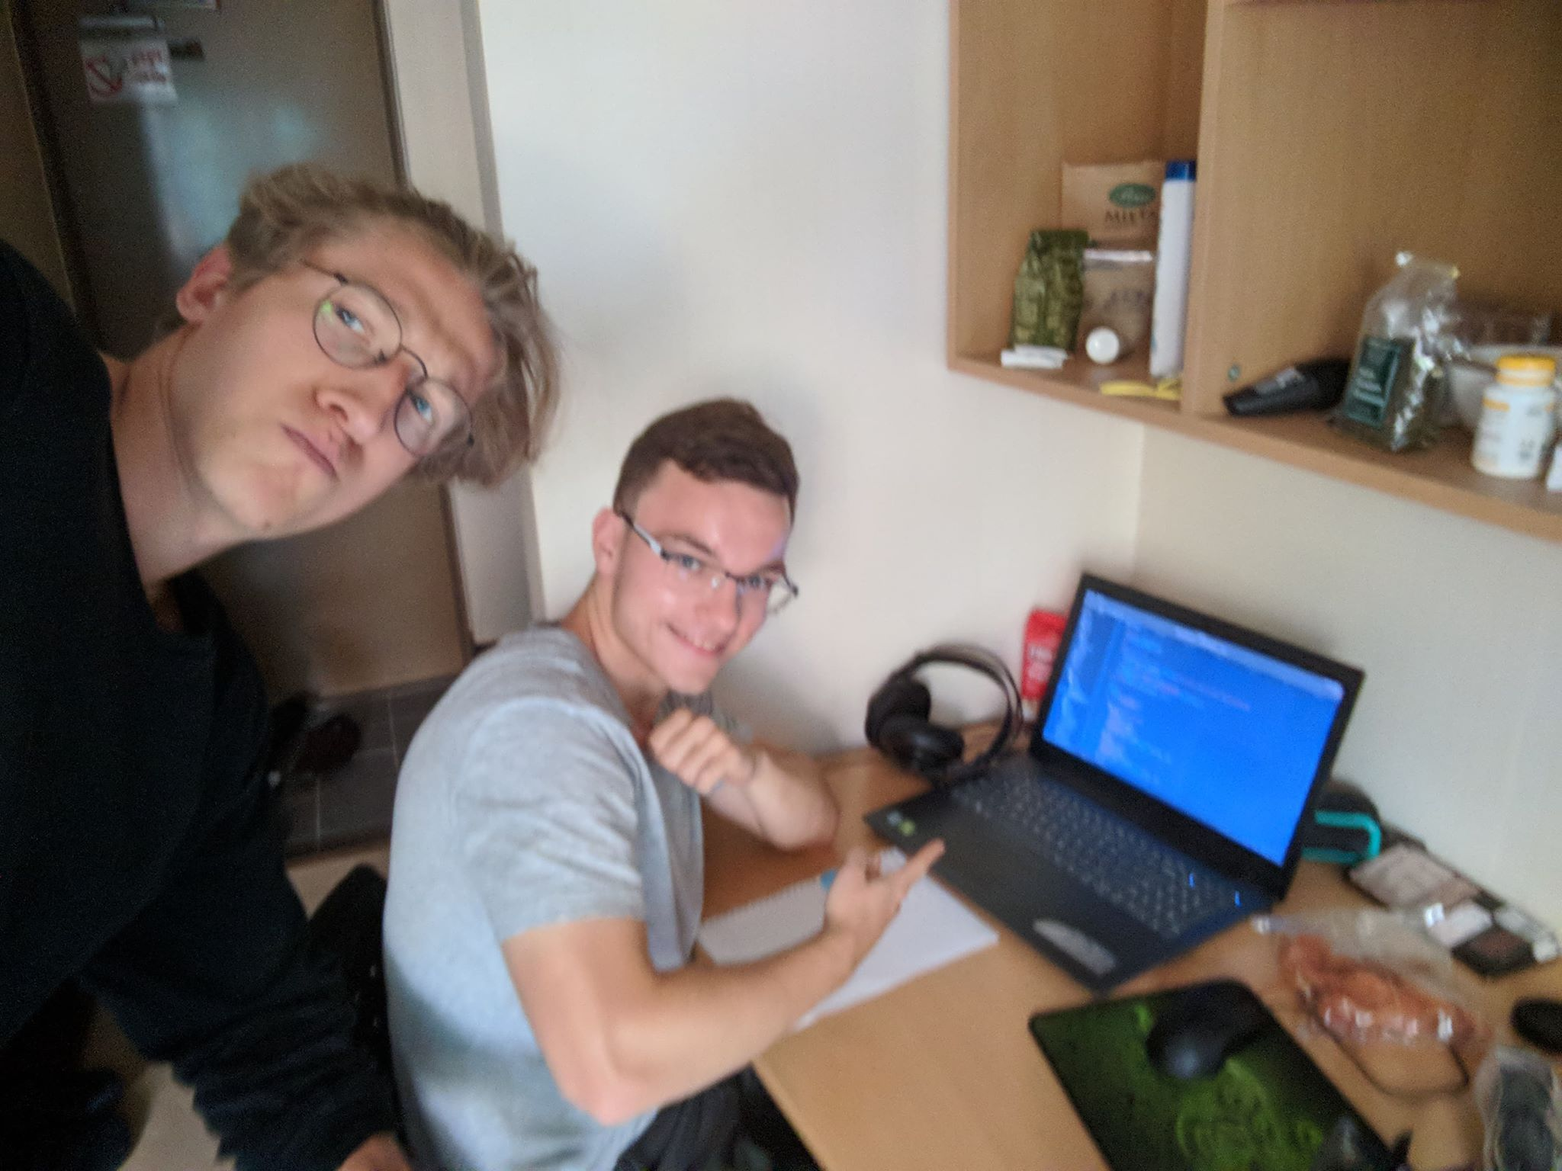
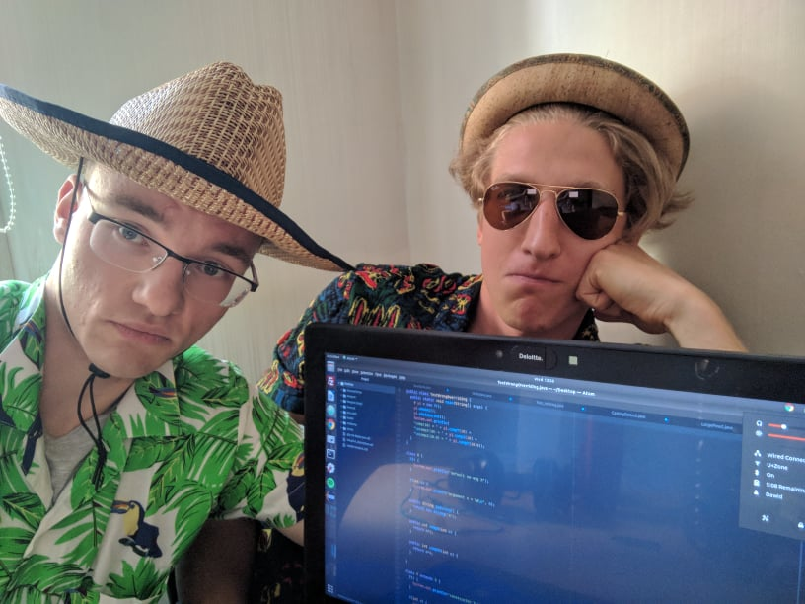
Project Meetings

Slide 11


Future Plans
1. Work on the front-end
2. Deploy application to Play Store and iOS App Store
3. Promote application

Slide 12
Thank you for your attention

