Slide 1
Extra Motivation
Data Science, Careers in Data Science, and Econometrics

Slide 2
What is Data Science?
This is a book about doing data science with Python, which immediately begs the question: what is data science? It's a surprisingly hard definition to nail down, especially given how ubiquitous the term has become. Vocal critics have variously dismissed the term as a superfluous label (after all, what science doesn't involve data?) or a simple buzzword that only exists to salt resumes and catch the eye of overzealous tech recruiters.
In my mind, these critiques miss something important. Data science, despite its hype-laden veneer, is perhaps the best label we have for the cross-disciplinary set of skills that are becoming increasingly important in many applications across industry and academia. This cross-disciplinary piece is key: in my mind, the best existing definition of data science is illustrated by Drew Conway's Data Science Venn Diagram, first published on his blog in September 2010
https://jakevdp.github.io/PythonDataScienceHandbook/00.00-preface.html

Slide 3
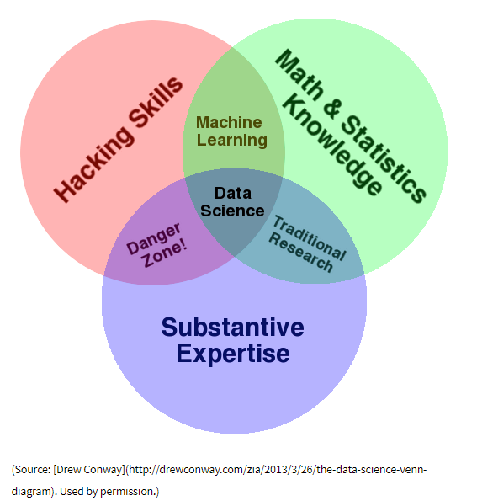
https://jakevdp.github.io/PythonDataScienceHandbook/00.00-preface.html

Slide 4
Roles and Responsibilities in a Data Scientist Job Description
https://www.springboard.com/blog/data-scientist-job-description/
This means that you’ll have to know, one way or another:
1– How to organize and “wrangle” large datasets so that you can get actionable insights from them. This may include finding innovative ways to combine fields of data that don’t naturally mesh together.
2– How to collect data from all kinds of different sources, from web APIs, to internal databases encoded in SQL.
3– How to do exploratory data analysis so you can navigate a dataset and come out with some broad conclusions based on some initial appraisal (ex: the averages of NBA player performance in a dataset that compares NBA game statistics with player salaries).
4– How to use algorithms and programming to efficiently go through large datasets and apply treatments, filters and conditions to your data.
5– How to create meaningful data visualizations that communicate your findings and relate them back to how your insights create business impact.

Slide 5
Examples of Data Science Jobs
Search Entry Level Data Science Jobs
Search for Jobs that include technologies that you know (e.g., Pandas, Numpy,…)
Some require MS or extra experience. There are many, however, that do not.

Slide 6
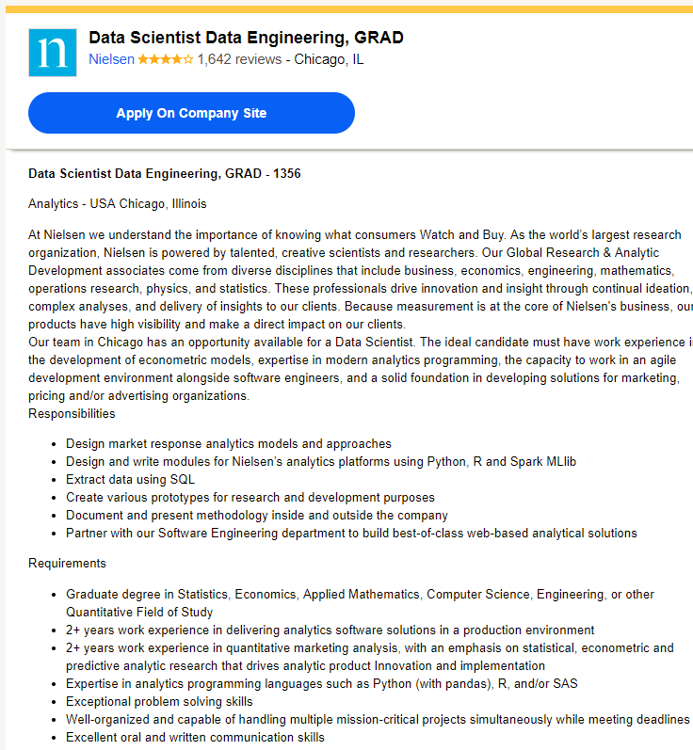

Slide 7
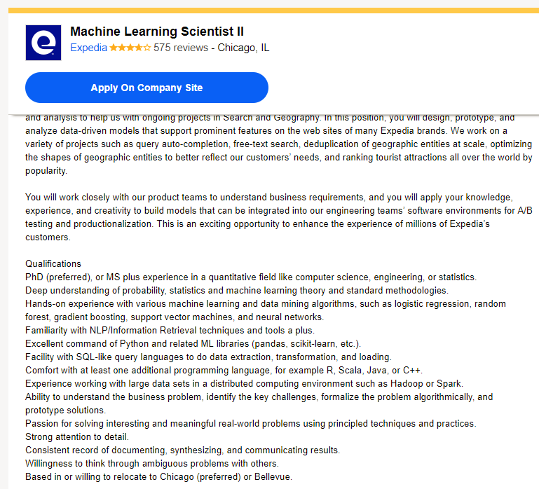

Slide 8
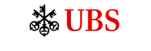
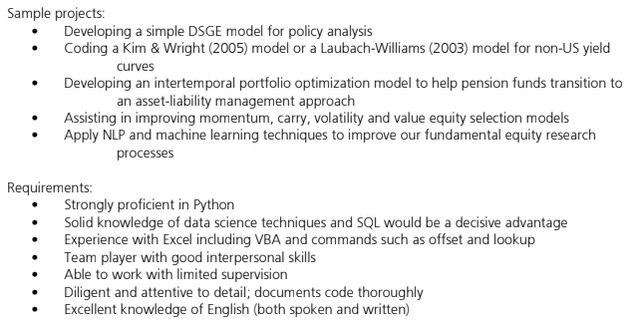

Slide 9


Slide 10
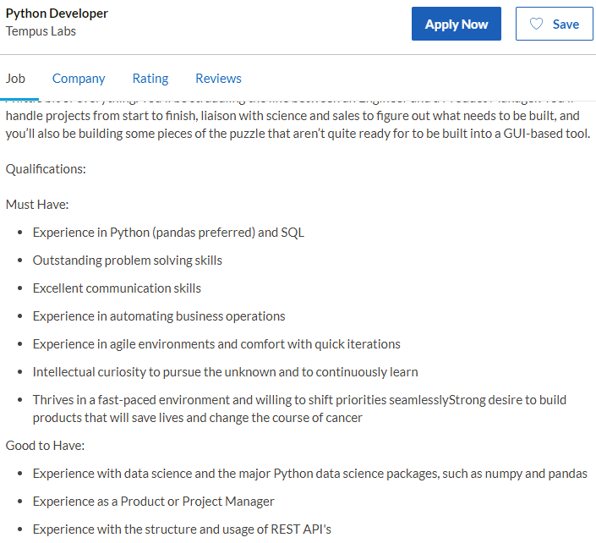

Slide 11
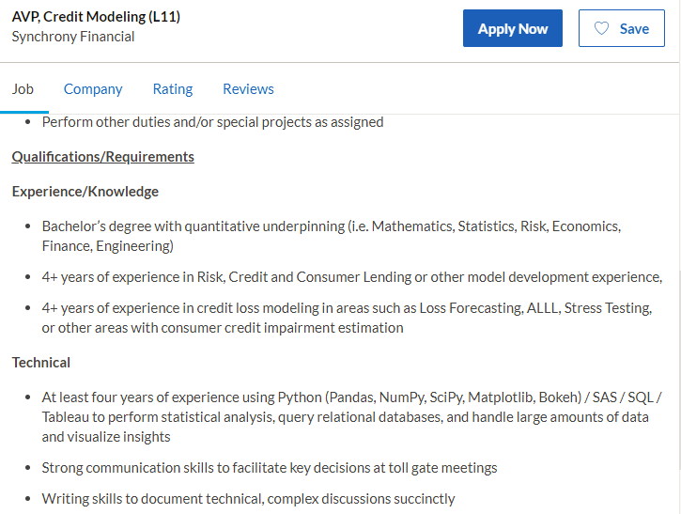

Slide 12
