Slide 1
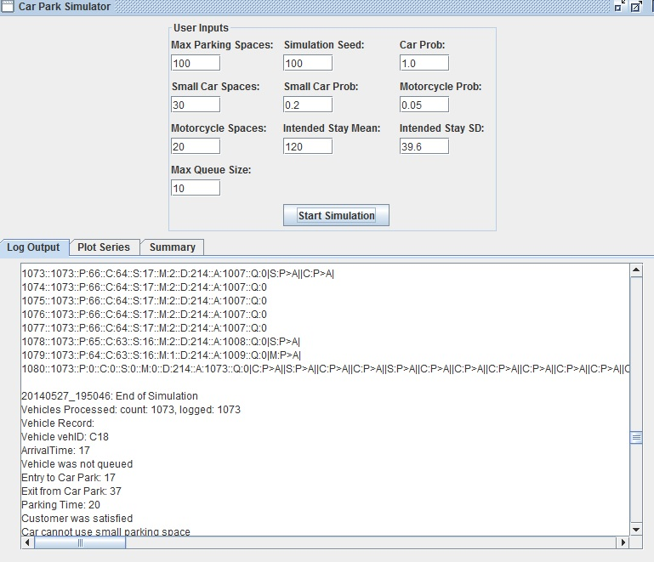
Default scenario test
Expecting with probability of 1 for Cars there would be at minimum 1079 vehicles but isn’t. Vehicle log and overall car park transitions throughout the simulation are consistent with expectations for a normal scenario.

Slide 2
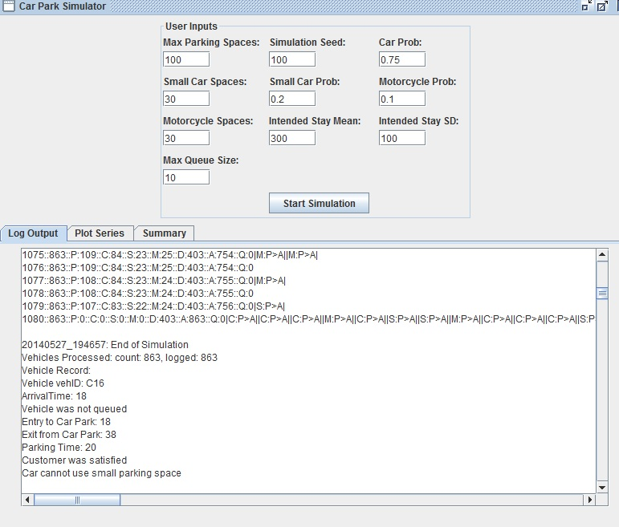
Long stay time probability
Expecting with a lowered probablity for vehicles count would be substantially lower which it was. Expecting with the longer stay time the number dissatisfied would be higher as well due to parks being held longer, which was consistent.

Slide 3
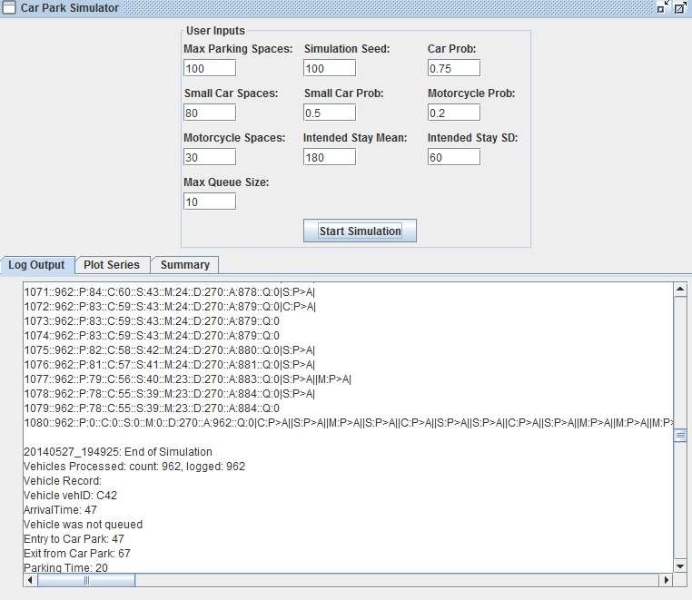
Small Cars probability
Expecting with increased motorcycle and small car spaces there would be more which was consistent. Expected a much lower number of dissatisfied customers due to more parking spaces for car types which was consistent.

Slide 4
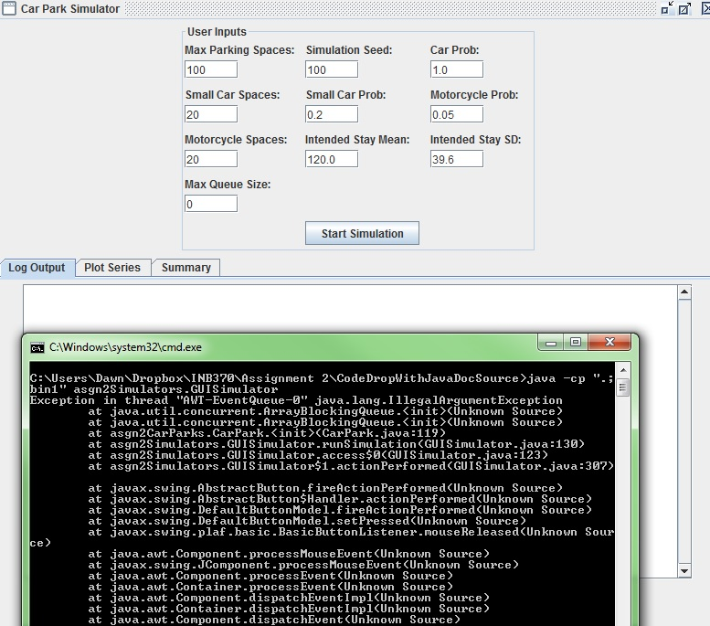
No Queue Test
Default values with no queue would be expecting a larger number of dissatisfied customers which was not consistent. Reason being the data type used for the queue did not allow for a queue to be constructed with a size of 0.

Slide 5
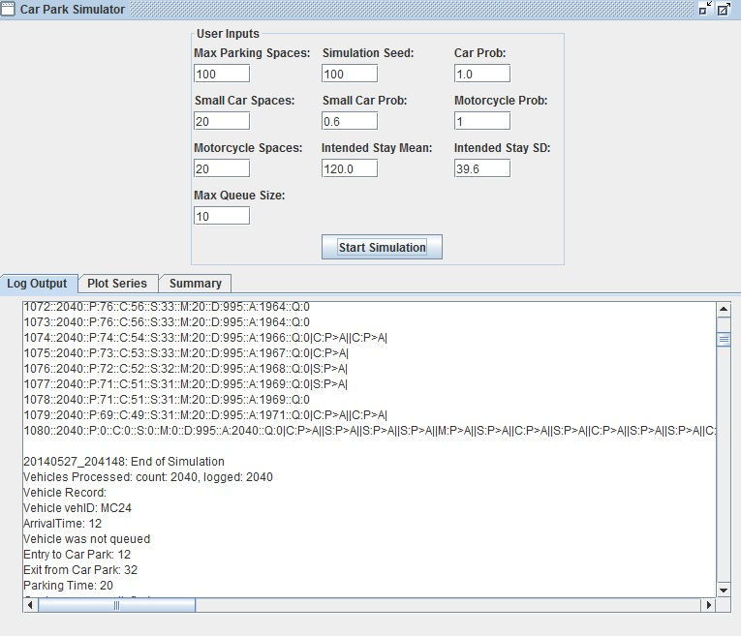
High Probabilities Test
Expecting with high probabilities for each vehicle type there would be a large number of dissatisfied customers which was consistent. Expecting there to also be a large number of vehicles in general which was also consistent.

