Slide 1
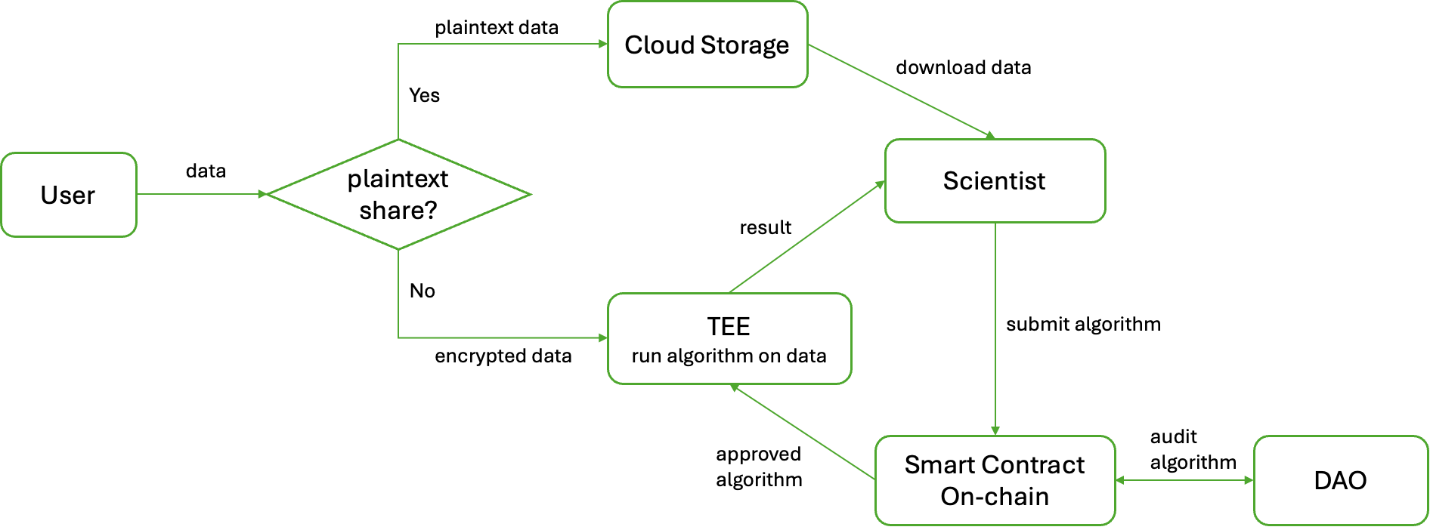
Delong
Data Privacy
User data: end-to-end encryption to TEE
after verifying the attestation and reviewing the program on TEE
All algorithms running on data
are ensured to be available on-chain
should be approved by the DataDAO
Algorithm result: end-to-end encryption to scientist
Data Validation
Verify signatures from trusted institutions / wearable devices
If no signatures:
zkEmail: if users can receive personal data from institutions by email
zkTLS: if users can see personal data when logging in to the websites/apps

