Slide 1
YOU LOGO
HOME
ABOUT
CARD
BANK
前端&数据可视化
根据一些总结报告，对2020年前端的趋势进行总结
designed by 1PPT.com creative
Dawnlck
2020.12.20

Slide 2
BUSINESS PLAN
WANDERFUL
Medium 模板编辑Or管理
Normal Ant Design Landing
This template is exclusively designed by Fei er
BUSINESS PLAN

Slide 3







Slide 5
可视化应用
DOM
声明式绘图
2D
SVG
声明式绘图
数据可视化的技术实现
Canvas
指令式绘图
3D
WebGL

Slide 6
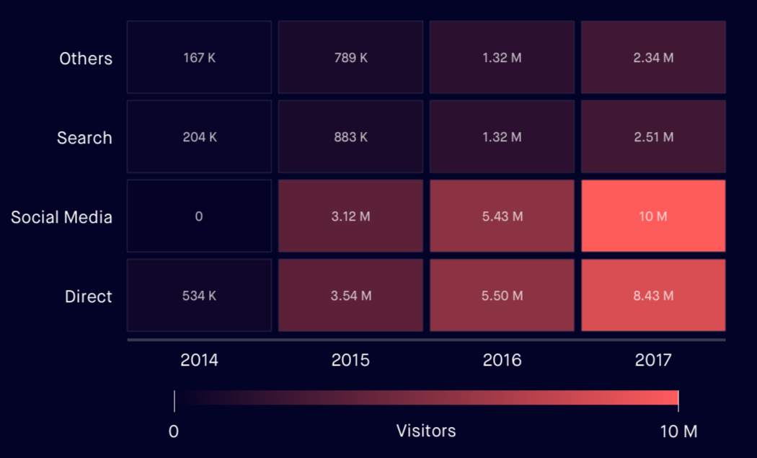
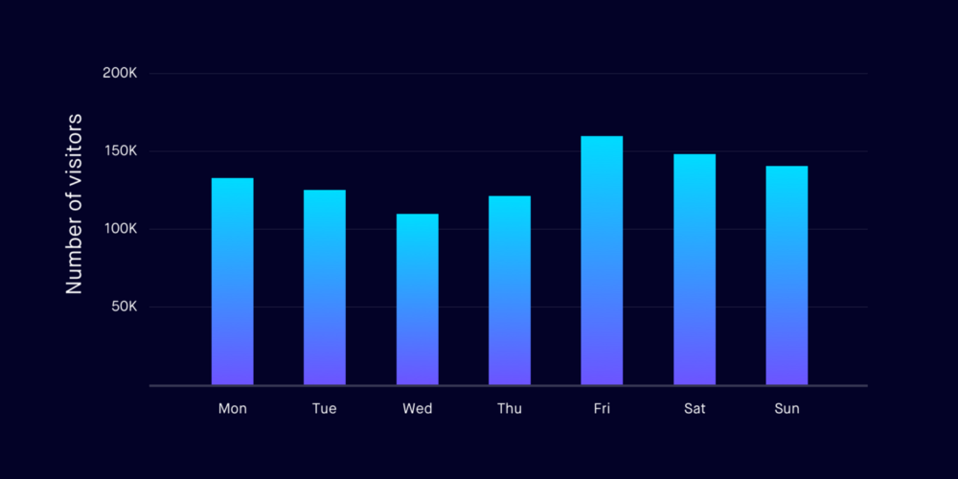
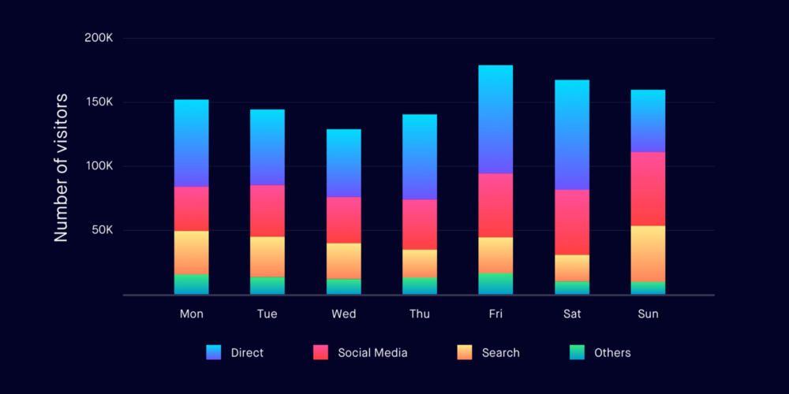
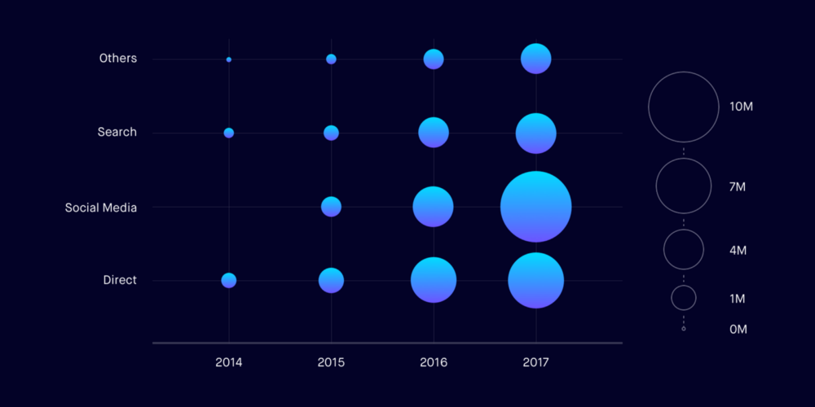
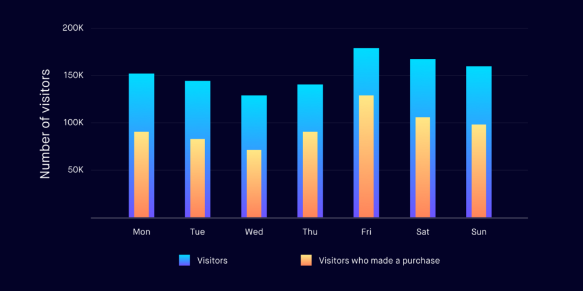
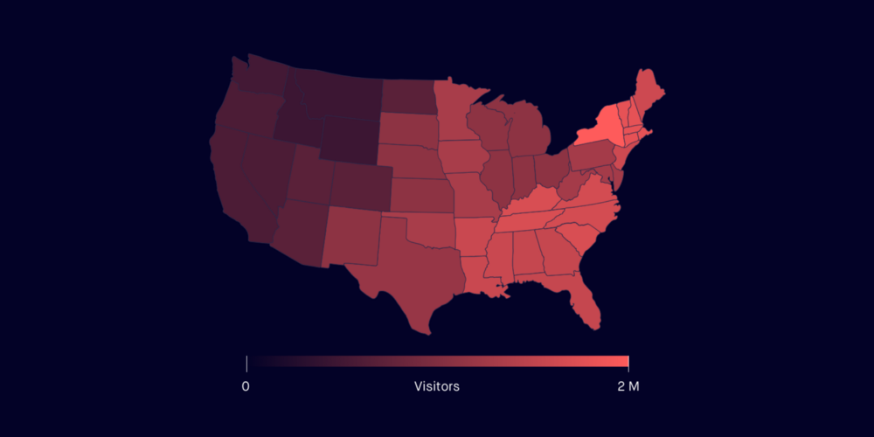
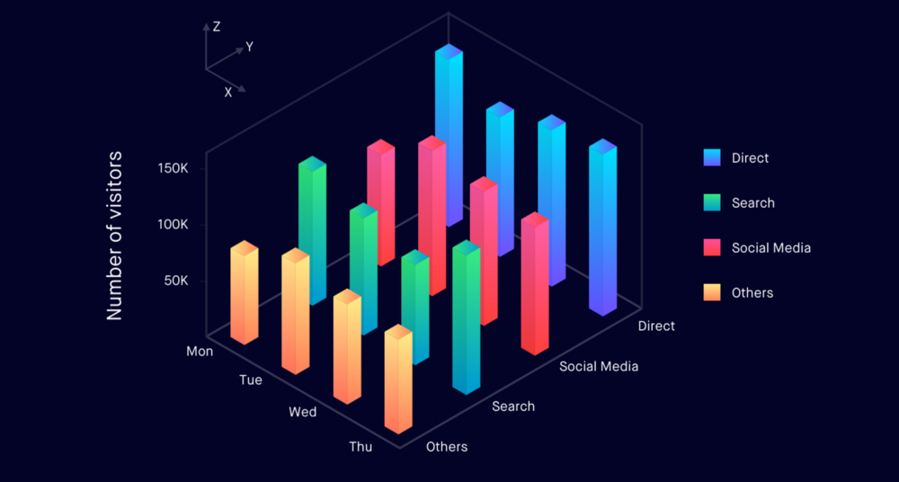
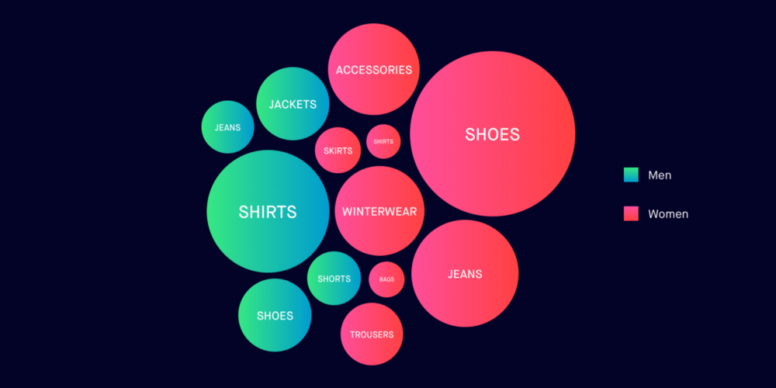
可视化应用

Slide 7
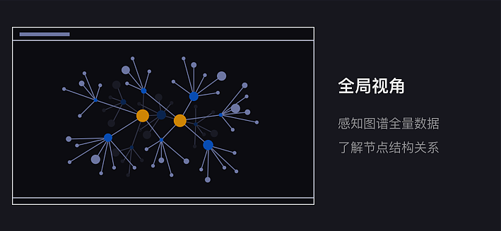
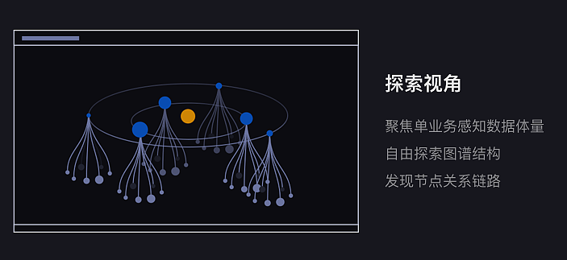
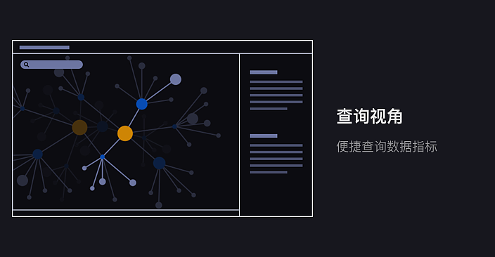
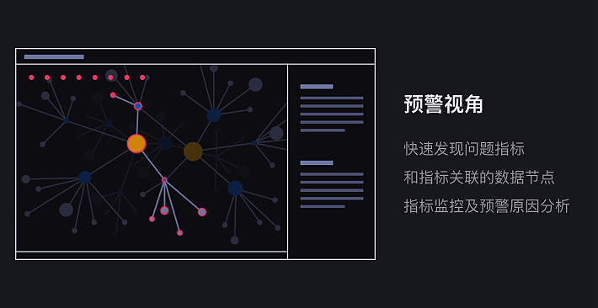
可视化应用

Slide 8





数字孪生
数字孪生的链路
数据采集
数据融合
数据建模
交互映射

Slide 9
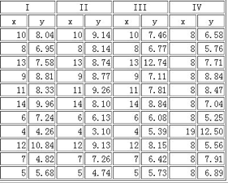
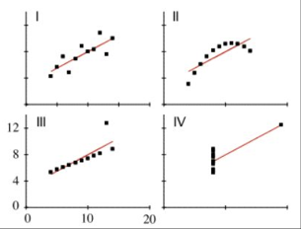
前端数据可视化领域小例子

Slide 10
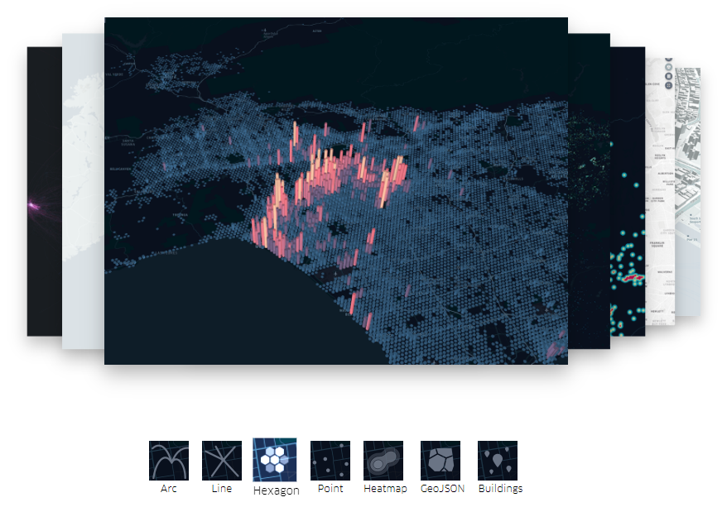

Uber Kepler.gl

Slide 11
Echarts 的发展历程
...
...
SVG渲染器
数据区域缩放
元素自定义
...
...
动态类型切换
按需加载
三维数据可视化
动态叙事
Github开源
拖拽重计算
配置统一
高性能用户交互
标签增强
1.0发布
大规模数据
视觉编码
流加载和增量渲染
状态增强
值域漫游
坐标系
Dataset
Typescript
2012
2014
2016
2018
2020
...
项目成立
2.0发布
3.0发布
4.0发布
5.0发布

Slide 12


国外可视化产品分类
图形语法
图表枚举

Slide 13
国内外可视化产品分类
AntV
Echarts
Google Chart
AntV - ChartCube
Flourish
D3.js
综合型首选
在线生成图表
Echarts
AntV - G2/G2-Plot
AntV - L7
OpenLayer
Kepler.gl
HighCharts
Chart.js
Chartist
Echarts
高德 - Loca / MapLab
基础图表应用与研究
MapV
GIS 地理信息数据可视化
DataV
腾讯云图
Tableau
SandDance
BizChart
AVA
DeepInsight
PowerBI
数据大屏
& BI
AntV - G6/Graphin/X6
其他

Slide 15
CONTENTS
01
YOU TEXT HERE
02
YOU TEXT HERE
This template is exclusively designed by Fei er creative, and copyrights belong to Bao tu internet.
This template is exclusively designed by Fei er creative, and copyrights belong to Bao tu internet.
03
YOU TEXT HERE
04
YOU TEXT HERE
This template is exclusively designed by Fei er creative, and copyrights belong to Bao tu internet.
This template is exclusively designed by Fei er creative, and copyrights belong to Bao tu internet.

Slide 16
01.
YOU TEXT HERE
WANDERFUL

Slide 17

BUSINESS PLAN
This template is exclusively designed by Fei er creative, and copyrights belong to Bao tu internet.
WANDERFUL
This template is exclusively designed by Fei er creative
WANDERFUL PLAN
WANDERFUL PLAN
WANDERFUL PLAN

Slide 18

BUSINESS PLAN
NO.01
NO.02
WANDERFUL PLAN
WANDERFUL PLAN
This template is exclusively designed by Fei er creative, and copyrights belong to Bao tu internet. This template is exclusively designed by Fei er creative, and copyrights belong to Bao tu internet. This template is exclusively designed by Fei er creative, and copyrights belong to Bao tu internet.
This template is exclusively designed by Fei er creative, and copyrights belong to Bao tu internet. This template is exclusively designed by Fei er creative, and copyrights belong to Bao tu internet. This template is exclusively designed by Fei er creative, and copyrights belong to Bao tu internet.

Slide 19
BUSINESS PLAN
95
126
168
361
WANDERFUL PLAN
WANDERFUL PLAN
WANDERFUL PLAN
WANDERFUL PLAN

Slide 20



BUSINESS PLAN
WANDERFUL PLAN
This template is exclusively designed by Fei er creative, and copyrights belong to Bao tu internet. This template is exclusively designed by Fei er creative, and copyrights belong to Bao tu internet. This template is exclusively designed by Fei er creative, and copyrights belong to Bao tu internet.

Slide 21
BUSINESS PLAN
WANDERFUL
WANDERFUL
This template is exclusively designed by Fei er creative, and copyrights belong to Bao tu internet.
This template is exclusively designed by Fei er creative, and copyrights belong to Bao tu internet.
WANDERFUL
WANDERFUL
This template is exclusively designed by Fei er creative, and copyrights belong to Bao tu internet.
This template is exclusively designed by Fei er creative, and copyrights belong to Bao tu internet.

Slide 22
02.
YOU TEXT HERE
WANDERFUL

Slide 23




BUSINESS PLAN
This template is exclusively designed by Fei er creative, and copyrights belong to Bao tu internet.
NO.01
NO.02
NO.03
NO.04
baotuwang
baotuwang
baotuwang
baotuwang

Slide 24
BUSINESS PLAN
This template is exclusively designed by Fei er creative, and copyrights belong to Bao tu internet.
This template is exclusively designed by Fei er
This template is exclusively designed by Fei er
This template is exclusively designed by Fei er
This template is exclusively designed by Fei er
This template is exclusively designed by Fei er

Slide 25
BUSINESS PLAN
NO.01
NO.02
WANDERFUL PLAN
WANDERFUL PLAN
BUSINESS PLAN
This template is exclusively designed by Fei er creative, and copyrights belong to Bao tu internet. This template is exclusively designed by Fei er creative,
BUSINESS PLAN
BUSINESS PLAN
This template is exclusively designed by Fei er creative, and copyrights belong to Bao tu internet. This template is exclusively designed by Fei er creative, and copyrights belong to Bao tu internet.
BUSINESS PLAN

Slide 26

BUSINESS PLAN
This template is exclusively designed by Fei er creative, and copyrights belong to Bao tu internet.
WANDERFUL
WANDERFUL
WANDERFUL
WANDERFUL
WANDERFUL
This template is exclusively designed by Fei er creative, and copyrights belong to Bao tu internet. This template is exclusively designed by Fei er creative,

Slide 27
03.
YOU TEXT HERE
WANDERFUL

Slide 28

BUSINESS PLAN
NO.01
WANDERFUL
WANDERFUL PLAN
This template is exclusively designed by Fei er creative, and copyrights belong to Bao tu internet. This template is exclusively designed by Fei er creative, and copyrights belong to Bao tu internet. This template is exclusively designed by Fei er creative, and copyrights belong to Bao tu internet.
WANDERFUL
NO.01
WANDERFUL

Slide 29
BUSINESS PLAN
WANDERFUL PLAN
75%
This template is exclusively designed by Fei er creative, and copyrights belong to Bao tu internet. This template is exclusively designed by Fei er creative, and copyrights belong to Bao tu internet. This template is exclusively designed by Fei er creative, and copyrights belong to Bao tu internet.
BUSINESS
60%
BUSINESS
45%
BUSINESS
96%
WANDERFUL
BUSINESS

Slide 30



BUSINESS PLAN
This template is exclusively designed by Fei er creative, and copyrights belong to Bao tu internet.
WANDERFUL PLAN
WANDERFUL PLAN
WANDERFUL PLAN
1
2
3
This template is exclusively designed by Fei er creative, and copyrights belong to Bao tu internet. This template is exclusively designed by Fei er creative,
This template is exclusively designed by Fei er creative, and copyrights belong to Bao tu internet. This template is exclusively designed by Fei er creative,
This template is exclusively designed by Fei er creative, and copyrights belong to Bao tu internet. This template is exclusively designed by Fei er creative,

Slide 31
BUSINESS PLAN
This template is exclusively designed by Fei er creative, and copyrights belong to Bao tu internet.
WANDERFUL
PLAN
WANDERFUL
PLAN
WANDERFUL
PLAN
WANDERFUL
PLAN
WANDERFUL
PLAN
WANDERFUL
PLAN

Slide 32
BUSINESS PLAN
WANDERFUL PLAN
WANDERFUL PLAN
1
2
This template is exclusively designed by Fei er creative, and copyrights belong to Bao tu internet. This template is exclusively designed by Fei er creative,
This template is exclusively designed by Fei er creative, and copyrights belong to Bao tu internet. This template is exclusively designed by Fei er creative,
WANDERFUL PLAN
WANDERFUL PLAN
3
4
This template is exclusively designed by Fei er creative, and copyrights belong to Bao tu internet. This template is exclusively designed by Fei er creative,
This template is exclusively designed by Fei er creative, and copyrights belong to Bao tu internet. This template is exclusively designed by Fei er creative,

Slide 33
04.
YOU TEXT HERE
WANDERFUL

Slide 34

BUSINESS PLAN
This template is exclusively designed by Fei er creative, and copyrights belong to Bao tu internet.
NO.01
NO.02
NO.03
WANDERFUL PLAN
WANDERFUL PLAN
WANDERFUL PLAN
This template is exclusively designed by Fei er creative, and copyrights belong to Bao tu internet. This template is exclusively designed by Fei er creative,
This template is exclusively designed by Fei er creative, and copyrights belong to Bao tu internet. This template is exclusively designed by Fei er creative,
This template is exclusively designed by Fei er creative, and copyrights belong to Bao tu internet. This template is exclusively designed by Fei er creative,
WANDERFUL
WANDERFUL
WANDERFUL

Slide 35
BUSINESS PLAN
WANDERFUL
PLAN
WANDERFUL
PLAN
WANDERFUL
PLAN
WANDERFUL
PLAN
WANDERFUL
PLAN
WANDERFUL
PLAN
WANDERFUL
PLAN
WANDERFUL
PLAN

Slide 36
BUSINESS PLAN
This template is exclusively designed by Fei er creative, and copyrights belong to Bao tu internet.
This template is exclusively designed by Fei er creative, and copyrights belong to Bao tu internet.
This template is exclusively designed by Fei er creative, and copyrights belong to Bao tu internet.
This template is exclusively designed by Fei er creative, and copyrights belong to Bao tu internet.
This template is exclusively designed by Fei er creative, and copyrights belong to Bao tu internet.
This template is exclusively designed by Fei er creative, and copyrights belong to Bao tu internet.

Slide 37
BUSINESS PLAN
WANDERFUL
WANDERFUL
This template is exclusively designed by Fei er creative, and copyrights belong to Bao tu internet.
This template is exclusively designed by Fei er creative, and copyrights belong to Bao tu internet.
WANDERFUL
WANDERFUL
This template is exclusively designed by Fei er creative, and copyrights belong to Bao tu internet.
This template is exclusively designed by Fei er creative, and copyrights belong to Bao tu internet.

Slide 38
YOU LOGO
HOME
ABOUT
CARD
BANK
THANK YOU
This template is exclusively designed by Fei er creative, and copyrights belong to Bao tu internet.
designed by 1PPT.com creative
第一PPT
2030.12.20

