Slide 1
YOU LOGO
HOME
ABOUT
CARD
BANK
前端&数据可视化
根据一些总结报告，对2020年前端的趋势进行总结
designed by 1PPT.com creative
Dawnlck
2020.12.20

Slide 2

BUSINESS PLAN
WANDERFUL
Medium 模板编辑Or管理
Normal Ant Design Landing
This template is exclusively designed by Fei er
BUSINESS PLAN

Slide 3



Slide 4
可视化应用
DOM
声明式绘图
2D
SVG
声明式绘图
数据可视化的技术实现
Canvas
指令式绘图
3D
WebGL

Slide 5
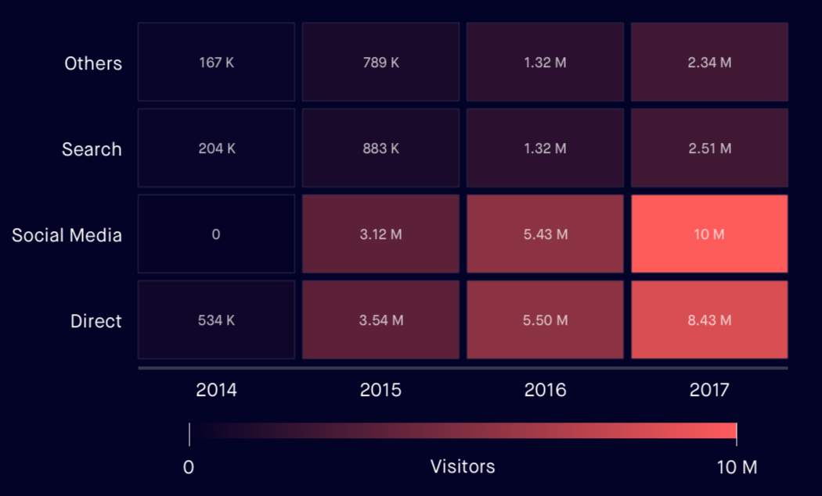
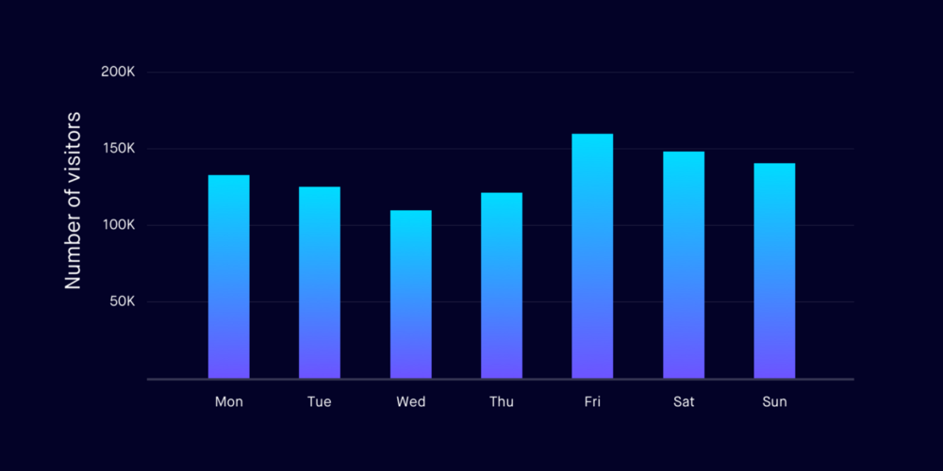
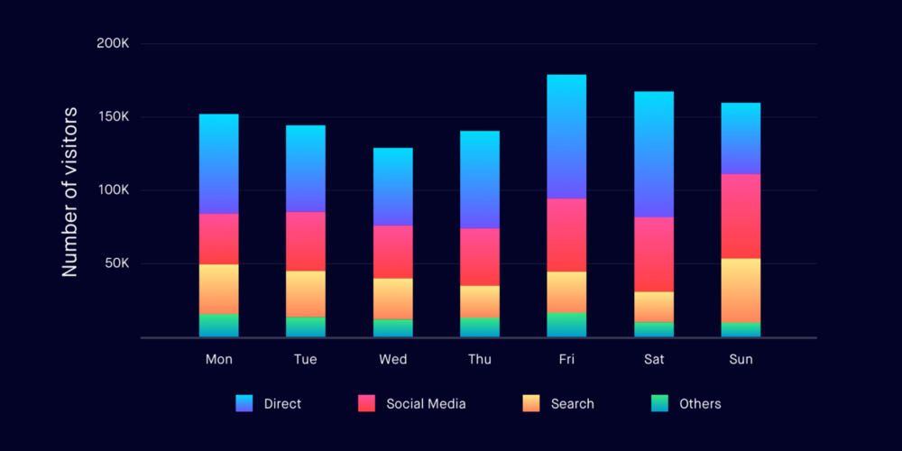
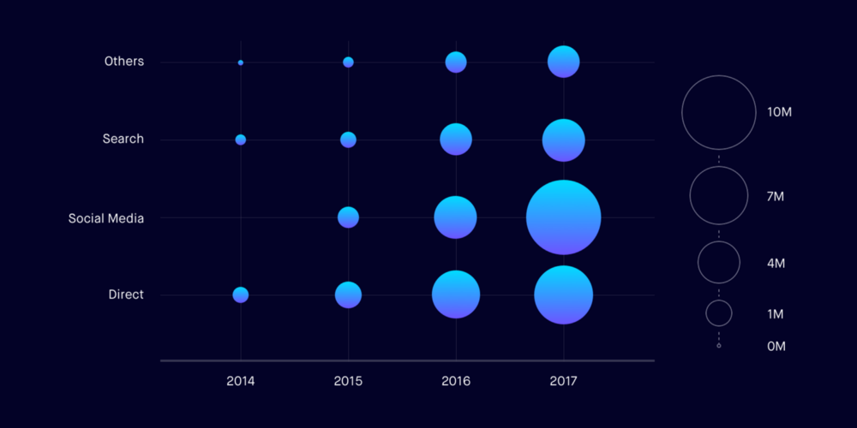
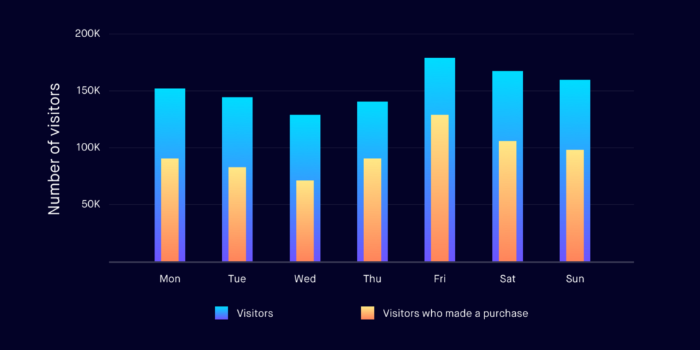
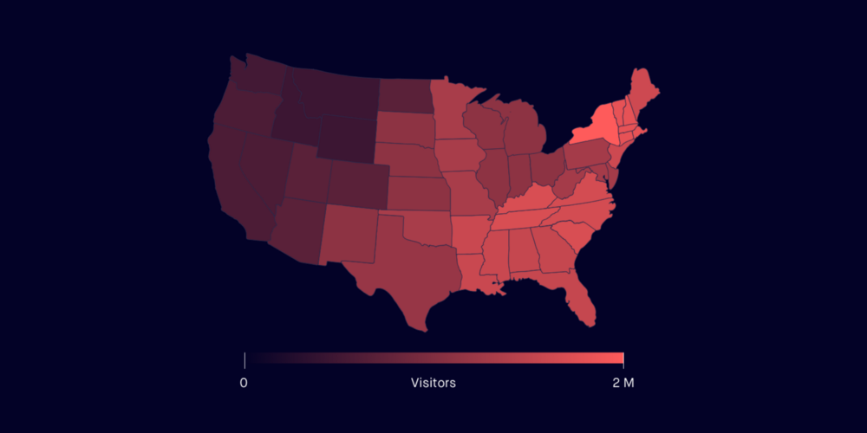
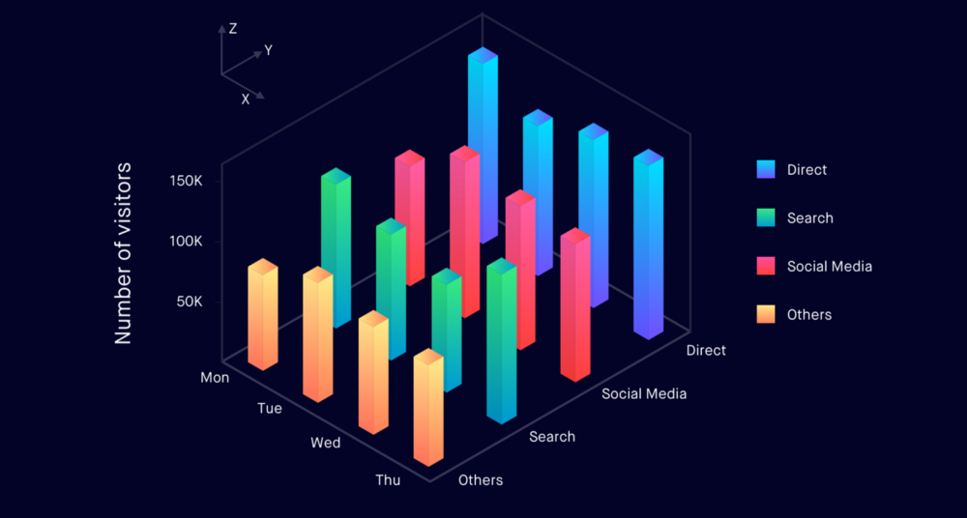
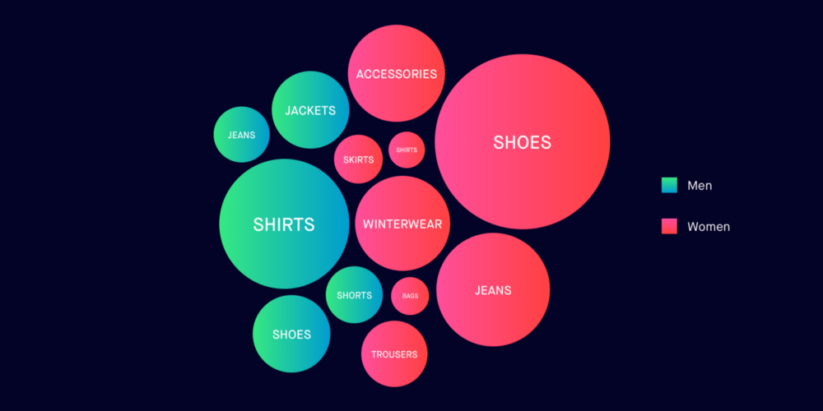
可视化应用

Slide 6
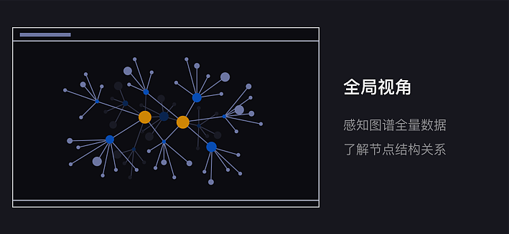
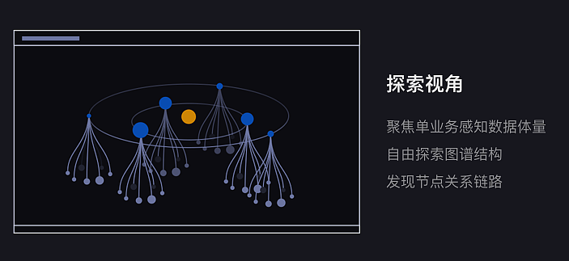
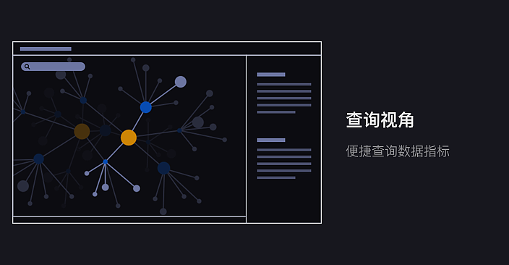
可视化应用

Slide 7





数字孪生
数字孪生的链路
数据采集
数据融合
数据建模
交互映射

Slide 8
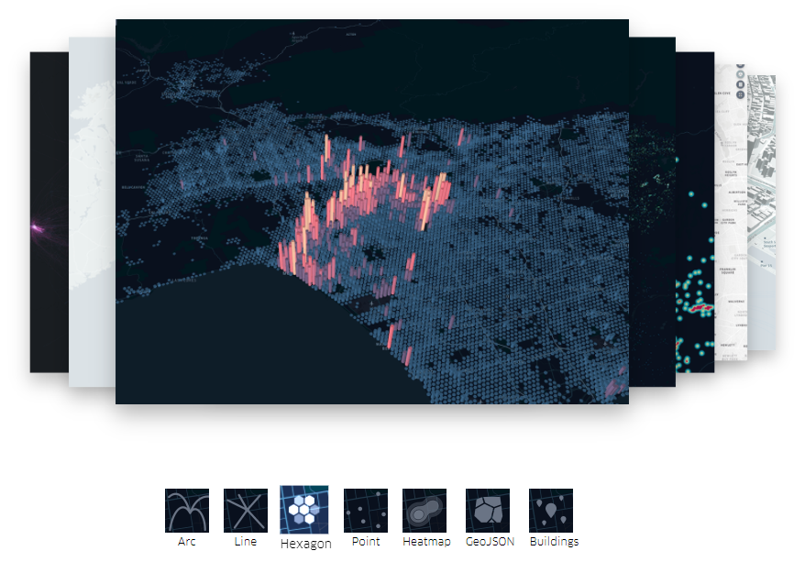
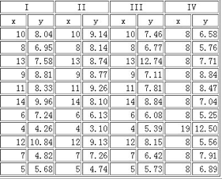
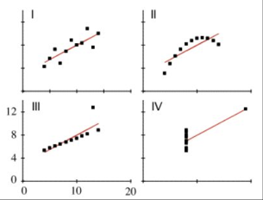
前端数据可视化领域小例子

Slide 9

Uber Kepler.gl

Slide 10
CONTENTS
01
YOU TEXT HERE
02
YOU TEXT HERE
This template is exclusively designed by Fei er creative, and copyrights belong to Bao tu internet.
This template is exclusively designed by Fei er creative, and copyrights belong to Bao tu internet.
03
YOU TEXT HERE
04
YOU TEXT HERE
This template is exclusively designed by Fei er creative, and copyrights belong to Bao tu internet.
This template is exclusively designed by Fei er creative, and copyrights belong to Bao tu internet.

Slide 11
01.
YOU TEXT HERE
WANDERFUL

Slide 12

BUSINESS PLAN
This template is exclusively designed by Fei er creative, and copyrights belong to Bao tu internet.
WANDERFUL
This template is exclusively designed by Fei er creative
WANDERFUL PLAN
WANDERFUL PLAN
WANDERFUL PLAN

Slide 13

BUSINESS PLAN
NO.01
NO.02
WANDERFUL PLAN
WANDERFUL PLAN
This template is exclusively designed by Fei er creative, and copyrights belong to Bao tu internet. This template is exclusively designed by Fei er creative, and copyrights belong to Bao tu internet. This template is exclusively designed by Fei er creative, and copyrights belong to Bao tu internet.
This template is exclusively designed by Fei er creative, and copyrights belong to Bao tu internet. This template is exclusively designed by Fei er creative, and copyrights belong to Bao tu internet. This template is exclusively designed by Fei er creative, and copyrights belong to Bao tu internet.

Slide 14
BUSINESS PLAN
95
126
168
361
WANDERFUL PLAN
WANDERFUL PLAN
WANDERFUL PLAN
WANDERFUL PLAN

Slide 15



BUSINESS PLAN
WANDERFUL PLAN
This template is exclusively designed by Fei er creative, and copyrights belong to Bao tu internet. This template is exclusively designed by Fei er creative, and copyrights belong to Bao tu internet. This template is exclusively designed by Fei er creative, and copyrights belong to Bao tu internet.

Slide 16
BUSINESS PLAN
WANDERFUL
WANDERFUL
This template is exclusively designed by Fei er creative, and copyrights belong to Bao tu internet.
This template is exclusively designed by Fei er creative, and copyrights belong to Bao tu internet.
WANDERFUL
WANDERFUL
This template is exclusively designed by Fei er creative, and copyrights belong to Bao tu internet.
This template is exclusively designed by Fei er creative, and copyrights belong to Bao tu internet.

Slide 17
02.
YOU TEXT HERE
WANDERFUL

Slide 18




BUSINESS PLAN
This template is exclusively designed by Fei er creative, and copyrights belong to Bao tu internet.
NO.01
NO.02
NO.03
NO.04
baotuwang
baotuwang
baotuwang
baotuwang

Slide 19
BUSINESS PLAN
This template is exclusively designed by Fei er creative, and copyrights belong to Bao tu internet.
This template is exclusively designed by Fei er
This template is exclusively designed by Fei er
This template is exclusively designed by Fei er
This template is exclusively designed by Fei er
This template is exclusively designed by Fei er

Slide 20
BUSINESS PLAN
NO.01
NO.02
WANDERFUL PLAN
WANDERFUL PLAN
BUSINESS PLAN
This template is exclusively designed by Fei er creative, and copyrights belong to Bao tu internet. This template is exclusively designed by Fei er creative,
BUSINESS PLAN
BUSINESS PLAN
This template is exclusively designed by Fei er creative, and copyrights belong to Bao tu internet. This template is exclusively designed by Fei er creative, and copyrights belong to Bao tu internet.
BUSINESS PLAN

Slide 21

BUSINESS PLAN
This template is exclusively designed by Fei er creative, and copyrights belong to Bao tu internet.
WANDERFUL
WANDERFUL
WANDERFUL
WANDERFUL
WANDERFUL
This template is exclusively designed by Fei er creative, and copyrights belong to Bao tu internet. This template is exclusively designed by Fei er creative,

Slide 22
03.
YOU TEXT HERE
WANDERFUL

Slide 23

BUSINESS PLAN
NO.01
WANDERFUL
WANDERFUL PLAN
This template is exclusively designed by Fei er creative, and copyrights belong to Bao tu internet. This template is exclusively designed by Fei er creative, and copyrights belong to Bao tu internet. This template is exclusively designed by Fei er creative, and copyrights belong to Bao tu internet.
WANDERFUL
NO.01
WANDERFUL

Slide 24
BUSINESS PLAN
WANDERFUL PLAN
75%
This template is exclusively designed by Fei er creative, and copyrights belong to Bao tu internet. This template is exclusively designed by Fei er creative, and copyrights belong to Bao tu internet. This template is exclusively designed by Fei er creative, and copyrights belong to Bao tu internet.
BUSINESS
60%
BUSINESS
45%
BUSINESS
96%
WANDERFUL
BUSINESS

Slide 25



BUSINESS PLAN
This template is exclusively designed by Fei er creative, and copyrights belong to Bao tu internet.
WANDERFUL PLAN
WANDERFUL PLAN
WANDERFUL PLAN
1
2
3
This template is exclusively designed by Fei er creative, and copyrights belong to Bao tu internet. This template is exclusively designed by Fei er creative,
This template is exclusively designed by Fei er creative, and copyrights belong to Bao tu internet. This template is exclusively designed by Fei er creative,
This template is exclusively designed by Fei er creative, and copyrights belong to Bao tu internet. This template is exclusively designed by Fei er creative,

Slide 26
BUSINESS PLAN
This template is exclusively designed by Fei er creative, and copyrights belong to Bao tu internet.
WANDERFUL
PLAN
WANDERFUL
PLAN
WANDERFUL
PLAN
WANDERFUL
PLAN
WANDERFUL
PLAN
WANDERFUL
PLAN

Slide 27
BUSINESS PLAN
WANDERFUL PLAN
WANDERFUL PLAN
1
2
This template is exclusively designed by Fei er creative, and copyrights belong to Bao tu internet. This template is exclusively designed by Fei er creative,
This template is exclusively designed by Fei er creative, and copyrights belong to Bao tu internet. This template is exclusively designed by Fei er creative,
WANDERFUL PLAN
WANDERFUL PLAN
3
4
This template is exclusively designed by Fei er creative, and copyrights belong to Bao tu internet. This template is exclusively designed by Fei er creative,
This template is exclusively designed by Fei er creative, and copyrights belong to Bao tu internet. This template is exclusively designed by Fei er creative,

Slide 28
04.
YOU TEXT HERE
WANDERFUL

Slide 29

BUSINESS PLAN
This template is exclusively designed by Fei er creative, and copyrights belong to Bao tu internet.
NO.01
NO.02
NO.03
WANDERFUL PLAN
WANDERFUL PLAN
WANDERFUL PLAN
This template is exclusively designed by Fei er creative, and copyrights belong to Bao tu internet. This template is exclusively designed by Fei er creative,
This template is exclusively designed by Fei er creative, and copyrights belong to Bao tu internet. This template is exclusively designed by Fei er creative,
This template is exclusively designed by Fei er creative, and copyrights belong to Bao tu internet. This template is exclusively designed by Fei er creative,
WANDERFUL
WANDERFUL
WANDERFUL

Slide 30
BUSINESS PLAN
WANDERFUL
PLAN
WANDERFUL
PLAN
WANDERFUL
PLAN
WANDERFUL
PLAN
WANDERFUL
PLAN
WANDERFUL
PLAN
WANDERFUL
PLAN
WANDERFUL
PLAN

Slide 31
BUSINESS PLAN
This template is exclusively designed by Fei er creative, and copyrights belong to Bao tu internet.
This template is exclusively designed by Fei er creative, and copyrights belong to Bao tu internet.
This template is exclusively designed by Fei er creative, and copyrights belong to Bao tu internet.
This template is exclusively designed by Fei er creative, and copyrights belong to Bao tu internet.
This template is exclusively designed by Fei er creative, and copyrights belong to Bao tu internet.
This template is exclusively designed by Fei er creative, and copyrights belong to Bao tu internet.

Slide 32
BUSINESS PLAN
WANDERFUL
WANDERFUL
This template is exclusively designed by Fei er creative, and copyrights belong to Bao tu internet.
This template is exclusively designed by Fei er creative, and copyrights belong to Bao tu internet.
WANDERFUL
WANDERFUL
This template is exclusively designed by Fei er creative, and copyrights belong to Bao tu internet.
This template is exclusively designed by Fei er creative, and copyrights belong to Bao tu internet.

Slide 33
YOU LOGO
HOME
ABOUT
CARD
BANK
THANK YOU
This template is exclusively designed by Fei er creative, and copyrights belong to Bao tu internet.
designed by 1PPT.com creative
第一PPT
2030.12.20

