Slide 1
DSO-2 Lesson 10
R Final

Slide 2

Install Packages and Libraries
install.packages(“Ecdat”)
install.packages(“Car”)
install.packages("tidyverse")
library(ggplot2)
library(dplyr)
library(Ecdat)
library(car)
library(tidyverse)
This Photo by Unknown Author is licensed under CC BY-NC

Slide 3

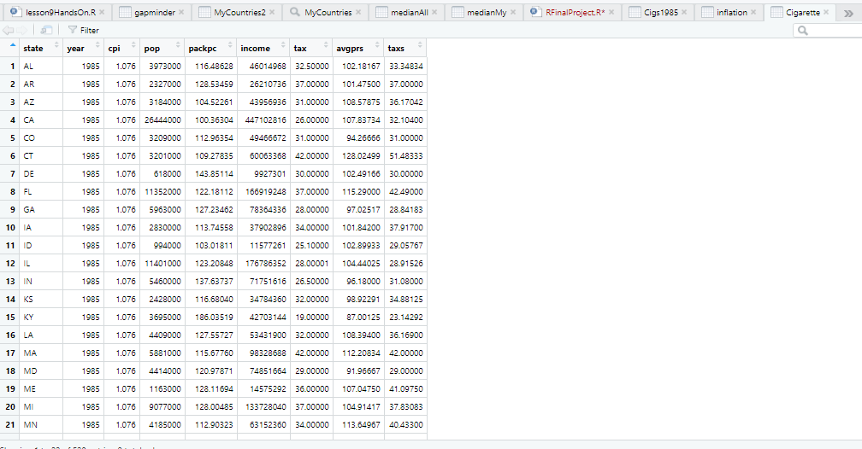

View Data
You can see the first 6 rows of data by typing
Head(Cigarette)
You can scroll through all the data by
clicking on the data set name
head(Cigarette)
state year cpi pop packpc income tax
1 AL 1985 1.076 3973000 116.4863 46014968 32.5
2 AR 1985 1.076 2327000 128.5346 26210736 37.0
3 AZ 1985 1.076 3184000 104.5226 43956936 31.0
4 CA 1985 1.076 26444000 100.3630 447102816 26.0
5 CO 1985 1.076 3209000 112.9635 49466672 31.0
6 CT 1985 1.076 3201000 109.2784 60063368 42.0
avgprs taxs
1 102.18167 33.34834
2 101.47500 37.00000
3 108.57875 36.17042
4 107.83734 32.10400
5 94.26666 31.00000
6 128.02499 51.48333

Slide 4
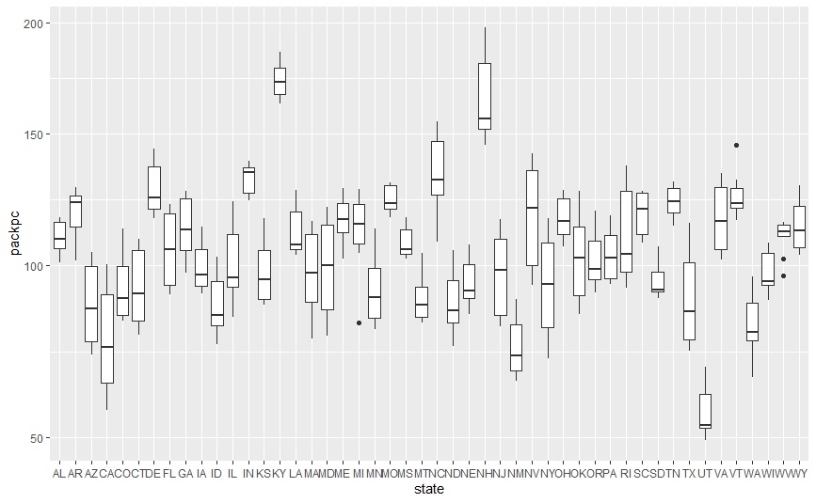
Boxplot of the Average Number of Packs of Cigarettes Per Capita by State
ggplot(Cigarette, aes(x= state, y= packpc)) + geom_boxplot()
Kentucky and New Hampshire had the highest number of cigarette packs
California and Utah had the lowest number of cigarette packs

Slide 5
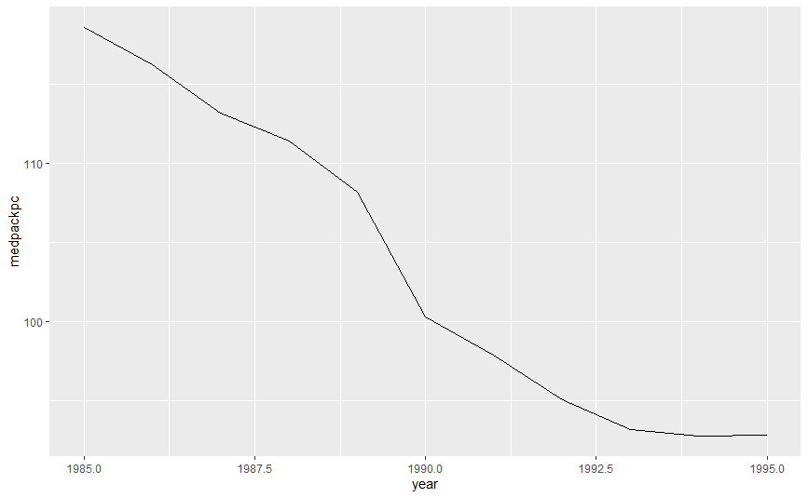
All States Packs of Cigarettes per Capita
Between 1985 and 1995 there
was a steady decrease in the
amount of cigarette packs per
capita. Therefore, cigarette usage
went way down from 1985 to 1995.
ggplot(medianAll, aes(x = year, y = medpackpc )) + geom_line()

Slide 6
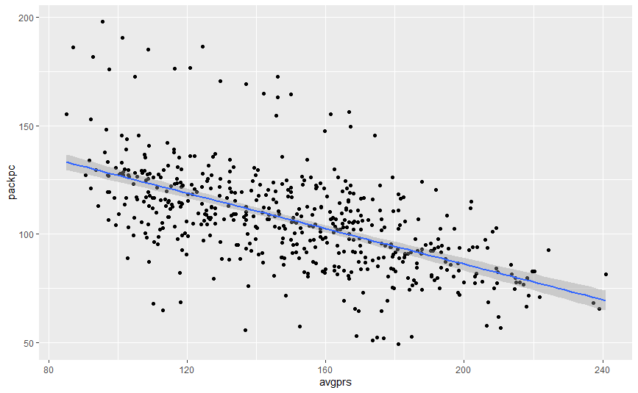
Scatterplot of Price Pack vs Number of Packs per Capita
For all States and Years
The price of cigarette packs and the number of packs per capita are negatively correlated. This is evident
because the line starts higher at
the y axis and slants downward
ggplot(Cigarette, aes(x = avgprs, y = packpc)) + geom_point() + geom_smooth(method = lm)

Slide 7


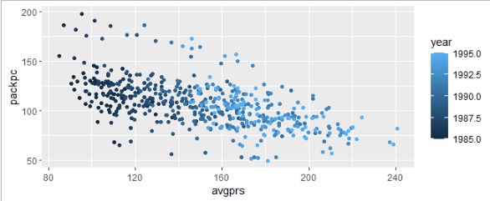
Scatterplot of Price Pack vs Number of Packs per Capita
For all States and Years with colors for years
This Photo by Unknown Author is licensed under CC BY-SA
As you can see on this scatterplot,
the darker the blue the older the
year. In ten years, the amount of
cigarettes smoked decreased
significantly

Slide 8
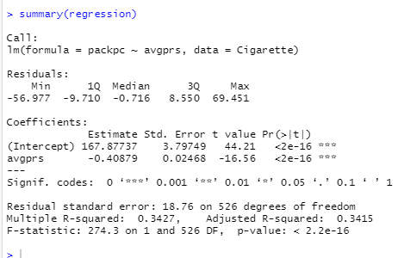
Finding the variability can be done
by running this code and summary()
And then by finding the adjusted R-squared…
The adjusted R-squared measures the variance,
in this case the variance is 34%

Slide 9
Adjusting for Inflation
In order to adjust for inflation
you need to create a new data set for inflation. You can do
so with the following code:
inflation <- Cigarette %>% mutate(adjprice = avgprs/cpi)

Slide 10
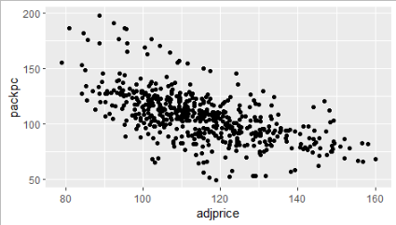
New Scatter plot with adjusted price
ggplot(inflation, aes(x = adjprice, y = packpc)) + geom_point()

Slide 11
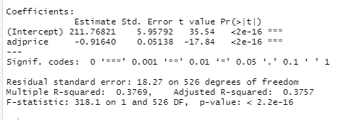
Finding the new variability by
running this code and summary()
regression <- lm(packpc~adjprice,inflation )
summary(regression)
The variability with inflation is higher at 39%

Slide 12
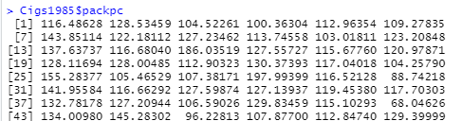
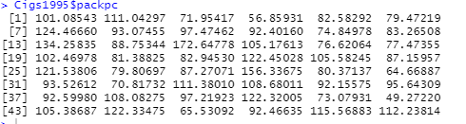
Create a vector for the number
of packs per capita in the year 1985
With the code:
Cigs1985$packpc
Create a vector for the number
of packs per capita in the year 1995
With this code:
Cigs1995$packpc

Slide 13
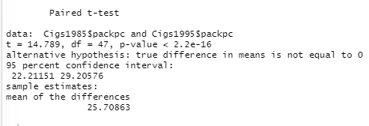
Paired t-test to see if the number of packs per capita in 1995
was significantly different than the number of packs per capita in 1985
t.test(Cigs1985$packpc, Cigs1995$packpc, paired=TRUE)
… and there is a significant difference

Slide 14
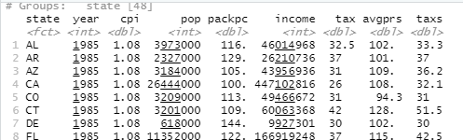
As I was working through this data I was wondering what the cheapest consumer price index for cigarettes was between
1985 and 1995 and which state it was in…
With this code:
Cigarette %>% group_by(state) %>% arrange(cpi)
I found the cheapest consumer price index for the year was found in 1985 in Alabama

