Slide 1
Building a Digital Twin from the IED
Prasath Manickam
ENI603 2021, HAGENBERG, and 10-05-2021
1
Notes:
1

Slide 2

Overview of Thesis
Background:
A research project with Sprecher Automation GmbH (power supply & automation) in Linz, Austria.
Energy 4.0 reformation and the customer’s alternative need.
The research & innovation team wants to explore an option to get virtual replica of a physical system.
The physical system is a protection device (IED device with Embedded Linux).
Issue:
Physical presence of operator needed, devices cost fortune, and accessibility is not intuitive.
Motivation:
Digitalization and Energy efficiency.
Goal:
To find best framework to bring a Digital Twin of physical system (SPRECON-EP).
2
Notes:
2

Slide 3
Overview of Thesis
Protection device (SPRECON-E-P DDx6) used for power system monitoring.
The physical accessibility and devices cost are setback.
Digital Twin is the solution.
Research question:
What is the best approach to bring the Digital Twin directly into a web browser for simulation?
Is this new framework model (Digital Twin) performance impact acceptable?
The design should be available as a playground remotely?
Objective:
A framework brings Digital twin which can run protection
Introduction
State of the art
Related work, approach and problems to be further investigated.
Architecture
The framework in detail explained and discussed.
Implementation
System requirement, technologies, and manual procedure explained.
Evaluation
Epilogue
Background and hypothesis.
Research questions, objectives, and outline structure.
Data acquistion, testing and results are compared.
Conclusion, discussion and future work explained
3
Notes:
3

Slide 4
Introduction
- Industry 4.0 and Energy 4.0 are the biggest revolution for smart grids, cyber-physical system, IoT and energy efficiency.
- The diverged and distributed systems integration led to system inconsistency.
- Simulation is a vital part to solve real-time problems.
Research question:
What is the best approach to bring the Digital Twin directly into a web browser for simulation?
Is this new framework model (Digital Twin) performance impact acceptable?
The design should be available as a playground remotely?
4
Notes:
4

Slide 5
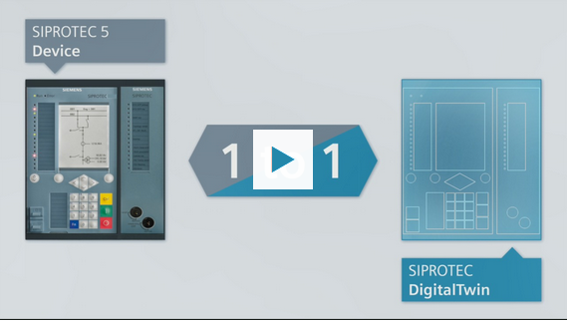
State of the Art
GE DigitalTwin
Siemens DigitalTwin
Source: GE, Siemens
5
Notes:
5

Slide 6






Cont..
Hardware
NAT router
Web
Digital Twin
Kernel
Issue: In-bound traffic to the web browser must be further researched.
6
Notes:
6

Slide 7
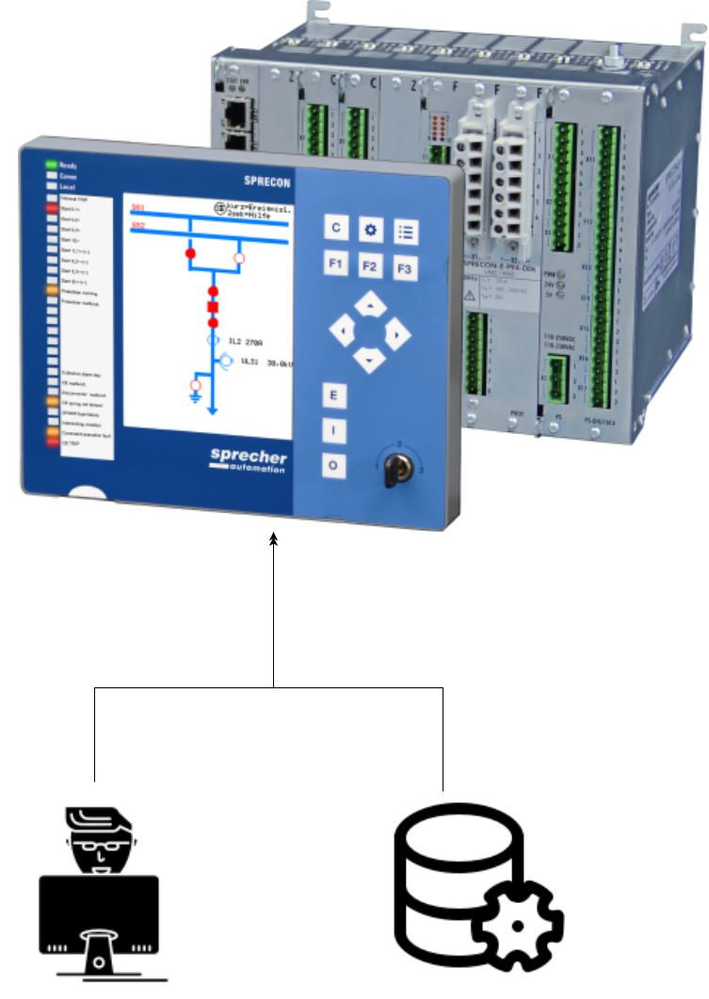
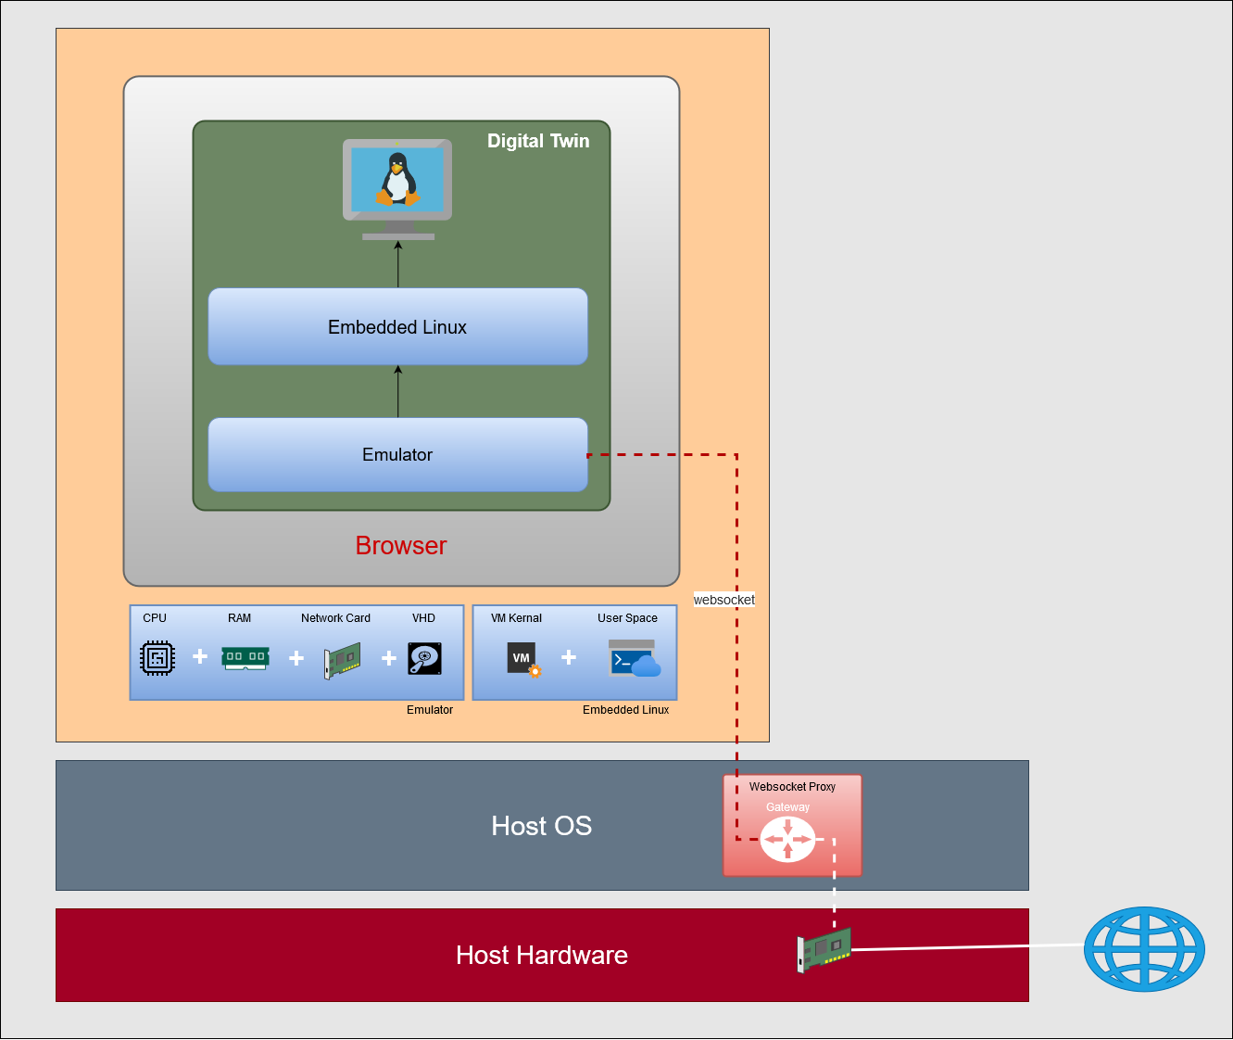

Architecture
Current:
Source: protection
7
Notes:
7

Slide 8
Architecture
Transformation:
8
Notes:
8

Slide 9
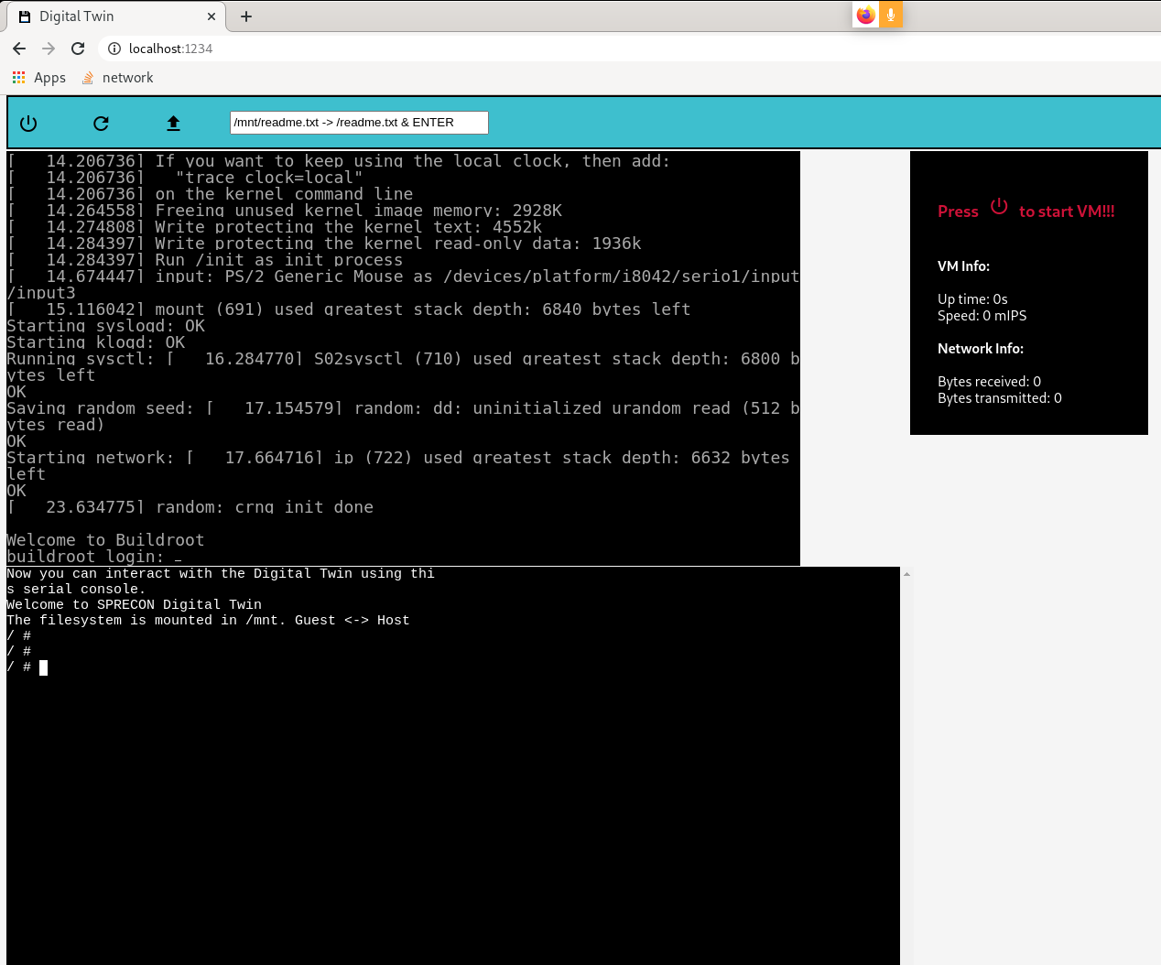
Implementation
A web framework achieved using JavaScript and WebAssembly.
Emulator
Bootable Embedded Linux image
COMM-3 protection device settings
COMTRADE(Common format for Transient
Data Exchange for power systems)
9
Notes:
9

Slide 10
Evaluation
Data
Embedded bootable Linux image, Protection device settings, Comtrade file, testing procedure and results.
Testing
Three use-cases of different Comtrade play with amount of data.
Evaluation
Machine performance/day and comparison of CPU, memory and network usages with physical and VM.
10
Notes:
10

Slide 11
Current status of the work
Status:
A web framework is in place.
WebSocket proxy for out-bound traffic (bit tricky).
Writing the second and third chapter.
Currently integrating protection system image into Digital twin.
Next finding best use-case, test, evaluate and get results.
Open issues:
Find an approach to make in-bound traffic using network stack or serial communication.
11
Notes:
11

Slide 12
Cont..
Timeline
May end
Finished writing 2nd chapter(State of the art)
June end
Finished 3rd (Architecture) and 4th (Implementation) chapter.
Demonstrate final prototype to Company and Advisor.
Before deadline
Finished all chapters with Abstract ready for submission.
Start preparing for the Thesis defense.
Testing and results evaluation.
12
Notes:
12

Slide 13
Q & A
Thank you for listening!!!
13
Notes:
13

