Slide 1
Digital Twin
Prasath Manickam

Slide 2
What is a Digital Twin?
Digital Twin is a virtual replica of physical system in the browser.
DT is an UNIX-like OS for improved browsers and written in JavaScript.
It comprises a virtual machine, shell, process management, virtual file system, and terminal window.

Slide 3
Problem statement
The testing and validation of SPRECON device need operators to be available locally due to model limitation.
The data simulation device costs a fortune.
The system is not available as playground to the user.

Slide 4
Goal
Finding a model to bring the Linux system into the web-browser.
The model should behave as similar to physical system.
The simulation, testing and validation of the SPRECON device must be achieved from the web-browser.

Slide 5
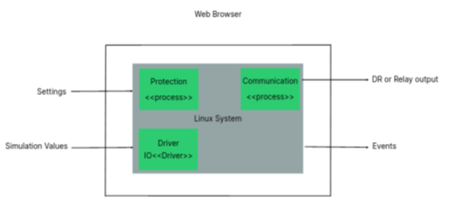
Model
The system constitutes protection specific processes, drivers and communication.
Takes COMM3 settings & Comtrade values as input.
The event list, disturbance record, and measurement values are desired outputs.

Slide 6
Technology recommendation
Emulators – JSLinux or v86 or TinyEMU or jor1k
Language – QT, C++, JavaScript & Web Assembly
Compiler – Emscripten
Architecture – x86 compatible CPU
File system – VirtIO
Distribution – Alpine or Buildroot

Slide 7
Technology recommendation
Terminal.js
JSLinux.js
CPU.js
HTML
Emscripten
Kernel + asm.js + DOM

