Slide 1
Go for New Intermediate-Advanced Developers
sathishvj

Slide 2
Examples
Speed up execution with sync-wait
Cross Compilation
No Code VMs like JVM, .NET, Python, Node, Perl
Easy deploy
Communicating with Concurrent Routines
Near OOPs with structs and interfaces

Slide 3
Speed Up Execution with Easy Concurrency

Slide 4
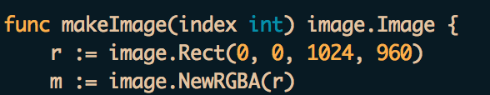
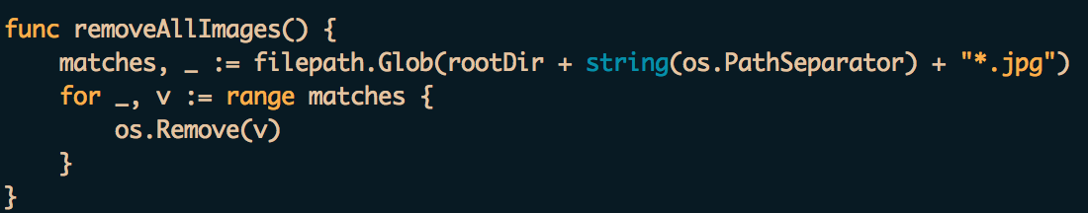
First Read Some Code

Slide 5
Language Constructs You’ll Find New
New variable initialization with :=
Multiple return values from functions
Return values can be ignored with underscore
sum, _ := SumAvg(5, 6)
Variables declared HAVE to be used
Compile time error if not used
Forget semicolons (mostly)
Some new keywords: range, defer

Slide 6
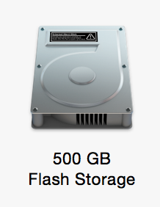
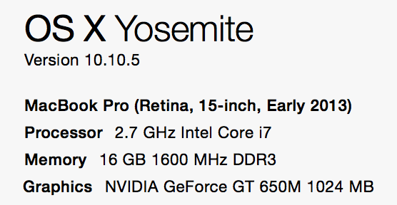
My Machine

Slide 7
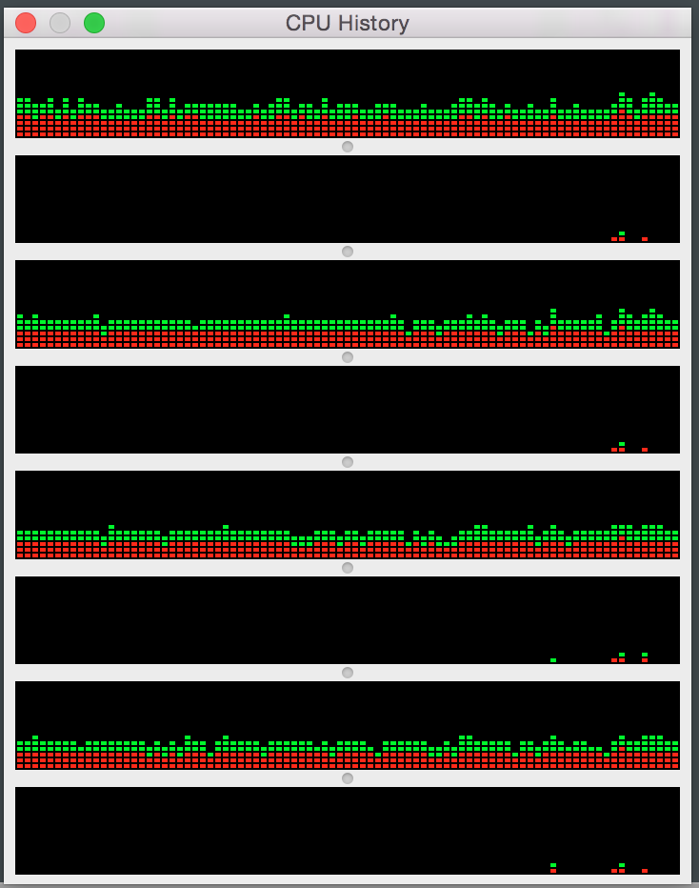
Normal CPU Usage

Slide 8
Problem Statement
CPU Intensive Bitmap Work
Create 1000 images …
Jpg {1024x960}
Highest Quality
Save to disk

Slide 9
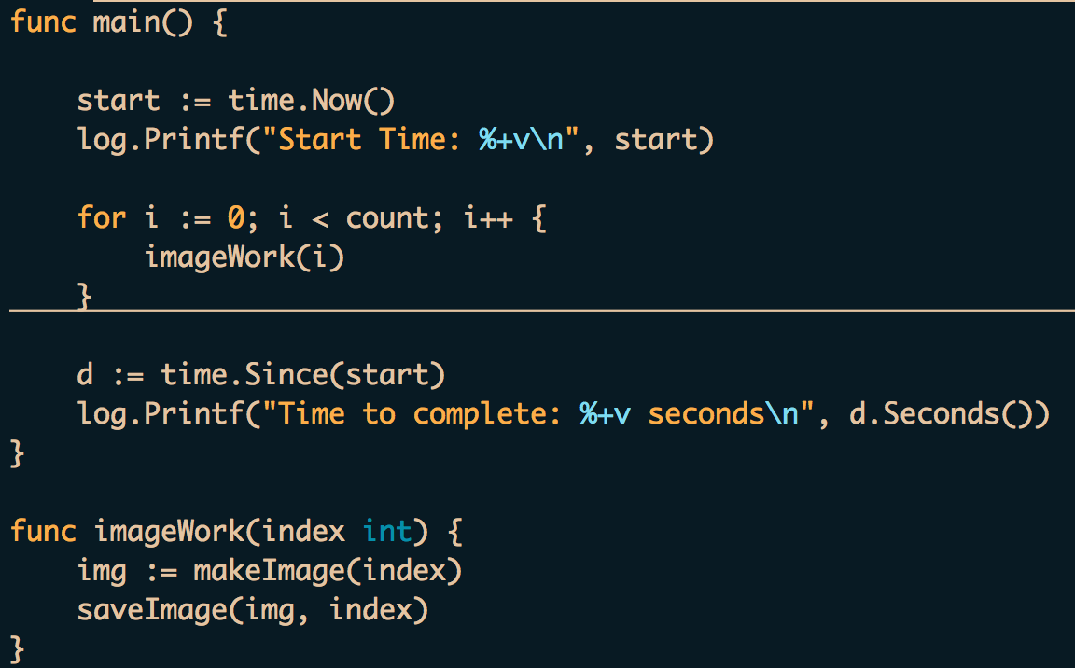
Direct Looping

Slide 10
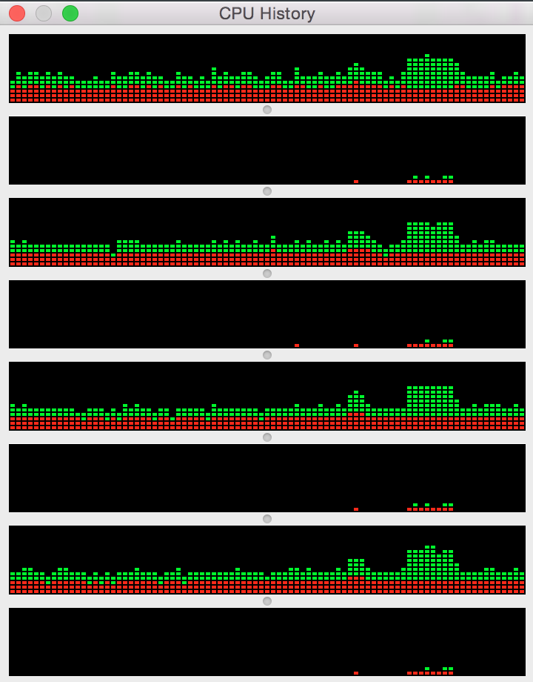

Direct Looping
~ 42 seconds

Slide 11
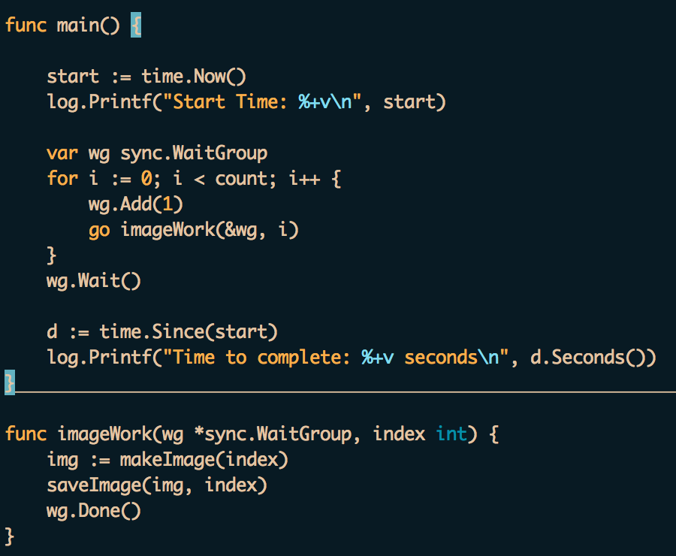
Sync-Wait

Slide 12
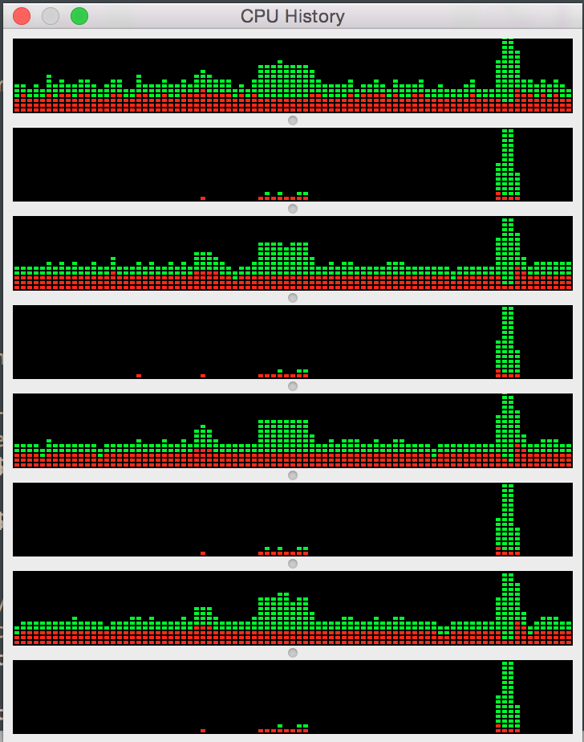
Sync-Wait
~ 14 seconds

Slide 13
Cross Compilation
GOOS=windows GOARCH=amd64 go build -o program.exe

Slide 14
Communicating with Concurrent Routines

