Slide 1
Data Overview:
performance.tsv | Match Stats.
identity_card_0.tsv + identity_card_1.csv | Player Identity.
medical_information.xlsx | Physical & Health Data.
moms_notes.json | Additional Notes.
hockey_scouting_notes.csv | Scouting Attributes.
Contracts_competition.pkl | Contract/Salary data.
Approach & Workflow
Loaded Files
Cleaned Formats
Merge Tables
Exploratory Data Analysis
Insights
Loaded Files

Slide 2
Preprocessing – Loading & Format Diversity
Loading 6 heterogeneous data source:
File | Format | Challenge
performance.tsv | TSV | Tab-separated, needs explicit sep="\t"
identity_card_0 | TSV | Column names in Latin
identity_card_1 | CSV | Standard, used for concat
medical_information | Excel | No header row, junk rows at top
moms_notes | JSON | Needed null check
contracts | PKL | Binary format, loaded via pickle

Slide 3
Preprocessing: Format Standardization
Format Standardization Before Merge
Latin Column Names → English (identity_card_0)
praenomen → first_name , cognomen → last_name, sexus → gender
Roman Numeral IDS → Integers (identity_card_0)
International_id was stored as Roman numerals (e.g. XIV → 14)
Custom roman_to_int() function applied.
Medical Excel file had no header + junk rows
Columns manually assigned (medical_id, height, weight, age, shoe_size, body_fat, ...)
First 3 rows skipped with iloc[3:]
Result: Two identity files safely concatenated into one unified identity data frame

Slide 4
Data Relationships: Joining Sources Into One Master Dataframe
performance
identity
on: international_id
Base Table
scouting
on: international_id
contracts
on: international_id
medical
on: medical_id
Why two keys? Medical data uses a separate medical_id system — it is linked through the identity table via international_id

Slide 5
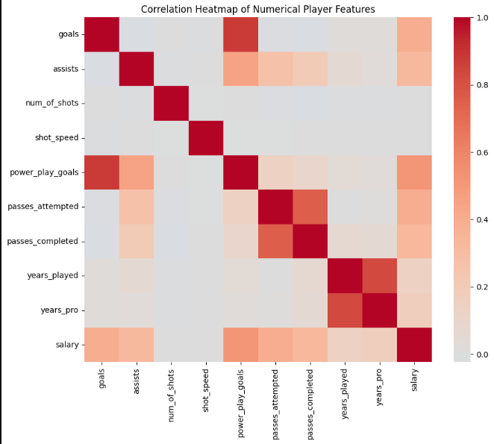
Data Relationships: Correlation Analysis
Numerical Feature Relationships:
passes_attempted ↔ passes_completed
Very High · Effort consistency metric
goals ↔ power_play_goals
High · Top scorers dominate power plays
years_played ↔ years_pro
High · Expected career progression
shot_speed ↔ goals
Weak · Raw speed ≠ scoring ability

Slide 6
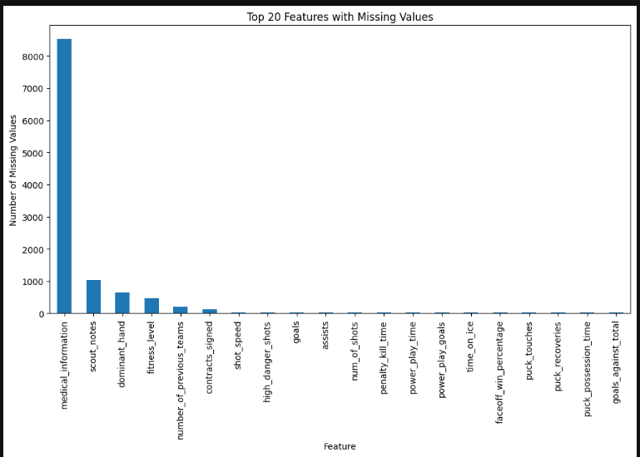
Data Cleaning: Missing Values
Missing Data Analysis:
moms_notes has its own missing value profile — checked separately.
Some columns have structural missingness (e.g. not all players have medical records)
Left joins intentionally keep NaNs rather than dropping rows
Strategy: Identify → Understand → Flag. No rows dropped at this stage.

Slide 7
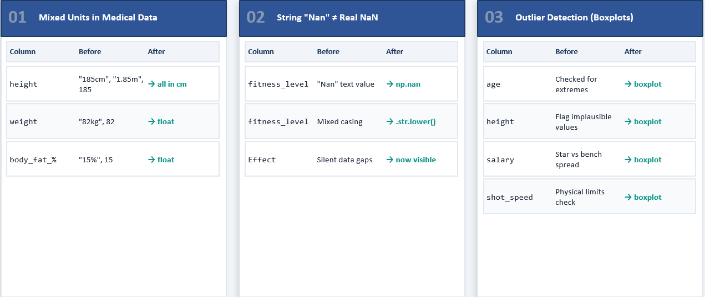
Cleaning: Outliers & Unit Inconsistencies
Fixing Dirty Values — Units, Outliers & Encoding:

Slide 8
Key Insights & Discussion
Most important findings from the unified dataset
Player Profiles
Positions, dominant hand, experience levels quantified.
Skewed distributions — more veterans than rookies
Performance Signals
Pass completion rate is stable & measurable → reliable feature
Power play goals tightly correlate with total goals.
Performance Stats are strongest predictors.
Salary vs Output
Salary correlates moderately with performance metrics
Some outliers suggest over/underpaid players worth investigating
Data Quality
moms_notes: highest missingness → supplementary only
Medical records missing for subset of players

