Slide 1
Rainfall Prediction
Machine Learning Approach for detecting Rain in the second day of prediction.
Members: Dawoud Tormos, Ghandi Mahmoud

Slide 2
Problem Definition
Detecting whether tomorrow will be rain or no based on measurements and factors collected from the previous day.

Slide 3
How Rain is Predicted Usually?
Atmospheric water vapor: Measured using precipitable water to determine moisture availability.
Cloud formation triggers: Analysed for stability and height to predict rain type (e.g., stratiform or convective).
Weather models: Use satellite imagery and weather balloon data to provide precipitation forecasts.
Human expertise: Forecasters add local knowledge to refine predictions, especially for thunderstorms.
Measurement tools: Rainfall is recorded using gauges and modern automated systems.

Slide 4
Our Machine Learning Approach
Although it may not be perfect, it highlights the potential of Machine Learning in weather prediction and similar fields.
By achieving respectable accuracy, it demonstrates the ability to reduce human effort in weather forecasting.

Slide 5
Dataset
Dataset is used collected from several weather station in Australia and provided on the official government website.

Slide 6
Source & Acknowledgements
The observations were gathered from a multitude of weather stations. You can access daily observations from http://www.bom.gov.au/climate/data. For example, you can check the latest weather observations in Canberra here: Canberra Weather.
Definitions have been adapted from the Bureau of Meteorology's Climate Data Online. Data source: Climate Data and Climate Data Online.
Copyright Commonwealth of Australia 2010, Bureau of Meteorology.

Slide 7
Features Used
All Features in the dataset where used as they all where relevant to the target.
Date | Location | MinTemp | MaxTemp | Rainfall | Evaporation
Sunshine | WindGustDir | WindGustSpeed | WindDir9am | WindDir3pm | WindSpeed9am
WindSpeed3pm | Humidity9am | Humidity3pm | Pressure9am | Pressure3pm | Cloud9am
Cloud3pm | Temp9am | Temp3pm | RainToday | RainTomorrow (Target)

Slide 8
Target
RainTomorrow: Yes or No

Slide 9
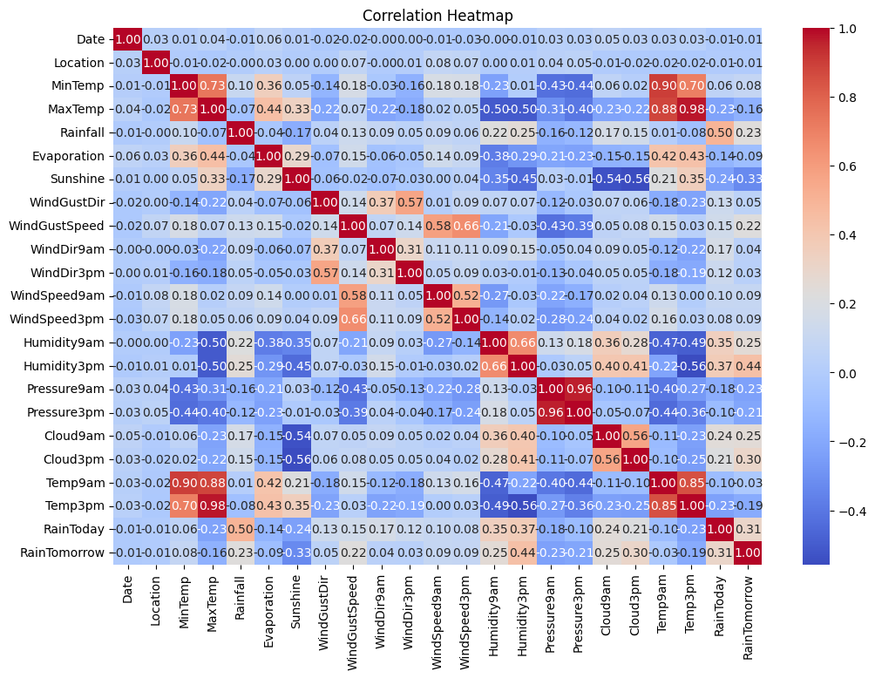
CORRELATION HEAT MAP

Slide 10
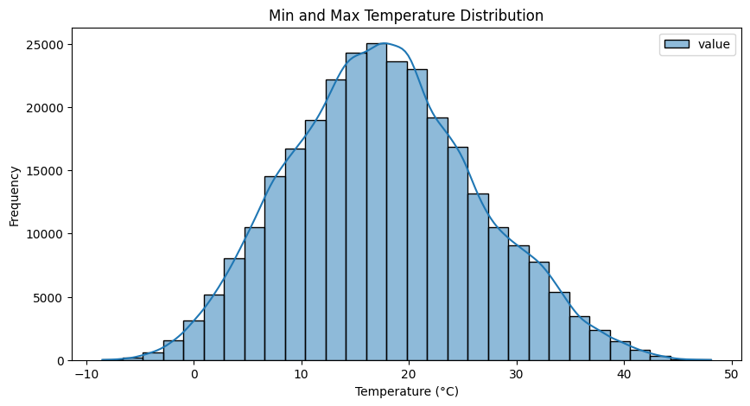
Min and Max Temperature Distribution

Slide 11
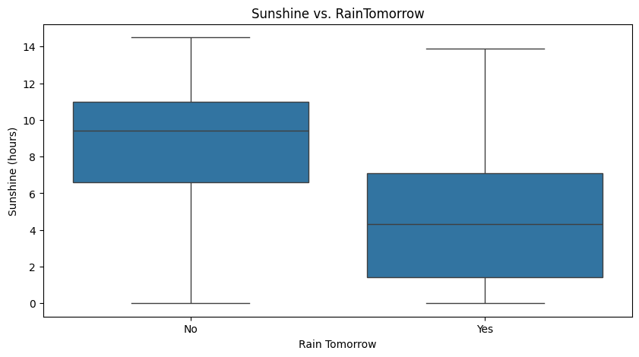
Sunshine vs. RainTomorrow

Slide 12
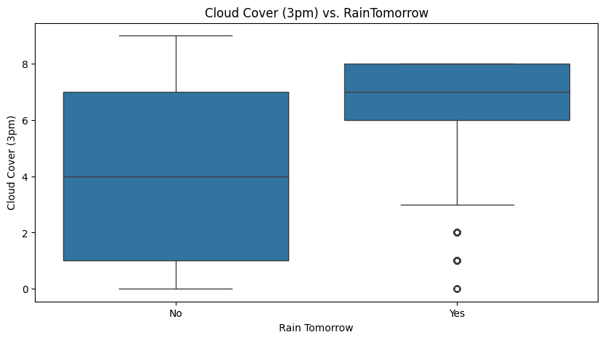
Cloud Cover (3pm) vs. RainTomorrow

Slide 13
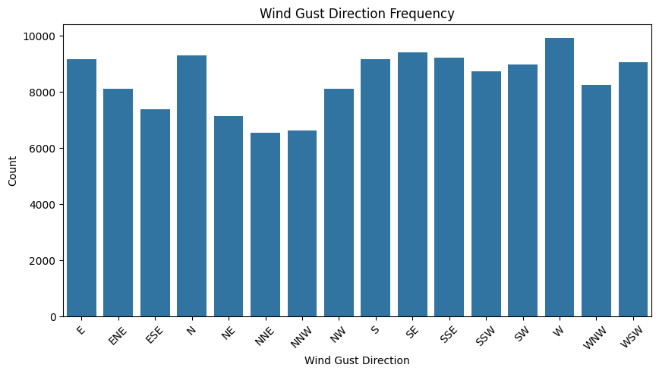
Min and Max Temperature Distribution

Slide 14
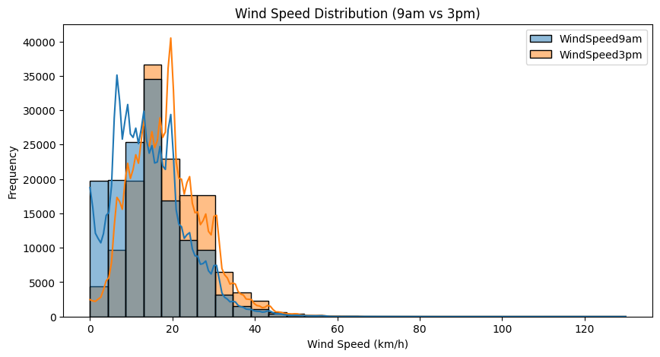
Wind Speed Distribution (9am vs 3pm)

Slide 15
Min and Max Temperature Distribution

Slide 16
Data Preprocessing
Missing-Values Handling
Scaling / Normalization
Encoding Technique

Slide 17
Missing-Values Handling
Missing values if numerical were replaced with their average and if categorical were replaced with the most used value.
Rows with over 8 of missing values where dropped.

Slide 18
Scaling / Normalization
Numerical values where normalized using MinMaxScaler

Slide 19
Encoding Technique
Encoding used was Label Encoding.
Label Encoding is a crucial technique in machine learning for transforming categorical variables into a numerical format that algorithms can process.

Slide 20
Algorithms Used
K-Nearest Neighbors (KNN)
Logistic Regression
Decision Tree Classifier
Random Forest Classifier
Naive Bayes NB

Slide 21
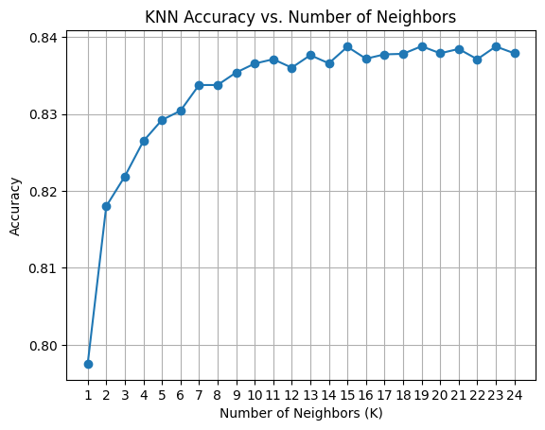
CHOOSING BEST K-VALUE FOR K-NN MODEL

Slide 22
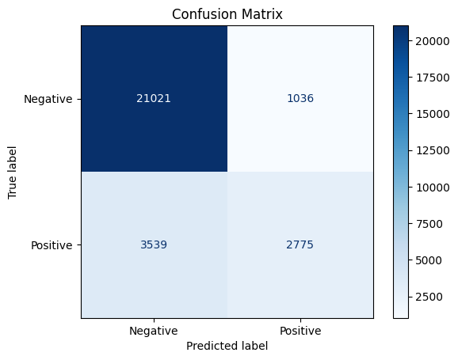
CONFUSION MATRIX FOR K-NN RESULTS

Slide 23

CONFUSION MATRIX FOR LOGISTIC MODEL RESULTS

Slide 24
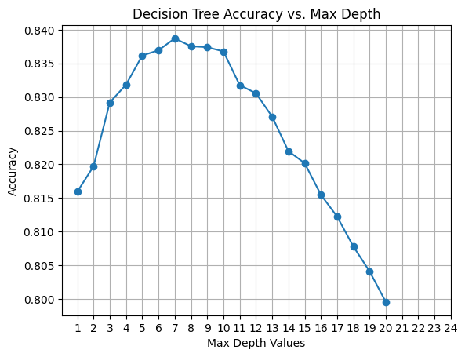
CHOOSING BEST MAX-DEPTH FOR DECISION-TREE MODEL

Slide 25

CONFUSION MATRIX FOR DECISION-TREE Model RESULTS

Slide 26
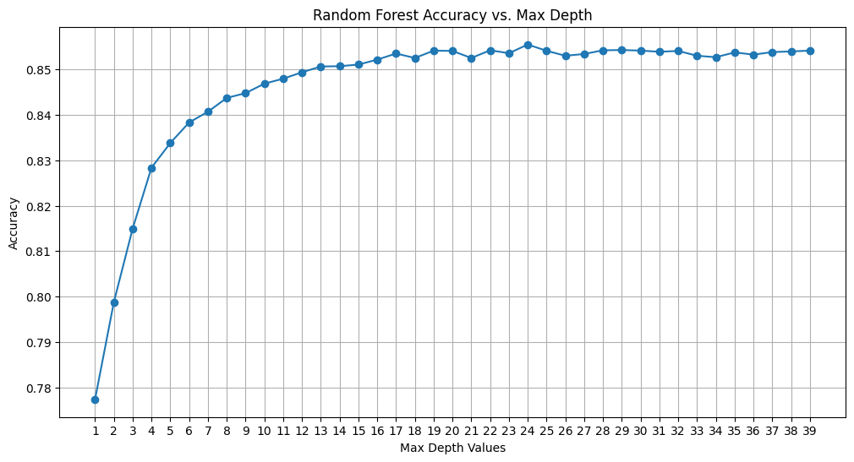
CHOOSING BEST MAX-DEPTH VALUE FOR RANDOM FOREST MODEL

Slide 27

CONFUSION MATRIX FOR RANDOM FOREST MODEL RESULTS

Slide 28
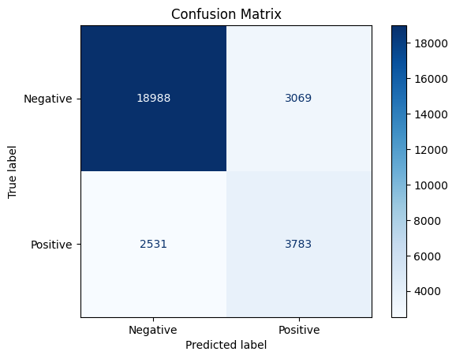
CONFUSION MATRIX FOR NAÏVE BAYES MODEL RESULTS

Slide 29
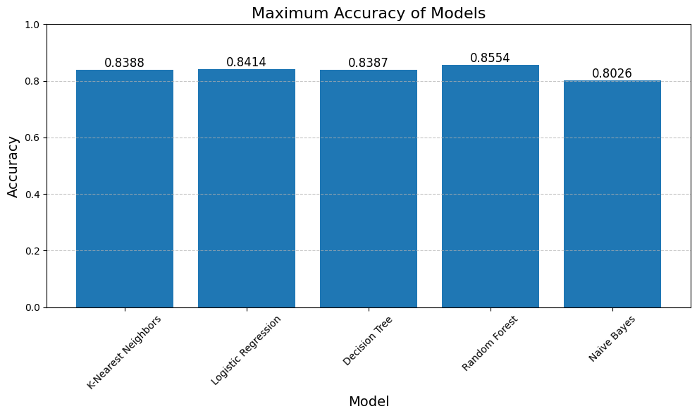
Accuracy Comparison

Slide 30
CONFUSION MATRIX FOR NAÏVE BAYES MODEL RESULTS

Slide 31
CONFUSION MATRIX FOR NAÏVE BAYES MODEL RESULTS

