Slide 1
ECE 298 Greenhouse Agriculture Monitoring System
Group 1 – Wanxin Zhang and Yuxiang Lu

Slide 2
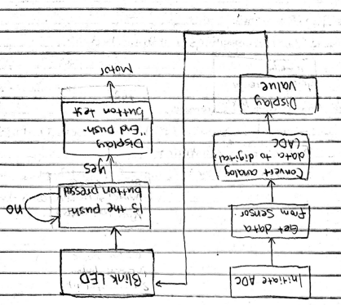
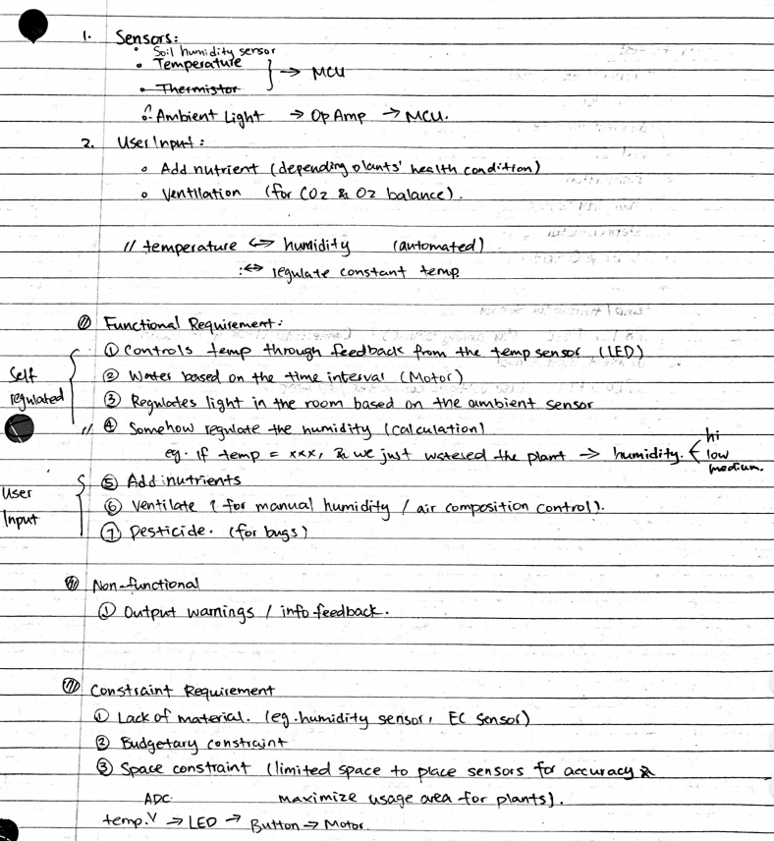
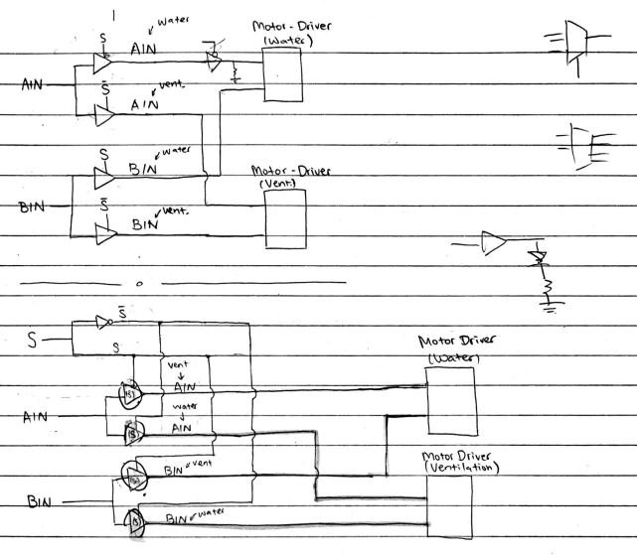
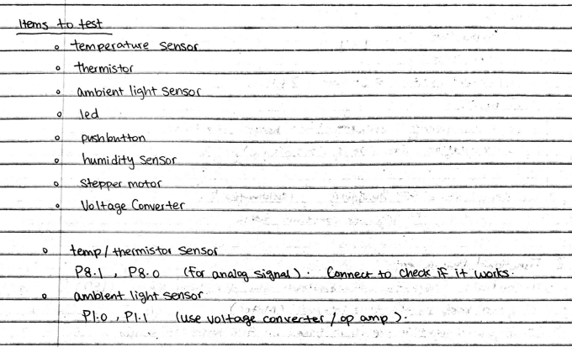
Early Stage Planning

Slide 3
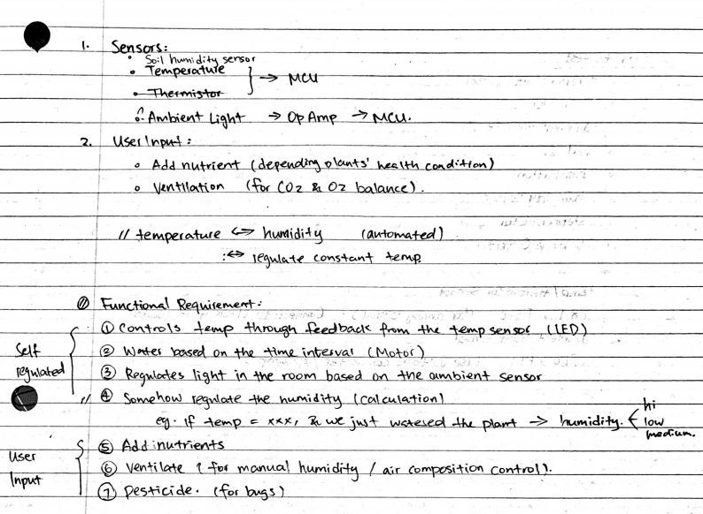
Original Concepts and Design Goals vs. Reality

Slide 4
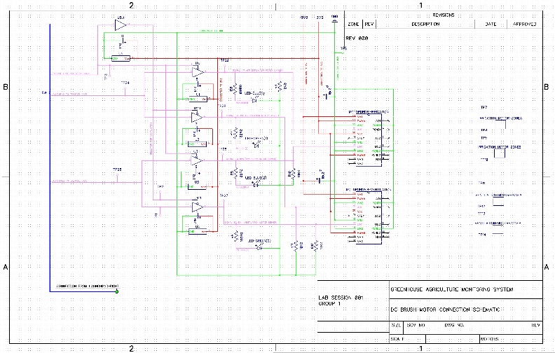
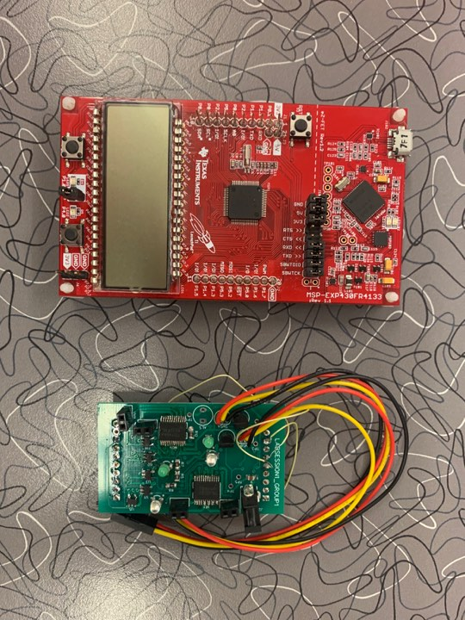
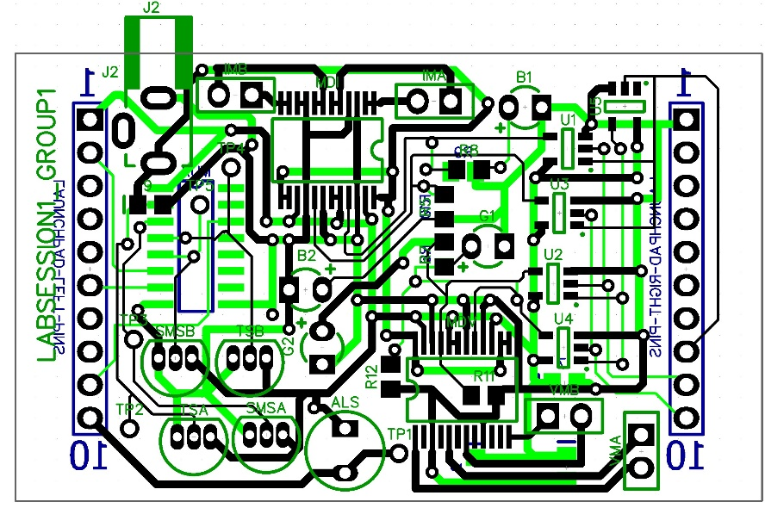
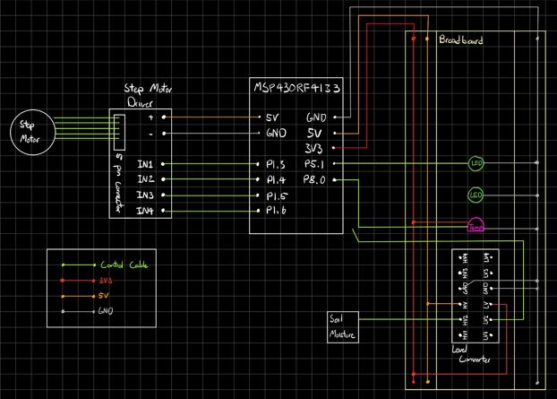
Feasibility Model Prototype Production Model

Slide 5
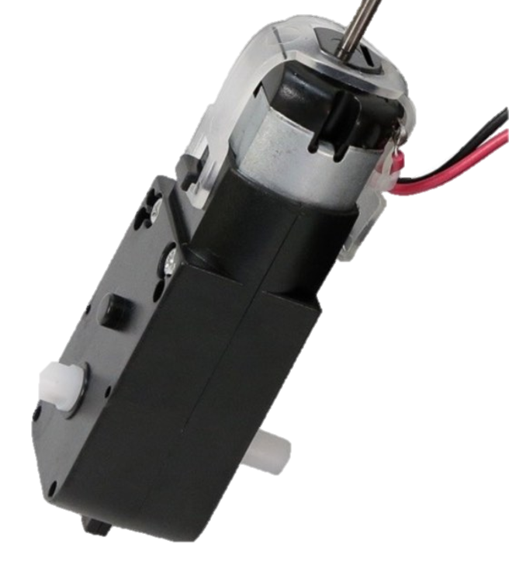
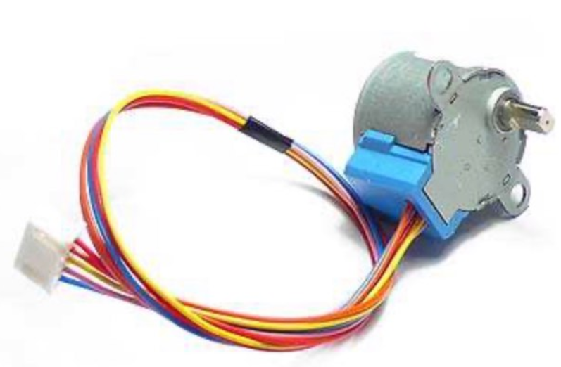
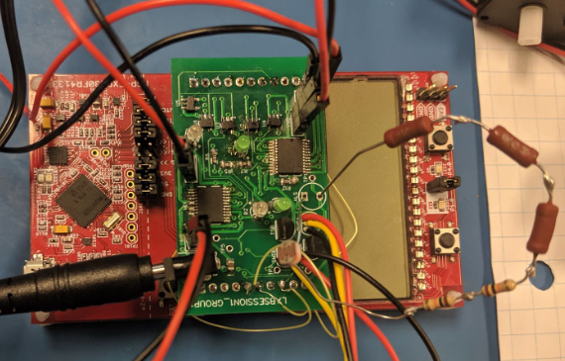
Feasibility Model – Prototype – Production Model
Stepper Motor
DC Brush Motor
Feasibility to Prototype:
Component Replacement
eg. Stepper Motor to DC Motor
Signal Processing
Add components to minimize port use
Circuit Optimization
Add resistor to control current flow (eg. LED)
Prototype to Production Model:
I/O Port Change
Circuit Optimization

Slide 6


Personal Reflection
Independent Learning
Time Management
Challenge: Face Common Weakness
Collaboration
To the fellow students:
“Don’t procrastinate☺”
“Be careful with each step, otherwise problems pile up ☺”
“Test your circuit board while you solder☺”

Slide 7
Questions?

