Slide 1
[Re] Unpaired Image-to-image Translation Using Cycle-consistent Adversarial Networks (CycleGAN)

Slide 2
Introduction

Slide 3

Adding schedule to regularization term
Main Objective Function:
$$L\left(G,F,D_{X},D_{Y}\right)=L_{GAN}\left(G,D_{Y},X,Y\right)+L_{GAN}\left(F,D_{X},Y,X\right)+λ∗L_{cycle}(G,F)$$
Replaced $λ$ with $(λ_{0}+c ∗t)$ where $λ_{0}$ is the initial weight, $c$ is a constant, and $t$ is the epoch count.

Slide 4
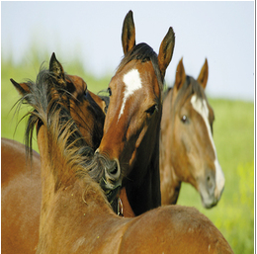
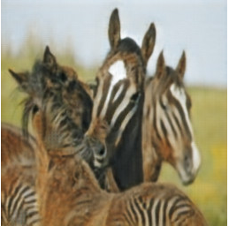
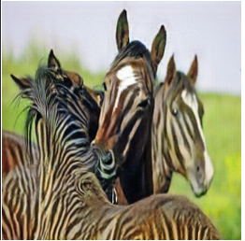

Adding schedule to regularization term
Setting $λ_{0}=0.9, c=0.1$
Smaller discriminator and generator models than original paper
Stronger preprocessing for faster training.
With Regularization
Schedule
Original Image
Zhu et al. (2020)

Slide 5
Using an Ensemble of Discriminators
Use multiple discriminators during the training of a single generator
Forces generator to generalize in order to satisfy ensemble
Makes up for weak discriminators

Slide 6
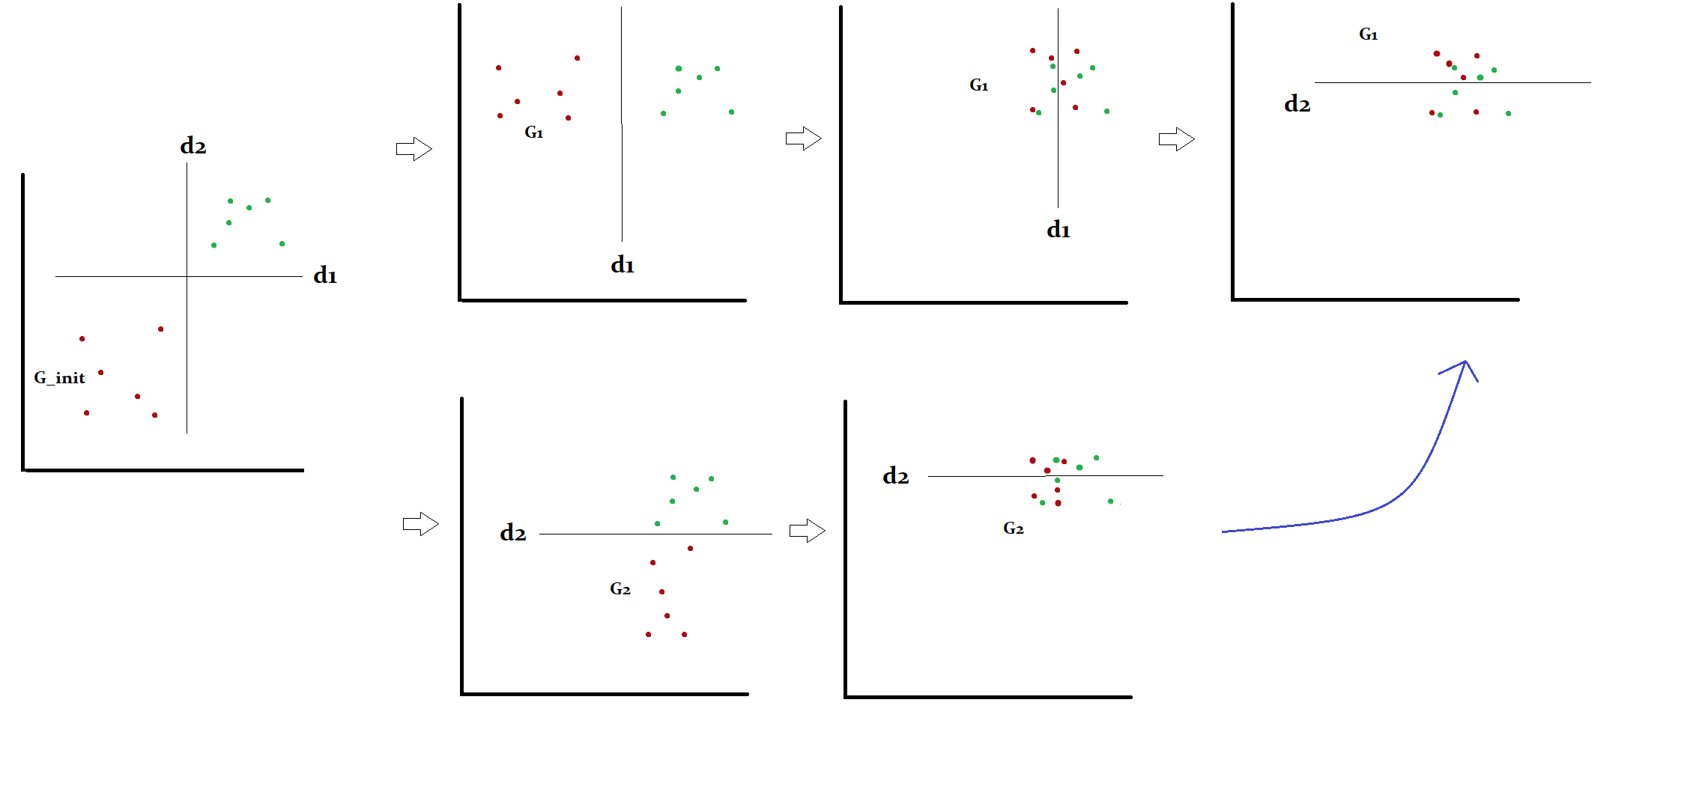
Using an ensemble of discriminators

Slide 7
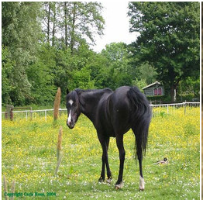
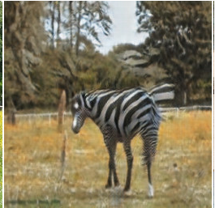
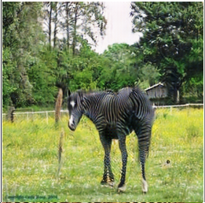
Using an Ensemble of Discriminators
Trained two CycleGANs, A and B, in same way as paper
Used smaller generators and stronger preprocessing for faster training time.
Fine tuned generators from set A with an extra 20 epochs on discriminators from set B
Original Image
Zhu et al. (2020)
With Regularization
Schedule

Slide 8
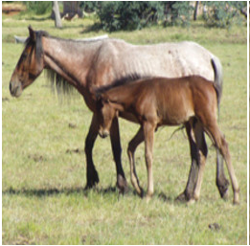
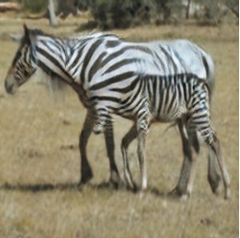
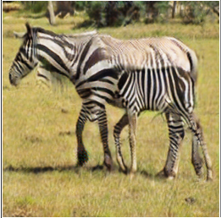
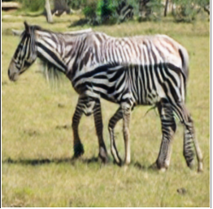
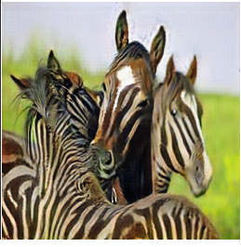
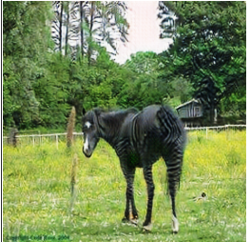
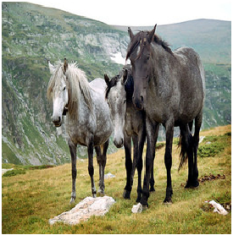
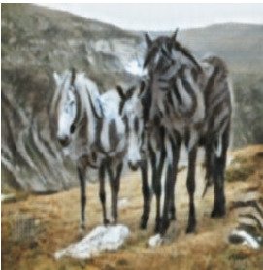
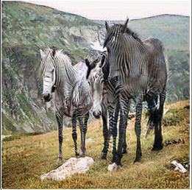
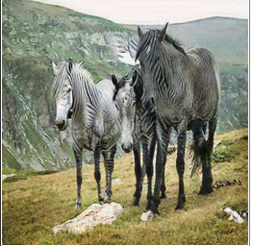
Original Image
With Regularization
Schedule
Discriminator
Ensemble
Zhu et al.(2020)

