Slide 1
[Re] Unpaired Image-to-image Translation Using Cycle-consistent Adversarial Networks (CycleGAN)

Slide 2
Introduction

Slide 3
Discriminator Experiment
Standard GAN discriminator (SGAN) used in original paper
Discriminator maximises capacity to distinguish real from fake images
Looking to optimise D(x) = 0 for fake images and D(x) = 1 for real images
Problem
For high resolution images there is high degree of freedom, makes it easy for d(x) = 0
It hurts performance and stability because it can lead to greedy optimization
Due to gradient, that SGAN is learning mostly from fake images, not trying to make it look more natural

Slide 4
Relativistic Discriminator
Measure the difference in between real and fake images D(xr –xf)
Means it scores the fake differently subject to how "natural" the fakes are
Harder for the discriminator model to overfit, balances training between generator and discriminator better
Relativistic GANs measures the probability that the real data is more realistic than the generated data (or vice versa)
Ultimately D(x) = 0.5 As in the discriminator has random odds of detecting fakes

Slide 5
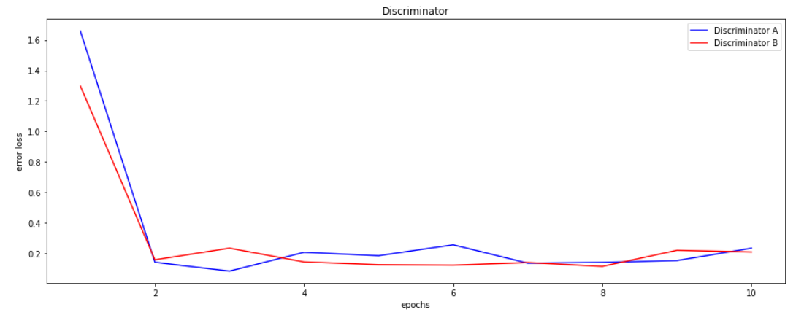
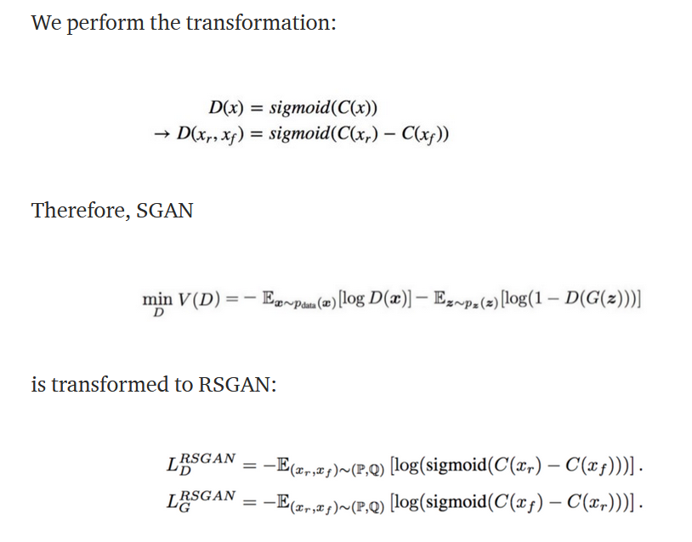
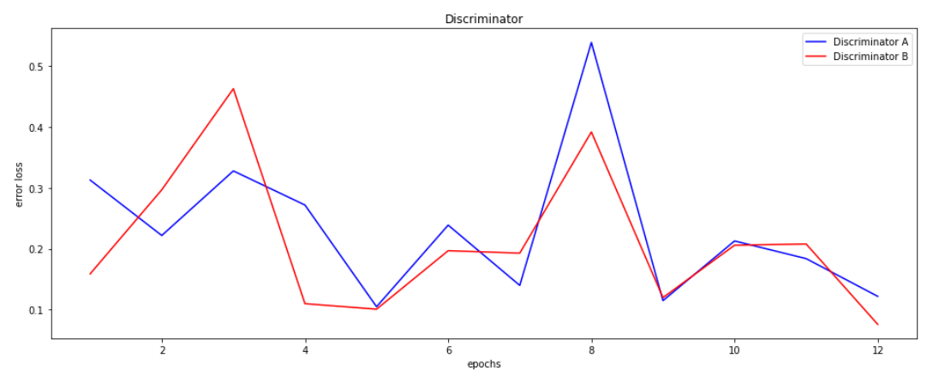
Transformation and results
SGAN - Original
RGAN - Experiment

Slide 6

Adding schedule to regularization term
Main Objective Function:
$$L\left(G,F,D_{X},D_{Y}\right)=L_{GAN}\left(G,D_{Y},X,Y\right)+L_{GAN}\left(F,D_{X},Y,X\right)+λ∗L_{cycle}(G,F)$$
Replaced $λ$ with $(λ_{0}+c ∗t)$ where $λ_{0}$ is the initial weight, $c$ is a constant, and $t$ is the epoch count.

Slide 7
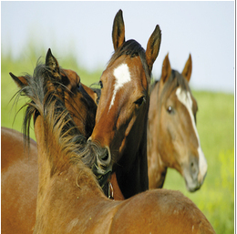
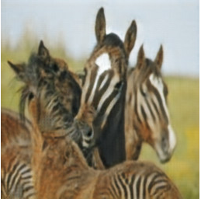
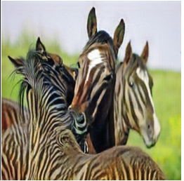

Adding schedule to regularization term
Setting $λ_{0}=0.9, c=0.1$
Smaller discriminator and generator models than original paper
Stronger preprocessing for faster training.
With Regularization
Schedule
Original Image
Zhu et al. (2020)

Slide 8
Using an Ensemble of Discriminators
Use multiple discriminators during the training of a single generator
Forces generator to generalize in order to satisfy ensemble
Makes up for weak discriminators

Slide 9
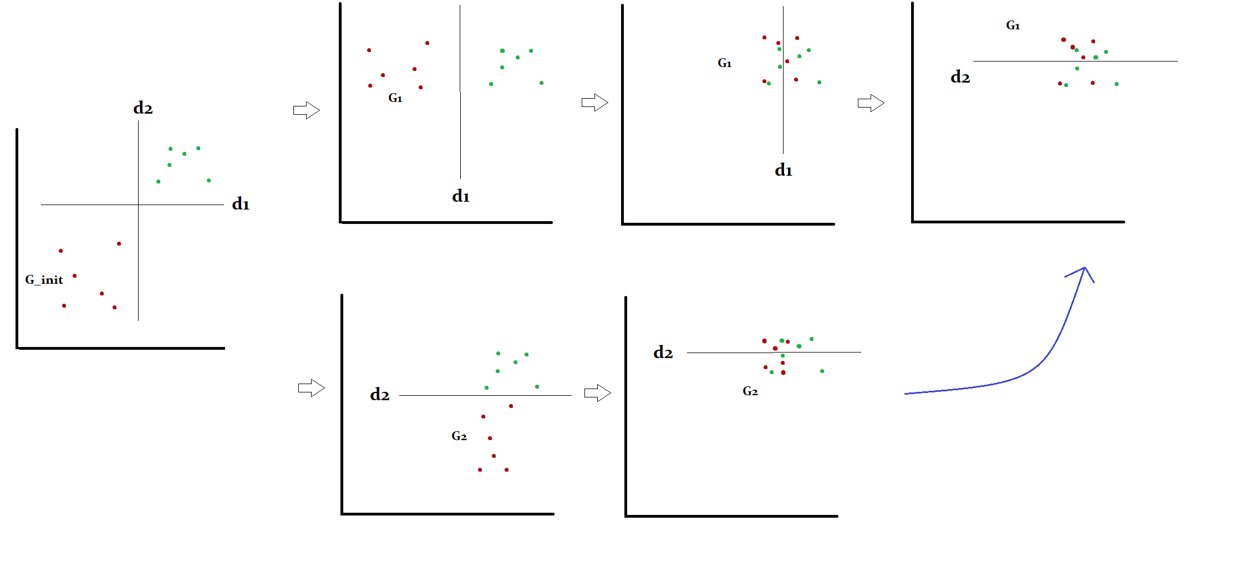
Using an ensemble of discriminators

Slide 10

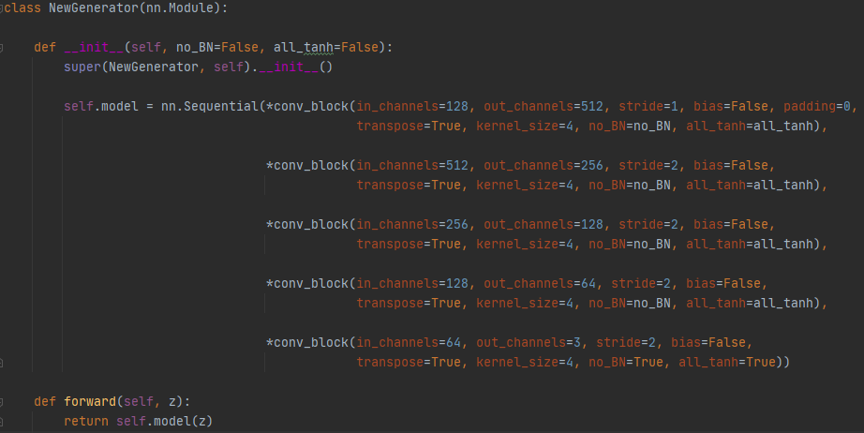
Convolutional NEURAL NETWORK
# of inputs, weight sum, activation function, output
Image classified as label

Slide 11
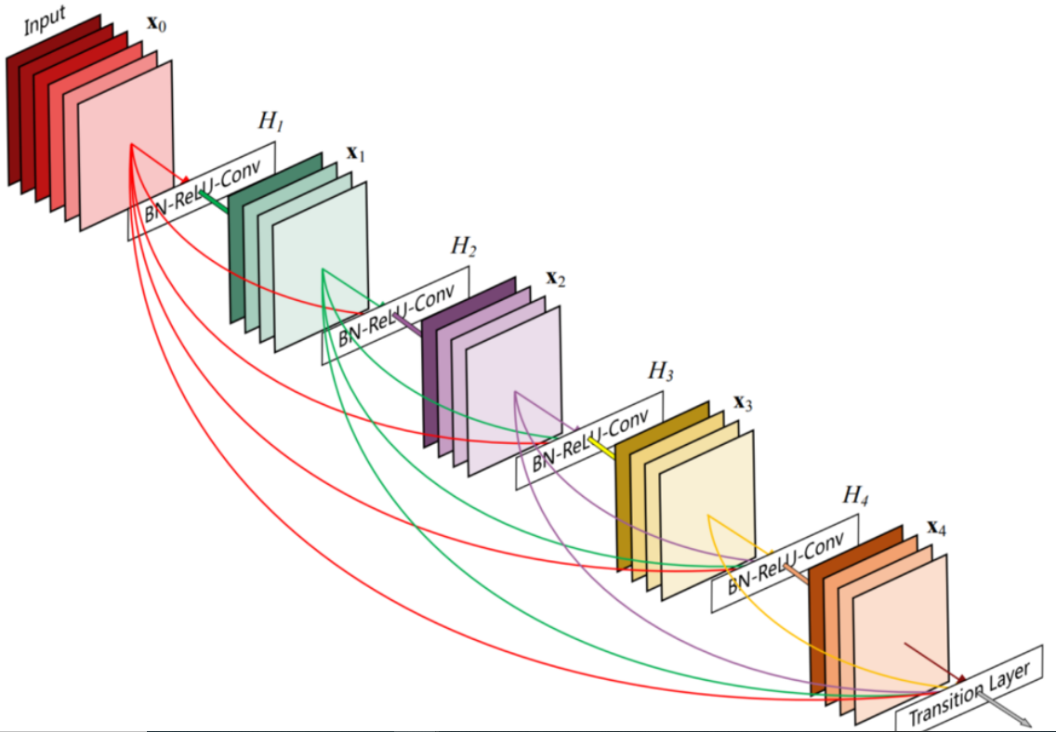
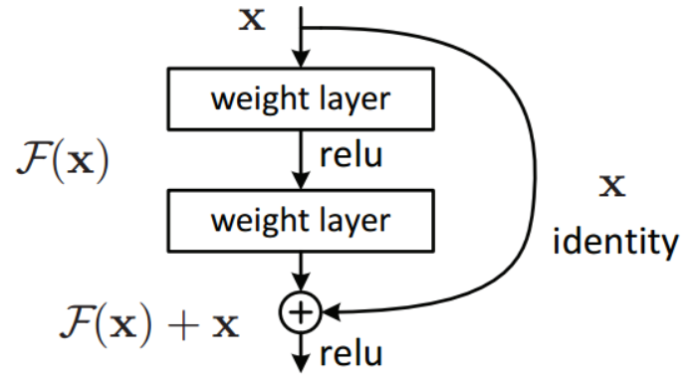
Res-net
Residual blocks w/ skip connections
Vanishing gradient problem: limit in # of layers added in accuracy improvement
Activation is fast-forwarded

Slide 12
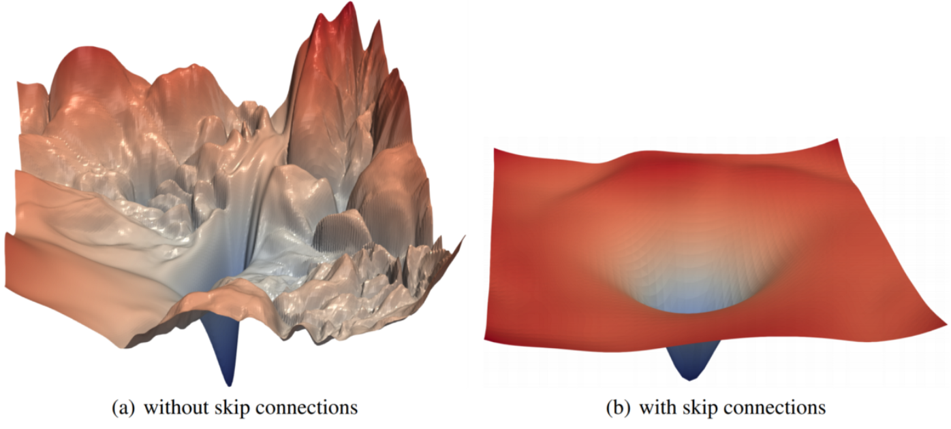
RES-NET
Smoothness of loss function: easier to train model with optimal weights

Slide 13
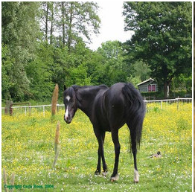
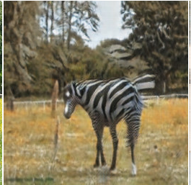
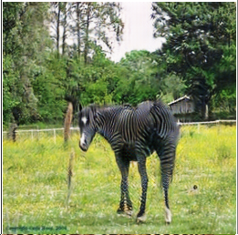
Using an Ensemble of Discriminators
Trained two CycleGANs, A and B, in same way as paper
Used smaller generators and stronger preprocessing for faster training time.
Fine tuned generators from set A with an extra 20 epochs on discriminators from set B
Original Image
Zhu et al. (2020)
With Regularization
Schedule

Slide 14
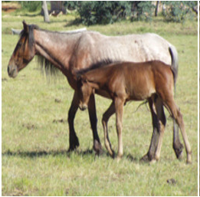
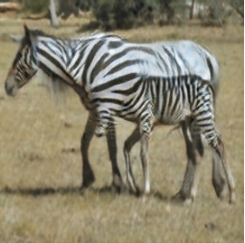
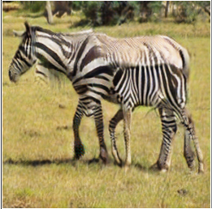
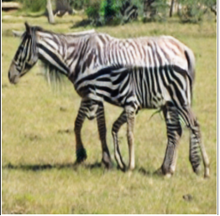
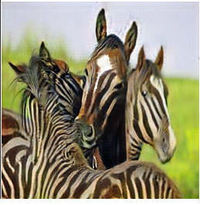
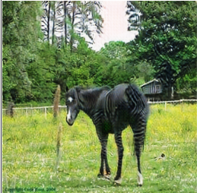
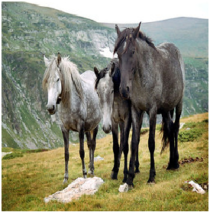
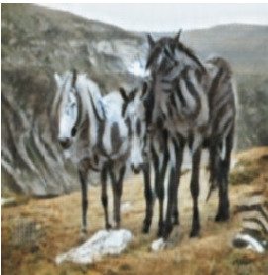
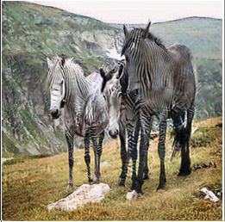
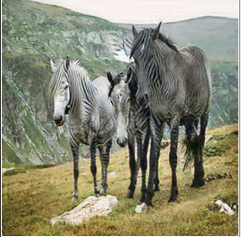
Original Image
With Regularization
Schedule
Discriminator
Ensemble
Zhu et al.(2020)

