Slide 1
Customer Segment Analysis in E-Commerce Data
Dawson Conlon
Ricky Doucette

Slide 2
Introduction of Dataset
E-commerce: The buying and selling of goods online
Origin of data: synthetically generated from Kaggle (publicly available)
Population data: information on customers, products, and order history
Over 150,000 customer transactions
Largest table containing 46 features

Slide 3
What is Customer Segment ?
A classification of the customer importance to the store
Segments from least to most important:
Consumer, Business, Premium, VIP

Slide 4
Goal of Analysis
We want to differentiate between customer segments.
How do customers in different segments interact with the store?

Slide 5
Investigated Features Related to Customer Segment
Customer Lifetime Value: overall spending of a customer within the store
Customer Rating: customers' average overall rating of purchased products
Shipping Cost: how much customers pay for shipping

Slide 6
Importance of Investigated Features
Question we can have insights on:
Do higher segmented customers...
  Spend more money on average
  Rate products better on average
  Spend less on shipping

Slide 7
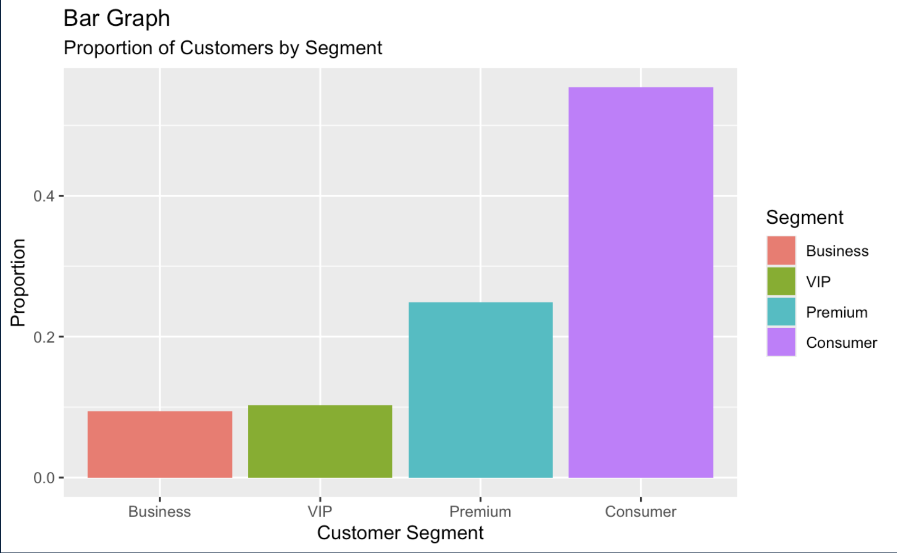

Slide 8
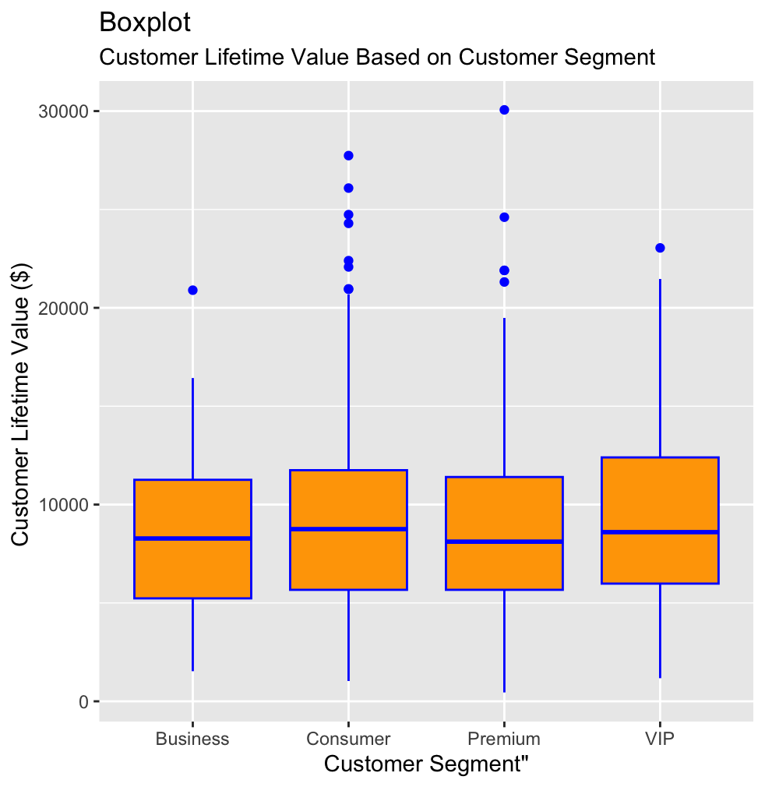
Customer Lifetime Value
Between all customer segments the spread of customer lifetime value Is relatively similar
Consumer segment has the most outliers

Slide 9
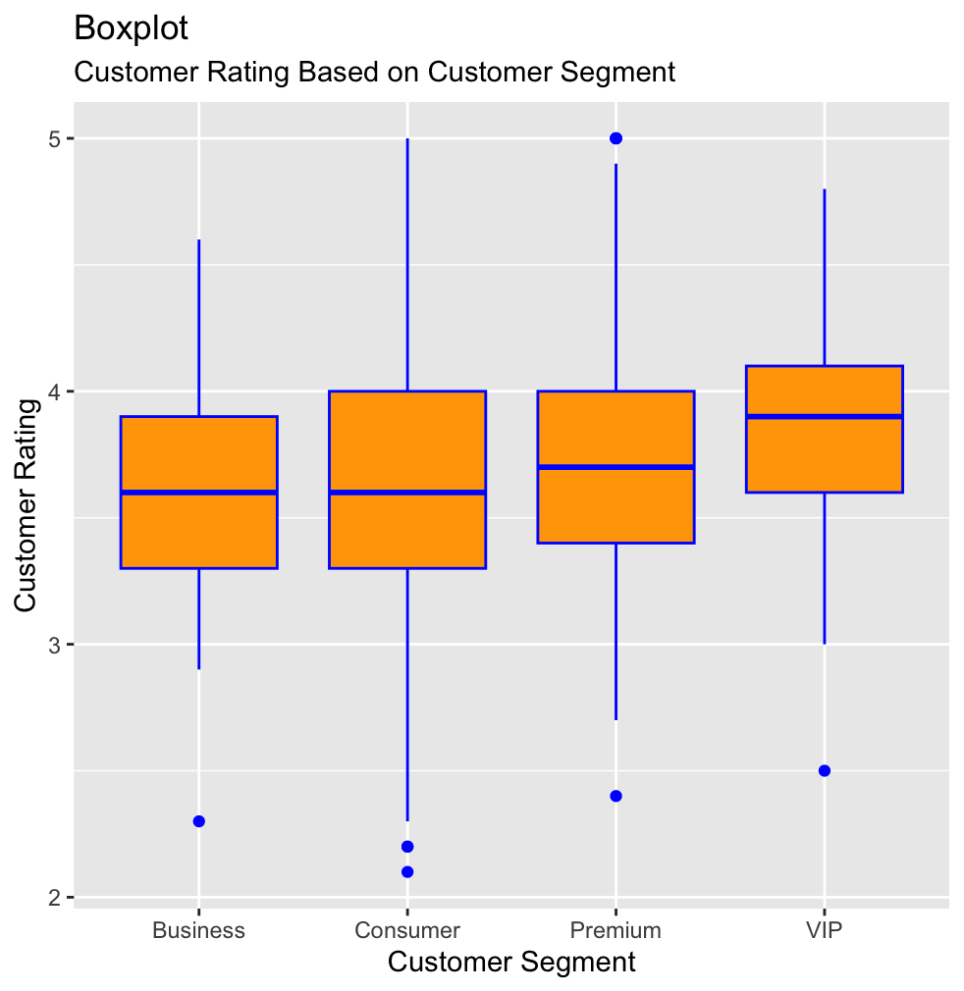
Customer Rating
The first three customer segments have approximately the same median and interquartile range of customer ratings
Vip’s median and first quartile of customer ratings appear higher
Consumer’s range of lower and upper bound is greatest

Slide 10
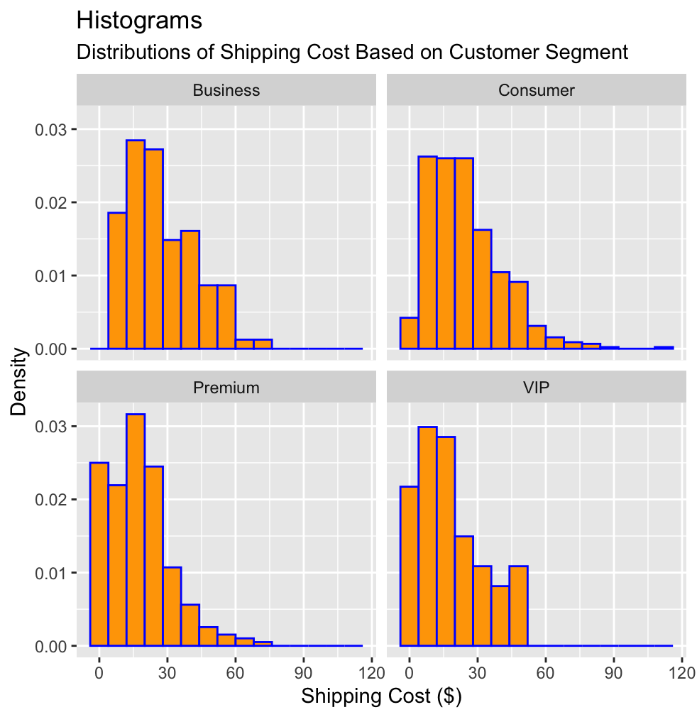
Shipping Cost
Higher segments appear to have more opportunity for free shipping
Business appears to not receive free shipping
Consumers appear to rarely receive free shipping

Slide 11
Approach to Statistical Analysis
Random Sampling to reduce the size of the dataset
Hypothesis test to test significance of claims with Linear Regression models
Confidence intervals to support our findings

Slide 12
Do Mean Customer Lifetime Values Differ Between The Four Customer Segments
H₀: μ_Business = μ_Consumer = μ_Premium = μ_VIP
H_{A}: At least one customer segment’s mean customer lifetime value differs from at least one other customer segments mean customer lifetime value
Linear Regression model for customer lifetime value using customer segment created
Through the ANOVA test, the p-value calculated is 0.3166 which is greater than 0.05.
We fail to reject the null hypothesis that the mean customer lifetime value is equal across customer segments.
Therefore, there is insufficient evidence to conclude that the mean customer lifetime value differs between customer segments.

Slide 13
95% Confidence Intervals For Mean Customer Lifetime Value Separated by Customer segment
Business: $8758.26 - $9492.44
Consumer: $8758.26 - $9492.44
Premium: $8284.14 - $9391.10
VIP: $8556.19 - $10364.03
As we can see the 95% confidence intervals for mean customer lifetime value between customer segments overlap quite a bit.
None of the intervals fall outside the range of any others.
This supports the conclusion we came to of there being insufficient evidence of a difference in mean customer lifetime value between customer segments.

Slide 14
Do Mean Customer Ratings Differ Between Customer Segments
H₀: μ_Business = μ_Consumer = μ_Premium = μ_VIP
H_{A}: At least one segment's mean customer rating
differs from at least one other’s
Linear Regression model for customer rating using customer segment created
Through the ANOVA test, a p-value of 0.000005489 is calculated which is less than 0.05.
We have sufficient evidence to reject the null hypothesis that the mean customer rating is the same for all customer segments.
This means that at least one customer segment’s mean customer rating differs from at least one other customer segment’s mean customer rating.

Slide 15
95% Confidence Intervals For Mean Customer Rating For Each Customer Segment
Business: 3.53 - 3.71
Consumer: 3.57 - 3.65
Premium: 3.69 - 3.81
VIP: 3.77 - 3.96
The 95% confidence intervals for mean customer rating shows that premium customers’ confidence interval falls outside the range of the consumer customers’ confidence interval.
The 95% confidence interval for mean customer rating for VIP customers also falls outside the range of the confidence intervals of both the business and the consumer customers.
This supports our findings that at least one customer segment’s mean customer rating differs from at least one other customer segment’s.

Slide 16
Do Mean Shipping Costs Differ Between Customer Segments?
H₀: μ_Business = μ_Consumer = μ_Premium = μ_VIP
H_{A}: At least one segment's mean shipping cost differs from at least one other’s
Linear Regression model for shipping cost using customer segment created
Through an ANOVA test, a p-value of 0.00000000008602 is calculated which is less than 0.05.
We have sufficient evidence to reject the null hypothesis that mean shipping cost is the same between customer segments.
This means that at least one customer segment’s mean shipping cost differs from at least one other customer segment’s mean shipping cost.

Slide 17
95% Confidence Interval For Mean Shipping Cost For Each Customer Segment
Business: $24.01 - $30.43
Consumer: $22.84 - $25.55
Premium: $15.69 - $19.16
VIP: $15.38 - $21.24
Our 95% confidence intervals for mean shipping cost for the different customer segments supports our findings that at least one customer segment’s mean shipping cost differs from at least one other customer segment’s mean shipping cost.
We can see that the premium and VIP customer segments’ confidence intervals for mean shipping cost fall outside the confidence intervals for mean shipping cost of consumer and business customers.

Slide 18
Conclusion
We found there to be no difference in mean customer lifetime value between customer segments.
We found there to be at least one customer segment’s mean customer rating that is different from at least one other customer segment’s mean customer rating.
Through our findings we suspect that premium and VIP customers’ average rating of products to be higher than that of the lower customer segments .
We also found that mean shipping cost differs for at least one customer segment. Through our findings we suspect that on average premium and VIP customers spend less on shipping.

Slide 19
Discussion
Based on our findings, to increase this e-commerce store’s average product ratings, they could move customers of lower customer segments to higher ones
However, doing so will not directly increase average customer spending.
This finding is valuable to the company because increasing a store’s product ratings tend to bring in more customers and could therefore indirectly increase profit.

Slide 20

Next Steps
Higher customer segments tend to give higher ratings and tend to pay less in shipping
Is there a significant relationship between customer ratings and shipping cost
Do customers who pay less for shipping rate products higher on average
We would also want to determine if customers in higher segments are granted cheaper shipping for being in a higher segment of if they just tend to accept long delivery times to pay less shipping.

