Slide 1
Work hypothesis and background
Current purpose:
Validate QE bulk and vacancy benchmarks.
- Compare QE and DFTpy vacancy energetics.
- Separate numerical convergence from method limitation.
Literature anchor:
Gillan 1989: relaxed Al vacancy ≈ 0.56 eV; experiment ≈ 0.66 eV.

Slide 2
Computational / technical details
QE bulk EOS / B₀ workflow
QE vacancy supercell definition
- Primitive fcc Al bulk cell: 1 atom.
- EOS scan: 9 points from a0 = 4.000 to 4.080 A.
- ecut scan: 300-1000 eV at fixed 16x16x16.
- High-k check extended to 20, 24, 30, 40, 60, 80.
Primitive fcc Al cell: 1 atom
Defect supercell: primitive 4×4×4 repetition
Pristine / vacancy: 64 atoms → 63 atoms
Supercell vector length: ≈ 11.43 Å
Supercell volume: ≈ 1054.9 Å³
Important: n×n×n means primitive-cell replication, not volume in Å³.
DFTpy status and supercell notation caveat
- Primitive-cell size scan completed: 4×4×4 to 14×14×14.
- All DFTpy vacancy relaxations reached fmax < 0.02 eV/A.

Slide 3
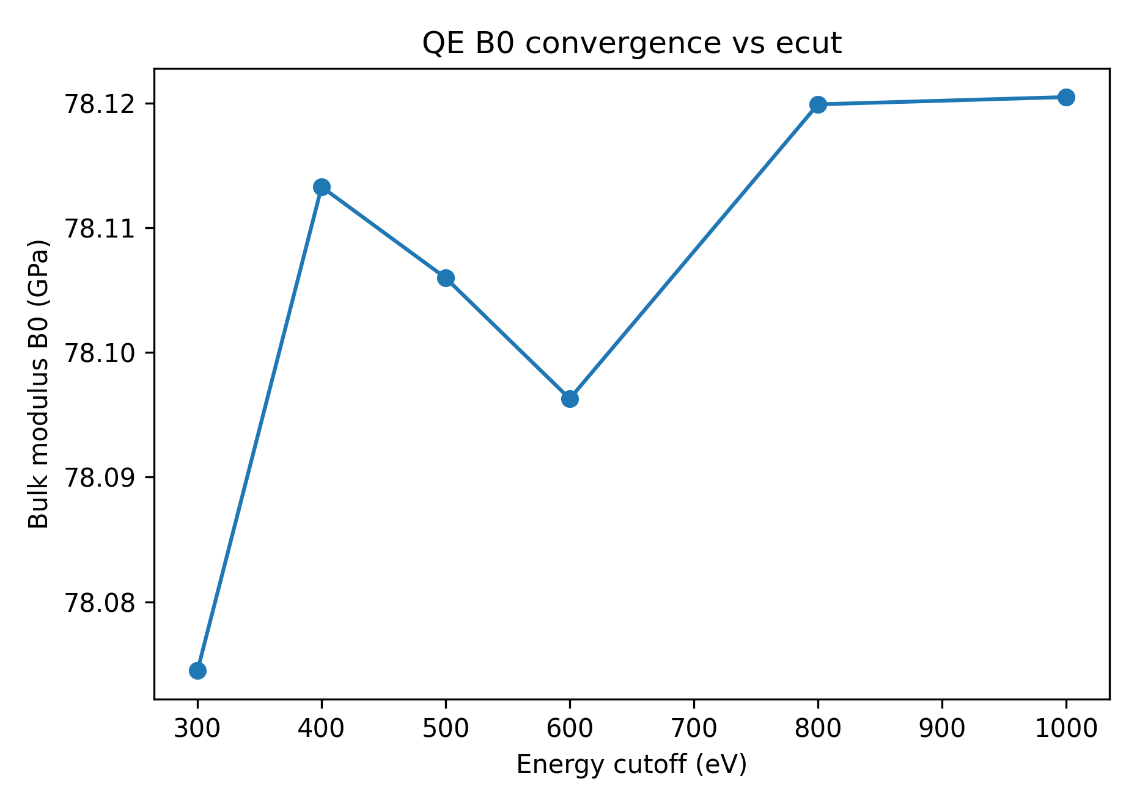
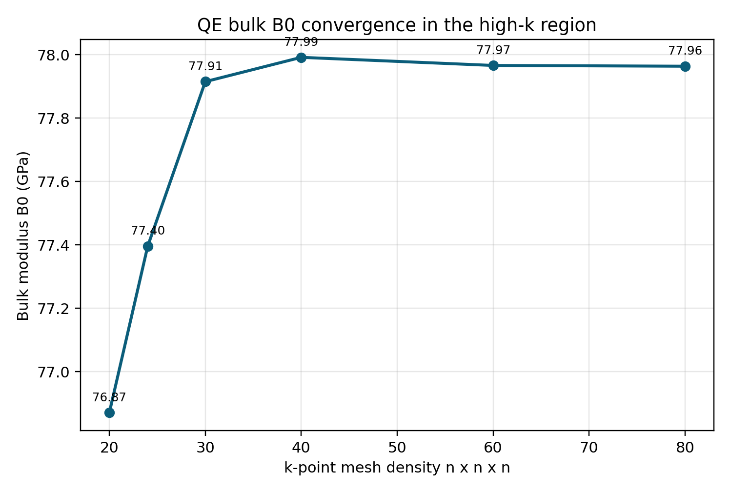
Results: bulk EOS convergence
B0 vs energy cutoff (plotting scripts:/OFDFT/ploting_scripts)
B0 vs high-k mesh (20-80) (plotting scripts:/OFDFT/ploting_scripts)
Reference a0 (Å) B0 (GPa)
Experiment ~4.05 ~76
QE 40×40×40 4.039825 77.991
QE 80×80×80 4.039865 77.963
Difference 0.000040 0.028
Data at /OFDFT/convergence_test

Slide 4
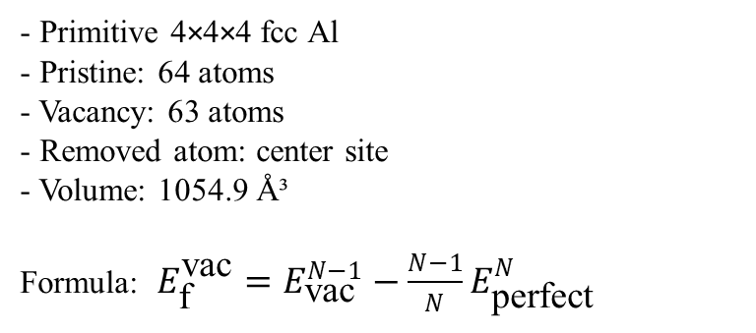
Results : QE vacancy convergence and Gillan benchmark
Cutoff convergence at 2×2×2
300 eV 0.7324 eV
400 eV 0.7345 eV
500 eV 0.7346 eV
600 eV 0.7347 eV
Dense-k cutoff check at 5×5×5
400 eV 0.572389 eV
500 eV 0.572440 eV
600 eV 0.572529 eV
Cutoff effect is negligible above 400 eV.
Structure inspection
- Primitive 4×4×4 fcc Al
- Pristine: 64 atoms
- Vacancy: 63 atoms
- Removed atom: center site
- Volume: 1054.9 Å³
Formula: $E_{\text{f}}^{\text{vac}}=E_{\text{vac}}^{N−1}−\frac{N−1}{N}E_{\text{perfect}}^{N}$
Data ://OFDFT/convergence_test/QE_ecut_scan
QE dense-k table at 600 eV
k-mesh | Ef_vac (eV) | note
1x1x1 | -1.113 | unphysical
2x2x2 | 0.735 | reference
3x3x3 | 0.945 | high
4x4x4 | 0.648 | near exp 0.66
5x5x5 | 0.573 | near Gillan 0.56
6x6x6 | 0.615 | moderate
Data :/OFDFT/convergence_test/qe_vacancy_all_recursive_summary.csv

Slide 5
Results: DFTpy vacancy formation energy
DFTpy / OFDFT setup
spacing Å | ecut analogue eV | Ef_vac eV
0.30 | 418 | 2.9366
0.25 | 602 | 2.9332
0.22 | 777 | 2.9329
0.20 | 940 | 2.9371
0.18 | 1161 | 2.9371
- KEDF: TFvW
- Pseudopotential: BLPS local Al recpot
- XC: PBE-GGA
- Geometry: primitive FCC supercells
- Lattice constant fixed to QE a0 for direct comparison
- Vacancy: one central Al atom removed
- Relaxation target: fmax < 0.02 eV/Å
Size scan remains around 2.89–2.95 eV.
Therefore, the high DFTpy value is not caused by insufficient supercell size.
DFTpy / TFvW gives a numerically stable but systematically higher vacancy formation energy:
DFTpy ≈ 2.9–3.2 eV, while QE ≈ 0.57–0.62 eV and literature / experiment ≈ 0.56–0.66 eV.
Data :/OFDFT/convergence_test/DFTpy_ecut_spacing scan/spacing_scan

Slide 6
Interpretation / discussion
What is already defensible
Bulk Convergence: 80×80×80 k-mesh validates that 40×40×40 is sufficient.
Vacancy Formation (QE): 0.5725 eV, closely matching Gillan 1989 (0.56 eV).
DFTpy Stability: Vacancy energy is stable at ~2.94 eV across both grid spacing and supercell size scans (up to 14×14×14).
Key Insight: Discrepancy is attributed to functional limitations (TFvW) rather than numerical parameters (spacing/size).

