Slide 1
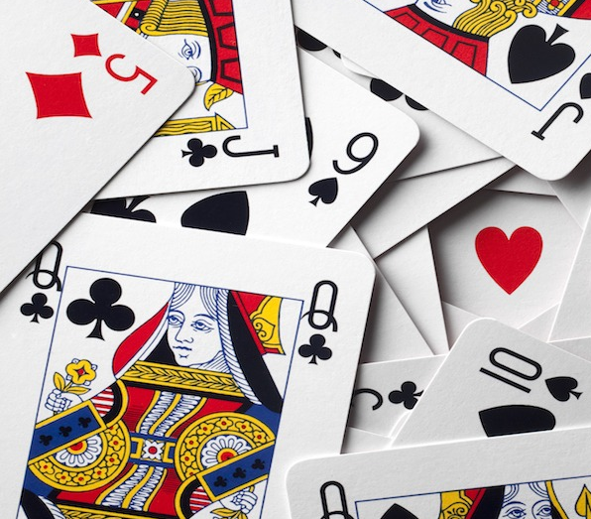
President Neural Network
Dawson Theroux

Slide 2

Goal
Implement a neural network to play the card Game President

Slide 3
The Rules of President
Win by playing all the cards in your hand

Slide 4
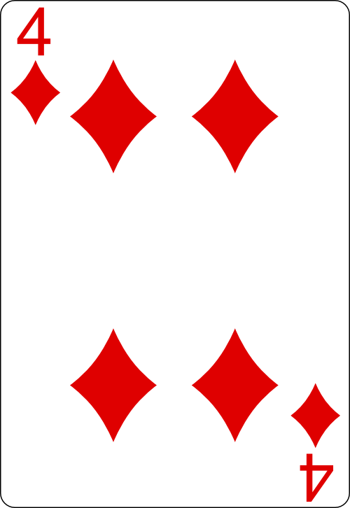
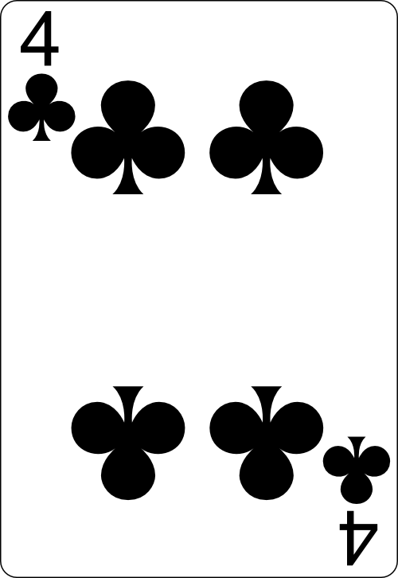
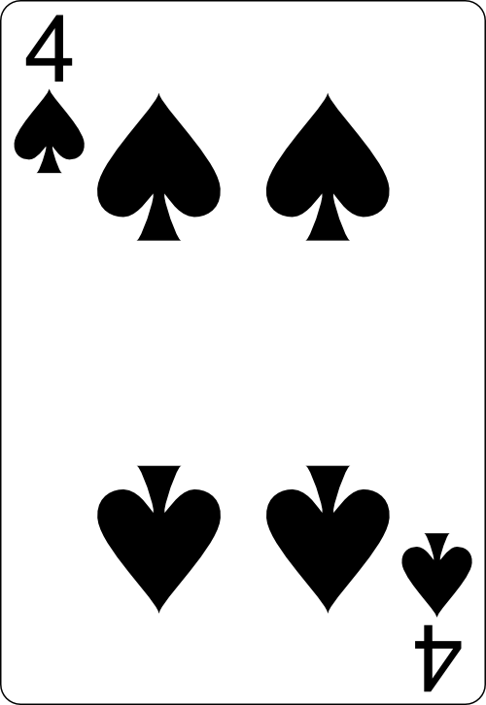
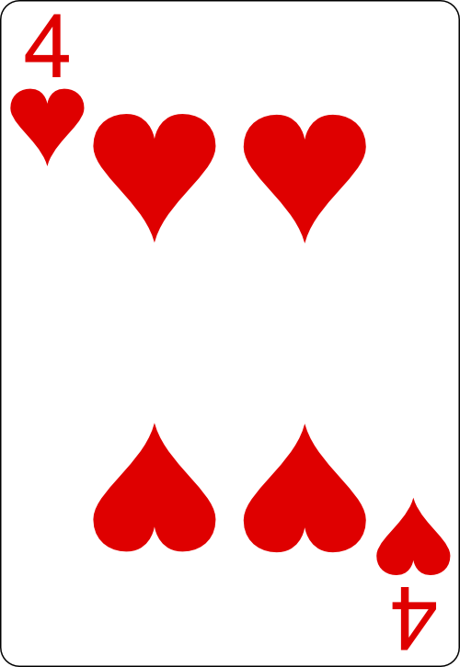
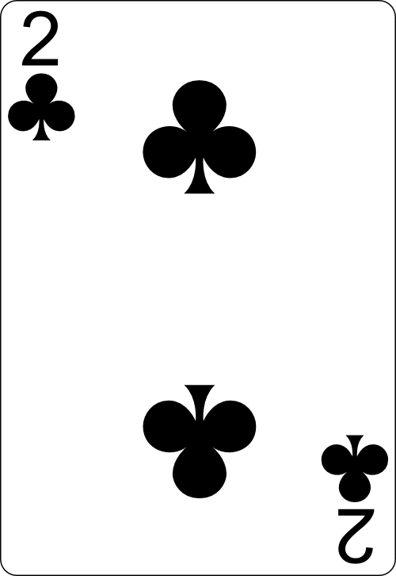
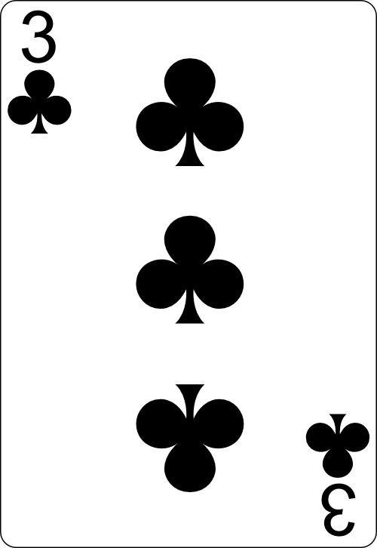
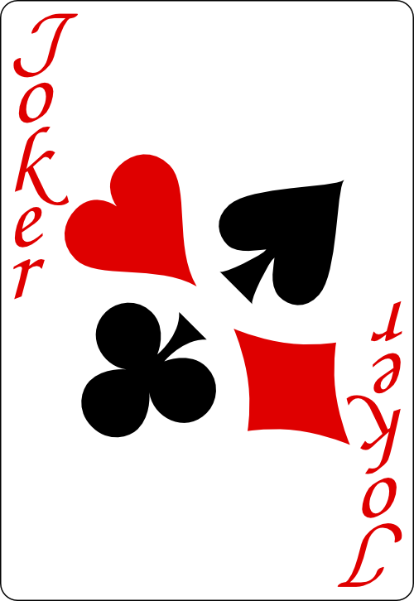
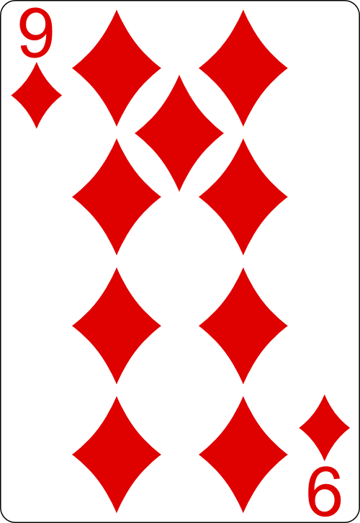
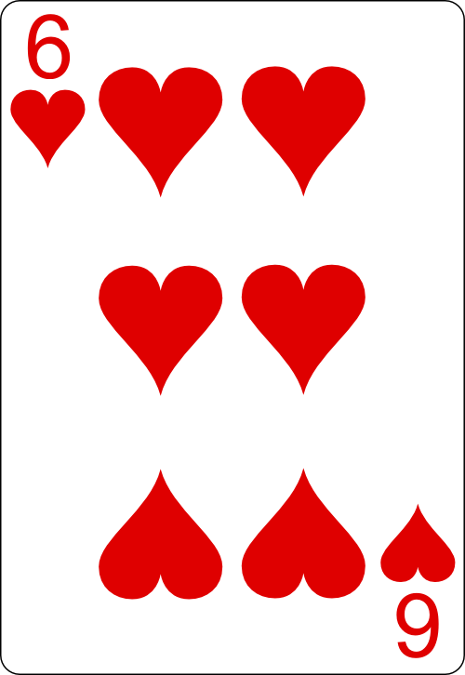
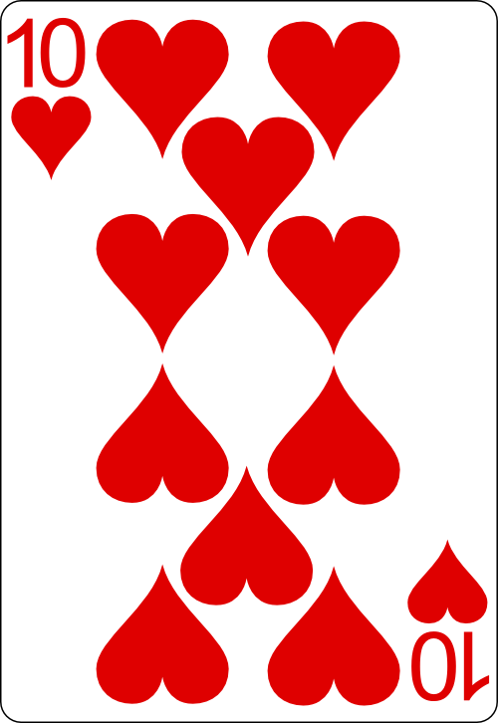
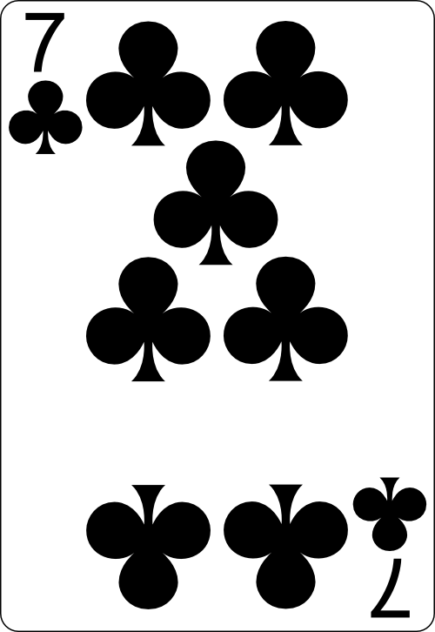
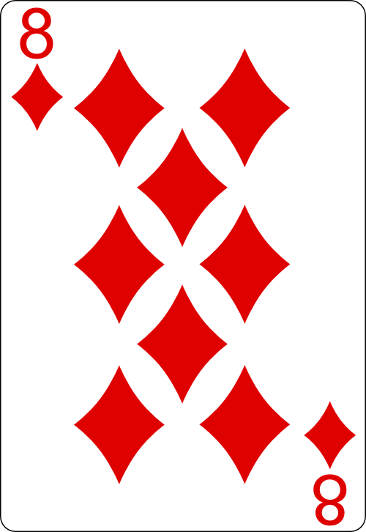
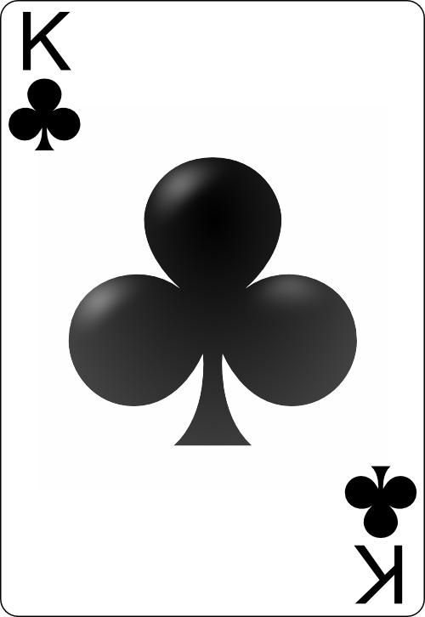
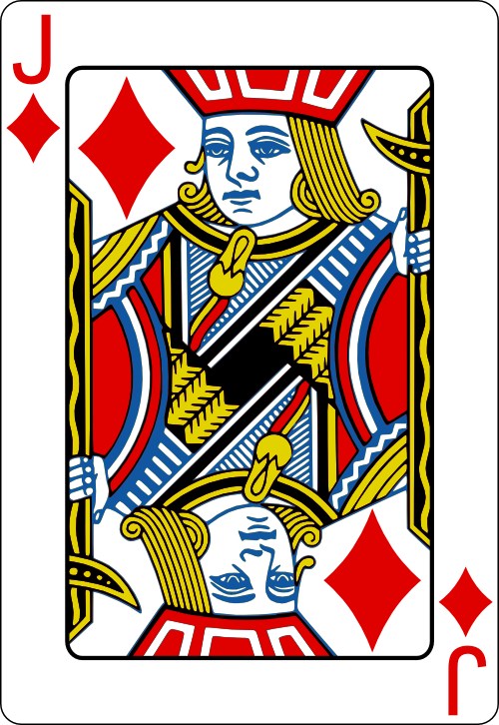
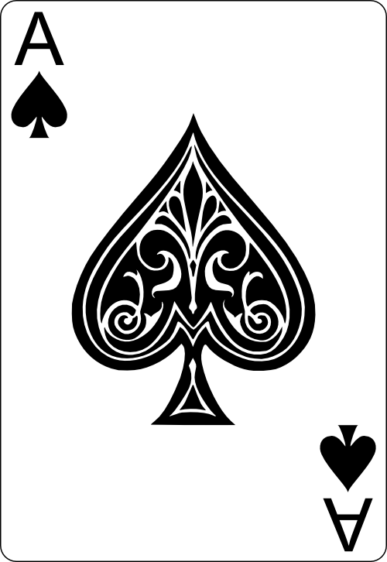

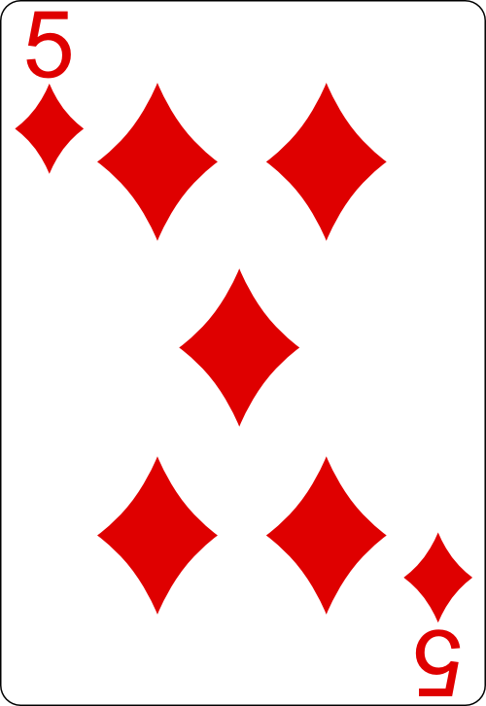
The Power of Cards
* Played together
Cards of higher value beat lower value cards
Power Cards (2, 3, Joker) beat any non power card. Even doubles and triples
Bombs (4 of a kind) beat all other plays

Slide 5

Demo

Slide 6
President Neural Network

Slide 7
Encoding game states
Input: Encoded 1-hot (-1,1)
Players in the game (6)
Cards in hand (54)
Cards on the table (54)
Cards discarded (54)
Player has passed (1)
Total Shape: 168
Label: Encoded with position score (0, Score)
Play Selected (55)

Slide 8
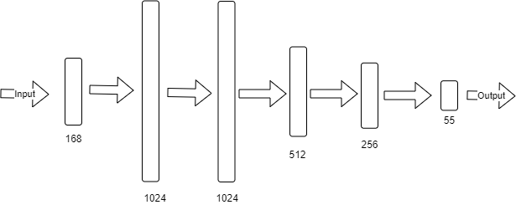
Neural Network Structure

Slide 9
Making Predictions
Model is fed the current game state as input.
The highest value output that leads to a legal play is selected

Slide 10
Training
**SHOW A PICTURE OF HOW IT WAS TRAINED

Slide 11
Demo

