Slide 1
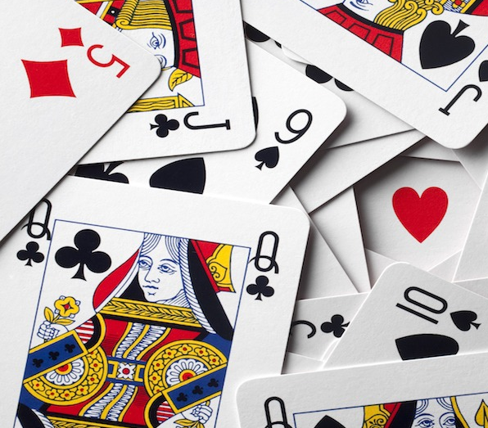
President Neural Network
Dawson Theroux

Slide 2
Goal
Implement a neural network to play the card Game President

Slide 3
Rules of President
Cards are dealt to all players
Play all your cards as quickly as possible

Slide 4
Implementing President
ADD A PICTURE OF THE NETWORK STRUCTURE
Python
Game implemented from scratch
Neural Network implemented with pyTorch

Slide 5
President Neural Network

Slide 6
Encoding game states
Input:
Label:

Slide 7
Neural Network Structure

Slide 8
Making Predictions

Slide 9
Training
**SHOW A PICTURE OF HOW IT WAS TRAINED

Slide 10
Demo

