Slide 1
Stacks, Circular Queues,
and Binary Search Trees
Understanding core data structures, operations, and traversal methods

Slide 2
Stack Operations (LIFO)
A stack follows Last In, First Out (LIFO) — the last item added is the first item removed.
1
Empty Stack
2
Push 1
3
Push 2
4
Push 3
5
Pop
PUSH
PUSH
PUSH
POP
3
TOP
2
TOP
2
2
1
1
1
1
TOP
TOP
(empty)
1 item
2 items
3 items
2 items
The stack is empty
at the beginning.
The value 1 is pushed
onto the stack.
The value 2 is pushed
onto the stack.
The value 3 is pushed
onto the stack.
The top item (3) is popped
from the stack.

Slide 3
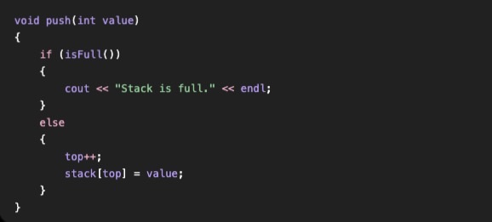
push()
Adds an item to the top of the stack.

Slide 4
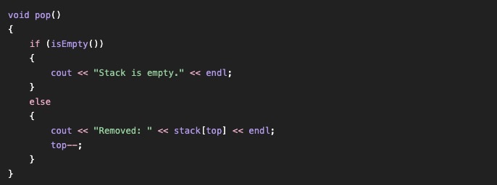
pop()
Removes the item from the top.

Slide 5
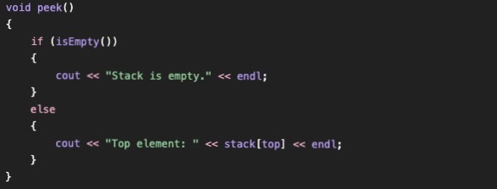
peek() / top()
Views the top item without removing it.

Slide 6

isEmpty()
Checks whether the stack contains any items.

Slide 7

isFull()
Checks whether an array-based stack has reached capacity.

Slide 8
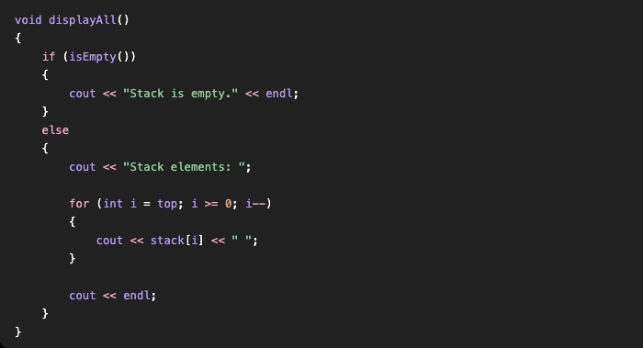
displayAll()
Displays the items currently stored in the stack.

Slide 9
Stack Overflow and Underflow
Overflow
Trying to add an item when the stack is already full.
Underflow
Trying to remove an item when the stack is empty.
Limited shelf capacity → overflow.
Nothing left to remove → underflow.
5

Slide 10
Array-Based Stack
Elements are stored inside an array.
Simple to implement and understand.
push(), pop(), and peek() can be performed quickly.
Traditional arrays have fixed capacity.
A full array can cause overflow unless resized or additional space is created.
An oversized array can leave unused space.
6

Slide 11
Queue (FIFO)
A queue follows First In, First Out (FIFO) — the first item added is the first item removed.
FRONT
Queue
ENQUEUE
DEQUEUE
1
2
3
4
5
FRONT
Points to the first item in the queue (the next item to be removed).
REAR
Points to the last item in the queue (the next position to add an item).
REAR
DEQUEUE
Removes the item from the front of the queue.
ENQUEUE
Adds an item to the queue.

Slide 12
The Problem With a Linear Queue
After removals, empty positions can remain at the beginning of the array.
The rear keeps moving toward the end.
The rear can reach the last position even while earlier positions are empty.
Available space exists, but it cannot be reused efficiently.
Circular queues are designed to solve this problem.
8

Slide 13
Circular Queue Representation
In a circular queue, when the end of the array is reached, the next position wraps around to the beginning of the array.
New element can be inserted by incrementing Rear.
2
9
Rear
0
4
Front
3
1
Front
= Points to the first item in the queue (next to be removed).
Rear
= Points to the last item in the queue (next position to add).
Light blue segment
= Array location with a value.
0
= Index position.
1
3
-2
2

Slide 14
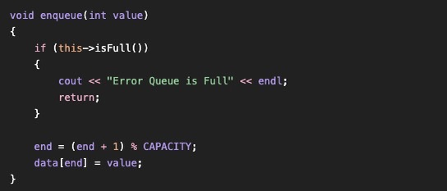
enqueue()
Adds a new item to the rear; the rear can wrap to the beginning.

Slide 15
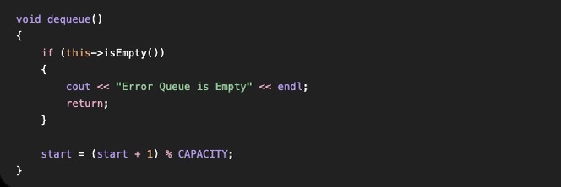
dequeue()
Removes an item from the front; the front advances.

Slide 16

isEmpty()
Checks whether there is anything available to remove.

Slide 17

isFull()
Checks whether the available positions are all being used.

Slide 18
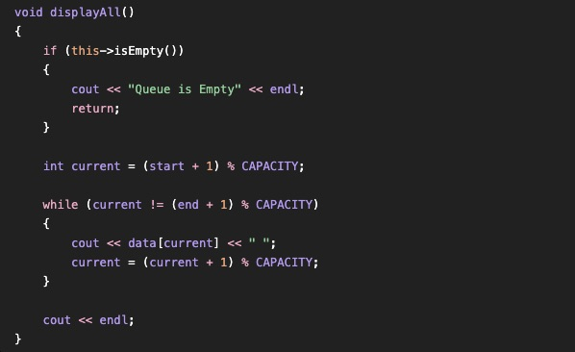
displayAll()
Displays the queue contents and helps show the current front and rear positions.

Slide 19
Circular Queue — Real-World Example
Cars enter at the rear and leave from the front.
As cars leave, spaces at the beginning become available.
New cars can reuse those positions.
The rear travels to the end and wraps back to the beginning.
11

Slide 20
Binary Trees
A binary tree is made of nodes.
Each node can have a maximum of two children: left and right.
The root is the starting point at the top.
A node with no children is a leaf.
A basic binary tree does not require values to be arranged in a particular order.

Slide 21
Binary Search Tree (BST)
A BST is a special type of binary tree.
Smaller values go left.
Greater values go right.
Comparisons guide the search direction.
In this implementation, duplicate values are ignored.

Slide 22
Binary Search Tree (BST)
Original Array of Values 50,70,30,25,21,44,65,85,68,25,43,45
Legend
Green = Root node
Blue = Regular node
Gray lines = edges
50
Left Subtree
Parent
30
Right Subtree
70
Predecessor
Left Child
Right Child
25
44
65
85
Successor
21
43
45
68
Leaf
Leaf
Leaf
Leaf

Slide 23
Inorder Traversal
Visit Left → Root → Right (sorted order for BST)
7
50
3
10
30
70
2
5
11
25
44
65
8
85
1
4
6
9
21
43
45
68
Inorder: 21 → 25 → 30 → 43 → 44 → 45 → 50 → 65 → 68 → 70 → 85

Slide 24
Preorder Traversal
Visit Root → Left → Right
1
50
2
8
30
70
3
5
11
25
44
65
9
85
4
6
7
10
21
43
45
68
Preorder: 50 → 30 → 25 → 21 → 44 → 43 → 45 → 70 → 65 → 68 → 85

Slide 25
Postorder Traversal
Visit Left → Right → Root
11
50
10
30
70
6
2
5
25
44
65
8
85
9
1
21
3
43
45
68
4
7
Postorder: 21 → 25 → 43 → 45 → 44 → 30 → 68 → 65 → 85 → 70 → 50

Slide 26
Applications of Trees
Useful for organizing information
Guiding searches
Decision-making
Collection of information where each comparison helps us decide which direction to go next.

Slide 27
Conclusion
Stacks → LIFO; push, pop, and peek; overflow and underflow.
Queues → FIFO; front for removal and rear for insertion.
Circular queues → wrap around to reuse available array positions.
Binary trees → nodes with up to two children.
BSTs → smaller values left, greater values right; duplicates ignored here.
Traversals → inorder, preorder, and postorder.

