Slide 1
Graph and Queue Data Structures Working Together
Breadth-First Search, Applications, and Graph-Based Technologies
Data Structures and Algorithms II

Slide 2
Introduction
1
• Graph and queue data structures are important concepts in computer science because they help programs organize information and solve problems efficiently.
• A graph represents objects and the relationships between them, while a queue controls the order in which items are processed.
• One common example of this combination is Breadth-First Search, also known as BFS.
• This algorithm explores a graph level by level, starting with nearby connections before moving to more distant ones.
Graph and Queue Data Structures Working Together

Slide 3
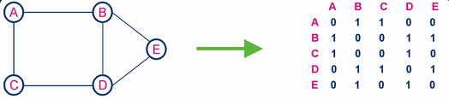
Definition and Organization
2
• A graph is a non-linear data structure consisting of vertices, also called nodes, and edges that connect them.
• Graphs can be organized using adjacency lists or adjacency matrices, which store information about the connections between nodes.
• A queue is a linear data structure that follows the First-In, First-Out principle, commonly known as FIFO.
• This means that the first element added to the queue is the first element removed.
• When a graph and a queue are combined, each structure performs a different but complementary role.
Graph and Queue Data Structures Working Together

Slide 4
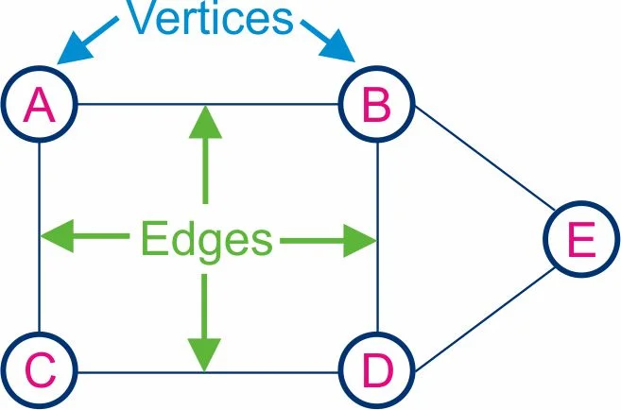
How Graphs and Queues Work Together
3
• To understand how graphs and queues work together, imagine a social network containing six people named A, B, C, D, and E.
• Each person represents a node, and every connection represents an edge in the graph.
• Suppose a program needs to find person E, starting from person A.
• The program begins by placing A into the queue and marking it as visited.
• Next, the program processes B and discovers D.
Graph and Queue Data Structures Working Together

Slide 5
Important Operations
4
• Graph and queue systems rely on several operations to manage information and process nodes efficiently.
• Graph operations include adding nodes, adding edges, removing connections, and finding neighboring nodes.
• Queue operations control the order in which discovered nodes are processed.
• Enqueue adds an element to the back of the queue, while dequeue removes the element at the front.
• These operations work together during graph traversal.
Graph and Queue Data Structures Working Together

Slide 6
Breadth-First Search (BFS)
5
• Instead of following one path as far as possible, BFS examines nearby nodes first before moving to the next level of the graph.
• The algorithm begins by selecting a starting node, marking it as visited, and adding it to the queue.
• The program then removes the node at the front of the queue and examines all its neighbors.
• A visited set is important because graphs can contain cycles and multiple paths leading to the same node.
Graph and Queue Data Structures Working Together

Slide 7
Time Complexity and Space Requirements
6
• The efficiency of graph traversal can be measured using time complexity and space complexity.
• Let V represent the number of vertices in a graph and E represent the number of edges.
• With an adjacency-list representation and a suitable queue implementation, Breadth-First Search has a time complexity of O(V + E).
• Queue operations such as enqueue, dequeue, and peek can take O(1) time with an appropriate implementation.
Graph and Queue Data Structures Working Together

Slide 8
Advantages and Limitations
7
• Combining graphs and queues provides several advantages.
• One major benefit is efficient traversal because BFS can examine an entire graph in O(V + E) time when adjacency lists are used.
• Another advantage is the ability to handle cycles and repeated connections.
• By maintaining a visited set, the algorithm avoids processing the same node multiple times.
• However, this combination also has limitations.
Graph and Queue Data Structures Working Together

Slide 9
Real-World Applications
8
• In navigation systems, graphs represent roads and intersections, allowing algorithms to explore possible routes between locations.
• Cybersecurity systems can use graphs to represent accounts, devices, transactions, and other related entities.
• Robotics applications can also represent locations and possible movements as graphs, allowing pathfinding algorithms to explore routes through an environment.
• Another important area is generative artificial intelligence.
Graph and Queue Data Structures Working Together

Slide 10
Navigation and Route Planning
9
• Navigation systems can represent road networks as graphs, where intersections and destinations are nodes and roads are edges.
• Breadth-First Search can explore a road network by starting at one intersection and examining its neighboring intersections before moving farther away.
• The queue stores the locations waiting to be explored, while the graph provides the available connections.
• However, real road networks are more complicated because roads have different lengths and travel times.
• The route with the fewest road segments may not be the shortest or fastest route.
Graph and Queue Data Structures Working Together

Slide 11
Cybersecurity and Fraud Detection
10
• Cybersecurity and fraud detection are important areas where graph technology can help identify relationships that might otherwise be difficult to recognize.
• A graph can represent bank accounts, customers, computers, mobile devices, and financial transactions as nodes.
• Suppose a financial institution identifies an account associated with suspicious transactions.
• A graph-search algorithm can begin at that account and explore its direct connections.
• Neo4j is an example of a company that provides graph database technology for applications such as fraud detection and relationship analysis.
Graph and Queue Data Structures Working Together

Slide 12
Social Networks
11
• Social networks are another example of how graphs and queues can work together.
• BFS can begin at a selected user and explore their direct connections first.
• This process continues outward through the network, with the queue controlling which discovered user is examined next.
• This technique can help demonstrate how shortest connection paths are found between users.
• For example, if two people are connected through several mutual relationships, BFS can identify a path containing the fewest edges in an unweighted network.
Graph and Queue Data Structures Working Together

Slide 13
Robotics and Pathfinding
12
• Robotics is another field in which graphs and queues can support navigation and pathfinding.
• A graph can model this environment by representing locations as nodes and available movements as edges.
• Imagine a warehouse robot that needs to travel from a charging station to a shelf containing an item.
• If the graph is unweighted, BFS can search for a route containing the fewest edges.
• The queue stores locations that have been discovered but have not yet been examined.
Graph and Queue Data Structures Working Together

Slide 14
Emerging Technology: Generative Artificial Intelligence
13
• Generative artificial intelligence is a growing field in which computer systems create content such as text, images, code, and summaries.
• However, many applications also need access to external information and relationships between facts.
• Knowledge graphs can help organize this information.
• A knowledge graph represents entities as nodes and their relationships as edges.
• Queues can support the background tasks needed to maintain and process this information.
Graph and Queue Data Structures Working Together

