Slide 1


Exploratory Data Analysis of Amazon Shipping Data
Prepared by : Dax Patel
Project type : Internship Project 1
Project Guide : Mr. Mario Thokchom

Slide 2
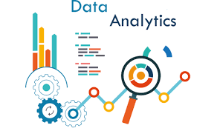
Table of content
What is EDA?
2. Steps involved in EDA.
Data Collection
Explore about Data
Data cleaning
Univariate Analysis
Bivariate/Multivariate Analysis
3. What is Business Intelligence(BI).
4. Tableau as a BI Tool.
5. Insights found out from Tableau.
6. Dynamic Dashboard Preparation.

Slide 3
What is EDA?
Exploratory data analysis which is one of the basic and essential steps of a data science project.
EDA is an approach that is used to analyze the data and finding meaningful insights from data through Statistical as well as Graphical visualization techniques.
EDA allow us to understand the data in depth and learn the different data characteristics, often with visual means. This allows you to get a better feel of your data and find useful patterns in it.

Slide 4
Steps Involved in EDA?
Data Collection
Data collection is an essential part of exploratory data analysis. It refers to the process of finding and loading data into our system.
Data Gathering
CSV File
JSON/SQL file
From APIs
Web Scrapping

Slide 5
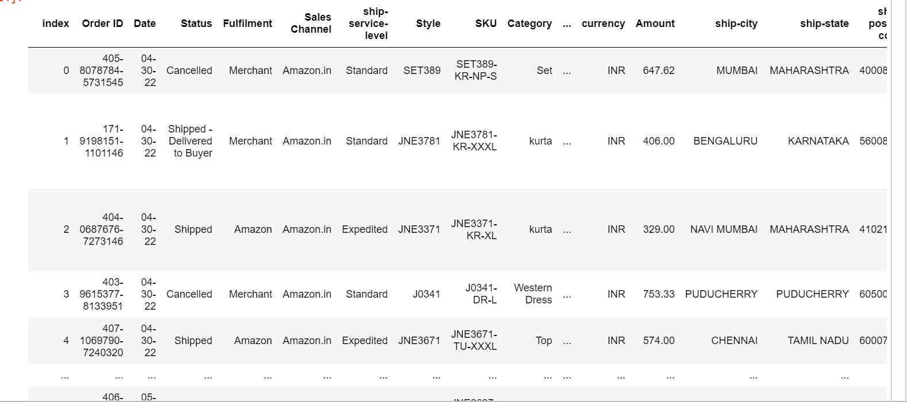
Load CSV File into Pandas Data frame

Slide 6
2. Explore about Data
After getting data we need to have quick overview about data. We can explore fundamentals of our dataset by finding answer to following questions.
How Big our Data is?
How does data look like?
What is the Data type of each column?
Are there any missing values?
How does data look mathematically?
Are there any duplicate rows present in our Data set?
Number of Unique elements in each columns?

Slide 7
3. Data Cleaning
When it comes to data, there are many different sorts of quality issues, which is why data cleansing is one of the most time-consuming aspects of data analysis.
Data cleaning usually takes approximately 80% of our time when analyzing any data and the modeling process takes only 20%, Before we do any modeling we need to make sure our data is clean and credible.
In data cleaning we need to deal with Missing Values, Outliers, Redundant Data, Unnecessary columns etc…

Slide 8
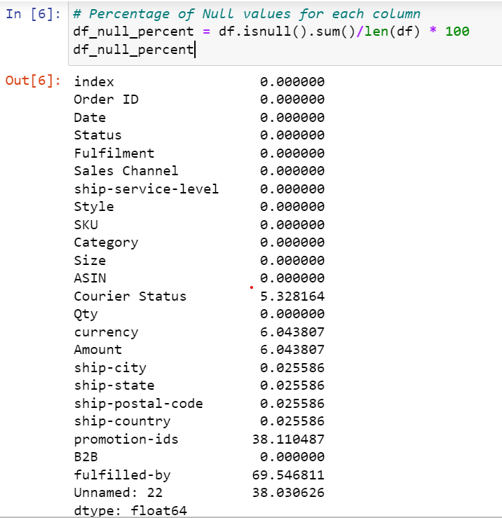
Handling Missing Values
This figure represent the percentage of missing values for each column.
Removed 3 column from Data set as it contains more than 35% Missing value.

Slide 9
Handle Missing Values for Categorical Columns.
For categorical I have replaced Null Values with Column Mode
Ex. Courier Status, Currency, Ship-Country, Ship-State, Ship-City, Ship-postal-code.
# Replace Null values of ship-country column with its mode i.e. IN
df['ship-country'].fillna(df['ship-country'].mode()[0],inplace = True)
# Replace Null Values of ship-state column with its mode i.e. MAHARASHTRA
df['ship-state'].fillna(df['ship-state'].mode()[0],inplace = True)
As Per Observation From data set ,
# replace Courier Status with Cancelled where Qty = 0
df['Courier Status'].mask(df['Qty'] == 0, 'Cancelled', inplace=True)

Slide 10
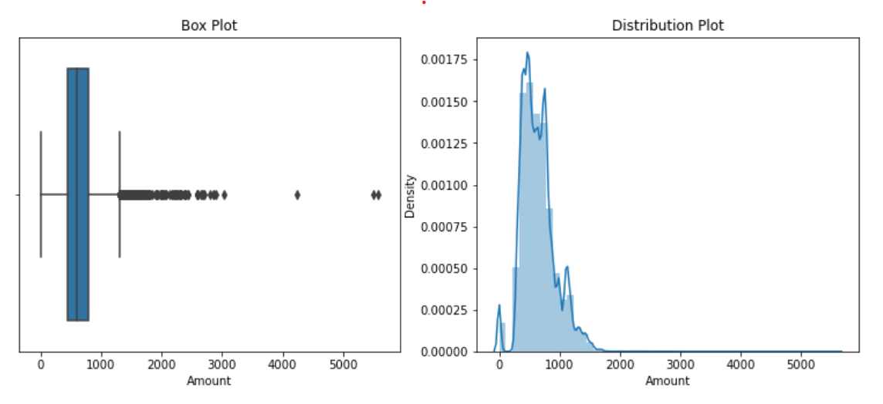
Handle Missing Values for Numerical Columns.
For Numerical column we can replace Null values with either Mean or Median.
Ex. For column Amount.
From Box plot we can observed that large amount of outliers are present and from above distribution curve we can say that distribution is slightly skewed , so we have to replace Null values with Median because it is less affected by outliers compare to mean.

Slide 11
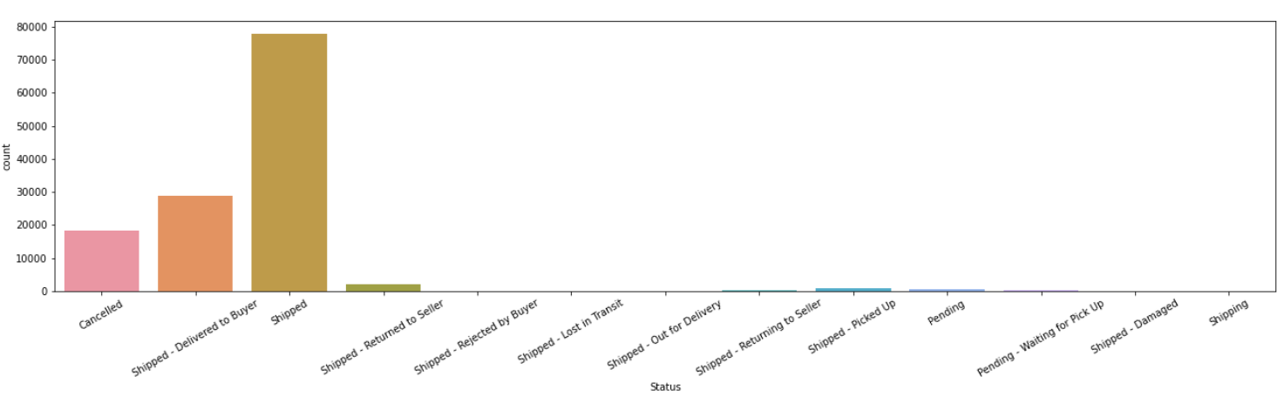
4. Univariate Analysis.
Univariate Analysis is the simplest of the three analyses where the data you are analyzing is only one variable at a time.
Main purpose of the analysis is to describe the data and find patterns that exist within it.
Count Plot for Column Status.

Slide 12
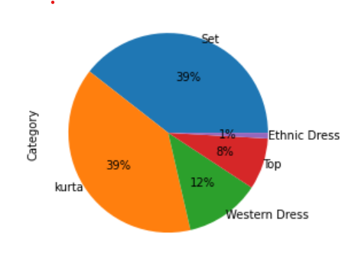
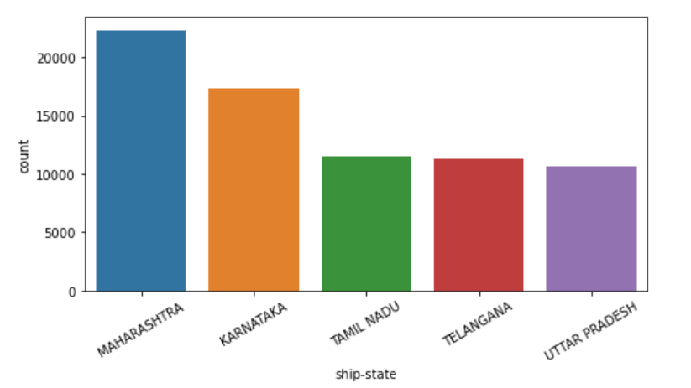
Pie chart for Column Category.
Count Plot for Column Ship State.

Slide 13
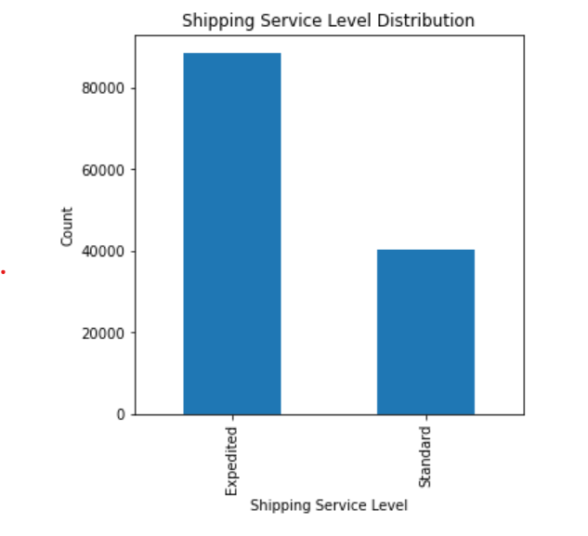
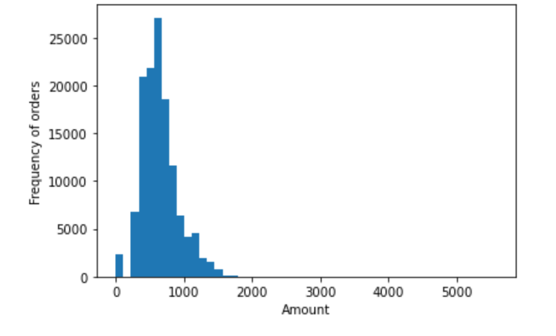
Histograms for Column Amount
Count plot for Column Shipping service level.

Slide 14
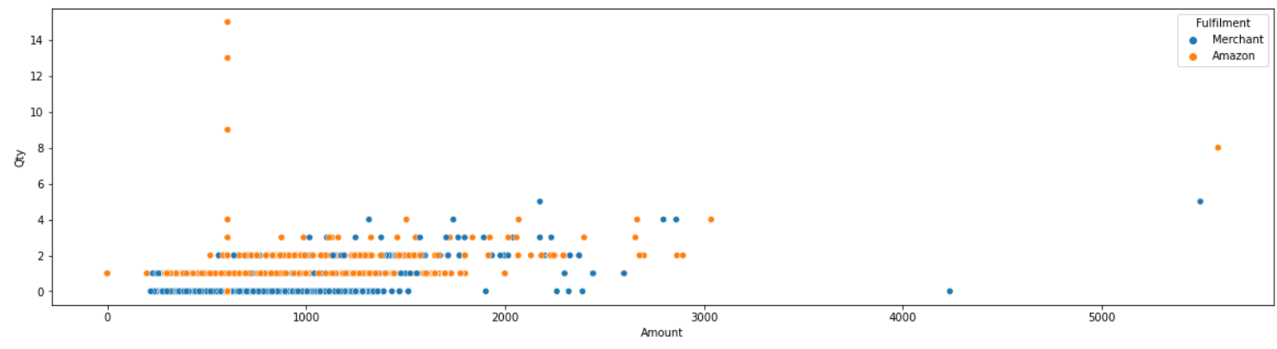
5. Multivariate Analysis.
Bivariate analysis is where you are comparing two variables to study their relationships. These variables could be dependent or independent to each other.
Scatter Plot between Amount and Qty Column. It further categorize by Mode of Fulfilment

Slide 15
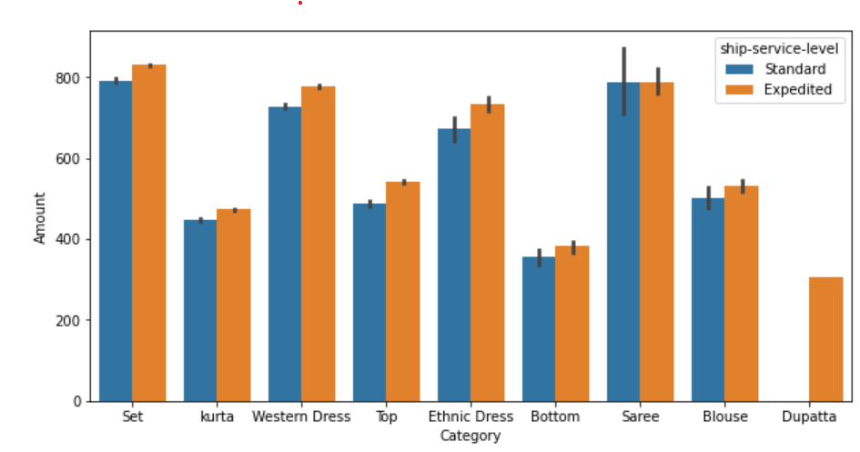
Bar graph between column Amount and Category. Each Category is divided by 2 ship-service level.

Slide 16
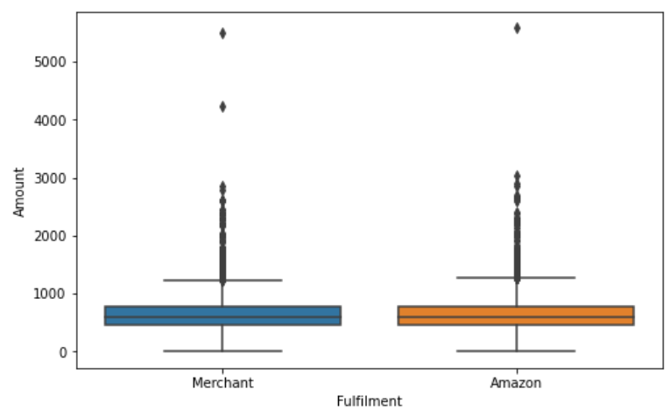
Box Plot of Amount Column for 2 mode of Fulfilment

Slide 17
What is Business Intelligence (BI).
Business intelligence (BI) combines business analytics, data mining, data visualization, data tools and infrastructure, and best practices to help organizations to make more data-driven decisions.
BI Tools
Raw Data
(Unorganized Data)
Business Insights
(Organized Data)

Slide 18

Tableau as a Business Intelligence (BI) Tool.
Tableau allows you to perform data analysis, data manipulation, and data visualization to make sense of business data and draw insights.
Tableau is a data visualization and business intelligence tool that enables users to connect, visualize and share data in a highly interactive and intuitive way.
It allows users to quickly analyze and explore large and complex datasets using a drag-and-drop interface without requiring coding or programming skills.
Tableau provides a wide range of chart types and visualization options, such as line charts, bar charts, maps, scatter plots, and many more

Slide 19
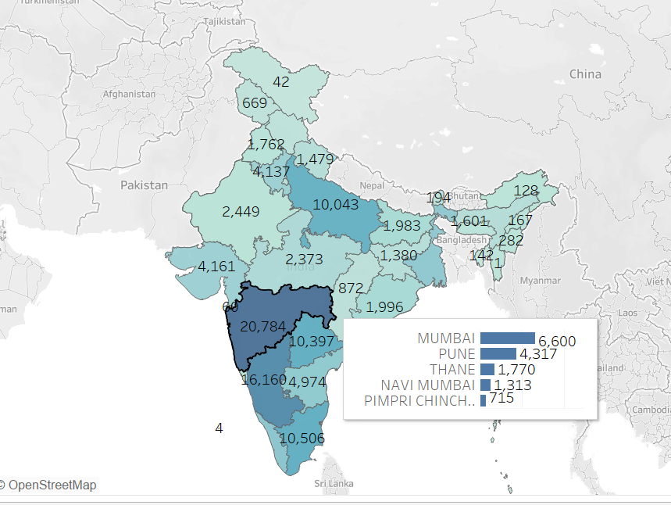
Insights found out from Tableau.
This Map Visualization represent the total number order received state wise.
Added Tooltip visualization that shows top 5 city for each state for contribution in total number of order received.

Slide 20
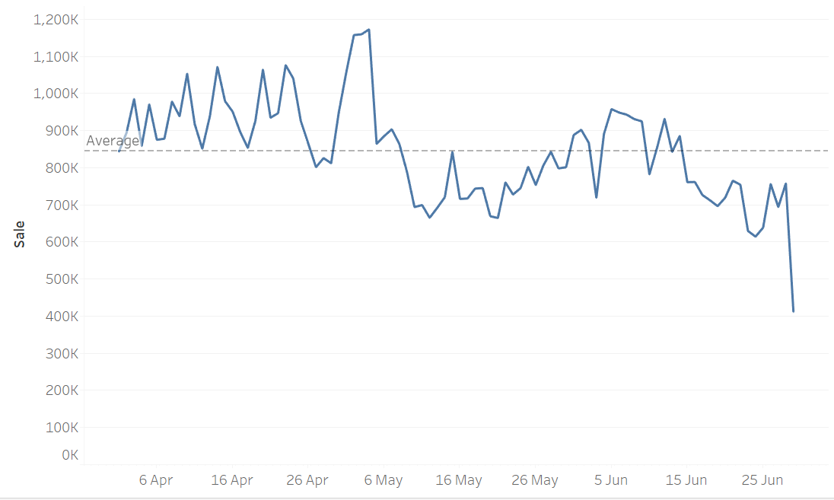
Line graph that shows Month on month trends for Total Sale

Slide 21
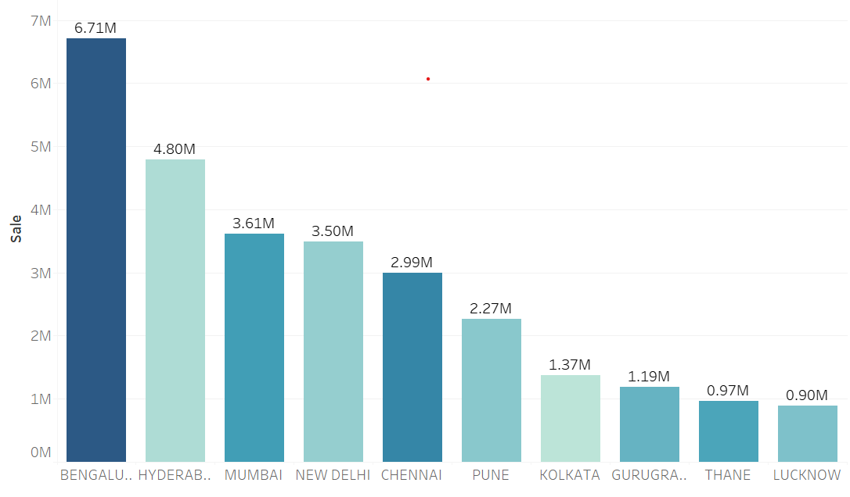
Bar chart that represent Top 10 City sale wise.

Slide 22
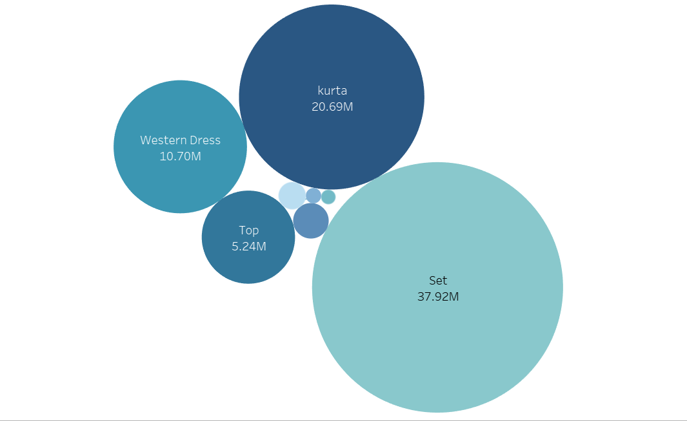
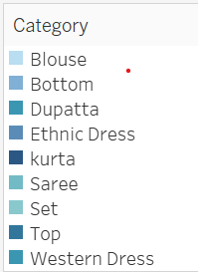
Bubble size represent Total sale amount.
Bubble chart for Category

Slide 23
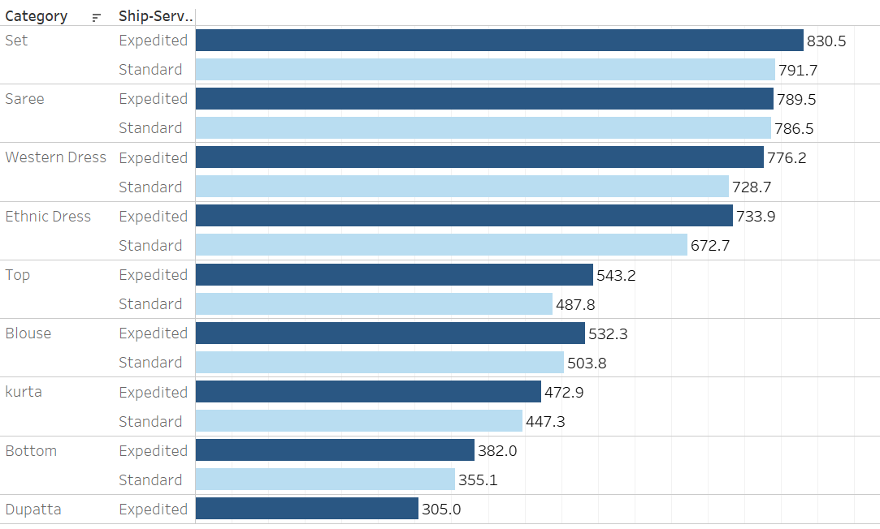
Horizontal stacked bar chart that represent average amount for each category and Ship-service level

Slide 24
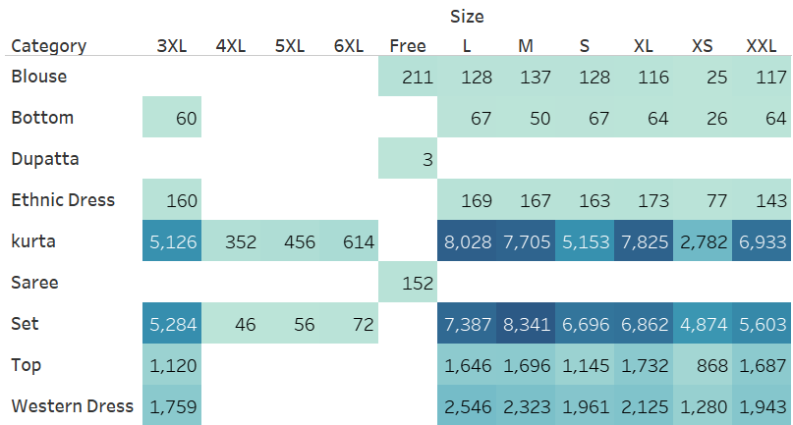
Highlight table that represent total Qty ordered by each category and size

Slide 25
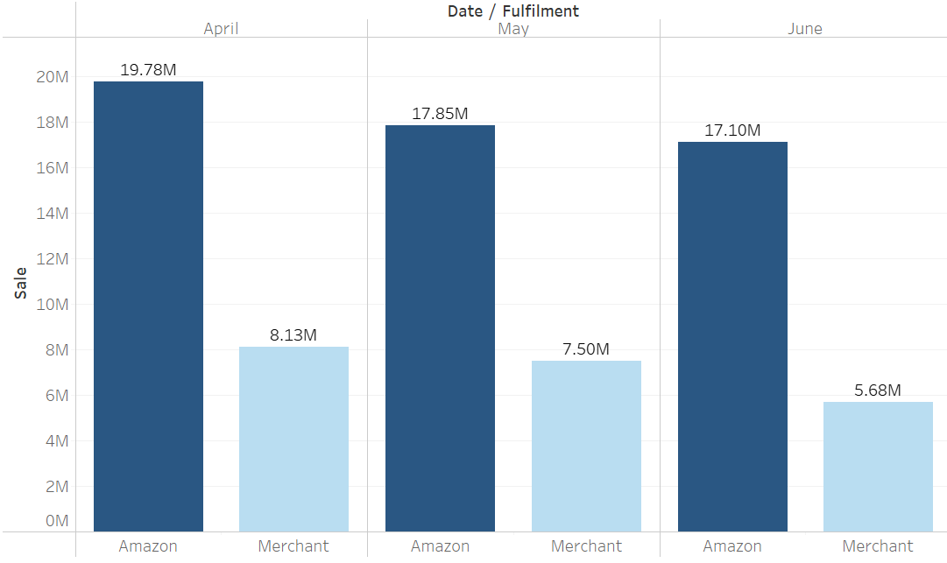
Vertical side by side stacked bar chart that represent monthly sale for 2 mode of fulfilment

Slide 26
Tableau Dashboard Link
https://public.tableau.com/app/profile/dax.patel/viz/AmazonShippingDataAnalysis_/Dashboard2

Slide 27


