Slide 1
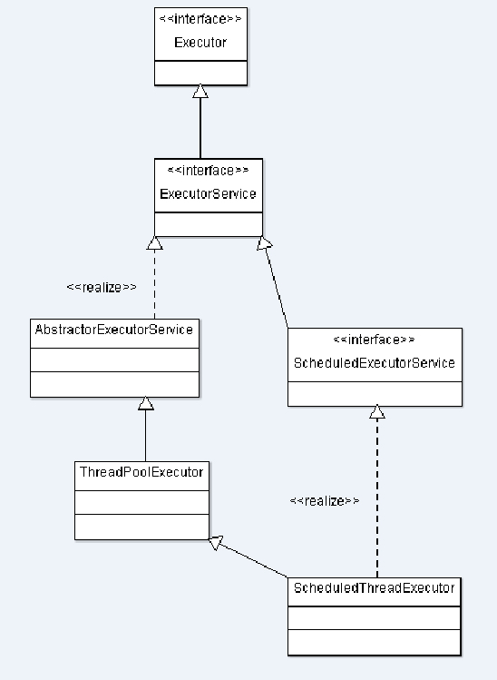
public interface Executor {
/**
* Executes the given command at some time in the future. The command
* may execute in a new thread, in a pooled thread, or in the calling
* thread, at the discretion of the {@code Executor} implementation.
*
* @param command the runnable task
* @throws RejectedExecutionException if this task cannot be
* accepted for execution
* @throws NullPointerException if command is null
*/
void execute(Runnable command);
}
可见Executor就是一个执行器，用来执行实现Runnable接口的任务
public interface ExecutorService extends Executor {
void shutdown();
List<Runnable> shutdownNow();
Future<?> submit(Runnable task);
boolean isShutdown();
boolean isTerminated();
//省略部分代码，看名字就知道， ExecutorService 是Executor的一个服务类，提供任务提一些服务方法
}

Slide 2
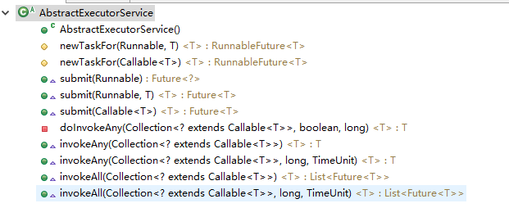
AbstractExecutorService的实现类，提供不可以定时的线程池： public class ThreadPoolExecutor extends AbstractExecutorService

