Slide 1
Attention in Translation.
Oladapo Ogunnaike A20435197

Slide 2
Problem Statement
Attention mechanisms have been essential to successful sequence modeling and transduction models. They are used with recurrent neural networks or on their own (transformers) for neural machine translation models.
Machine translation refers to the task of translating content from one language to another without any human input.
This project will explore the attention mechanism, its theoretical properties, and recent work in this area.
Here are some details about each of these topics:
Attention mechanism: The attention mechanism is a way for a model to focus on specific parts of an input sequence when generating an output sequence. This is useful for tasks like machine translation, where the model needs to be able to translate the meaning of a sentence, not just the individual words.
Theoretical properties: The attention mechanism has several theoretical properties that make it a powerful tool for machine learning. For example, it is able to learn long-range dependencies between different parts of an input sequence.
Recent work: There has been a lot of recent work on the attention mechanism. Some of the most notable work includes the development of the transformer architecture, which uses attention mechanisms in a novel way to achieve state-of-the-art results on machine translation and other tasks.

Slide 3
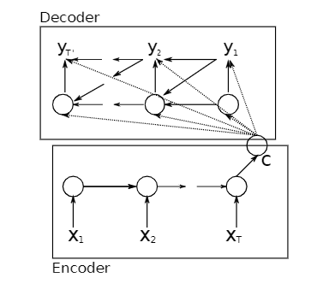
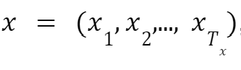


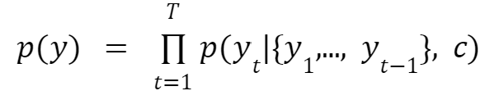

Background Work
The RNN Encoder-Decoder proposed by Cho, K. et al [1]
Encoder:
Input: a sequence of vectors
Output: context vector
Decoder:
Input: context vector c and previously predicted words
Output: Probability for next word in the sequence:

Slide 4
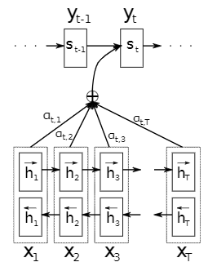
RNN Encoder-Decoder with Attention
Bahdanau, D [3] introduces the attention mechanism, particularly soft attention
Encoder:
Bidirectional RNN: encode the information from both the previous and following words in the hidden state
Decoder:
RNN with an extension - attention mechanism
Attention mechanism: compute the weighted sum of the input hidden state

Slide 5
Learning to align and translate
Basic RNN Encoder-Decoder | RNN Encoder-Decoder with Attention
Encodes the input sentence into a fixed length vector | Encodes the input sentence into a variable-length sequence of vectors While decoding the translation, chooses a subset of these vectors adaptively
Xiyang Chen presentation, https://aisc.ai.science/static/slides/20181018_XiyangChen.pdf

Slide 6
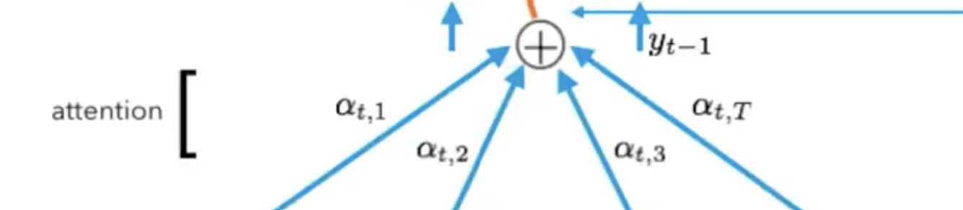

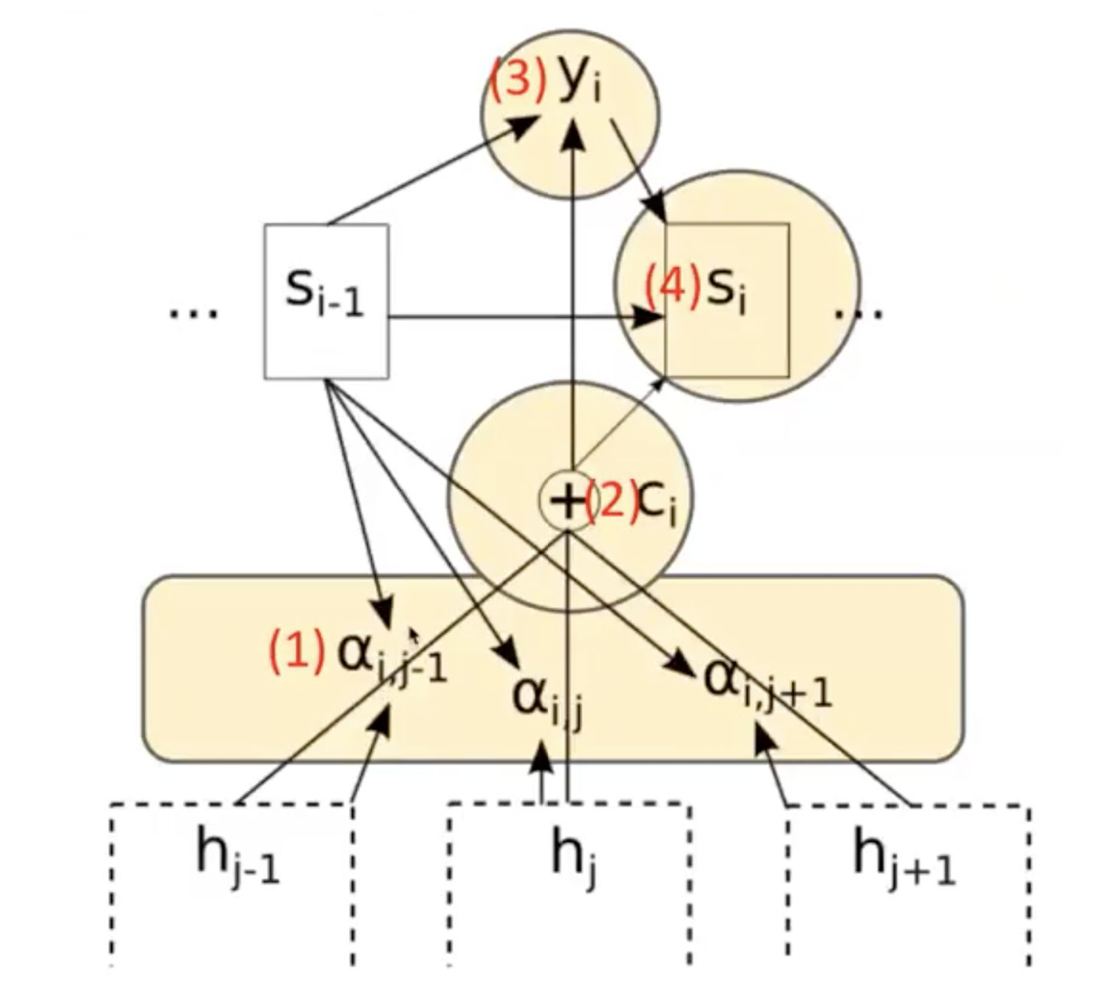
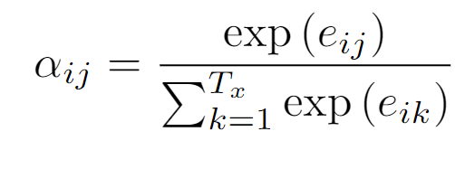
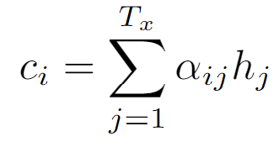
Attention Mechanism
Alignment model:
Alignment weight:
Context vector:

Slide 7
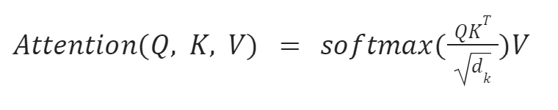
Alternative Interpretation: Q, K, V
Alternative interpretation: Q, K, V
The decoder state can be interpreted as a “query” vector and the encoder states are “key” vectors
The goal is to compute the weight for each query-key pair and normalize it by using the Softmax function
Scaled Dot-Product Attention:
Given a set of queries and keys of dimension d_{k} and values of dimension d_{v}
A set of queries packed in matrix Q, and matrix K, V containing the keys and values respectively

Slide 8
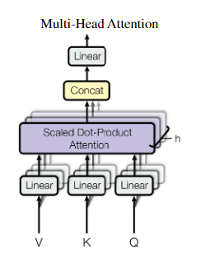
Multi-head Attention
Applies the attention function multiple times on different, learned linear projections of the keys, values, and queries. Each function produces a d_{v}-dimensional output.
These values are then concatenated and projected again, resulting in the final output.

Slide 9
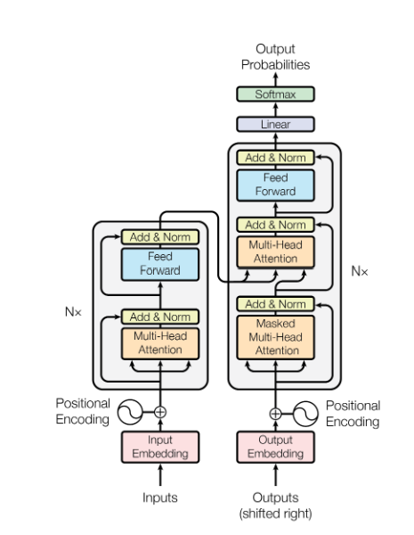
Transformers
Encoder:
N layers, 2 sub-layers in each layer
Sub-layer: Multi-head Attention layer + feed-forward network
Residual connection and layer normalization
Decoder:
N layers, 3 sub-layers in each layer
Sub-layer: 2 sub-layer in the Encoder + Multi-head Attention layer
Residual connection and layer normalization
Masking on self-attention sub-layer
Positional Encoding:
A mechanism for the network to be aware of word order

Slide 10
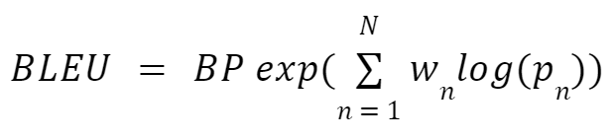

BLEU Score
The Bilingual Evaluation Understudy Score or BLEU is a metric used to evaluate performance of machine translation models
BLEU is widely used as it is quick, inexpensive, and language-independent. It correlates well with human evaluation.

Slide 11
Dataset: English - French translation
manythings.org/anki:
A subset of 50,000 English and 50,000 French sentences
English vocabulary size 15826, max length sentence 49
French vocabulary size 30186, max length sentence 57
Europarl (61M words):
A subset of 30,000 English and 30,000 French sentences
English vocabulary size 17558, max length sentence 149
French vocabulary size 25873, max length sentence 154

Slide 12
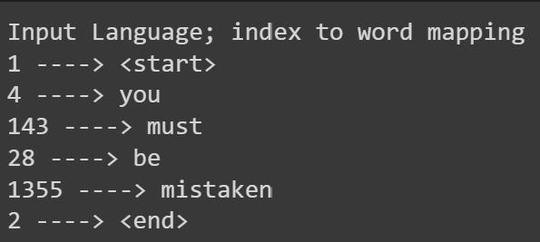
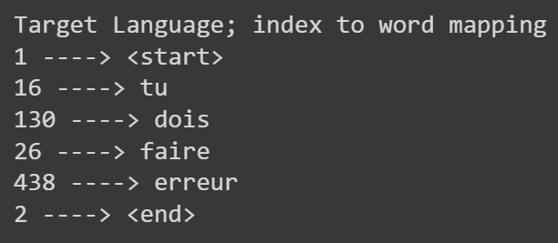
Implementation details
Sentences processing
Preprocessing: removing unwanted characters and symbols, lowercasing the letters, adding <start> and <end> symbols to the start and end of the sentences
Create a tokenizer for each language and encode the sentences
Pad the sentences to the maximum sentence length
Split into training and testing subsets

Slide 13
Implementation details
In our implementation,
We trained a Transformer model and a normal RNN Encoder-Decoder on the manythings.org/anki datasets
We trained 2 Encoder-Decoder with attention models with BiRNN Encoder and RNN Encoder on the manythings.org/anki datasets
We trained the Encoder-Decoder with attention model on the Europarl dataset which contains longer sentences
We plotted the attention weights of various sentence translations.

Slide 14
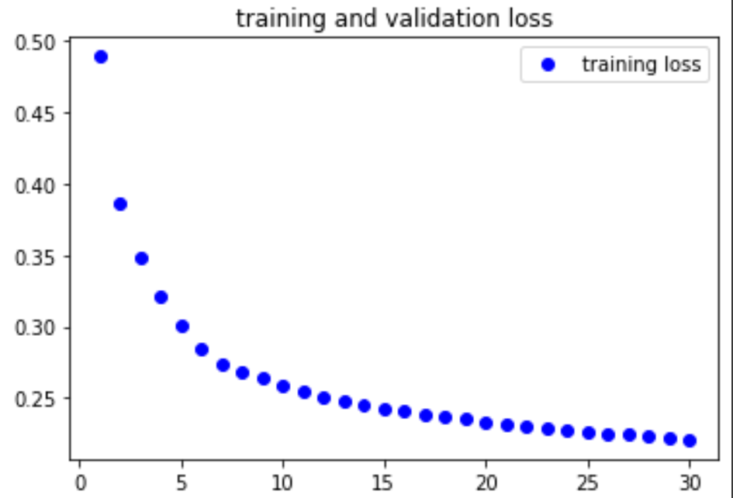
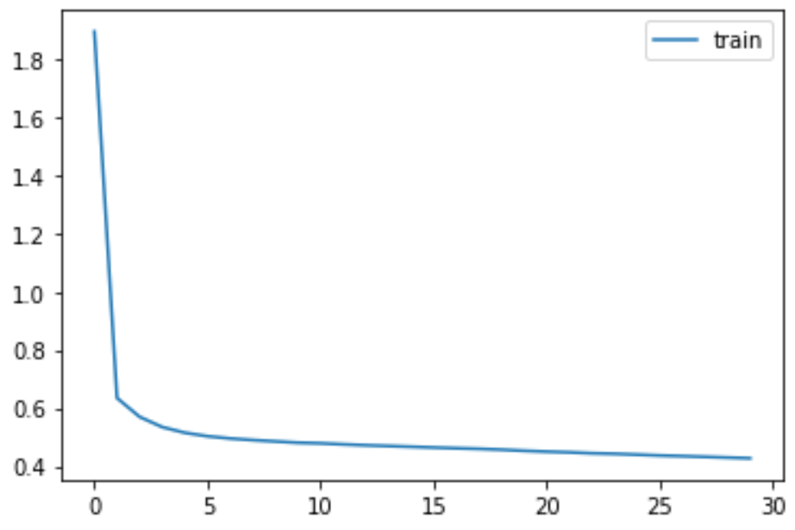
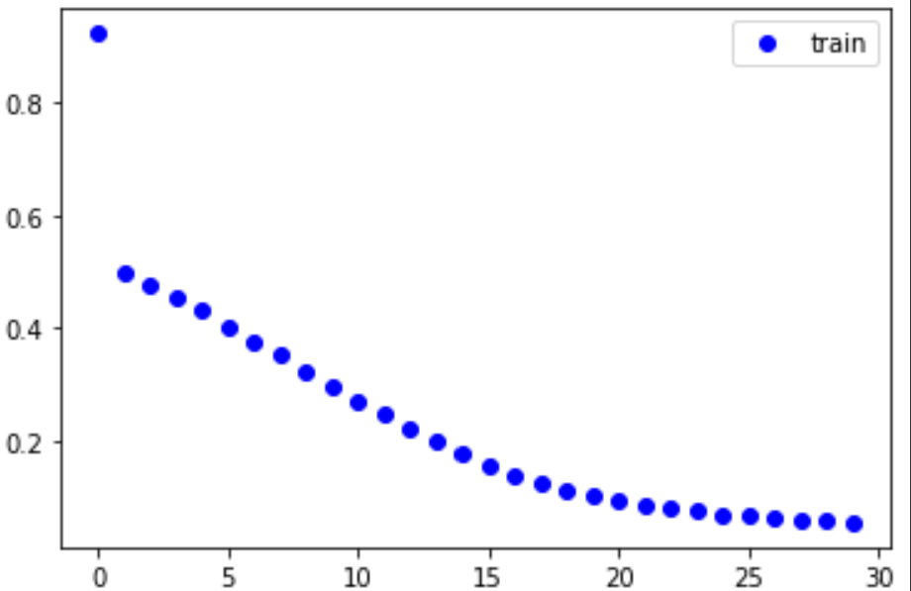
Results and discussion - our implementation
Transformers and normal RNN Encoder- Decoder models
Transformers - 46.9M params
RNN Enc-Dec - 27.8M params
RNN Enc-Dec - 161.4M params

Slide 15
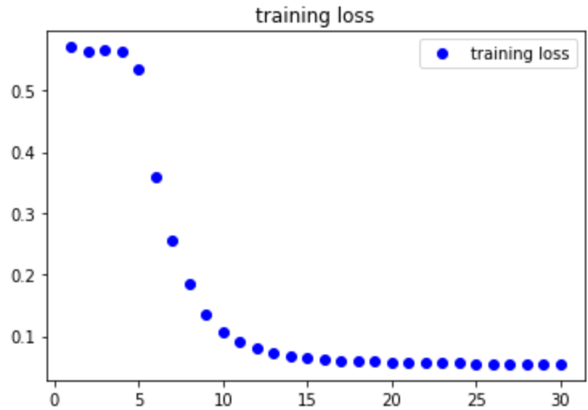
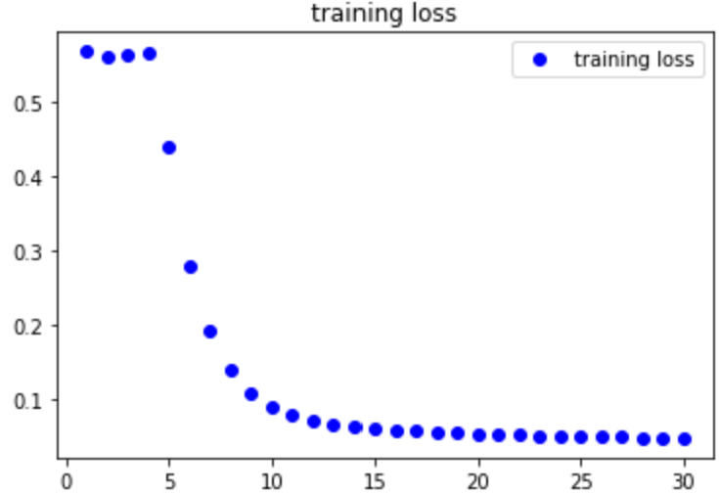
Results and discussion - our implementation
Encoder-Decoder model with BiRNN Encoder vs model with normal RNN Encoder

Slide 16
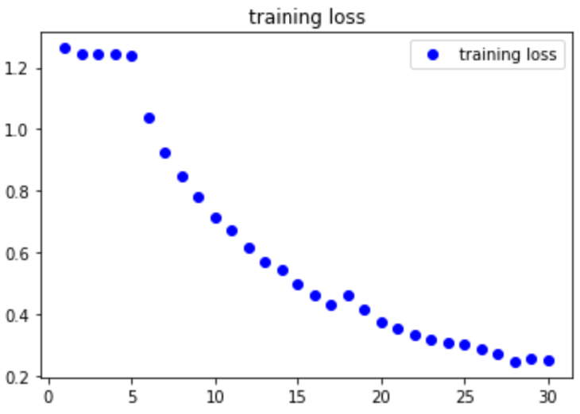
Results and discussion - our implementation
Encoder-Decoder models with BiRNN Encoder on different datasets
manythings.org/anki
Europarl

Slide 17
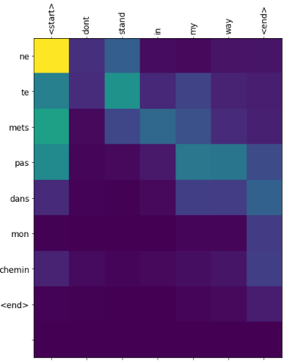
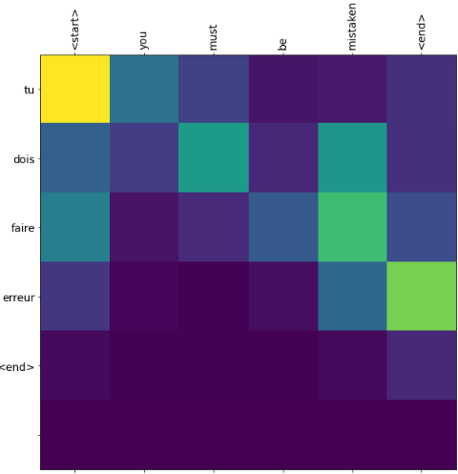
Results and discussion - our implementation
BLEU-1 | 0.784
BLEU-2 | 0.681
BLEU-3 | 0.582
BLEU-4 | 0.426

Slide 18
Conclusion
This project explores the notion of attention and its properties.
It goes over the development of the attention mechanism from being proposed as an extension of the RNN Encoder-Decoder network architecture to being a main component of a state-of-the-art network in Transformers.
The applications of such models expand beyond the task of machine translation into other NLP tasks like text summarization and even Computer Vision tasks through the proposal of Vision Transformers.

Slide 19
Reference
[1] Vaswani, A., Shazeer, N., Parmar, N., Uszkoreit, J., Jones, L., Gomez, A. N., ... & Polosukhin, I. (2017). Attention is all you need. Advances in neural information processing systems, 30.
[2] Cho, K., Van Merriënboer, B., Gulcehre, C., Bahdanau, D., Bougares, F., Schwenk, H., & Bengio, Y. (2014). Learning phrase representations using RNN encoder-decoder for statistical machine translation. arXiv preprint arXiv:1406.1078.
[3] Bahdanau, D., Cho, K., & Bengio, Y. (2014). Neural machine translation by jointly learning to align and translate. arXiv preprint arXiv:1409.0473.
[4] Manythings.org French-English corpus http://www.manythings.org/anki
[5] Tab-delimited Bilingual Sentence Pairs, retrieved 30 Oct 2022 from http://www.manythings.org/anki/

