Slide 1
Accelerometer and Gyroscope Based IoT System for Activity Classification and Monitoring
Séamus Knightly ()
Seán Kelly (21421506)
1MECE1
EE5127 Internet of Things System Design Project

Slide 2
The Need for Reliable Activity Monitoring in Healthcare
The Irish Nurses and Midwives Organisation (INMO) has reported that the nursing shortage that began in 2007 continues to worsen into 2025.
Hospitals, rehabilitation, and elder care facilities are struggling with reduced staff and increasing patient loads.
Fewer staff means less time to care for individual patients, especially those with immobility, or overexertion issues during recovery.
Devices like pendant alarms (e.g. the Seniors Alert Scheme) depend on patients pressing a button after a fall – no remote monitoring or alerting
Even modern fall detectors based on accelerometers still miss real world events or trigger false alarms.
For example, one study found only 80% of falls detected, with one false alarm every 40 hours of use.
Current systems don’t provide continuous, contextual monitoring of patient movement – no insight into their recovery
Wearable IoT devices can continuously collect, transmit, and process activity data in real time, enabling more reliable insights into patient behavior.
Goal: Reduce dependence on staff for recovery and patient monitoring and build a platform for future systems such as fall alarms

Slide 3
Aim & Objectives
Acquire accelerometer and gyroscope data from an IoT device
Transmit sensor data in real-time to an IoT Gateway
Perform preprocessing at the gateway (filtering, windowing, feature extraction)
Push the data to a Cloud-based Machine Learning and Data Analytics Platform for classification and storage
Implement monitoring of the time-series data with configurable alarms based on healthcare needs
Implement an IoT system for activity classification and monitoring

Slide 4
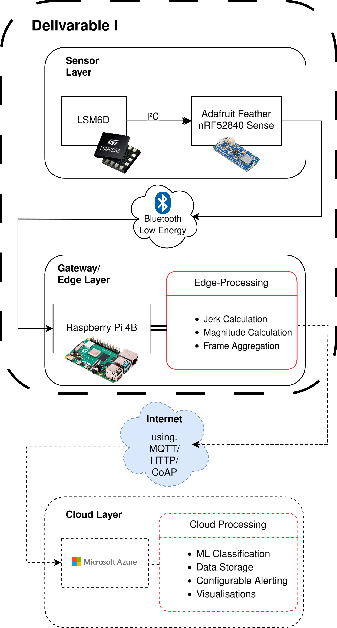
System Design AND ARCHITECTURE
Requirements
ARCHITECTURE
Long battery life
Medium-range communication (10-30m)
Reliable data transmission
Accurate motion sensing for classification
Comfort – small and lightweight
Sensing Layer:
Hip-worn IoT sensor node with 6-axis IMU (Accelerometer + Gyroscope), BLE, BMC, rechargeable battery
Gateway / Edge Compute Layer:
IoT Gateway with BLE, WiFi / Ethernet Connectivity, SoC w/ Linux for feature extraction
Application Layer:
Machine Learning and Data Analytics pipeline with classifier and time-series database

Slide 5
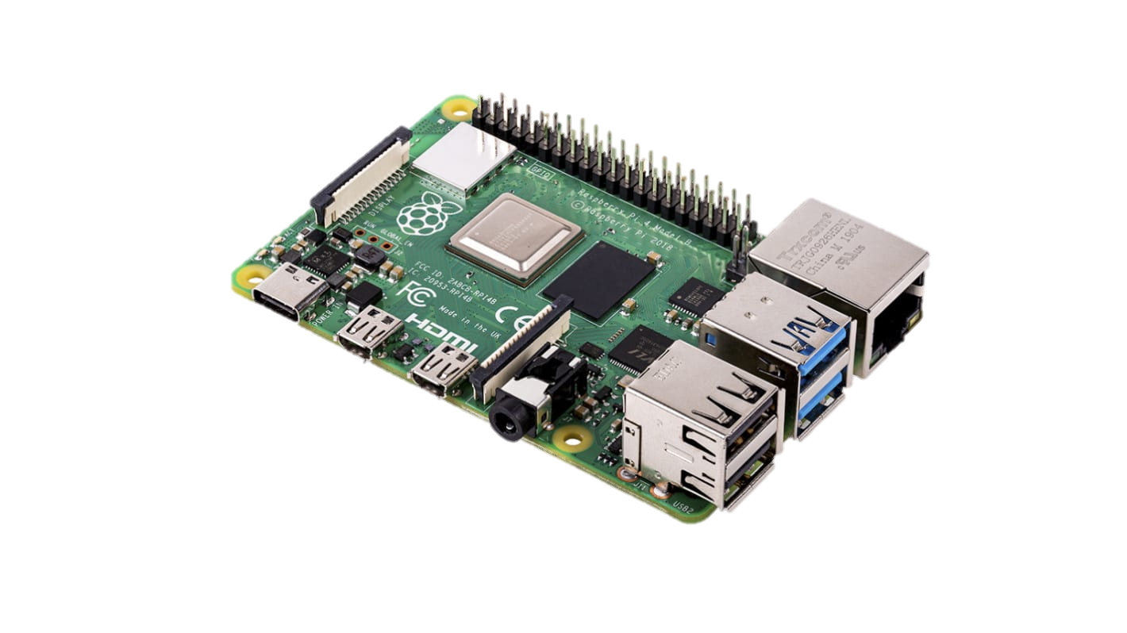
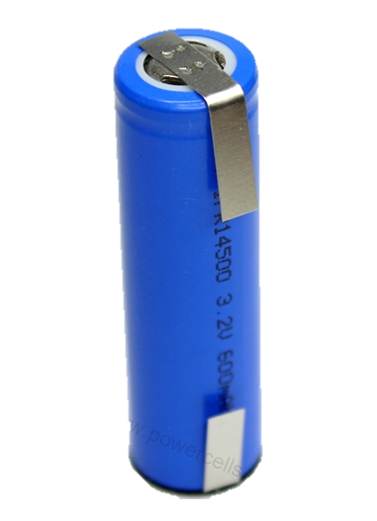
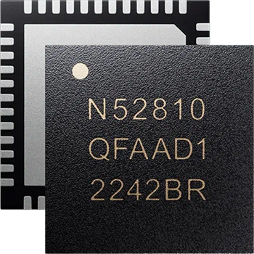
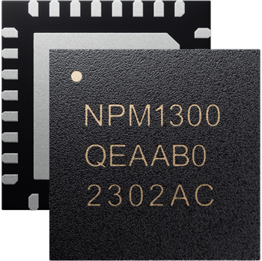
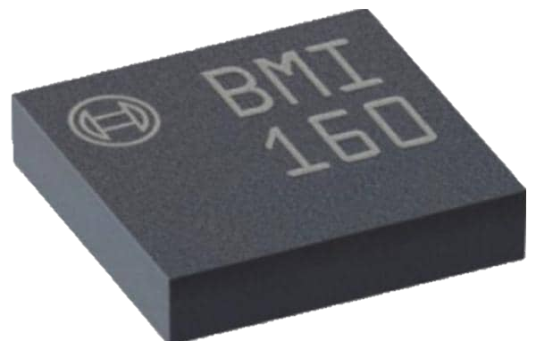
Component Selection
BMI160 + NRF52810 mcu
Raspberry pi 4/5
Lifepo4 + npm1300 pmic
3-axis Accelerometer + 3-axis Gyro
Configurable Sample Rate >100Hz
Both are ultra-low-power
Built in BLE 5.0, 2.4Ghz, both support 3.3v
Powerful quad-core ARM processor
Gigabit Ethernet + Bluetooth 5.0
Can handle a large number of devices
Compact and consumes 15w maximum
Extremely stable battery chemistry
600mAh per AA-sized cell with 2000+ charge cycles before replacement
Supports USB-C, 3.2v Battery voltage, battery level gauging, and more

Slide 6
IMPLEMENTATION
Feather sense iot node
Raspberry pi gateway node
LSM6DS3 IMU sampling at 50Hz
Initial implementation: CBOR data over UART – 11Hz
Revised implementation: GATT Service transmitting fixed size packets, supports 50 Hz
GATT communication highly reliable
Data retrieval via GATT with Bleak (easy subscription to characteristic)
50-sample average for zeroing
0.1m/s & 0.1deg/s dead zone
128-sample window – 50% overlap
Feature Extraction – Mean, Min/Max, FFT, derivatives, etc.

Slide 7
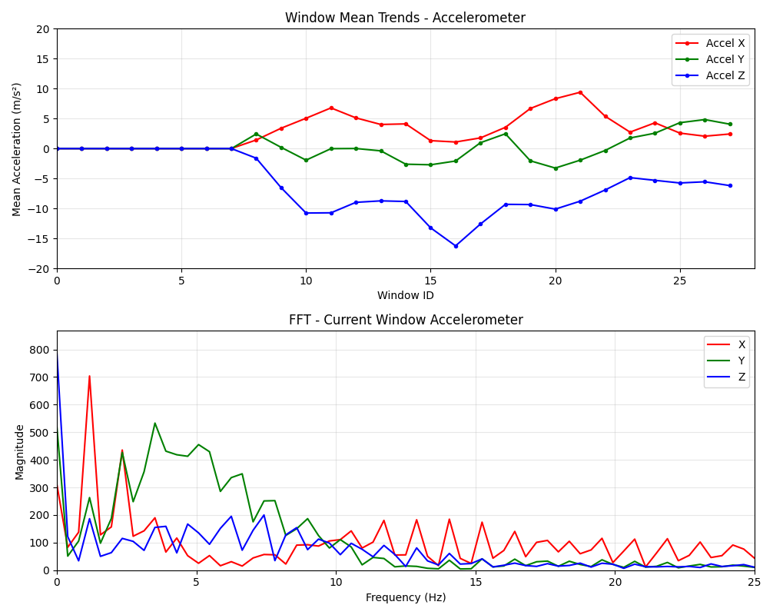
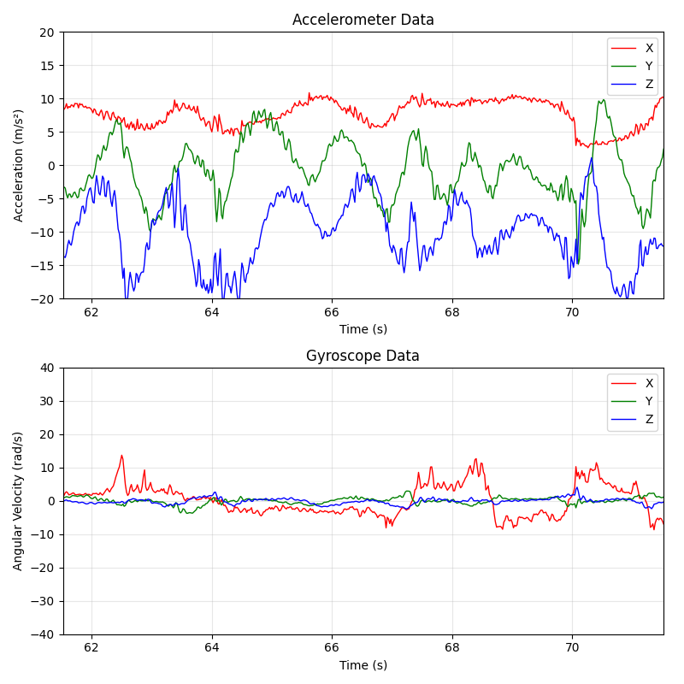
Outputs/Results

Slide 8
Discussion & Next Steps
Working Prototype completed
Next steps:
Remainder of feature extractions on windowed data
Cloud ML model in Azure ML Studio.
Real time prediction via Azure IoT + Power BI visualization.

