Slide 1
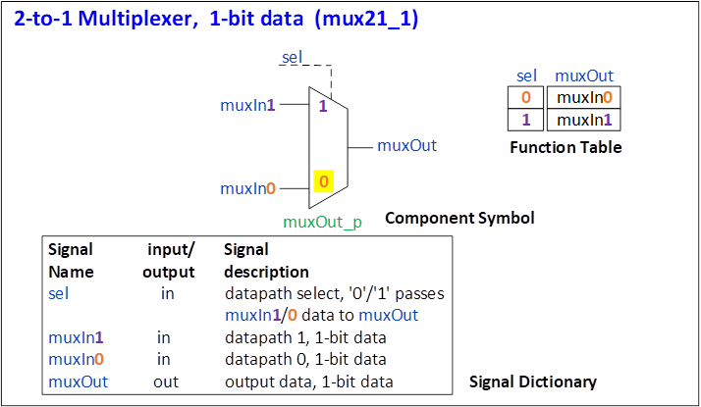
mux21_1 Design Specification
Component Name mux21_1
Title 2-to-1 multiplexer, 1-bit data
Description
muxOut = muxIn0 (default)
Assertion of sel selects muxOut = muxIn1
Component signal dictionary
sel datapath select,
'0'/'1' passes muxIn1/0 data to muxOut
muxIn1 datapath 1, 1-bit data
muxIn0 datapath 0, 1-bit data
muxOut output data, 1-bit data
Internal signal dictionary
None

Slide 2
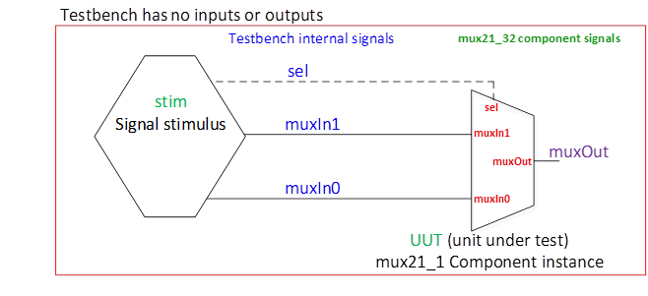
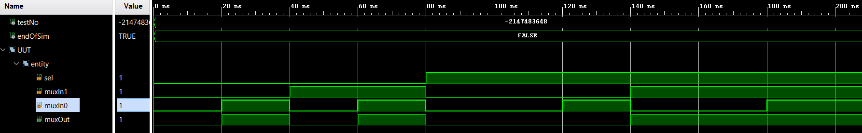
mux21_1 Test Specification
Testbench diagram
TestNo Input signals delay Output signals Note
sel muxIn1 muxIn0 muxOut
binary hexadecimal hexadecimal hexadecimal
1 0 0 0 (1*period) 0
2 0 0 1 (1*period) 1
3 0 1 0 (1*period) 0
4 0 1 1 (1*period) 1
5 1 0 0 (1*period) 0 datapath 1 active
6 1 0 1 (1*period) 0
7 1 1 0 (1*period) 1 datapath 1 active
8 1 1 1 (1*period) 1
Testplan
Simulation waveform

