Slide 1
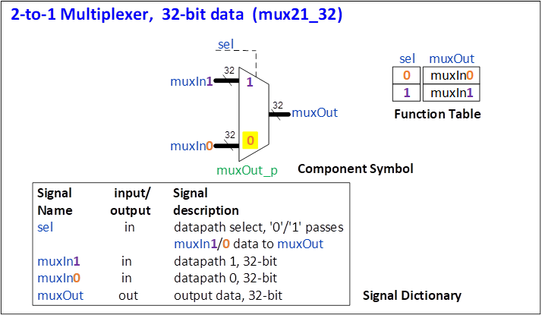
mux21_32 Design Specification
Component name mux21_32
Title: 2-to-1 multiplexer, 32-bit data
Description
muxOut = muxIn0 (default)
Assertion of sel selects muxOut = muxIn1
muxOut = muxIn0 default assignment
Pseudo code for non-default assignment
if sel = 1 muxOut = muxIn1
Internal signals None
Download specification text
Vicilogic mux21_32 demo

Slide 2
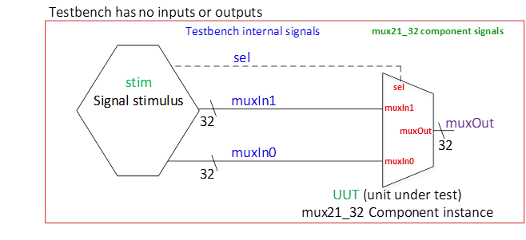
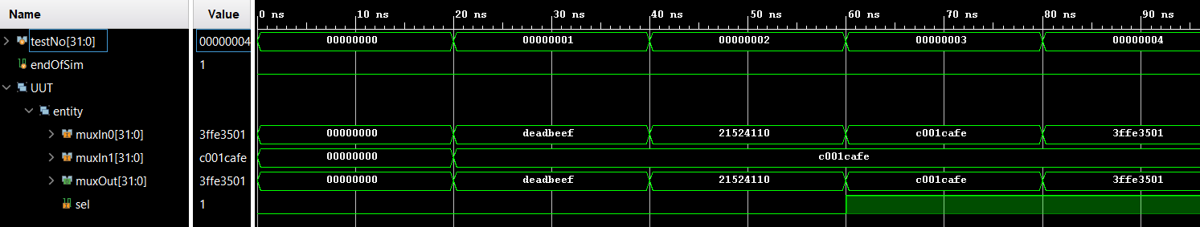
mux21_32 Test Specification
Testbench diagram
Testplan
Simulation waveform

