Slide 1
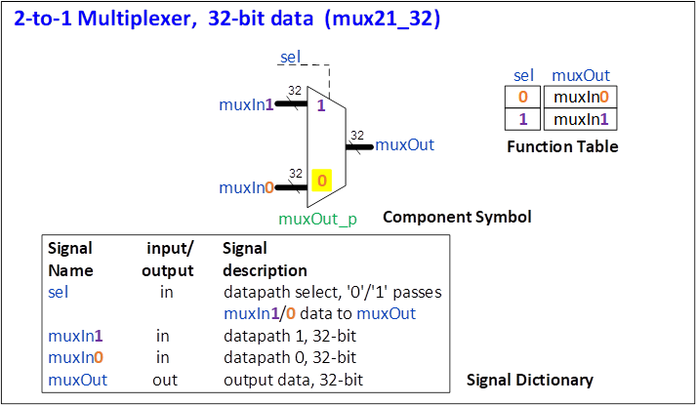
mux21_32 Standalone ChatGPT message
ChatGPT message
Create a mux21_32 VHDL model and testbench, with
input control signal sel (1-bit),
input 32-bit datapath signals muxIn1 and muxIn0,
output 32-bit signal muxOut.
If sel = 1, muxOut = muxIn1, else muxOut = muxIn0

Slide 2
HDLGen and ChatGPT Digital Systems Design Capture Automation
Download, open HDLGen, select VHDL or Verilog generation, modify settings
Setup project folders and files
Capture design in HDLGen, from the design and test specifications
Generate files
HDL model and testbench templates
EDA project and simulation waveform configuration
Open EDA toolsuite, syntax check, simulate, synthesise
Generate ChatGPT file for HDL model and testbench completion
Run ChatGPT
Generate complete HDL model
Generate testbench HDL stimulus and output signal checking HDL.
Paste in EDA tool
HDL model template
Testbench stimulus process
Simulate HDL (view and verify timing diagram and messages)
Synthesise logic (view schematics)

Slide 3
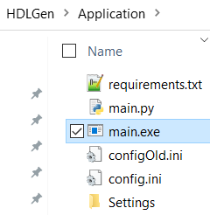
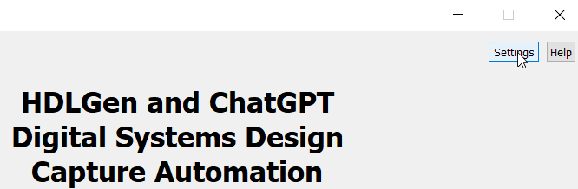
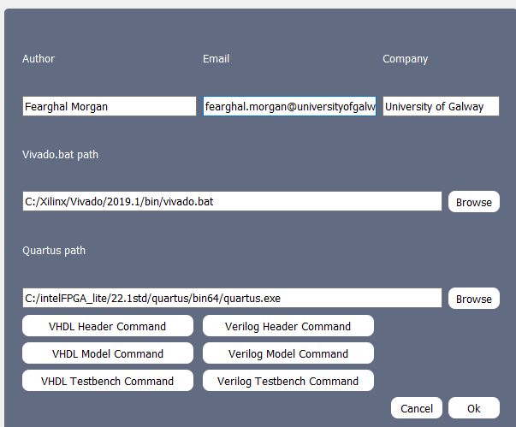
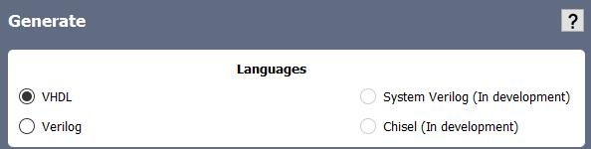

1. Download, open HDLGen, select VHDL or Verilog generation, modify settings
Download HDLGen https://github.com/fearghal1/HDLGen
Open HDLGen
Select VHDL or Verilog
Settings
Creator details
EDA tool link
ChatGPT message header default

Slide 4
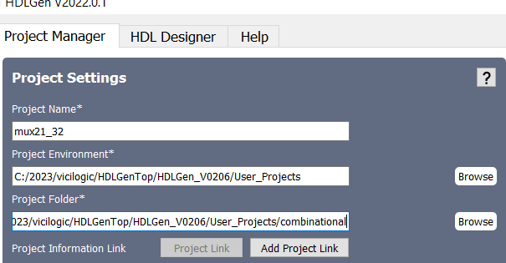
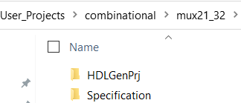
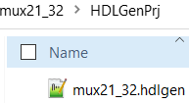
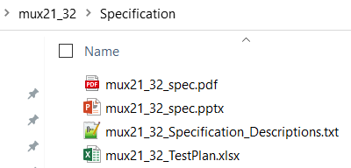
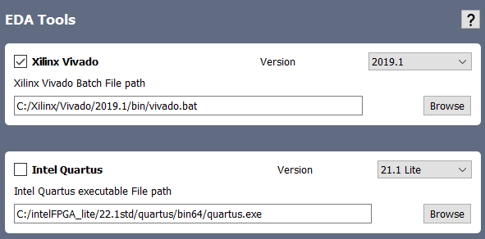
2. Setup project folders and files
Create
Project name
Project environment: folder for single or series of project
Project folder, within the project environment
Download project
Specification
Test Plan (excel file)
Specification text description file

Slide 5
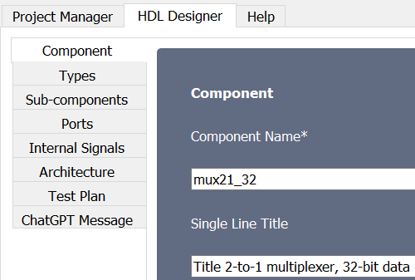
3. Capture Design in HDLGen, from the design and test specifications
Component
VHDL-specific
Signal Types
Sub-components: add component to MainPackage VHDL package)
Ports
Internal signals
Architecture
Test Plan
ChatGPT message

Slide 6
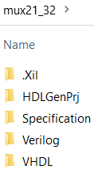
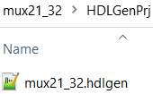
4. Generate files
HDL model and testbench templates
EDA project
Simulation waveform configuration

Slide 7
5. Open EDA toolsuite, syntax check, simulate, synthesise
G

Slide 8
6. Generate ChatGPT files for HDL model and testbench completion
G?? enerate complete HDL model
Generate testbench HDL stimulus and output signal checking HDL.
Paste in EDA tool
HDL model template
Testbench stimulus process

Slide 9
7. Run ChatGPT
Generate complete HDL model
Generate testbench HDL stimulus and output signal checking HDL.
Paste in EDA tool
HDL model template
Testbench stimulus process

Slide 10
8. Simulate HDL
Simulate
View and verify timing diagram and messages

Slide 11
9. Synthesise logic (view schematics)
Simulate
View and verify timing diagram and messages

