Slide 1
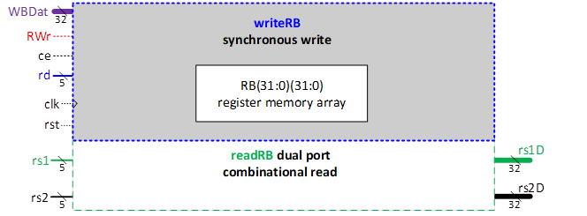
RISCV_RB Design Specification
Context diagram (CD)/ Component symbol
Component Name RISCV_RB
Title 32 x 32-bit Register Bank, with chip enable Single synchronous write port
Dual combinational read ports
Description
32 x 32-bit Register Bank registers, typically named x0 – x31
Using CSArray in the digital design process (CSArray(31:0)(31:0)) rather than x(31:0)(31:0) included in this slide
x0 is always 0
writeRB synchronous write port
if rst asserted (h)
x(31:0)(31:0) = 0 immediately clear all registers
else if rising_edge (clk)
x(31)(31:0) – x(0)(31:0) unchanged
if ce chip enable (h) = 1 enable
if RWr asserted (h) enable register write
if rd > 0
x(rd) = WBDat synchronous write
readRB dual combinational read ports rs1D = x(rs1) rs2D = x(rs2)
Signal dictionary
clk System clk strobe, rising edge active
rst asynchronous rst reset signals signal, asserted high
ce Chip enable, asserted high
RWr Synchronous register write enable, high asserted
rd Destination register address, address 0 - 31
rs1 Source register 1 address
rs2 Source register 2 address
rs1D Source register 1 data (32-bit)
rs2D Source register 2 data (32-bit)
WBDat Writeback data (32-bit)

Slide 2
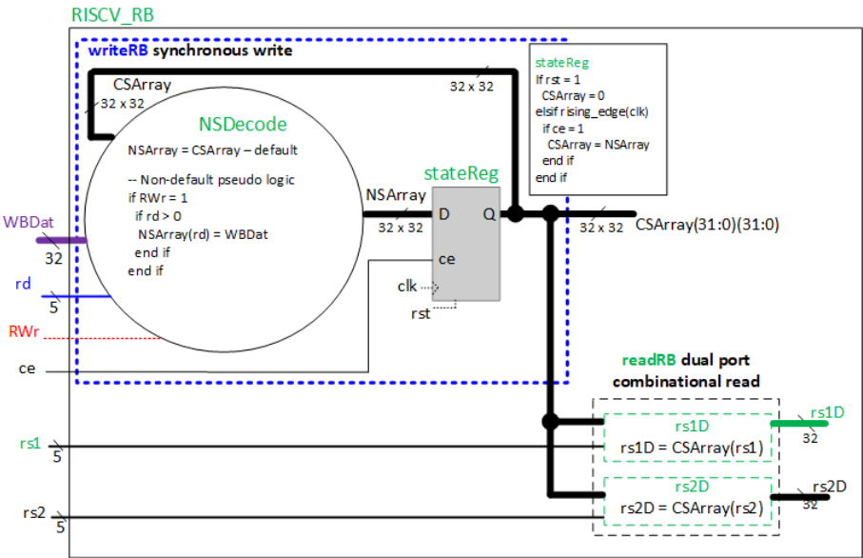
RISCV_RB Data Flow Diagram (DFD)
Incremental Signal Dictionary (ISD)
CSArray 32 x 32-bit memory array current state (registers)
NSArray 32 x 32-bit memory array next state
NSDecode pseudo code if RWr = 1
if rd > 0
NSArray(rd) = WBDat
end if
end if
Using ce as a register input, not in the NSDecode process
rs1D and rs2D process pseudo code rs1D = x(rs1)
rs2D = x(rs2)

Slide 3
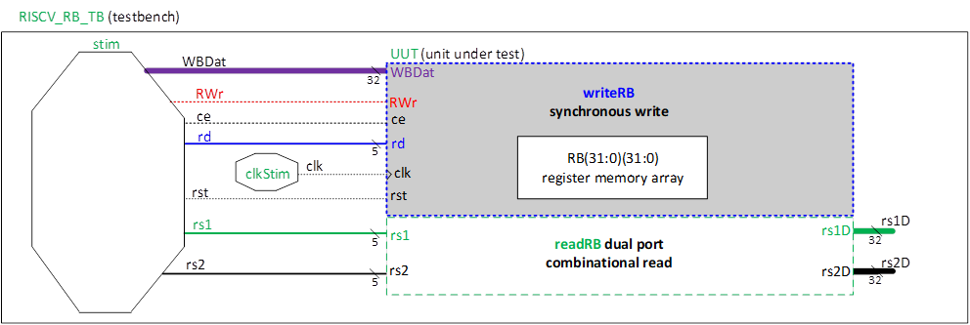
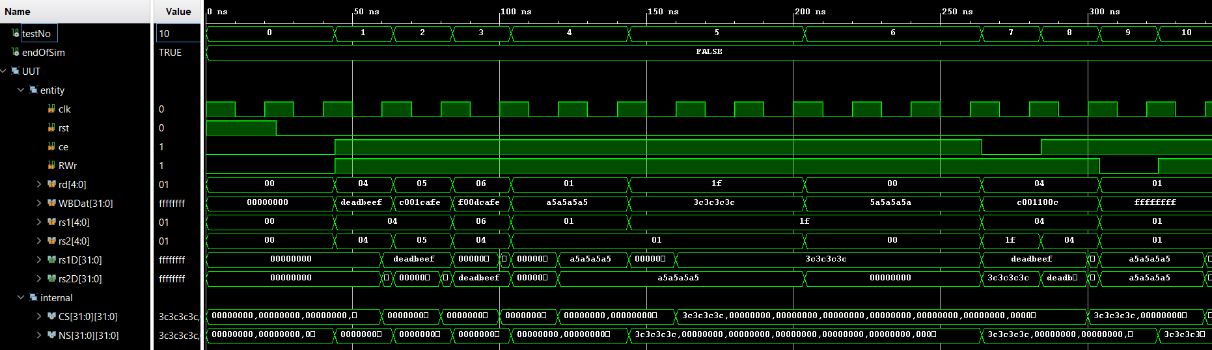
RISCV_RB Testbench Block Diagram
Key
Testbench internal signals
Unit under test signals
Testbench has no inputs or outputs
Example timing waveform
CS used for register array in t. diag

Slide 4
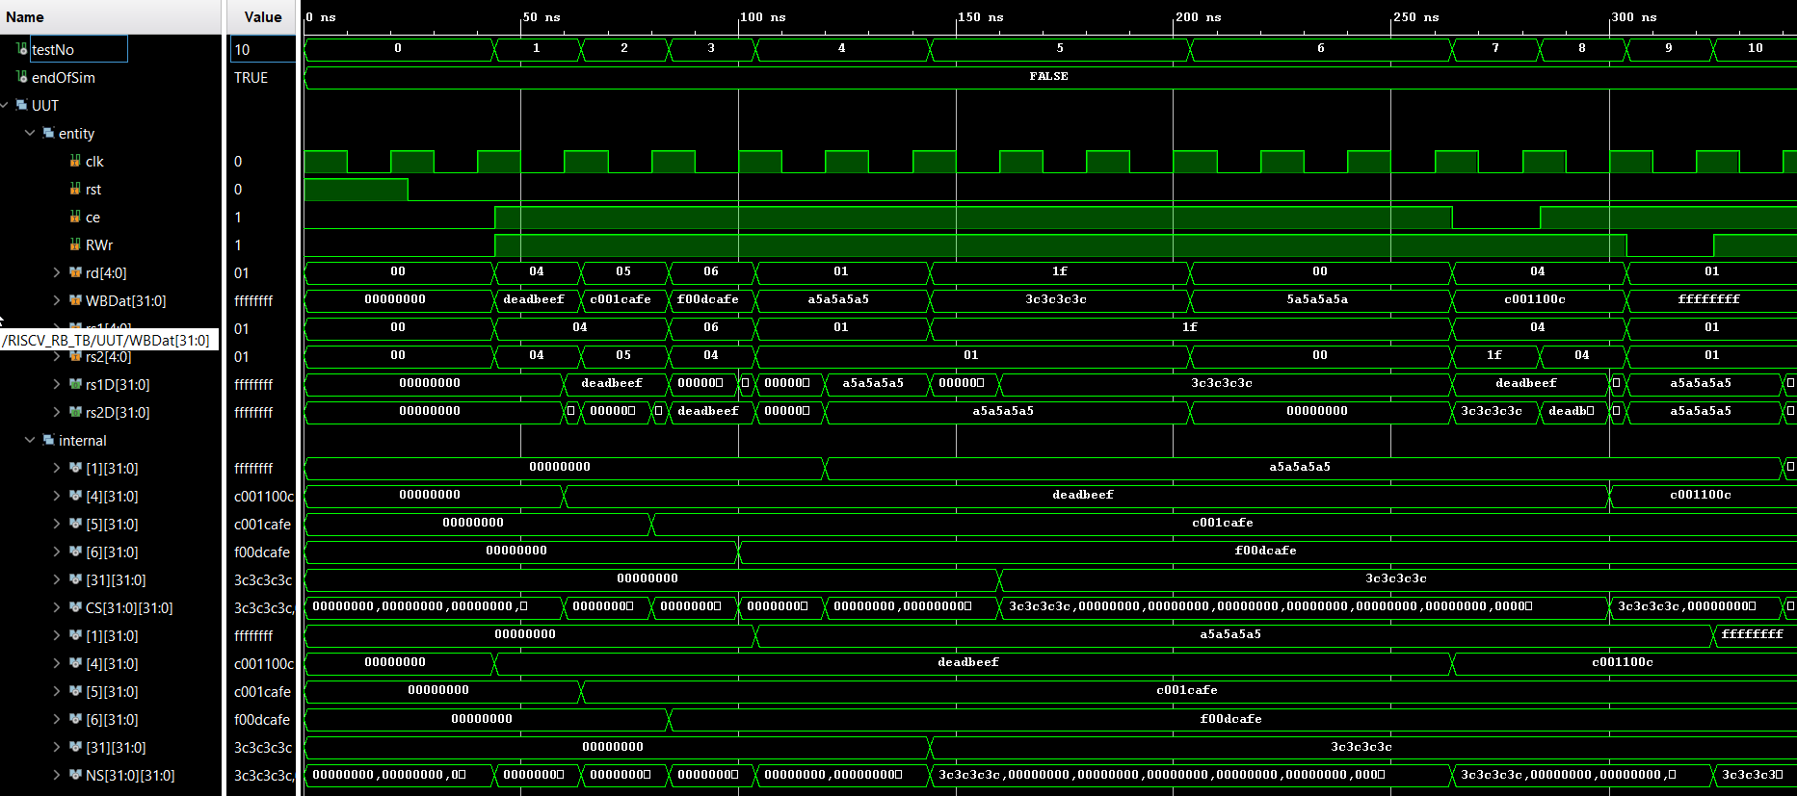
RISCV_RB Timing Diagram: all signals

Slide 5

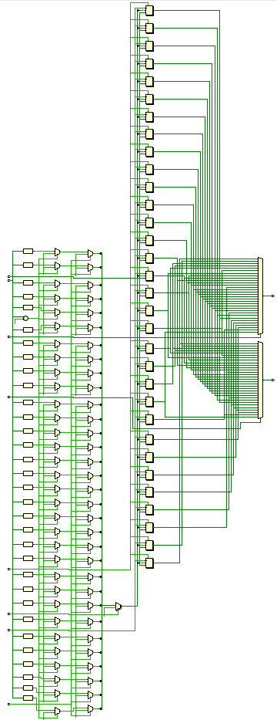
RISCV_RB Synthesised Schematics
32 x 32-bit registers Register components highlighted
Other components are combinational logic (multiplexers, ROMs, arithmetic)
Elaborated (technology-independent) schematic
32 x 32-bit registers
Synthesised (technology-specific) schematic

