Slide 1


578 - SAL Institute of Technology & Engineering Research Department of Computer Applications 94-Master of Computer Applications
Major Project (MC04094011 )
“AI-Based Document Authenticity Detection System”
Name:Dax Panchal
Enrollment No:245780694033
Name of Internal Guide :
Asst. Prof. Nairutvi Mistry
Name of External Guide :
Dr. Khyati Rami Mam
Guide
( )

Slide 2
Table of Contents
Project Profile
Company Profile
Project Description & Scheduling
System Design
Enrollment No:245780694033
Major Project (MC04094011 )

Slide 3
Project Profile
Title
AI-Based Document Authenticity Detection System
Category
Artificial Intelligence
Natural Language Processing (NLP)
Computer Vision
Web Application Development
Duration
18 Dec to 17 april
Member
Panchal Dax Hareshkumar
Enrollment No:245780694033
Major Project (MC04094011 )

Slide 4
Tools & Technologies
Backend : Python , Django
ML: PytTorch, HuggingFace Transformers, Sentence-Transformers, Scikit-learn
Frontend: HTML, CSS3, Bootstrap, JavaScript, jQuery
Database: SQLlite
Libraries : Pillow (Image Processing), ReportLab (PDF generation)
Enrollment No:245780694033
Major Project (MC04094011 )

Slide 5
Project Scope
Detect AI-generated textual content in documents.
Identify AI-generated images using deep learning models.
Perform sentence-wise AI vs Human classification.
Provide probability-based accuracy scores.
Generate downloadable PDF reports.
Restrict report downloads through authentication.
Enrollment No:245780694033
Major Project (MC04094011 )

Slide 6
Objectives of the Project
To develop a web-based AI content detection system.
To classify uploaded documents as AI-generated or Human-written.
To perform sentence-level AI detection with color highlighting.
To detect AI-generated images using pretrained CNN models.
To calculate semantic similarity with AI writing patterns.
To generate structured PDF analysis reports.
To implement secure user authentication for report downloads.
Enrollment No:245780694033
Major Project (MC04094011 )

Slide 7
Project Description
Introduction
Artificial Intelligence tools developed by companies like OpenAI, Google, and Microsoft have made it easier to generate automated text and images. While these technologies increase productivity, they also create challenges in maintaining content authenticity and academic integrity.
The proposed system is a web-based AI Document and Image Scanner that analyzes documents, text inputs, and images to identify whether the content is AI-generated or human-written. The system performs AI probability analysis, sentence-level highlighting, similarity detection with AI writing patterns, and AI image detection. It also generates secure downloadable reports using NLP and computer vision techniques implemented in a Django-based web application.
Enrollment No:245780694033
Major Project (MC04094011 )

Slide 8
Problem Statement
AI-generated assignments and essays submitted as original work
Difficulty in identifying AI-written content manually
Lack of sentence-level AI classification in many tools
No unified system that detects both AI text and AI images
Limited transparency in similarity estimation
There is a need for a robust, multi-modal detection system capable of identifying AI-generated text and images with measurable accuracy and explainable outputs.
Enrollment No:245780694033
Major Project (MC04094011 )

Slide 9
Existing System
Currently available tools include:
Turnitin – Primarily focused on plagiarism detection with limited AI detection capability.
Copyleaks – Provides AI detection but lacks deep transparency in model explanation.
Other standalone AI detectors – Provide probability scores but often do not perform sentence-level analysis or image detection.
Most existing systems focus only on textual plagiarism rather than AI-authorship detection and rarely combine text and image analysis.
Enrollment No:245780694033
Major Project (MC04094011 )

Slide 10
Limitations of Existing System
No integrated multi-modal detection (text + image in one platform).
Limited sentence-wise highlighting.
Lack of AI-style similarity explanation.
Report download not always secured with authentication.
Black-box output without technical transparency.
High dependency on internet-based APIs.
These limitations reduce trust and analytical clarity.
Enrollment No:245780694033
Major Project (MC04094011 )

Slide 11
Proposed System
The proposed system introduces a comprehensive AI detection platform with the following capabilities:
Upload and analyze PDF, DOCX, and TXT documents
Sentence-wise AI classification with red (AI) and green (Human) highlights
AI probability (%) and Human probability (%) display
AI-style semantic similarity calculation using embeddings
AI-generated image classification using pretrained CNN models
Authentication-based PDF report download
Structured result visualization with dynamic UI
Enrollment No:245780694033
Major Project (MC04094011 )

Slide 12
Advantages of Proposed System
Multi-modal detection (Text + Image).
Sentence-level explainable AI classification.
Secure user authentication for report downloads.
Scalable backend architecture.
Research-oriented design suitable for academic environments.
Modular ML integration for future expansion.
This makes the system more transparent and reliable compared to existing tools.
Enrollment No:245780694033
Major Project (MC04094011 )

Slide 13
Modules
1. User Authentication Module
Registration
Login
Secure session handling
Report access control
2. Document Upload Module
PDF/DOCX/TXT file handling
Text extraction
Data cleaning and preprocessing
3. Text AI Detection Module
Sentence tokenization
AI vs Human probability calculation
Highlight rendering
Enrollment No:245780694033
Major Project (MC04094011 )

Slide 14
4. Similarity Estimation Module
Sentence embeddings
Cosine similarity calculation
AI style similarity %
5. Image Detection Module
Image preprocessing
CNN-based classification
AI-generated probability output
6. Report Generation Module
PDF report creation using ReportLab
Accuracy metrics
Conclusion summary
Download restriction via login
Enrollment No:245780694033
Major Project (MC04094011 )

Slide 15
Project Scheduling & Planning
Phase 1 – Foundation & Setup
Project Setup
Install Library
Implement user authentication
Design database models and configure admin panel
Phase 2 – Text AI Detection Engine
Integrate HuggingFace model for AI text detection.
Implement sentence-level analysis.
Build scoring metrics
Store analysis reports in the database.
Enrollment No:245780694033
Major Project (MC04094011 )

Slide 16
Phase 3 – Image AI Detection
Build image processing pipeline using PyTorch.
Load pretrained CNN model.
Predict AI-generated vs real images.
Image detection model integration
Store image analysis reports.
Phase 4 – Advanced Analysis & Source ProbabilitySmall text testing
Extract stylometric features (sentence variation, vocabulary richness, repetition).
Build a probability scoring system.
Implement source classification logic.
Combine outputs from text and statistical models.
Calibrate accuracy.
Enrollment No:245780694033
Major Project (MC04094011 )

Slide 17
Phase 5 — Reporting & SecurityPDF report generation
Generate PDF reports using ReportLab.
Restrict report downloads to authenticated users.
Implement secure file access and permission checks.
Create download history tracking.
Phase 6 — Optimization & Deployment
Optimize performance and ML loading.
Conduct testing and handle edge cases.
Enrollment No:245780694033
Major Project (MC04094011 )

Slide 18
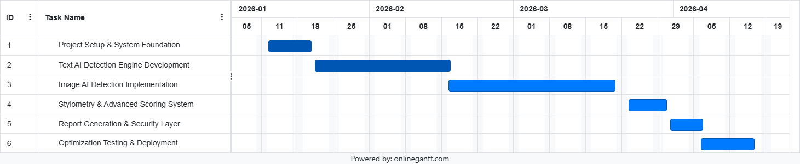
Gantt Chart
Enrollment No:245780694033
Major Project (MC04094011 )

Slide 19
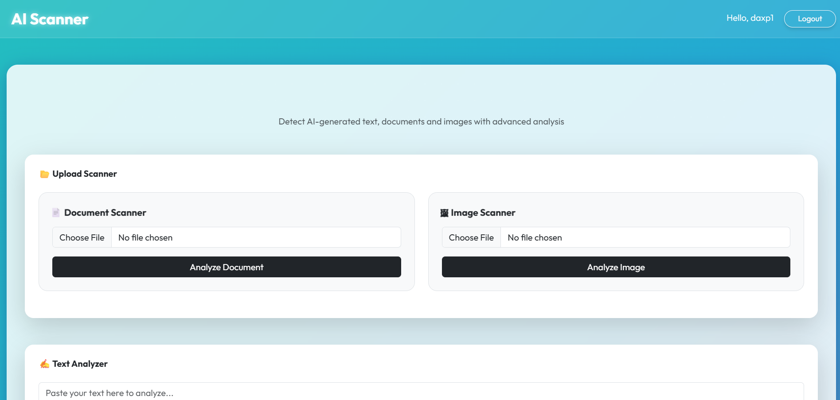
Screen Shot
Home Page:
Enrollment No:245780694033
Major Project (MC04094011 )

Slide 20
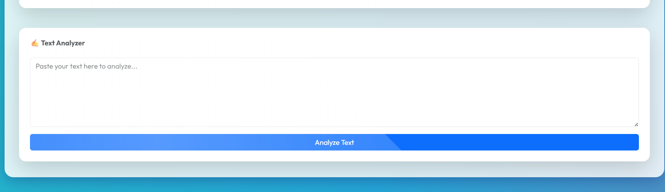
Enrollment No:245780694033
Major Project (MC04094011 )

Slide 21
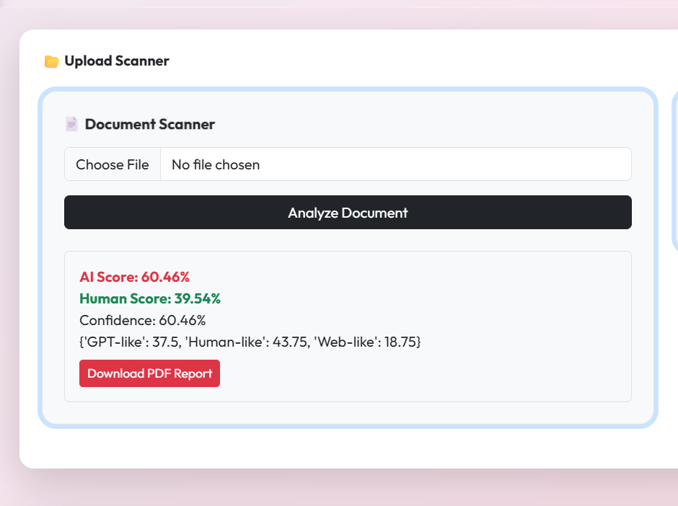
Output:
Enrollment No:245780694033
Major Project (MC04094011 )

Slide 22
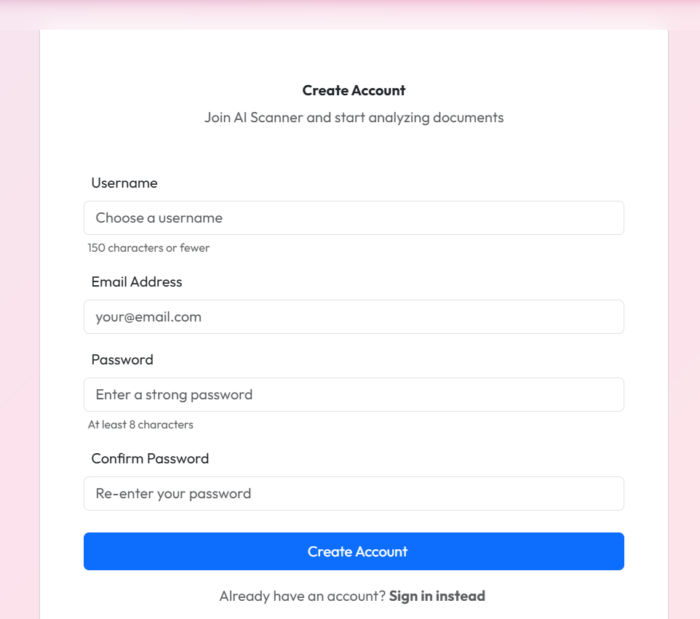
Register:
Enrollment No:245780694033
Major Project (MC04094011 )

Slide 23
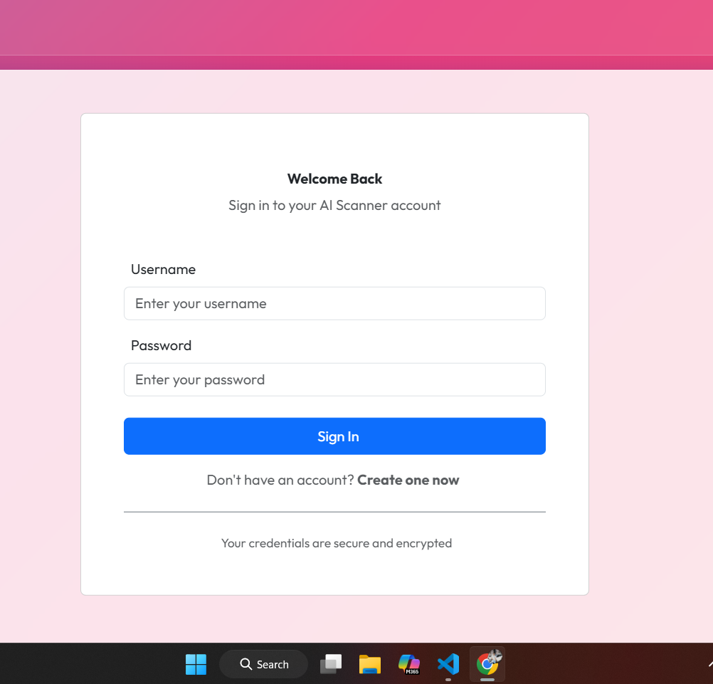
Login:
Enrollment No:245780694033
Major Project (MC04094011 )

Slide 24
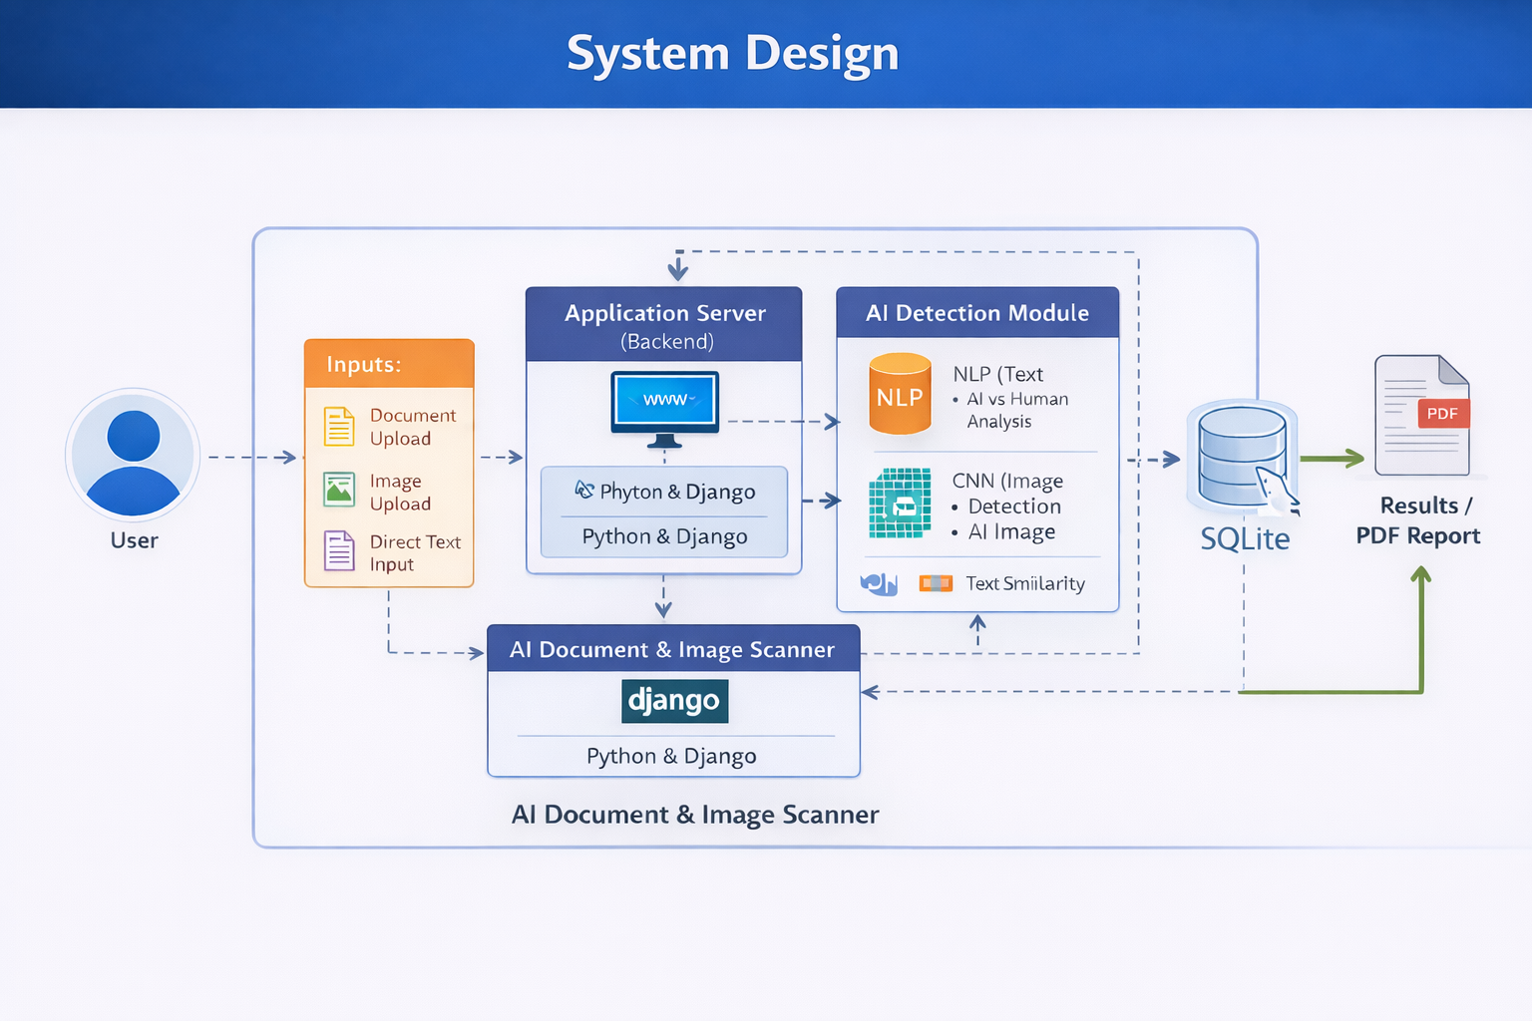
System Design

Slide 25
Thank YOU

