Slide 1


578 - SAL Institute of Technology & Engineering Research Department of Computer Applications 94-Master of Computer Applications
Major Project (MC04094011 )
The Project Title
“AI-Based Threat Detection and Automatic Response System”
SATYAM YADAV
245780694053
Internal Guide : Nairutvi Mam
External Guide: Dr. Khyati Rami Mam
Guide
( )

Slide 2
Table of Contents
Project Profile
Company Profile
Project Description & Scheduling
System Design
Project Screenshots

Slide 3
Project Profile
Project Title:
AI-Based Threat Detection and Automatic Response System.
Project Category:
Cybersecurity and Artificial Intelligence.
Project Duration:
December 2026 – April 2026
Team Member:
Satyam

Slide 4
Tools & Technologies
Programming Language: Python
Backend Framework: FastAPI
Database: PostgreSQL
AI/Machine Learning: Scikit-learn ,Pandas ,NumPy
Containerization: Docker
ORM : SQLAlchemy 2.0 Async
Additional Technologies:
Operating System: Linux
Log Sources: Auth logs and System logs, Application/Web logs
Development Tools: GitHub, VS Code
Infrastructure: Redis

Slide 5
Project Scope
The scope of this project is to develop an intelligent cybersecurity system capable of:
Monitoring system logs in real time.
Detecting suspicious patterns using machine learning.
Identifying security threats automatically.
Triggering automated responses against threats.
Helping organizations detect attacks early.
The system can be used by SOC teams, enterprises, and cloud environments.

Slide 6
Objectives of the Project
The main objectives of this project are:
To detect cyber threats using AI techniques.
To analyze system logs automatically.
To identify abnormal or malicious activities.
To automate response mechanisms for detected threats.
To reduce manual monitoring workload in security operations.

Slide 7
Introduction
Cyber attacks are increasing rapidly.
Modern computer systems generate large volumes of logs from authentication systems, applications, and network activities.
Traditional monitoring systems rely heavily on manual analysis and rule-based detection, which is slow and inefficient.
Security teams must continuously monitor these logs to detect cyber threats such as brute force attacks, unauthorized access, and suspicious activities.

Slide 8
Problem Statement
Traditional security monitoring systems face several challenges:
Large volume of logs generated daily.
Manual monitoring requires high effort.
Delayed detection of cyber threats.
Need for intelligent automated systems.
Slow incident response.

Slide 9
Existing System
In traditional security systems:
Traditional log monitoring.
Logs are manually analyzed
Threat detection is rule-based.
Security analysts monitor alerts.
Response actions are performed manually.
This approach is time consuming and inefficient for large scale systems.

Slide 10
Limitation of Existing System
Existing systems suffer from:
High false positives.
Slow threat detection.
Inability to handle large log volumes.
Heavy dependency on humans.
Poor scalability.
Limited automation.
These limitations reduce the effectiveness of cybersecurity operations.

Slide 11
Proposed System
The proposed system introduces an AI-based threat detection system that:
Collects logs from multiple sources.
Processes logs in real time.
Detects anomalies using machine learning.
Identifies suspicious activities.
Automatically triggers response actions.
This improves security monitoring and reduces manual effort.

Slide 12
Advantages of Proposed System
Advantages of the proposed system include:
Faster threat detection.
Automated security response.
Reduced manual monitoring.
Intelligent log analysis.
Improved cybersecurity protection.
Scalable architecture.

Slide 13
System Modules
Log Collection Module
Log Parsing & Processing Module
Feature Engineering Module
Threat Detection Module
Automated Response Module
Database Management Module
API & Backend Module
Dashboard & Visualization Module

Slide 14
Project Planning Phases
Phase 1 — Backend Foundation
FastAPI async backend
PostgreSQL database
SQLAlchemy integration
Docker environment setup
Phase 2 — Log Ingestion System
Async file ingestion
Log offset tracking
Log deduplication
Multi log source support
Phase 3 — Detection Engine
Rule based detection engine
Redis based event counters
Severity scoring system
ML model integration (in progress)

Slide 15
Project Planning Phases
Phase 4 — Response Automation
IP blocking using iptables
Email alert system
Telegram notification system
Incident tracking
Phase 5 — Dashboard Development
Real time attack monitoring
Top attacking IP visualization
Severity trend charts
Phase 6 — Production Hardening
JWT authentication
Role based access control
Audit logging
Monitoring integration

Slide 16
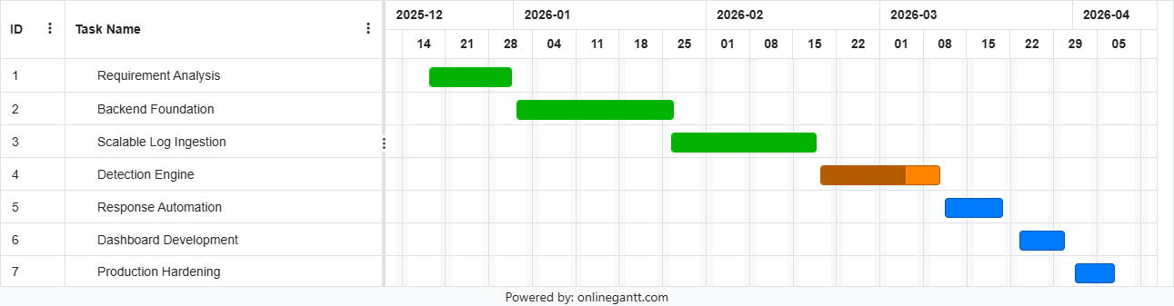
Gantt Chart Timeline

Slide 17
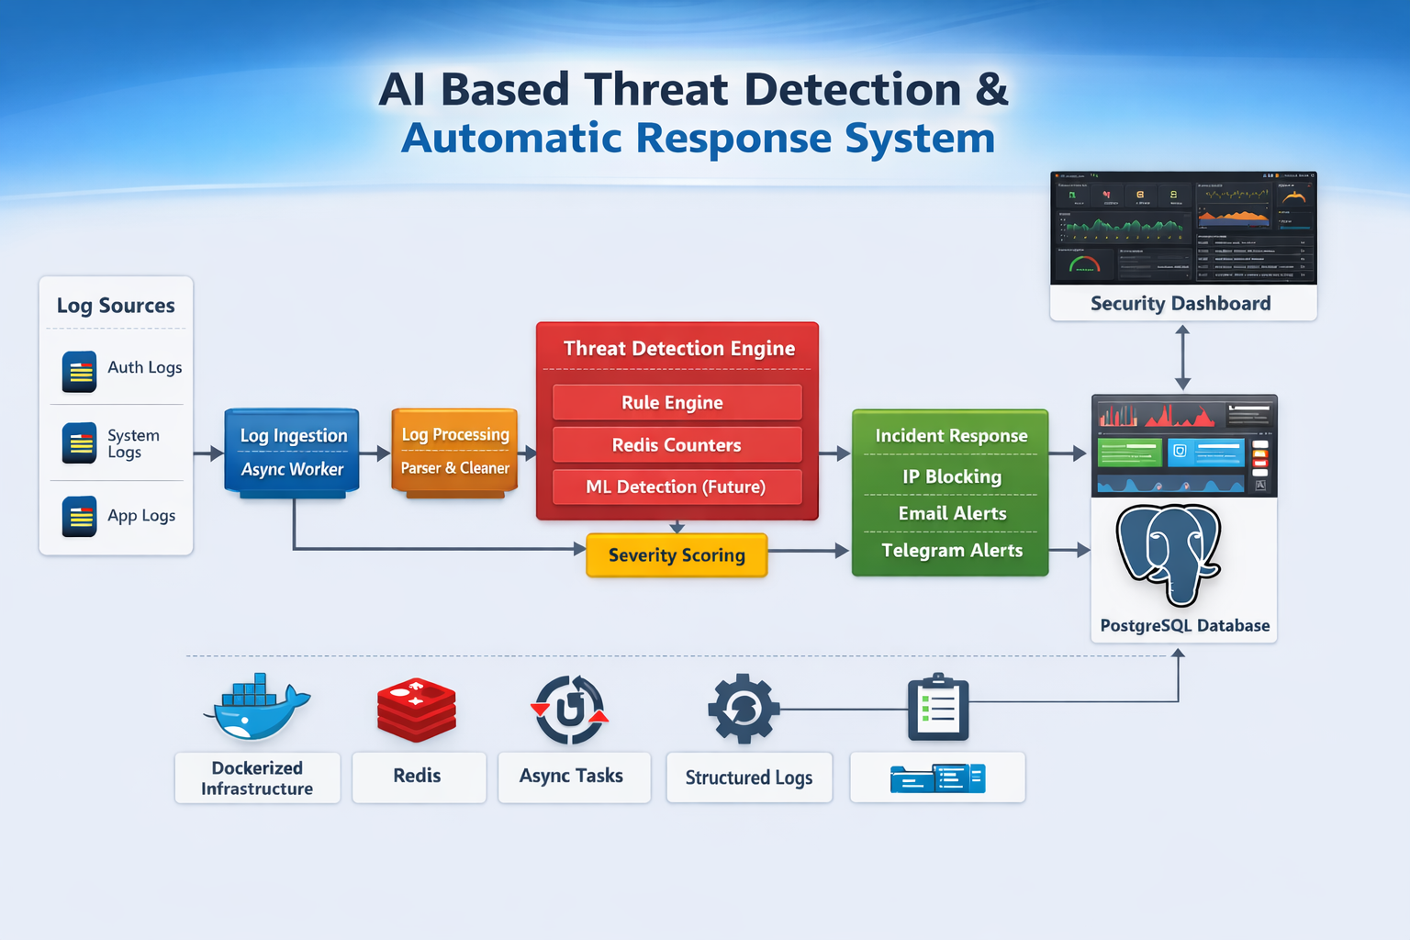
System Architecture

Slide 18
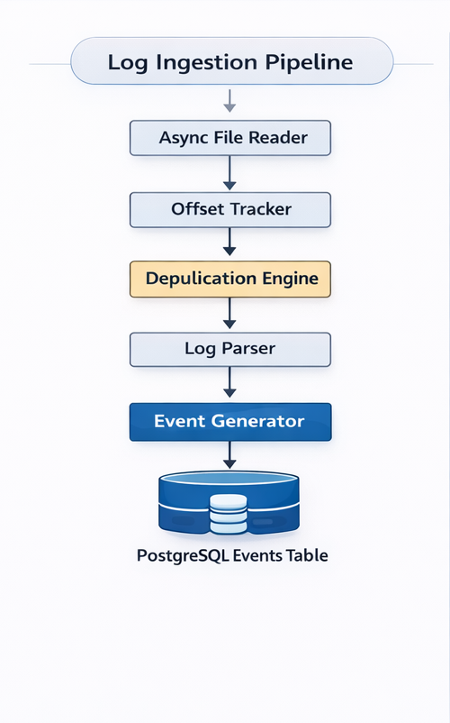
Log Ingestion Pipeline Diagram:

Slide 19
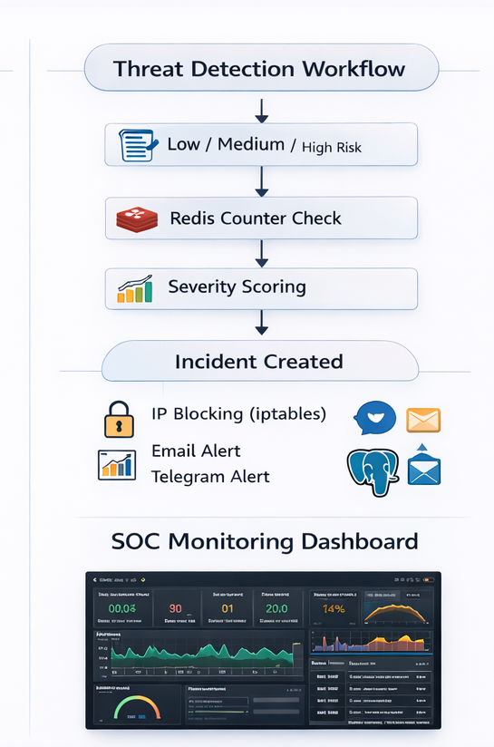
Threat detection Workflow

Slide 20
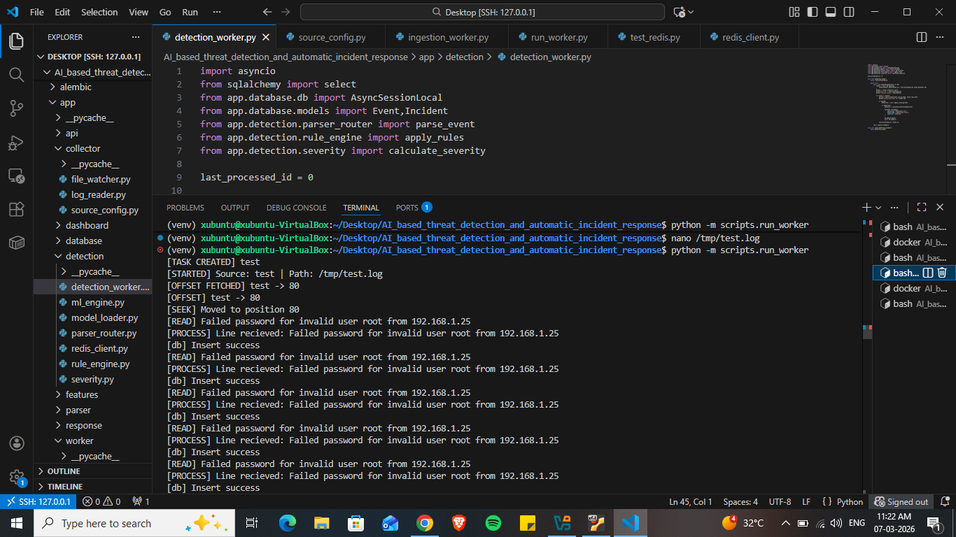
Project Screenshots
Log ingestion running

Slide 21
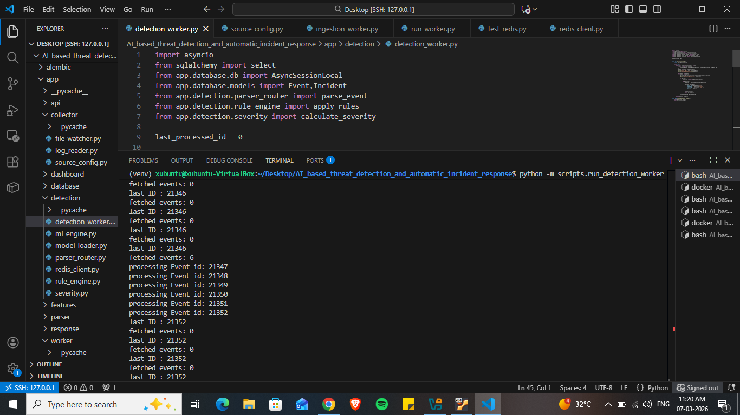
Threat detection results

Slide 22
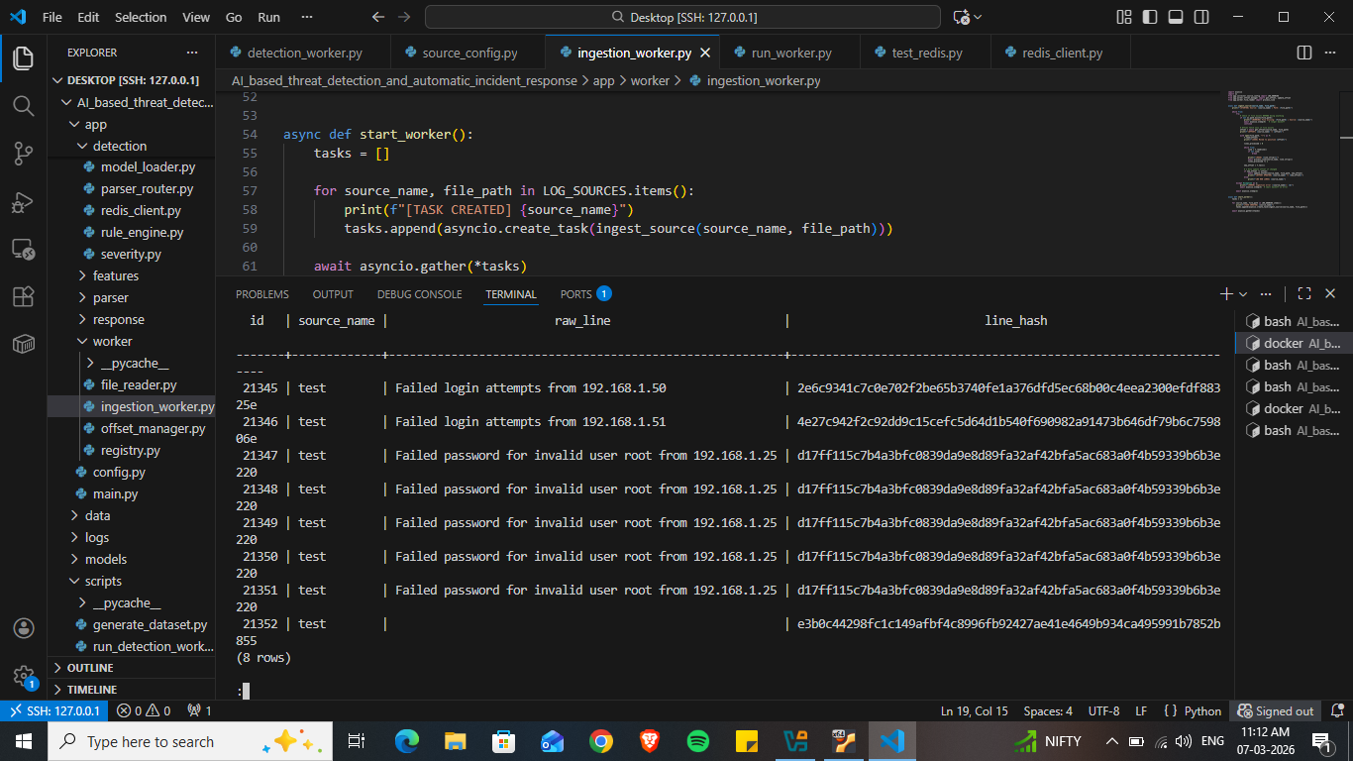
Database events table

Slide 23
Implementation Status Details:
Completed Components
FastAPI backend
PostgreSQL database
Async log ingestion
Offset tracking
Log deduplication
Multi log source support
Rule based detection engine
Redis based counters
In Progress
ML threat detection models
Planned
Response automation
Security dashboard
Production hardening

Slide 24
Thank You !!

