Slide 1
Software Design

Slide 2
Function Oriented Approach
The following are the features of a typical function-oriented design approach:
A system is viewed as something that performs a set of functions.
Starting at this high level view of the system, each function is successively refined into more detailed functions.
For example, consider a function create-new-library member
which essentially creates the record for a new member, assigns a unique membership number to him, and prints a bill towards his membership charge.
This function may consist of the following sub-functions:
assign-membership-number, create-member-record and print-bill
Each of these sub-functions may be split into more detailed sub-functions and so on.
The system state is centralized and shared among different functions.
For Ex., data such as member-records is available for reference and updating to several functions such as:
create-new-member
delete-member
update-member-record

Slide 3
Object Oriented Approach
In the object-oriented design approach, the system is viewed as collection of objects (i.e., entities).
The state is decentralized among the objects and each object manages its own state information.
For example, in a Library Automation Software,
each library member may be a separate object with its own data and functions to operate on these data.
In fact, the functions defined for one object cannot refer or change data of other objects.
Objects have their own internal data which define their state.

Slide 4
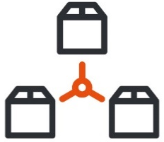



Cohesion & Coupling
A good software design implies clean decomposition of the problem into modules, and the neat arrangement of these modules in a hierarchy.
The primary characteristics of neat module decomposition are high cohesion and low coupling.
A cohesive module performs a single task, requiring little interaction with other components.
A Coupling is an indication of the relative interdependence among modules.

Slide 5
Cohesion
Classification of Cohesion
Cohesion is an indication of the relative functional strength of a module.
A cohesive module performs a single task, requiring little interaction with other components.
Stated simply, a cohesive module should (ideally) do just one thing.
A module having high cohesion and low coupling is said to be functionally independent of other modules.
By the term functional independence, we mean that a cohesive module performs a single task or function.
Classification of Cohesion
Coincidental
Low
Logical
Temporal
Procedural
Communicational
Sequential
Functional
High

Slide 6
Classification of Cohesion cont.
Coincidental cohesion
Logical cohesion
A module is said to have coincidental cohesion, if it performs a set of tasks that relate to each other very loosely.
In this case, the module contains a random collection of functions.
It is likely that the functions have been put in the module out of pure coincidence without any thought or design.
For Ex., in a transaction processing system (TPS), the get-input, print-error, and summarize-members functions are grouped into one module
At the outer layer, components service user interface operations.
A module is said to be logically cohesive, if all elements of the module perform similar operations.
For Ex., error handling, data input, data output, etc.
An example of logical cohesion is the case where a set of print functions generating different output reports are arranged into a single module In this case, the module contains a random collection of functions.

Slide 7
Classification of Cohesion cont.
Temporal cohesion
Procedural cohesion
When a module contains functions that are related by the fact that all the functions must be executed in the same time span.
For Ex., the set of functions responsible for initialization, start-up, shutdown of some process, etc.
If the set of functions of the module are all part of a procedure (algorithm) in which certain sequence of steps have to be carried out for achieving an objective
For Ex., the algorithm for decoding a message.
Communicational cohesion
If all functions of the module refer to the same data structure
For Ex., the set of functions defined on an array or a stack.

Slide 8
Classification of Cohesion cont.
Sequential cohesion
If the elements of a module form the parts of sequence, where the output from one element of the sequence is input to the next.
For Ex., In a Transaction Processing System, the get-input, validate-input, sort-input functions are grouped into one module.
Functional cohesion
If different elements of a module cooperate to achieve a single function.
For Ex., A module containing all the functions required to manage employees’ pay-roll exhibits functional cohesion.

Slide 9
Coupling
Classification of Coupling
Coupling between two modules is a measure of the degree of interdependence or interaction between the two modules.
A module having high cohesion and low coupling is said to be functionally independent of other modules.
If two modules interchange large amounts of data, then they are highly interdependent.
The degree of coupling between two modules depends on their interface complexity.
The interface complexity is basically determined by the number of types of parameters that are interchanged while invoking the functions of the module.
Classification of Coupling
Data
Low
Stamp
Control
Common
Content
High

Slide 10
Classification of Coupling Cont.
Data coupling
Stamp coupling
Two modules are data coupled, if they communicate through a parameter.
An example is an elementary (primal) data item passed as a parameter between two modules, e.g. an integer, a float, a character, etc.
This is a special case (or extension) of data coupling
Two modules (``A'' and ``B'') exhibit stamp coupling if one passes directly to the other a composite data item - such as a record (or structure), array, or (pointer to) a list or tree.
This occurs when ClassB is declared as a type for an argument of an operation of ClassA
Control coupling
If data from one module is used to direct the order of instructions execution in another.
An example of control coupling is a flag set in one module and tested in another module

Slide 11
Classification of Coupling Cont.
Common coupling
If data from one module is used to direct the order of instructions execution in another.
An example of control coupling is a flag set in one module and tested in another module.
Content coupling
Content coupling occurs when one component secretly modifies data that is internal to another component.
This violets information hiding – a basic design concept
Content coupling exists between two modules, if they share code.

Slide 12




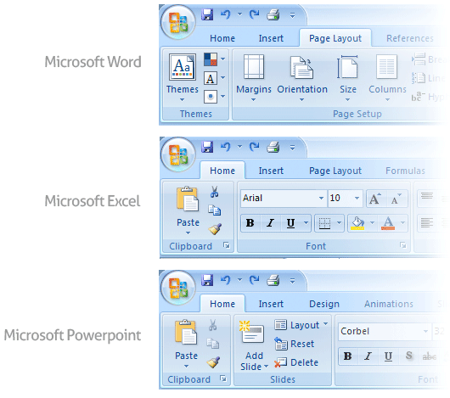
User Interface Design
Golden Rules of User Interface Design
Place the User in Control
Reduce the User’s Memory Load
Make the Interface Consistent

Slide 13
Golden Rules of User Interface Design Cont.
Place the User in Control
During a requirements-gathering session for a major new information system, a key user was asked about.
Following are the design principles that allow the user to maintain control:
Define interaction modes in a way that does not force a user into unnecessary or undesired actions.
Provide for flexible interaction
Allow user interaction to be interruptible and undoable.
Streamline interaction as skill levels advance and allow the interaction to be customized.
Hide technical internals from the casual user.
Design for direct interaction with objects that appear on the screen.

Slide 14

Golden Rules of User Interface Design Cont.
Reduce the User’s Memory Load
The more a user has to remember, the more error-prone the interaction with the system will be.
Following are the design principles that enable an interface to reduce the user’s memory load:
Reduce demand on short-term memory.
Establish meaningful defaults
Define shortcuts that are intuitive
The visual layout of the interface should be based on a real-world metaphor
Disclose information in a progressive fashion

Slide 15
Golden Rules of User Interface Design Cont.
Make the Interface Consistent
The interface should present and acquire information in a consistent fashion.
Following are the design principles that help make the interface consistent
Maintain consistency across a family of applications
If past interactive models have created user expectations, do not make changes unless there is a compelling (convincing) reason to do so

Slide 16

User Interface Analysis and Design Models
User profile model – Established by a software engineer
Establishes the profile of the end-users of the system
based on age, gender, physical abilities, education, cultural background, motivation, goals, and personality.
Design model – Created by a software engineer
Derived from the analysis model of the requirements.
Incorporates data, architectural, interface, and procedural representations of the software.
Implementation model – Created by the software implementers
Consists of the look and feel of the interface combined with all supporting information (books, videos, help files) that describe system syntax and semantics.
User's mental model – Developed by the user when interacting with the application
Often called the user's system perception.
Consists of the image of the system; that users carry in their heads.
The role of the interface designer is to merge these differences and derive a consistent representation of the interface.

Slide 17

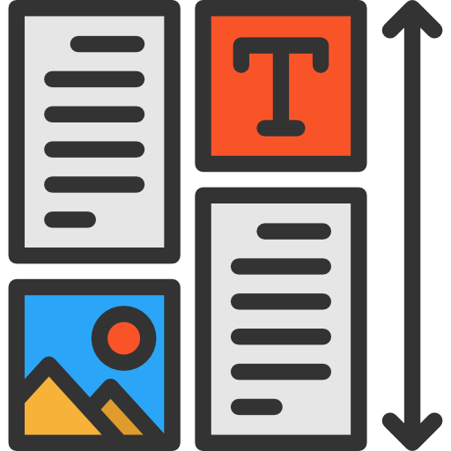
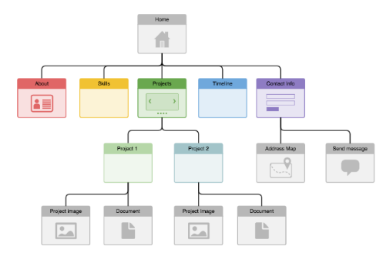


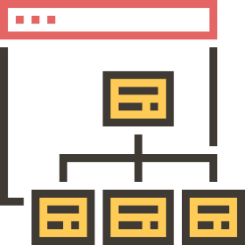
Web Application Design
Design for WebApp encompasses technical and nontechnical activities that include:
Establishing the look and feel of the WebApp
Defining the overall architectural structure
Developing the content and functionality that reside within the architecture
Planning the navigation that occurs within the WebApp

Slide 18
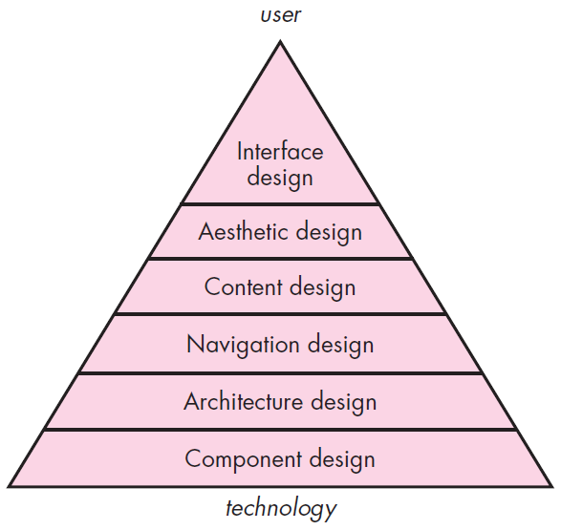
Web App Interface Design
Design pyramid for WebApps
The objectives of a WebApp interface are to
Establish a consistent window into the content and functionality provided by the interface.
Guide the user through a series of interactions with the WebApp.
Organize the navigation options and content available to the user
Interface Design
One of the challenges of interface design for WebApps is the nature of the user’s entry point.

Slide 19
Design pyramid for WebApps Cont.
Aesthetic Design
Content Design
Architecture Design
Also called graphic design, is an artistic endeavor (offer) that complements the technical aspects of WebApp design.
Generate content and design the representation for content to be used within a WebApp.
It is tied to the goals established for a WebApp, the content to be presented, the users who will visit, and the navigation that has been established.
Component-Level Design
Navigation Design
Modern WebApps deliver increasingly sophisticated processing functions that
Define navigation pathways that enable users to access WebApp content and functions.
Perform localized processing to generate content and navigation capability in a dynamic fashion
Provide computation or data processing capability that are appropriate for the WebApp’s business domain
Provide sophisticated database query and access
Establish data interfaces with external corporate systems

Slide 20
Thank You

