Slide 1



Pivotal Cloud Foundry
Services Overview
Your Name / Title
you@pivotal.io

Slide 2
Cloud Native Application Platform - Services
Professional Services for Agile, CI/CD
Cloud Native
Data Services
BDS
Services
Pivotal
Labs
Pivotal Cloud Foundry
PCF
Mobile
Services
Spring
Cloud
Services
Cloud Native
Mobile Services
Cloud Native
Application Framework

Slide 3

What is a Service
Allows resources to be easily provisioned on-demand
Typically middleware, frameworks, and other “components” necessary for applications
Can be a persistent, stateful layer

Slide 4

Two Types of Services
Managed - Fully integrated, with full lifecycle management
User-Provided – Created and managed external to the platform

Slide 5
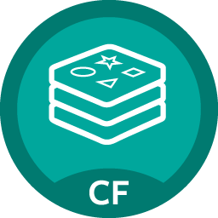
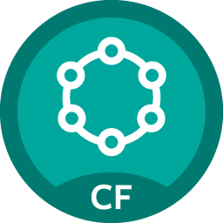













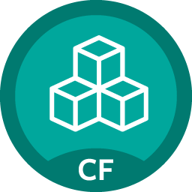

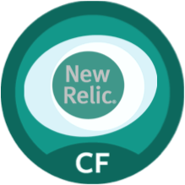

Pivotal Cloud Foundry Services
Mobile
Data
CI/CD
Cloud Native
DataStax Cassandra
Config Server
API Gateway
Redis
Git Lab
Jenkins Enterprise
Service Directory
Push Notifications
MySQL
RabbitMQ
Monitoring
Circuit Breaker
Security
Data Flow
PivotalHD
ELK (StayUp.io)
Single Sign-on
Session state caching
GemFire
Powered by
New Relic

Slide 6
Service Broker
Flexible, RESTful API
Allows Service Authors to provide self-provisioning Services to developers
Cloud Controller
Create
Service Broker
Service Nodes
Bind
Connect
Cell
Apps

Slide 7
Creating and Binding a Service
Service
credentials
DB
CLI
create service (HTTP)
Cloud Controller
create service (HTTP)
Service
Broker
reserve resources
Data
Service
Router
bind service (HTTP)
bind service (HTTP)
obtain connection data
Pivotal Cloud Foundry
Elastic Runtime
Notes:
An application runs in a DEA, which is a droplet execution agent. The Cloud Controller orchestrates the routing and lifecycle of all DEAs in the pool. Routers manage application traffic. Health Manager reports mismatched application states to the CC. A service gateway provides an interface for services (native or external). A messaging bus manages all system communication. Apps are accessed directly through the router while web and CLI clients (e.g., vmc, STS) access Cloud Controller via RESTful services.

Slide 8

Pivotal Cloud Foundry Services
Operated ‘as a Service’
Configured and integrated to enable push button deployment
Full lifecycle management - software updates and patching
Bind to apps through an easy-to-use interface
Common view into access control and audit trails across a breadth of services
EASY
Notes:
In many organizations, provisioning of data and messaging services for applications can take weeks, if not months because of the number of teams, administrators and exchange of credentials involved. We are striving to address this problem by providing a common model for services deployment via Pivotal Cloud Foundry that developers can easily find and their applications bind to – and scale those services as needed.
PCF Services allow administrators to provide pre-defined database and middleware services, and this gives developers the ability to rapidly deploy a software product from a menu of options without the typical slow and manual provisioning process. This is also done in a consistent and supportable way. PCF Services are managed and operated ‘as a Service,’ and this means they are automatically configured upon request. The provisioning process also incorporates full lifecycle management support, like software updates and patching.
This automation removes the overhead from developers, who are often saddled with service configuration responsibility. It makes administrators’ lives easier and addresses security risks by standardizing how services are configured and used.

Slide 9
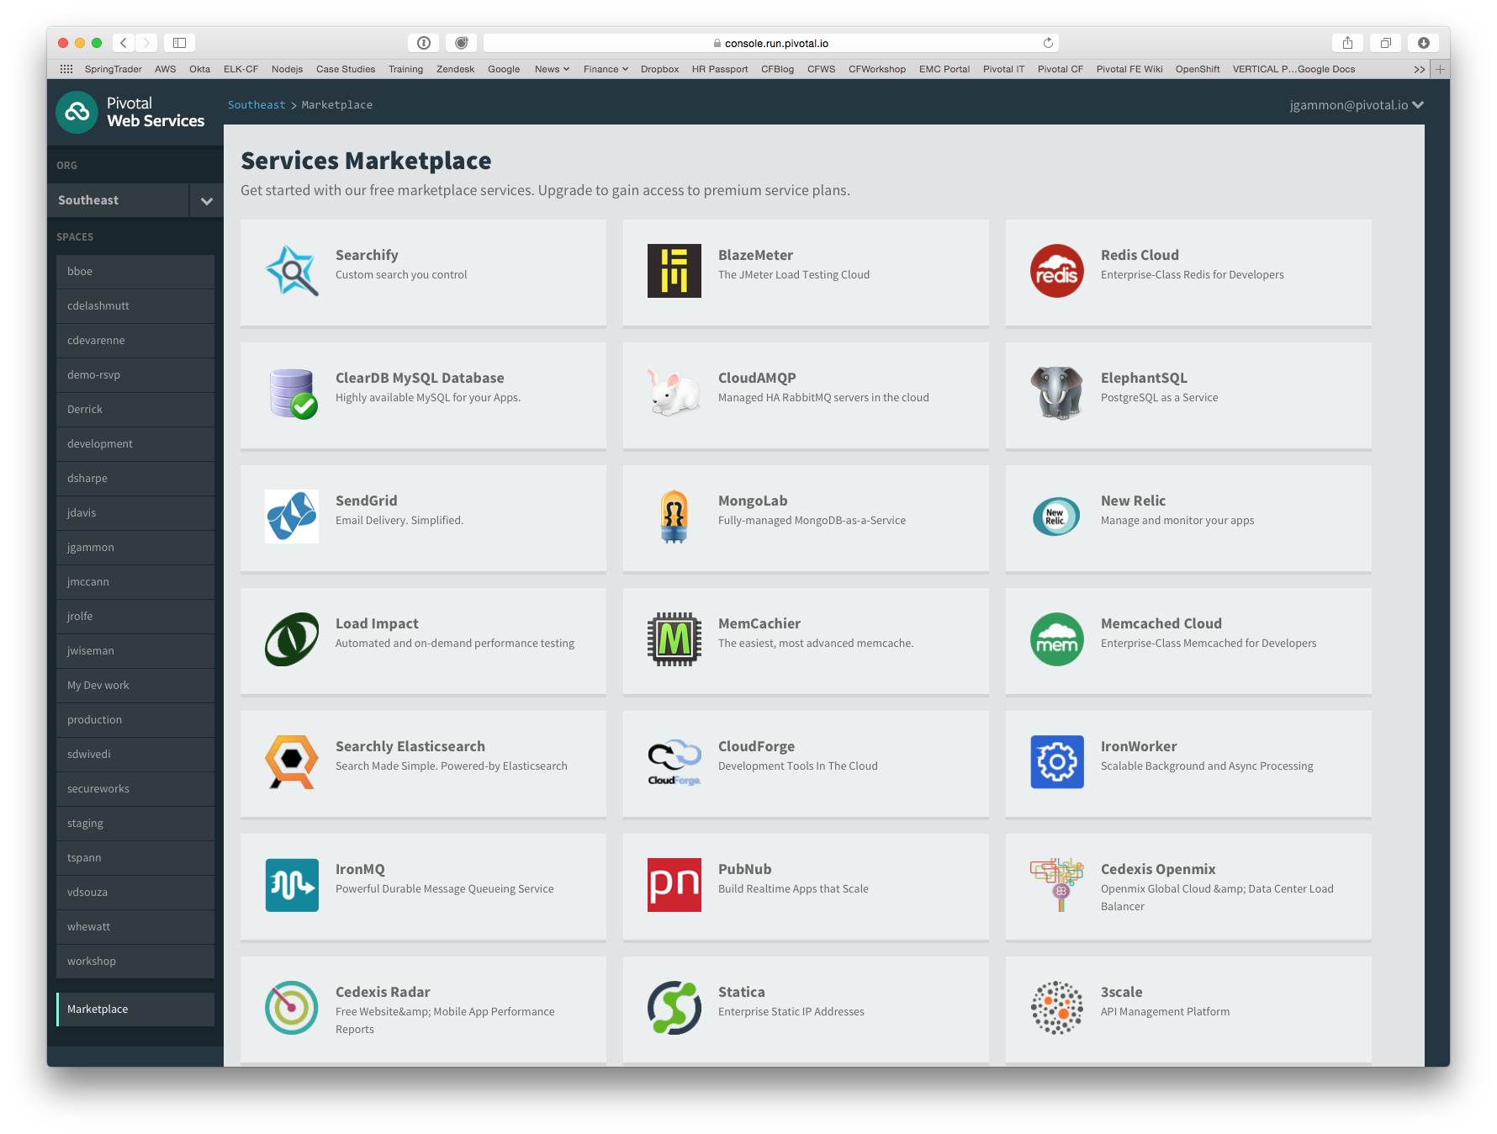
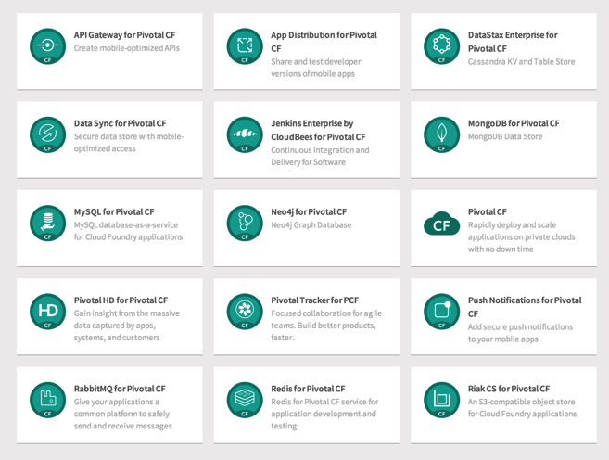
PCF Marketplace
Broad Services Ecosystem
Easy accessibility
Quick, self-provisioning

Slide 10
BDS Vision: Make all data products cloud-ready.
Open.
Agile.
Cloud-ready.
Pivotal BDS on PCF
Production: RabbitMQ, Redis, GemFire/Geode
Beta: PivotalHD (includes HAWQ), Spring XD

Slide 11
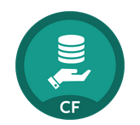
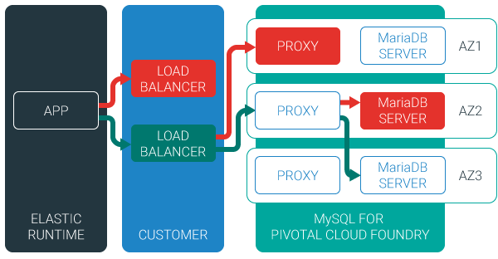
MySQL for Pivotal Cloud Foundry
Relational Database as a Service for Your Applications
Minimized effort to create, configure, and manage a MySQL cluster
Multi-node cluster
Data replication across nodes
Failover functionality ensures app traffic only routed to healthy nodes
Notes:
Deployed with a multi-node cluster; Balanced across Availability zones
Highly Available
Data replication
Failover functionality
Customizable plans
Secure - Different credentials to each application, operators can revoke access selectively!

Slide 12

Redis for Pivotal Cloud Foundry
Advanced Key-Value Store and Cache as a Service
Pre-provision a pool of Redis VMs
Supports persistence to disk
Consolidated logging and monitoring
VM health monitoring, and recovery
User Application
Binding
Instance (Redis process)
VM
VM
VM
VM
Pre-provisioned VMs in the ‘pool’
Ready to be created as instances and bound with apps
Notes:
Developers can quickly develop features for their applications such as:
live, in-memory caching for very fast reads
real-time computation on data structures
ranked lists and leaderboards
publishing and subscribing
queuing

Slide 13

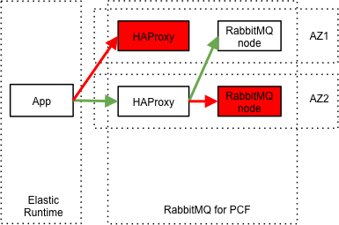
RabbitMQ for Pivotal Cloud Foundry
Apps safely send and receive messages at scale
Messaging broker for communication between servers, applications and devices
Highly available queues, flexible routing, support for multiple protocols and client libraries
Wide range of client libraries, in all languages
Push button deployment and upgrades of a RabbitMQ Cluster

Slide 14

Session State Caching (SSC) by GemFire
Configure, manage, monitor, and consume GemFire in a client/server topology
A turn-key GemFire session replication cache service optimized for Java buildpack apps deployed in Tomcat
No need to modify your app
Tomcat from the java buildpack “knows” how to use the service
GemFire pre-configured for session replication
Session state management independent from app servers
App servers can come and go without affecting session lifetime
Not affected by load balancing

Slide 15

Mobile Services

Slide 16




Diversity of clients, more load
In January 2014, mobile devices accounted for 55% of Internet usage in the United States. Apps made up 47% of Internet traffic and 8% of traffic came from mobile browsers.
http://money.cnn.com/2014/02/28/technology/mobile/mobile-apps-internet/
Notes:
When we established the predominant enterprise architecture paradigms, the vast majority of our clients were usually tethered to a desk with a workstation. Now that has flipped…

Slide 17

Pivotal CF Mobile Services
Consumer-grade, mobile backend services built for the enterprise
Built on Pivotal CF for simplified deployment and operation in private cloud
Enables businesses to apply the power of Pivotal’s Big Data Suite to mobile solutions
Enterprise Backend Applications
Pivotal CF Mobile Services
Push
Notifications
API
Gateway
Data
Sync
App
Distribution
Pivotal CF

Slide 18
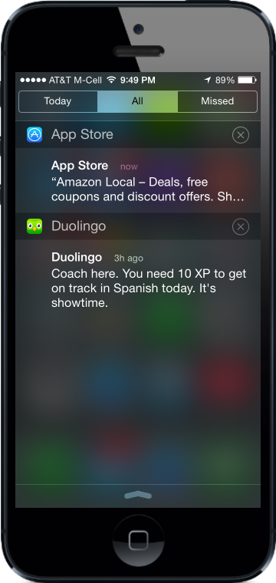
Push Notifications
Problem
Push is difficult to implement across platforms and at scale
Most existing push solutions are public / shared
Data owned by SaaS provider and cannot be fully leveraged by enterprise
Difficult to integrate SaaS push providers with services behind the firewall
Solution / Benefits
Dedicated, comprehensive solution built to scale
Full control of data and comprehensive logging / tracing
Direct integration with enterprise services

Slide 19
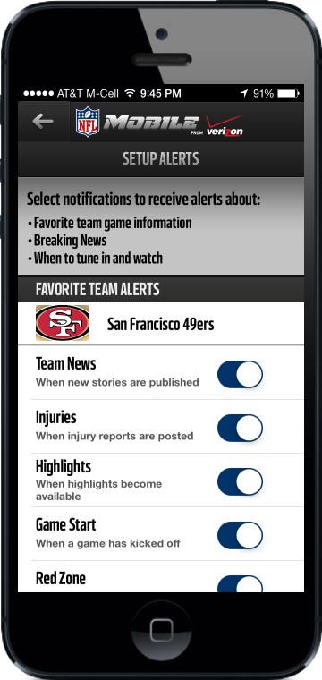
Data Sync
Problem
Apps need to store mobile-specific data, but the existing backend cannot accommodate
Data sync / store is difficult for an app developer to set up
Existing services provide public cloud “black box” storage
Solution / Benefits
Mobile-optimized API for access to multiple types of storage
Simple for developers, yet enterprise-grade and highly scalable

Slide 20
API Gateway
Problem
Legacy APIs are not optimized for mobile
Too much unnecessary content delivered to devices
Mobile very sensitive to latency (often weak or no signal)
Mobile apps often require several API calls to display a single page of content
Solution / Benefits
Allows mobile developers to easily transform APIs
Deliver mobile-optimized, device specific content
Results in improved performance and user experience

Slide 21
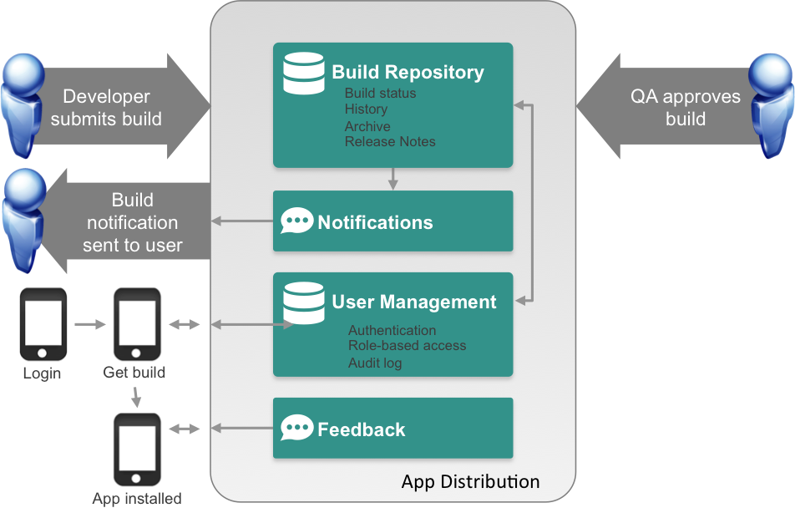
App Distribution
Problem
Extensive user testing of apps is critical to success
Difficult to distribute pre-release apps to test users
Existing solutions are public cloud
Solution / Benefits
Easy OTA app distribution
User / team management
Supports all major platforms
Private cloud for control / security

