Slide 1
Homogenous coordinates
TEAM 80
Daksh Shah
Sairam Babu
Karan Nijhawan

Slide 2
AIM of the PROJECT
Research on variety of fields where HomoCoords find their usage
Describing 3 major geometric transformations
Talking about Computer Graphics & Medical Imaging

Slide 3
Introduction
Homogenous Coordinates are a mathematical framework used in projective geometry. They provide an extension to the natural coordinate system using an extra coordinate.
They are widely used in modern world fields like Computer Graphics, 3D modeling, Medical Science, etc.
We can use them as powerful mathematical tools to simplify many tasks and rather complete them with efficiency.

Slide 4
Geometric transformations

Slide 5
Translation
Translation refers to moving of an object in a certain direction without changing its size/shape.
It is done by adding constant values to the coordinates of the object.
Further, as mentioned before, we add an extra coordinate to the natural cartesian coordinates generally represented as “w”.
The final coordinates look like [x, y, w].

Slide 6
rotation
Rotation as a transformation involves rotating an object about an axis or fixed point
Size/shape of the object remains intact
Also, we can represent multiple geometric rotations in a single equivalent matrix

Slide 7
scaling
Scaling of an object leads to change in its size, either enlarging or shrinking
Here too, we can represent an equivalent matrix for multiple scales just like rotation & translation
Although, position of the object with respect to the reference point remains the same

Slide 8
Computer graphics

Slide 9
HomoCoords play a vital role in Computer Graphcics by providing a unified framework for representation of points, lines and shapes
They are widely used in CG to make variety of scenes and beautify the existing ones using simple mathematical techniques
Majorly, the transformations mentioned before are used in it to perform these things

Slide 10
Heirarchical modeling

Slide 11
It refers to the method of building & representing complex scenes and images as very simplified small sized shapes
It dwells on the concept that an object can be made up of relatively simpler objects, which further can be made up even simpler objects
Thus, this can be bottomed down to a state where things are basically made of SIMPLE GEOMETRIC SHAPES like circles, rectangles, etc.

Slide 12
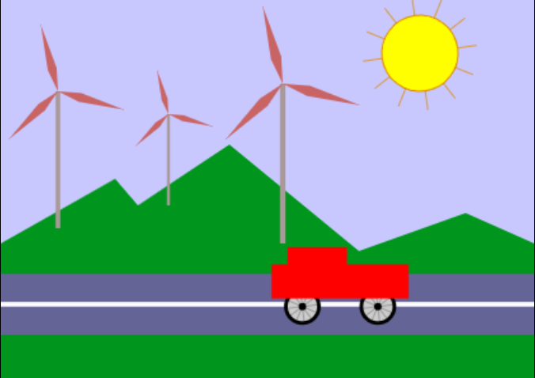
example

Slide 13
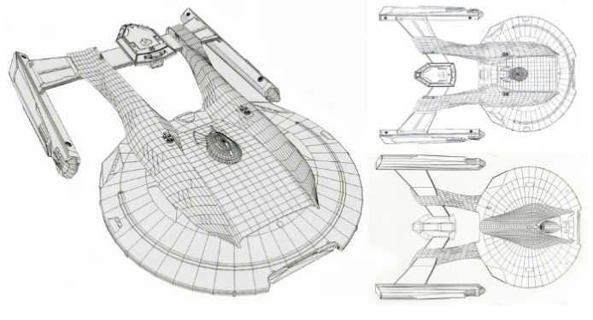
example

Slide 14
Medical Imaging

Slide 15
It is one of the real-world fields that has ALWAYS had a major usage of HomoCoords
Radiology is one big example which is primarily based on concepts of Linear Algebra
Tomographic Reconstruction is one of the methods that is used in the Computed Tomographic (CT) scans
Some of the exemplar images are shown as to how HomoCoords are used to generate numerous slices of images of our body parts in CT scans

Slide 16
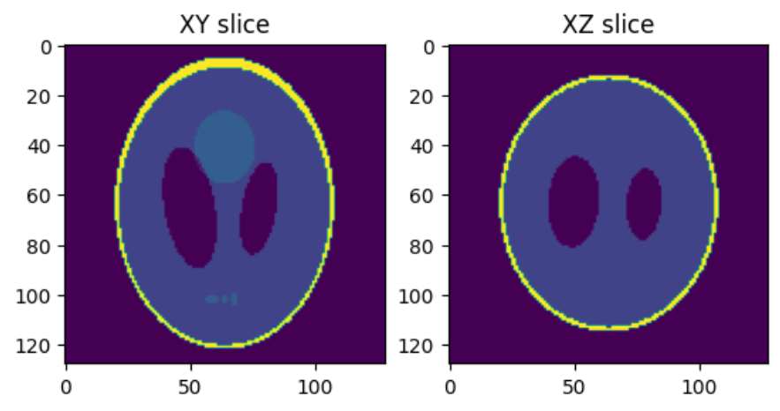
example

Slide 17
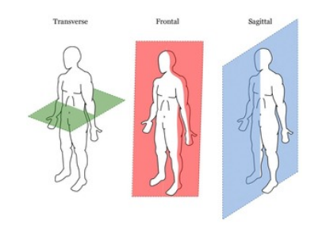
example

Slide 18
SUMMARY
Overall, this project has tried to cover the mathematical aspect of the topic HomoCoords in great detail as well as delved deep into its real-world applications
We have tried to cover the main points related to the fields like Computer Graphics & Medical Imaging
They are intensively wide fields and thus we have just tried to cover some of their concepts and usages

Slide 19



MEET OUR TEAM!
Sairam babu
Daksh Shah
Karan nijhawan

Slide 20
THANK YOU

