Slide 1
HTML Forms
HTML forms add a user interface to HTML pages
HTML forms are used to pass data to a server
Users can enter data into a form’s textboxes, or other controls to send information back to a server
A form can contain input elements like
  text fields (text boxes)
  checkboxes
  radio-buttons
  submit buttons
  select lists
  text areas

Slide 2
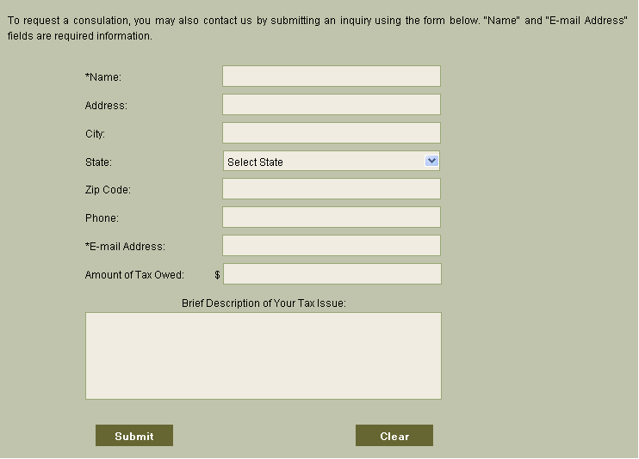
HTML Forms: An Example

Slide 3
HTML Forms
The <FORM> tag is used to create an HTML form:
<FORM action=“ “ method=“ “>
<INPUT type=“ “ name=“ “ value=“ “ />
<INPUT type=“ “ name=“ “ value=“ “ />
<INPUT type=“ “ name=“ “ value=“ “ />
…
</FORM>

Slide 4
HTML Forms
When the user submits the form (by clicking the Submit button):
  the browser collects all the data from the form
  and sends it to the URL specified as the form’s action
The server-side program (residing in a directory on the specified URL) receives the form information and processes it

Slide 5
Forms Attributes
The action attribute:
  specifies the URL to the server-side script that will process the form
  form data is submitted to the current URL if no URL is specified
The method attribute:
  can have one of two possible values
    post
    get

Slide 6
The method Attribute: post vs. get
The post method
  form data appears within a message body
  sent in the body of the request after the headers and is not visible to the user as a query string
  sends the form data in the body of the form to the server
The get method
  GET data is sent in the header part of a request to the server
  appends the form data to the URL specified in the action attribute
  form data is encoded (by a browser) into a URL
    encoded into a query string appended after a ? as name=value pairs
  search terms used with GET can be bookmarked as a result set
  the default method is GET if no method attribute is specified

Slide 7
The INPUT Element (tag)
Used to create form controls (visual user interface components) like textboxes, buttons, checkboxes, etc.
Input tag attributes:
  type
    specifies the type of the control
  name
    used to assign a name to the control, the name can be used by client or server-side script to refer to the control
  value
    used to display some text on the control

Slide 8
Different Input Types
(different controls)
Type | Purpose
text | Creates a single-line text field
password | Creates a single-line text field that masks user input
submit | Creates a Submit button that sends the form data to a server-side script
reset | Creates a Reset button that resets all form controls to their initial values
checkbox | Creates a check box
radio | Creates a radio button
image | Creates a button from an image

Slide 9
Different Input Types
(different controls)
Type | Purpose
button | Creates a pushbutton
hidden | Creates a single-line text field that masks user input
submit | Creates a hidden form control that cannot be seen by the user
file | Creates a file upload control that enables users to select a file with form data to upload to the server

Slide 10
Different Input Types
(different controls)
Type | Purpose
<button> | Creates a button that can have HML content
<textarea> | Creates a a text-entry field with multiple lines
<select> | Creates a menu or scrolling list if items. Individual items are indicated by the <option> tag
<option> | Creates individual items within a <select> element
<label> | Creates a label associated with a form control
<fieldset> | Organizes form controls into groups
<legend> | Displays a caption for a <fieldset> element

