Slide 1
HTML Frames
Frames enable you to
  divide the browser window into sections (separate windows)
    each section (window) can contain a different HTML document
  create links that open pages in new browser windows (linked windows)
Frames give you an entirely different level of layout control
With frames, you can display more than one HTML document in the same browser window
  each HTML document is called a frame
  each frame is independent of the others

Slide 2
HTML Frames
Frames enable you to
  make part of a site visible all the time even while other parts can be scrolled out of view
    the above can now be done using CSS positioning
  load new content into one section of a layout while leaving the rest of the page in place
    the above can now be accomplished using JavaScript

Slide 3
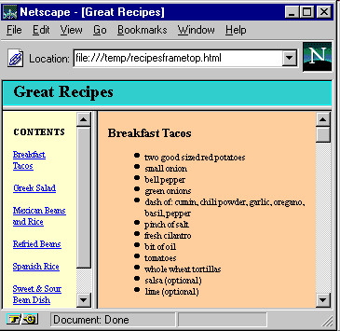
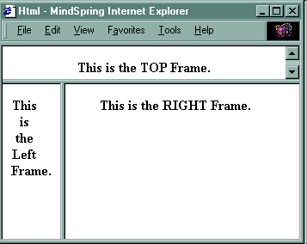
Some Examples

Slide 4
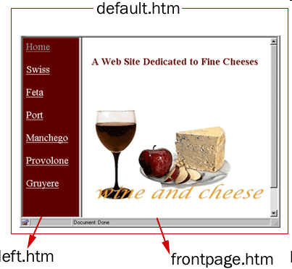
Some Examples

Slide 5
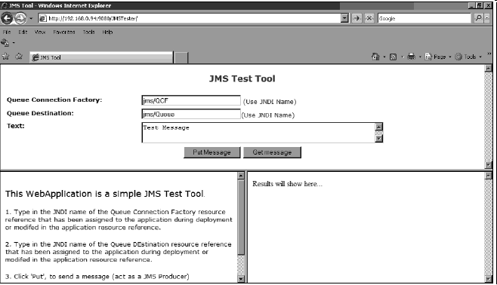
Some Examples

Slide 6


Slide 7
Frames:
Advantages & Disadvantages
Can make your website easier to navigate
Can also be misused to make your site
  confusing
  difficult to use
  annoying to users
Can detract from important content on the site if not used properly

Slide 8
Using Frames
Two ways to use frames:
  Using framesets
    divide the page into sections
    load documents into each of the frames
  Using inline frames
    embed a second document into an existing page (very much like embedding images or Flash movies)

Slide 9
Using Frames
Framesets
  have become less commonly used
  not supported by HTML 5
  browser support is still universal
Inline frames
  have become more commonly used over time
  recommended for new projects

Slide 10
Linked Windows
target attribute of the <A> tag
<A target=“window_name”> … </A>
The target attribute lets you open links in
  new windows
        or
  existing windows other than the one that the link is in

Slide 11
Creating Frames
Describe the frame layout
Choose which documents will be displayed in each frame

Slide 12
Frame Layout
HTML File
Frame Definition
HTML File
Frame 2 Contents
1 | 2
 | 3
 | 4
Frame 1 Contents
Frame 3 Contents
Frame 4 Contents
HTML File
HTML File
HTML File

Slide 13
The <FRAMESET> Tag
The <FRAMESET> tag is used to create a frameset document
Replaces the <BODY> tag when used in an HTML document

Slide 14
The <FRAMESET> Tag
<HTML>
<HEAD>
<TITLE>Page Title</TITLE>
</HEAD>
<FRAMESET>
… your frameset goes here …
</FRAMESET>
</HTML>

Slide 15
The cols & rows Attributes
Must include one of two attributes as part of the <FRAMESET> tag
The cols attribute:
  tells the browser how to split the screen into a number of vertical frames
The rows attribute:
  tells the browser how to split the screen into a number of horizontal frames

Slide 16
The cols & rows Attributes
<FRAMESET cols=“column_width, column_width, …”>
<FRAMESET rows=“row_height, row_height, …”>

Slide 17
The cols & rows Attributes
Column width or row height can be defined in one of three ways:
  explicitly in pixels
  as a percentage of the total width or total height of the <FRAMESET>
  with an asterisk (*)
    browsers use as much space as possible

Slide 18
The <FRAME> Tag
The <FRAME> tag associates an HTML document with each frame
<FRAME src=“HTML document URL” >

Slide 19
Example
<HTML>
<HEAD>
<TITLE>Page Title</TITLE>
</HEAD>
<FRAMESET cols=“100, 50%, *” >
<FRAME src=“doc1.html” >
<FRAME src=“doc2.html” >
<FRAME src=“doc3.html” >
</FRAMESET>
</HTML>

Slide 20
The <NOFRAMES> Tag
Browsers that do not support frames will display a blank page when they navigate to HTML documents with framesets
The <NOFRAMES> tag allows you to include additional HTML code/content that is displayed in browsers that don’t support frames

Slide 21
Inline Frames
Created by using the <IFRAME> tag
The <IFRAME> tag defines an inline frame that contains another document
  defines an inline frame for the inclusion of external objects including other HTML documents
Creates a frame that sits in the middle of a regular non-framed web page

Slide 22
Inline Frames
Works like <IMG ...>
  only instead of putting a picture on the page, it puts another web page
Commonly the means by which “widgets” are incorporated into other websites
  Twitter & Facebook offer widgets that you can incorporate into your own site

Slide 23
<IFRAME> Tag: An Example
<IFRAME src="hello.html" width=“450”
height=“100”>
If you can see this, your browser doesn't
understand IFRAME. However, we'll still <A
href="hello.html">link</A>
you to the file.
</IFRAME>

