Slide 1
Image Maps
Can define regions of an image as links
  can specify that certain areas of a map link to various pages
An image map is a way of defining "hot spot" links within an image on a Web page
Rather than having the whole image behave as one link, you can have lots of different links within the one image

Slide 2
Image Maps
An image map is a way of defining "hot spot" links within an image on a Web page
Rather than having the whole image behave as one link, you can have lots of different links within the one image

Slide 3
Image Maps
To create an image map, you need an image
The image will be most useful if it has several discrete areas that can be selected individually
  has clear cut-offs or lines
Photographs don’t make good image maps
  their various elements tend to blend together
  or, are of unusual shapes
  cannot be divided into different sections

Slide 4

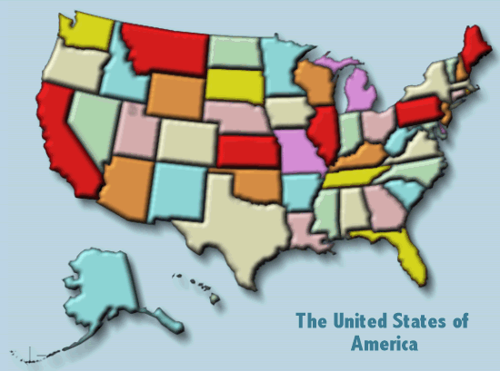
Examples: Good Candidates

Slide 5
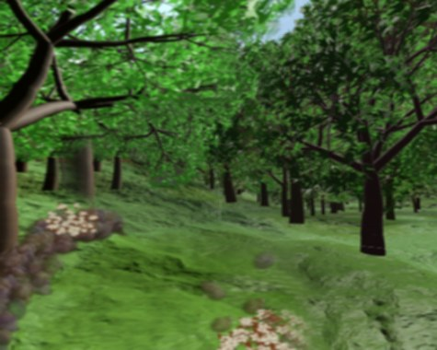
Examples: Not So Good A Candidate

Slide 6
Types of Image Maps
Client-side image maps
  this is the type we will learn in this course
Server-side image maps
  the browser simply sends the required information, i.e., (x,y) coordinates of the point clicked on to a server-side script

Slide 7
Creating HTML Image Maps
Image (load the image)
  need a suitable graphic/image
Map out your links
  Coordinates
    find the co-ordinates of different sections/parts
  Define Hot Spots
    three different shapes (commonly termed "hot spots") that can be used in image maps
      Rectangle
      Circle
      Polygon
Write the code

Slide 8
Creating an Image Map:
The Map Tag
Tell the browser where the hot spots are in the image, and what the hot spots need to link to
<map name="map-name">
<area shape=“…” coords=“…” href=“…” />
<area shape=“…” coords=“…” href=“…” />
…
</map>

Slide 9
Linking to an image map:
The usemap attribute
Add the usemap attribute to the img tag for the image to associate an image map with an image
<img src=“…” alt=“…” usemap=“#map-name“ />

Slide 10
Attributes of the Area Tag
Shape Attribute
  rect (a rectangular shape)
  circle (a circular shape)
  poly (an arbitrary polygon, with 3 or more points)
  default (which represents the remaining area of the image not defined by any area tags)

Slide 11
Attributes of the Area Tag
Coords Attribute
Shape | Coordinates
rect | coords="x1,y1,x2,y2" (The top left and bottom right corners of the rectangle)
circle | coords="x,y,r" (The centre and radius of the circle)
poly | coords="x1,y1,x2,y2,x3,y3,..." (The corners of the polygon)

Slide 12
Attributes of the Area Tag
HREF Attribute
  the URL that you'd like to link the hot spot to
    can specify a nohref attribute instead, in which case the hot spot will not link to anything
Target Attribute
  optional target window or frame to open the linked URL in
Title Attribute
  allows you to give the area a title
ALT Attribute
  Alternate text to be displayed by text-only browsers

Slide 13
Working out image map coordinates
One easy way to work out coordinates is to change your image map from client-side to server-side temporarily
  change the usemap=“#map-name" attribute to ismap="ismap“
  add a dummy <a href> tag around the image
<a href="#"><img src=“…” alt=“…” ismap=“ismap“ /></a>
As you roll the mouse over the image, you should see the coordinates appear after the "?" in the status bar of your browser

